Slide 1
Hash functions
Division method
k == Key
m = table size
Key mod table size
h(k) = k mod m
Especially bad if M has common factors with K
maybe ok If M is prime and not close to power of 2 or 10
Very common, often bad

Slide 2
Multiplication method
H(k) = [(a*k) mod 2**w] >> (w-r)
w - the word width of your machine in bits, i.e. a w-bit machine
a - a constant, picked randomly, odd, between 2**r and 2**(r-1)
r - how many bits I want in key, i.e. Log2 (m)
K = 0 1 1 0 0 1 0 0 0 0 1 0 1 0 0 1 0 0 1 0
A = 0 0 0 0 1 0 0 0 1 1 0 1 0 0 0 0 0 1 0 0
-----------------------------------------------------------------
Multiply
Now 2 words long
mod chooses the low word
Right shift (w-r) chooses the r high bits of the low word

Slide 3
Universal hashing
H(k) = [ (ak+b) mod p] mod m
a,b random numbers between
0 and (p-1)
p – a prime number > |U|
Probability of collision 1/m

Slide 4
Handling the collisions
:
chaining
linear probing
quadratic probing
overflow areas
re-hashing

Slide 5
Chaining
The linked list approach.
unlimited number of collisions
no a priori knowledge of how many elements

Slide 6
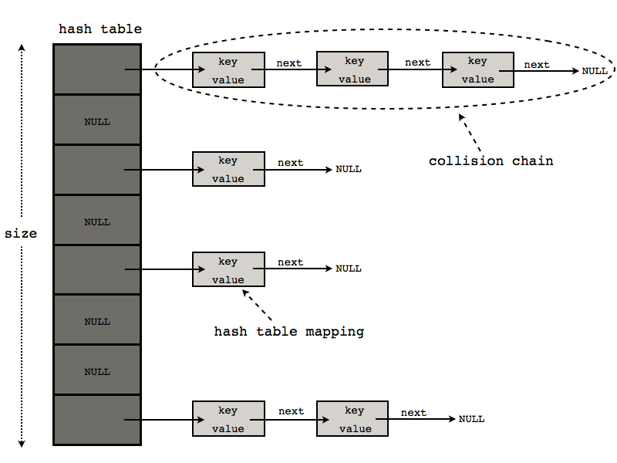

Slide 7
Linear probing
In case of collision, use the slot above/below
Keep going until you find an open slot
Key has to be stored as well as the value so you know when
you’ve found it when you come looking for it later on
Very fast since ++, -- is a single instruction
and due to caching on modern platforms

Slide 8
Quadratic Probing
Hash index + successive values of a quadratic polynomial until you find a spot
General form:

Slide 9
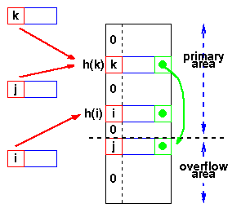
Overflow area
- University of Auckland
Same as chaining, but maybe better due to locality

Slide 10
Rehashing
If H(k) collides, try G(k), etc
Or
If H(k) collides, try
G(H(k)) where G may or may not = H

Slide 11
Organization | Advantages | Disadvantages
Chaining | Unlimited number of elements Unlimited number of collisions | Overhead of multiple linked lists
Re-hashing | Fast re-hashing Fast access through use of main table space | Multiple collisions may become probable
Overflow area | Fast access Collisions don't use primary table space | Two parameters which govern performance need to be estimated

Slide 12
Organization | Advantages | Disadvantages
Chaining | Unlimited number of elements Unlimited number of collisions | Overhead of multiple linked lists
Re-hashing | Fast re-hashing Fast access through use of main table space | Multiple collisions may become probable
Overflow area | Fast access Collisions don't use primary table space | Two parameters which govern performance need to be estimated

Slide 13
djb2
unsigned long hash(unsigned char *str)
{
unsigned long hash = 5381;
int c;
while (c = *str++)
hash = ((hash << 5) + hash) + c;
return hash;
}

Slide 14
unsigned long
sdbm(str)
char *str; {
unsigned long hash = 0;
int c;
while (c = *str++)
hash = c + (hash << 6) + (hash << 16) - hash;
return hash;
}

Slide 15
Core operations:
union(S,T) - combine S & T, toss duplicates
intersection(S,T): a set which has only elements in both S & T
difference(S,T): a set with elements in S, but not T
subset(S,T): are all elements of T also elements of S?.
sets
Store a group of unique, unordered items

Slide 16
sets
element_of(S, x): is x an element in S?
empty(S): is S ‘element-less’?
card(S) : how many elements are in S
loop(S): iterate over S
create(x₁,x₂,…,x_{n},): create a set containing
the given elements

Slide 17
sets
create(): creates a new, empty set
create(n): create a new, empty set and take my hint
about internal storage allocation
add(S,x): if (! element_of(S,x)) add x to S
capacity(S): returns the maximum number
of values that S can hold.
remove(S, x): if (element_of(S,x)) not any more.

Slide 18
sets
map(F,S): apply the function F to each
Element of S and return a set of the results
filter(P,S): apply the predicate P to each element
of S, return a set of those which pass
fold(A₀,F,S): map, where F operates in situ
clear(S): delete all elements of S.
equal(S₁, S₂): true if both sets contain exactly
the same elements

