Slide 1
Height Balanced AVL trees
Insert a new node, w
Starting from w, travel up and find the first unbalanced node.
Let
z be the first unbalanced node,
y be the child of z that comes on the path from w to z
x be the grandchild of z that comes on the path from w to z.

Slide 2
Height Balanced AVL trees
Re-balance the tree by performing appropriate rotations on the subtree rooted with z.
4 possible x,y,z combinations:
a) y is left child of z and x is left child of y b) y is right child of z and x is right child of y
c) y is left child of z and x is right child of y d) y is right child of z and x is left child of y

Slide 3
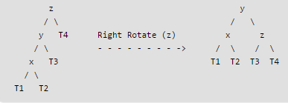
Height Balanced AVL trees
a. left - left

Slide 4
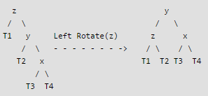
Height Balanced AVL trees
b. right - right

Slide 5
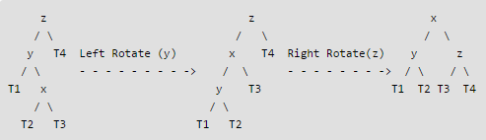
Height Balanced AVL trees
c. left - right

Slide 6
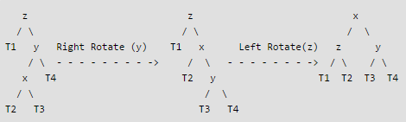
Height Balanced AVL trees
d. right - left

