Slide 1
Insertion sort
Think of the unsorted list as a queue of numbers
And the sorted list as an empty linked list
Q = dequeue();
Add Q to the linked list in the correct place
Repeat until queue is empty

Slide 2
Insertion sort
But really we use an array and do it in-situ, thus:
for (c = 1 ; c <= n - 1; c++) {
d = c;
while ( d > 0 && (array[d] < array[d-1])) {
t = array[d];
array[d] = array[d-1];
array[d-1] = t;
d--;
}
}

Slide 3
Insertion sort
Simple implementation
Efficient for (quite) small data sets
efficient for data sets that are already substantially sorted: the time complexity is O(n + d), where d is the number of inversions (this can happen a lot)
- Stable, i.e. does not change the relative order of elements with equal keys
In-situ, requires O(1) of additional memory space
streaming/online, i.e. can sort a list as it receives it
What is the average/worst case time/space?

Slide 4
Selection sort
i=0
Find the smallest item in a list and swap it with what’s in location i
i++
repeat

Slide 5
Selection sort
Simple implementation
Worst case O(n**2)
Average case ?
Best case ?
Streaming?
Worst case space complexity?

Slide 6
Merge sort
Step 1- how to combine two sorted lists:
Say you have two queues, and they are both sorted:
4 11
9 13
Put them together into a single sorted list
Repeatedly dequeue the smaller of head(list1) & head(list2)

Slide 7
Merge sort
Step 2
Put each item in its own queue, all the queues are sorted
Combine queue 0 and 1 using step 1 – gives us queue k
Combine queue 2 and 3 using step 1 – queue k1
Combine queues 4 and 5 using step 1 - queue k2
…
Combine queues k and k1 using step 1 - gives us queue z
Combine queues k2 and k3 using step 1 - gives us queue z1
…
Combine queues z and z1 using step 1
and so on

Slide 8
Merge Sort
O( n logn) - all the way
What about space complexity?

Slide 9
Quicksort
Partitioning process:
The entry a[j] is in its final place in the array, for some j.
No entry in a[lo] through a[j-1] is greater than a[j].
No entry in a[j+1] through a[hi] is less than a[j].

Slide 10
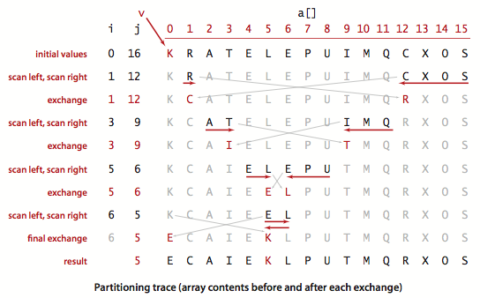
Quicksort
- Princeton.edu

Slide 11
Quicksort
function quicksort(array)
if length(array) ≤ 1 return(array) //base case
select and remove a pivot element pivot from 'array'
create empty lists less and greater
for each x in array
if x ≤ pivot
append x to less
else
append x to greater
return concatenate(quicksort(less), pivot, quicksort(greater))

Slide 12
Quicksort
Choosing the pivot
First
Random
Middle
Median of first, middle, last
(left + right)/2, can cause overflow
Use left + (right-left)/2

Slide 13
Quicksort
Best O(n log n)
Average O(n log n)
Worst O(n**2) -
because of this, some implementations randomize first
Space O(n), or O(log n)
Most efficient implementations tend to not be stable.

Slide 14
Quicksort
The standard deviation of the running time is about .65 N, so the running time tends to the average as N grows and is unlikely to be far from the average.
The probability that quicksort will use a quadratic number of compares when sorting a large array on your computer is much less than the probability that your computer will be struck by lightning!

Slide 15
Quicksort
Improvements:
Cutoff to insertion sort.
for tiny arrays (5-15) during the process, it
Is often better to switch to insertion sort
(java does this an n==7)
Median-of-three partitioning.
use the median of a small sample (3) of items taken
from the array as the partitioning item

Slide 16
Heapsort
1. Build a min/max heap from
the data to be sorted
Create empty sorted array
While heap not empty
remove top element
add to next free spot in sorted array
re-heapify the heap

Slide 17
Heapsort
What’s a heap again?
A complete binary tree which
satisfies the heap property

Slide 18
Heapsort
What’s a complete binary tree again?
…and what’s the heap property?

Slide 19
Heapsort
How do we like to
store them, and why?

Slide 20
Heapsort
For element at index i:
iParent = floor((i-1) / 2)
iLeftChild = 2*i + 1
iRightChild = 2*i + 2

Slide 21
Heapsort
Worst case O (n log n)
Best case O(n log n)
Average case O(n log n)

Slide 22
Heapsort
Can be done it-situ
Array is divided at point P
Everything to the right of P is the heap
Everything to the left of P is the sorted array

Slide 23
Radix sort
36 9 0 25 1 49 64 16 81 4

Slide 24
Radix sort
O(n) for k digit base b numbers
But…
it depends on K being constant
If k increases with n we are back to O (n log n)

Slide 25
Hash Table
An array of “buckets”
+
A hash function

Slide 26
Hash Table
Divide the data you want to store into two parts
a key
and the data (which may also contain the key)

Slide 27
Hash Table
The job of the has function is
to assign each key to a (hopefully unique) bucket
As always, hope is a poor strategy,
so we must deal with collisions

Slide 28
Hash Table
Open addressing + dynamic resizing (0.7)
linear probe
quadratic
double hashing
chaining

