Slide 1
The point
What attributes does it have?

Slide 2
For now, we will assume a constant frame of reference wrt to time
Suppose we have two points?
. .

Slide 3
We can have an implied connection between them
If the nature of that connection is consistent, we get
quite a lot of points for free
(in our rendered, discrete case of course)

Slide 4
.
p2
.
p1
p1 = x₁ , y₁
p2 = x₂ , y₂

Slide 5
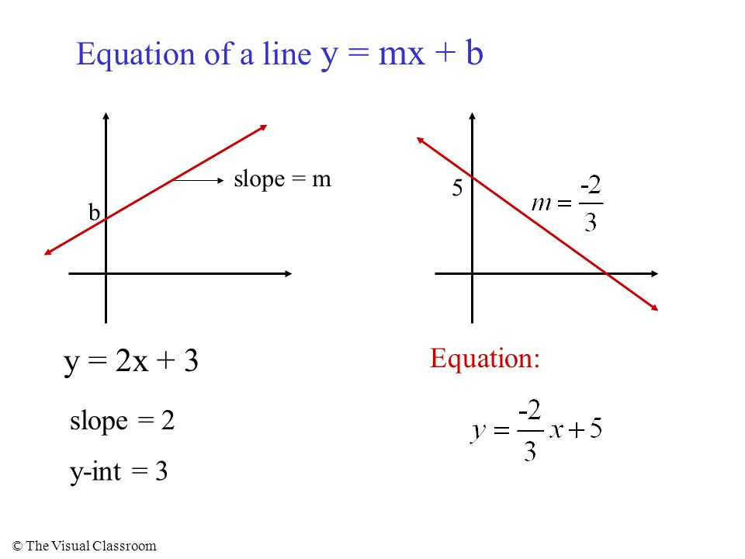
Representation wrt to a standard Cartesian coordinate system

Slide 6
Except we can’t draw lines, not really
fundamentally, we need to decide which pixels to turn on
to resemble a line
We could program this using y=mx+b

Slide 7
Iterate over successive x values, use the equation and floating point numbers to calculate the corresponding y values, then round to quantize to our coordinate system
Consider:
Y = X + 2
Y = X/2 + 1
Y = 2X + 1

Slide 8
Not to mention zero or undefined slopes
The basic problem though, is to decide:
up? or over?

Slide 9
Bresenham’s line drawing algorithm
https://www.youtube.com/watch?v=vlZFSzCIwoc
+ antialiasing

Slide 10
So we have a way to draw line segments, each
of which can be represented by a pair of points
Instead of using images, we can hold our image
as a set of lines segments which, when displayed,
show us the picture

Slide 11
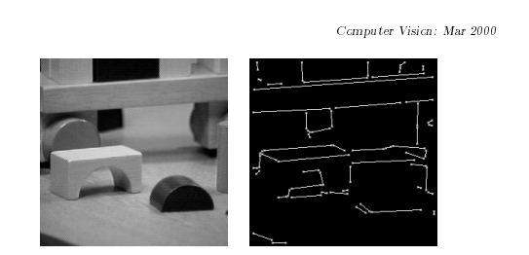
It is much more common though to construct the picture from
the line segments up, than trying to change representations
via edge detecion

Slide 12
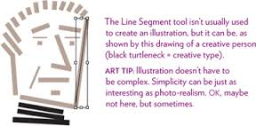
The Non-Designer's Illustrator Book: Drawing with Shape and Line Tools

Slide 13
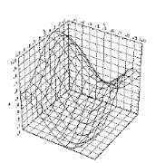
This may seem a primitive, or perhaps a bit pedantic,
but it is the basis of most CG today (not all)

Slide 14
2d transformations
Change both endpoints, the ‘free’ pixels change accordingly
Scale
Rotate
Translate

Slide 15
.
Vertex
Edge
.
.
0,0 --- 1,2
1,2 --- 1,0 or 0,0 --- 1,2 --- 1,0
1,0 --- 0,0

Slide 16
scale
0,0 --- 1,2 0,0 --- 2,4
1,2 --- 1,0 2,4 --- 2,0
1,0 --- 0,0 2,0 --- 0,0

Slide 17
p₀ = 0,0 p₀’ = 0,0
p₁ = 1,2 p₁’ = 2,4
p₂ = 1,0 p_{2’} = 2,0
or
p_{i}’ = S * p_{i}
S = scale factor = 2

Slide 18
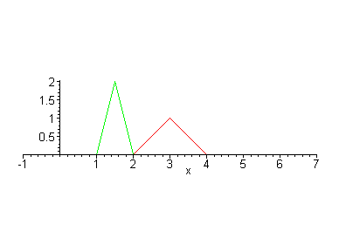
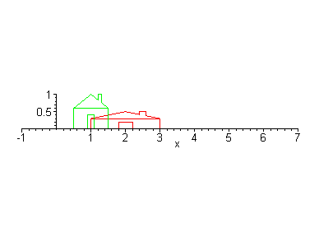
Scaling x,y can be independent
p_{i} = x_{i,} y_{i} p_{i}’ = S_{x*}x_{i,} S_{y}*y_{i}

Slide 19
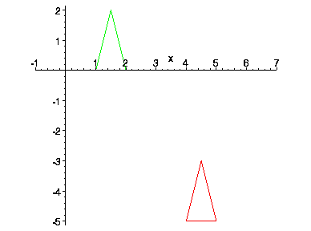
Translating (moving)
willamette.edu
Again, possibly independent, here dx=3 dy = -5
p_{i} = x_{i}, y_{i} p_{i}’ = x_{i} + d_{x} , y_{i} + d_{y}

Slide 20
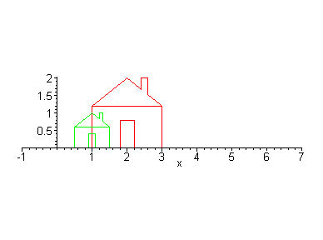
Scaling again, relative to a point
the house is running away
(because it is scaled relative to the origin)
If you want it to appear in-situ, scale
relative to a meaningful fixed point (center/corner etc)

Slide 21
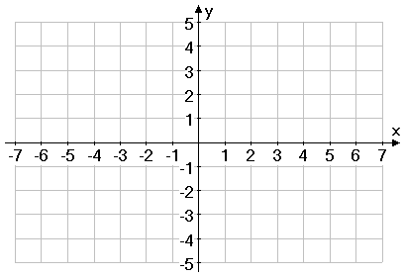
1. translate to the origin
2. scale
3. translate back
1,1 -½ , -½ -1, -1 ½ , ½
1,2 t_{x} = t_{y} = -3/2 -½ , ½ S_{x}=S_{y}=2 -1, 1 t_{x} = t_{y} = 3/2 ½ , 5/2
2,2 ½, ½ 1, 1 5/2, 5/2
2,1 ½ , -½ 1, -1 5/2, ½

Slide 22
Rotation
We have a point p(x,y) and wish to rotate it about the origin
p’(x’, y’)
Ɵ
p(x,y)
Given p and find p’
Ɵ

Slide 24
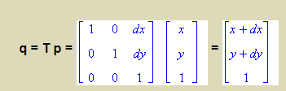
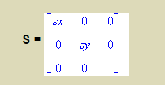
Our transforms so far:
translation
(on the vertices, then redraw the lines)
preserves lengths and angles
scale:
does not preserve lengths
preserves angles iff scale is uniform

Slide 25
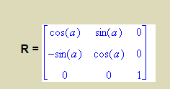
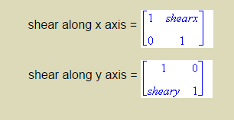
rotate:
preserves lengths and angles
shear:

Slide 26
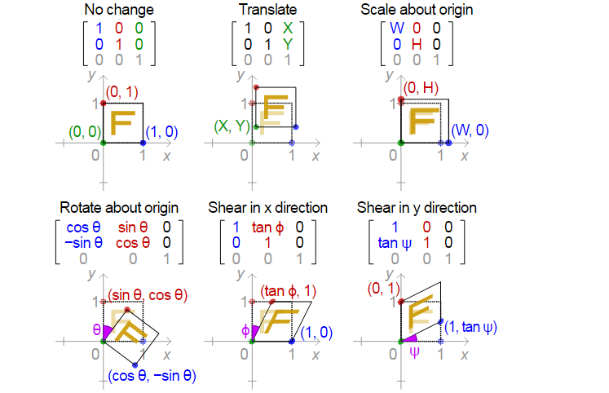

Slide 27
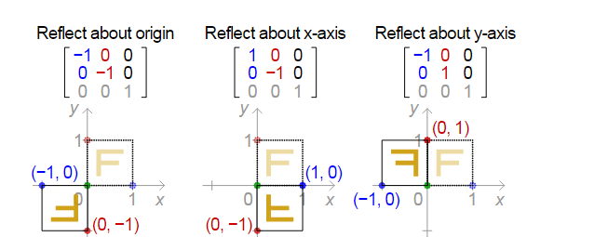

Slide 28
some others
stretch-x stretch-y (how does this differ from shear?)
k 0
0 1
1 0
0 k

Slide 29
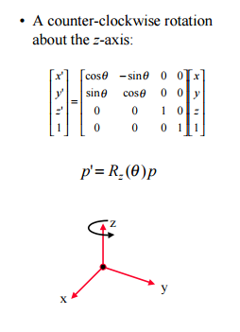

Slide 30
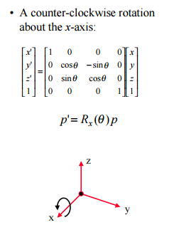

Slide 31
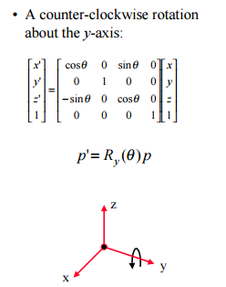

Slide 32
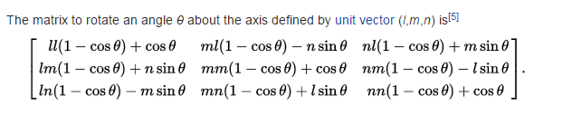
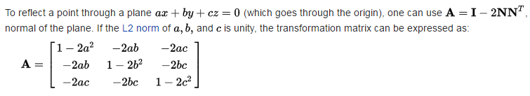
- Wikipedia, Transformation Matrix

Slide 33
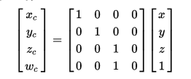
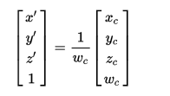
Perspective projection:

Slide 34
With homogeneous coordinates,
these are called Affine Transforms
A function between affine spaces which
preserves points, straight lines, planes,
and parallel-ness
i.e. parallel lines remain parallel
So what’s an Affine Space?
Euclidean space independent of distance and angles… a vector space without the zero vector

Slide 35
… a vector space without the zero vector
No vector has an origin nor can be uniquely associated with a point
We have displacement vectors (translations) between two points of the space
If A,B are points in the space, A – B gives a translation
Add a translation to a point to get a new point also in the space

Slide 36
Matrix addition:
Commutative A+B = B+A
Associative (A + B) + C = A + (B + C)
Identity Ǝ M=0, ɛ A + 0 = A = (0 + A), for all A
Inverse for any A Ǝ -A, ɛ A + (-A) = 0
Distributive (matrix) r(A + B) = rA + rB
Distributive (scalar) (r + s)A = rA + sA

Slide 37
Matrix Multiplication
Not commutative AB != BA
Associative (matrix) (AB)C = A(BC)
Associative (scalar) rs(A) = r(sA)
Distributive (vector) A(v + v’) = Av + Av’
Identity Ǝ I ɛ for all A, AI = A = IA
Inverse for some A, Ǝ A⁻¹ ɛ AA⁻¹ = I = A⁻¹A

Slide 38
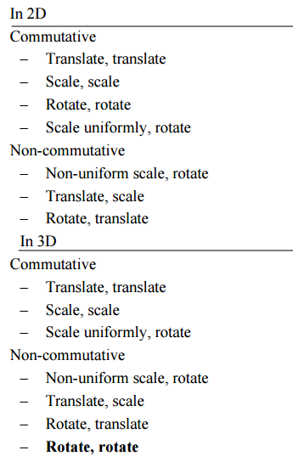

Slide 39
http://graphics.cs.brown.edu/research/exploratory/freeSoftware/repository/edu/brown/cs/exploratories/applets/transformationGame/transformation_game_guide.html

Slide 40
Vectors and vector space
A vector space V is closed under finite vector addition and scalar multiplication
R^{n} is a space where every element is represented by a list of n real numbers
[a1 a2 a3 … an-1 an]
Scalars are real numbers
Addition is component-wise
Scalar multiplication is on each term separately

Slide 41
For X,Y,Z ϵ V and scalars r,s ϵ F
Commutative: X + Y = Y + X
Associative vector addition: (X + Y) + Z = X + (Y + Z)
Additive Identity: For all X, 0 + X = X + 0 = X
Additive inverse. For any X there exists a -X such that: X + (-X) = 0
Associativity of scalar multiplication: r(sX) = (rs) X
Distributivity of scalar sums: r (X + Y) = rX + rY
Scalar multiplication identity: 1 X = X

Slide 42

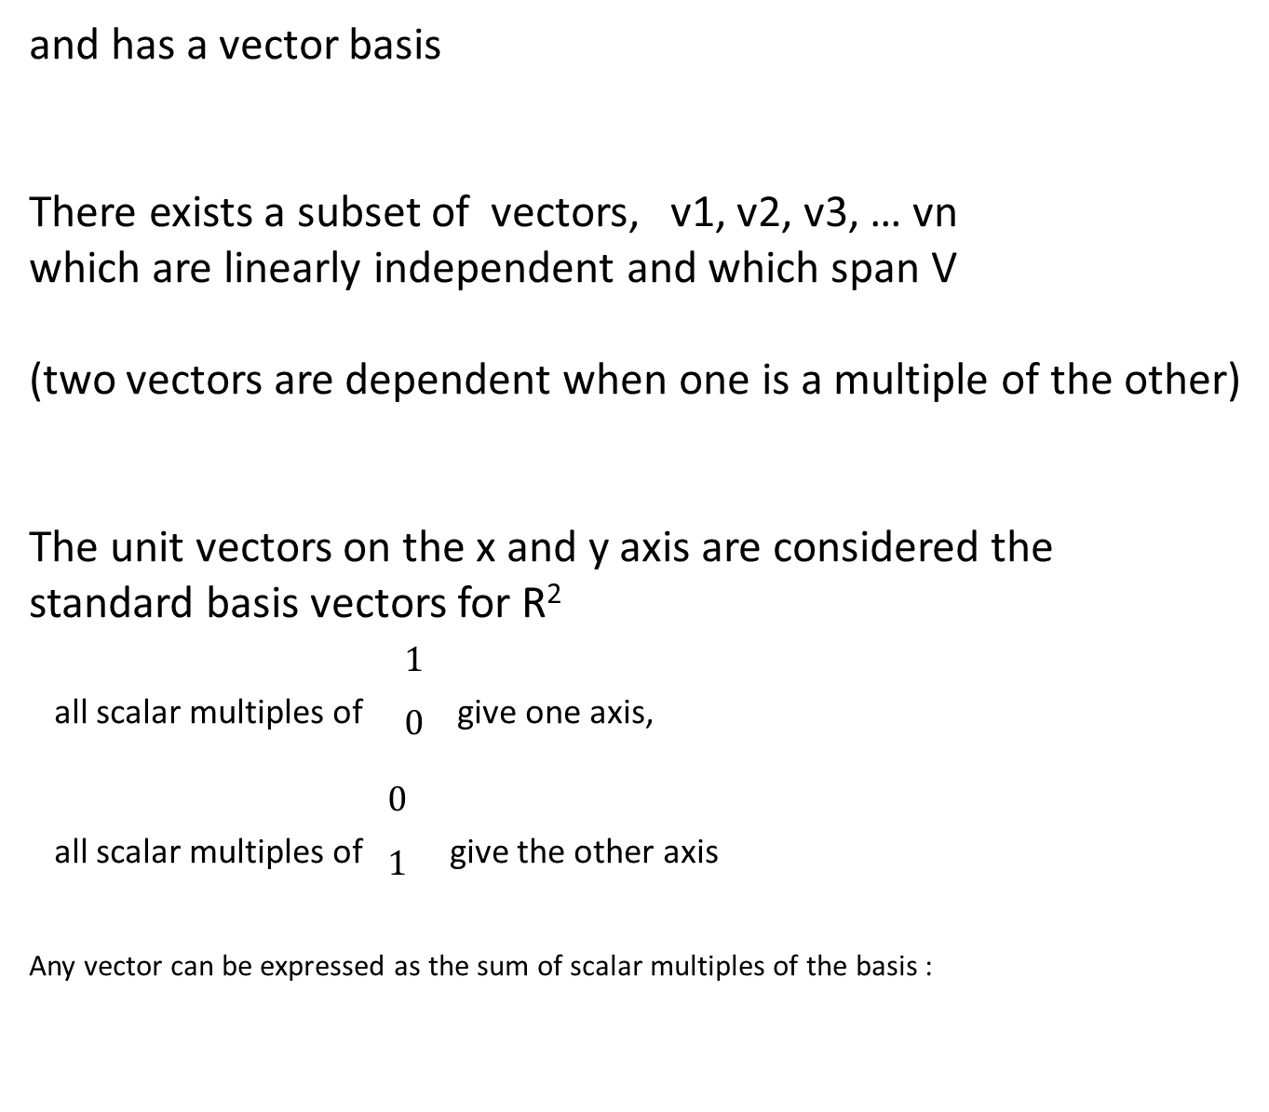
and has a vector basis
There exists a subset of vectors, v1, v2, v3, … vn
which are linearly independent and which span V
(two vectors are dependent when one is a multiple of the other)
The unit vectors on the x and y axis are considered the
standard basis vectors for R²
^{all scalar multiples of} $\begin{matrix}1 \\ 0\end{matrix}$ ^{give one axis,}
^{all scalar multiples of} $\begin{matrix}0 \\ 1\end{matrix}$ ^{give the other axis}
Any vector can be expressed as the sum of scalar multiples of the basis :

Slide 43
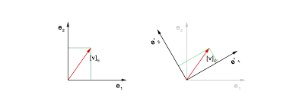
A vector tells you which direction (using the origin), and how far,
but not where to start/stop
We use them to
state an orientation (surface normal)
represent relative distances and orientations in 3space of
lights
objects
viewers
represent positions of vertices

Slide 44
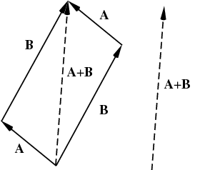
Vector addition in R¹ is just addition
In R² [a b] + [c d] = [a+c b+d]

Slide 45
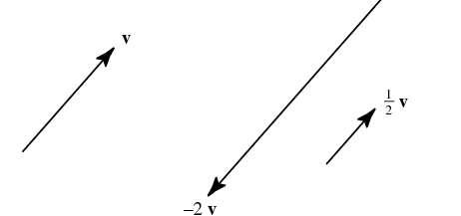
Scalar multiplication of a vector
In R¹ just multiplication
In R² 2 * [3 4] = [6 8]

Slide 46
Vector multiplication is not uniquely defined
But some useful types are:
Dot product - yields scalar
Cross product - yields pseudo vector
Vector direct product - yields tensor

Slide 47

Dot product
Find the length of a vector
Normalize vectors
Measure angle between vectors
Determine if vectors are normal to one another
Sum of the pair-wise multiplications
a = [1 3 -5] b = [4 -2 -1] = 4 -6 +5 = 3 = a dot b

Slide 48


The dot product of a vector with itself is the
square of the length of the vector,
so the length of a vector, called the ‘norm’ is:
To ‘normalize’ a vector, turn it into a unit vector
by dividing by its length

Slide 49

Geometric interpretation of dot product
(proof on board)
= length of the vectors times the cosine of the angle between them
Perpendicular vectors always have a dot product of zero

Slide 50

Cross product
Normal to the plane containing the two vectors
I,j,k are the unit basis vectors

Slide 51
The ‘pipeline’ notion
MVP
model
translate
rotate
scale
view
projection

Slide 52
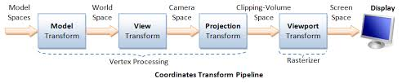

Slide 53
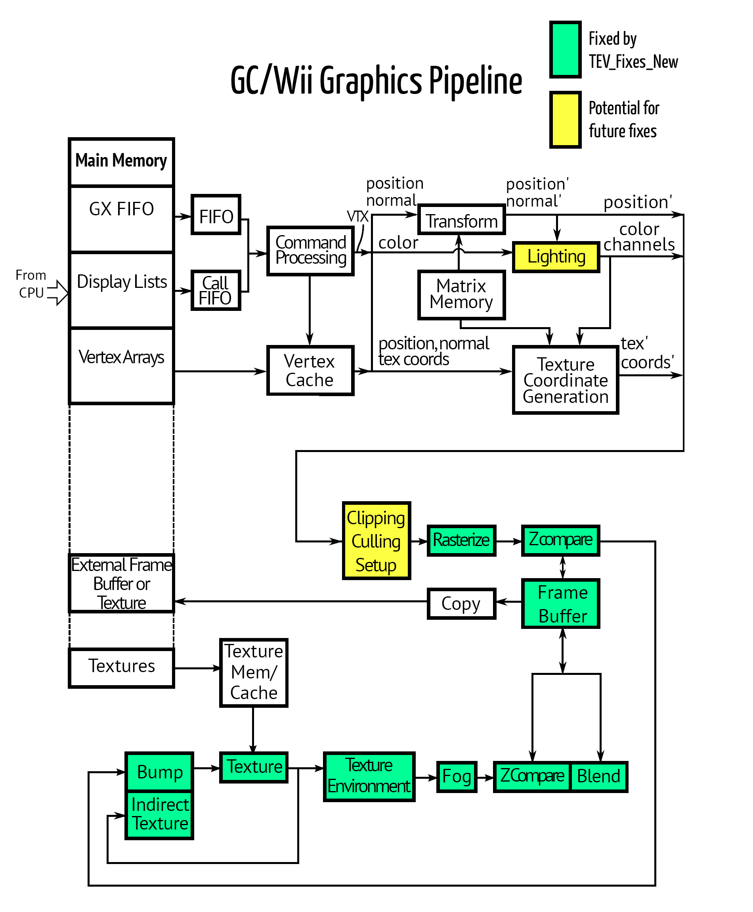

Slide 54
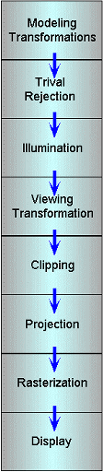
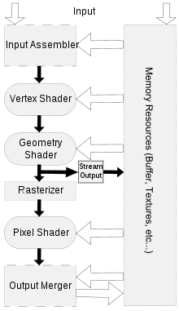

Slide 55
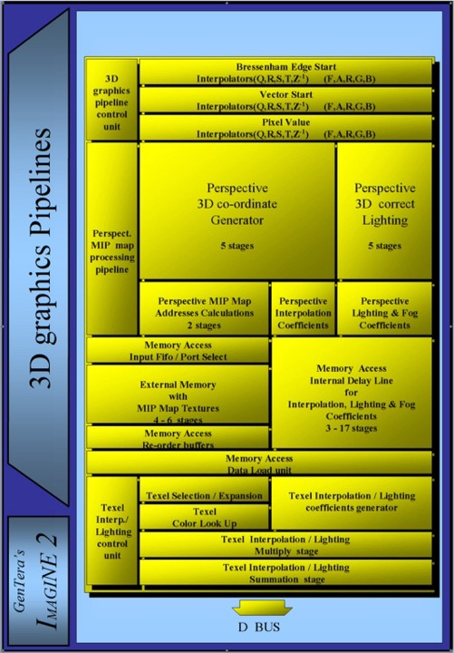

Slide 56
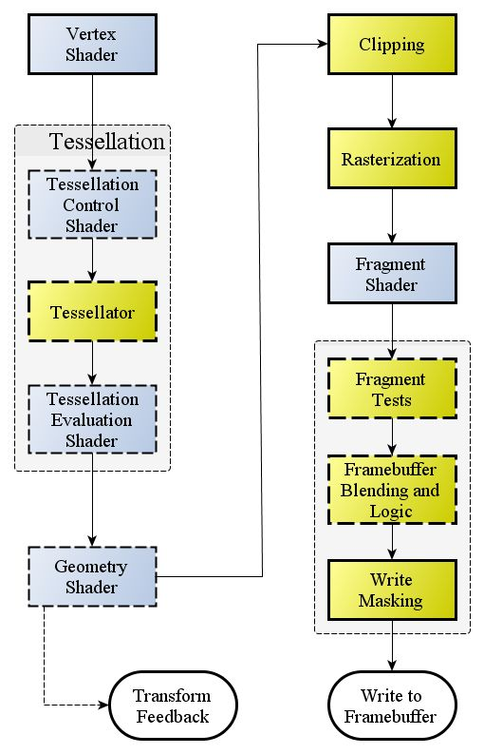

Slide 57
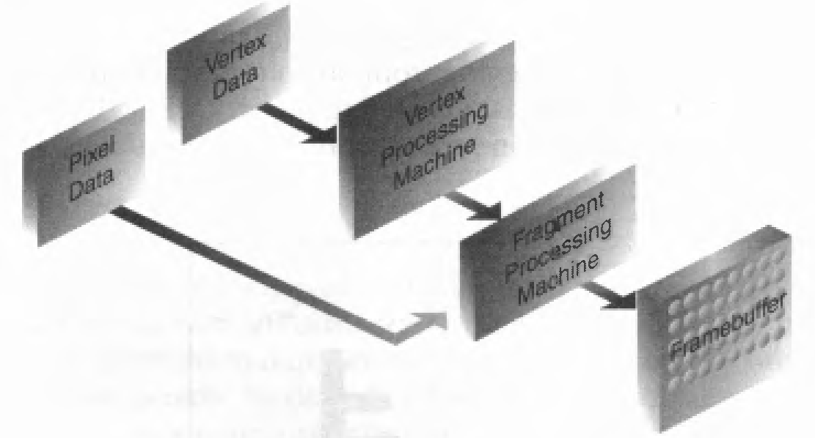
openGL

Slide 58
MVP
model
translate
rotate
scale
view
projection
clipping
lighting
texture mapping
depth testing

Slide 59
/var/www/Explorer/home/lvr/engine/src/lvr.cpp

Slide 60
For 3d graphics, the fundamental issue is:
How do I convert (x, y, z) to (x’, y’) for display
such that I can fool the user into believing the z still exists

Slide 61
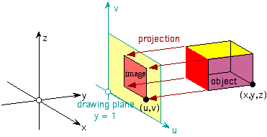
The act of 3d -> 2d is called projection
Basic notion
Projection plane

Slide 62
Parallel
vs
perspective

Slide 63
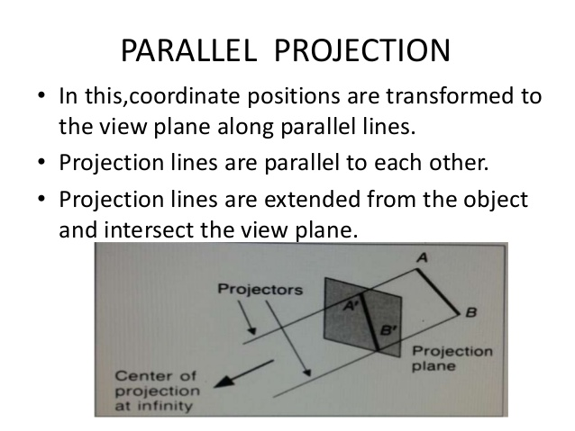

Slide 64
Parallel projections
orthographic
oblique

Slide 65
Parallel orthographic
Projection lines/rays are parallel to each other
and normal to the projection plane

Slide 66
Normal to the projection plane means the projection lines
are all really just the z axis (or whichever)
Therefore
P = (x, y, z)
P’ = (x’, y’) x’ = x, y’ = y

Slide 67
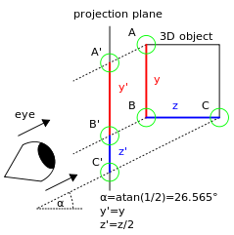
Parallel oblique
Or just oblique

Slide 68


Cabinet, cavalier, and
not of too much interest to us

Slide 69
Perspective Projections
distance from the center of projection to the projection plane is finite
the size of the object varies inversely with distance

Slide 70
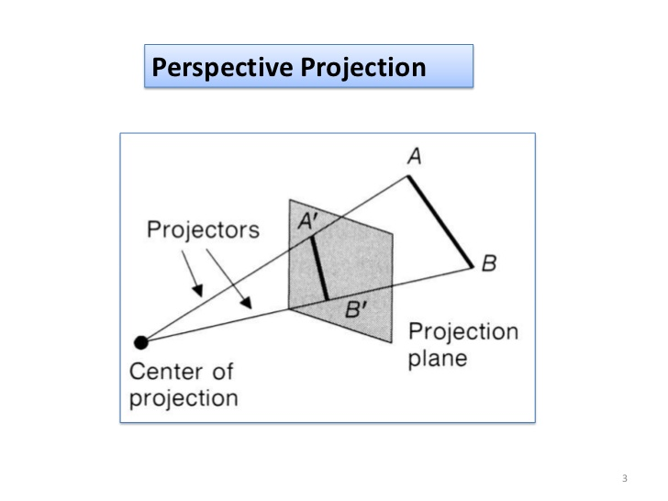

Slide 71
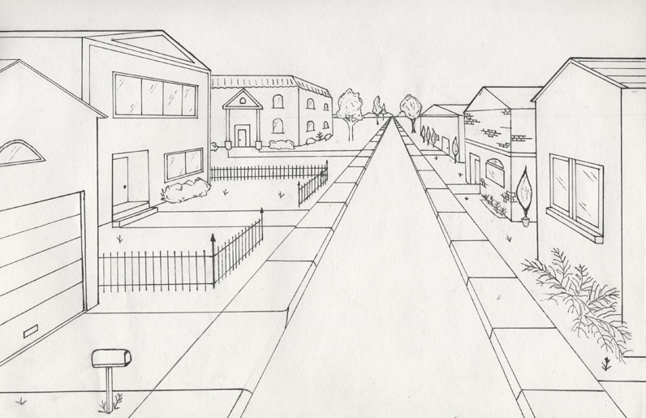

Slide 72
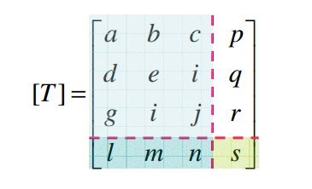
linear transforms
local scale, shear
rotations, reflections
perspective
transforms
translations along
x,y,z
overall scale

Slide 73
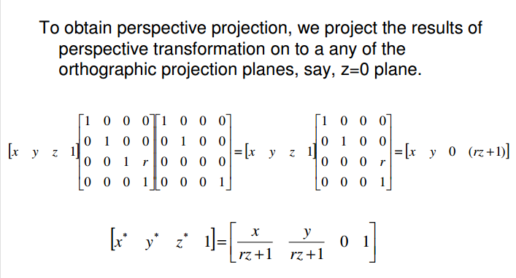

Slide 74
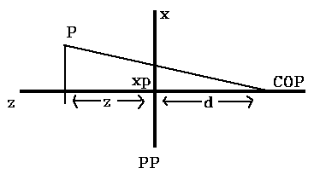

x
by similar triangles:
x / (z+d) == xp / d
xp == (d * x) / (z + d)
xp == x / (z/d + 1)
yp == y / (z/d + 1)

Slide 75
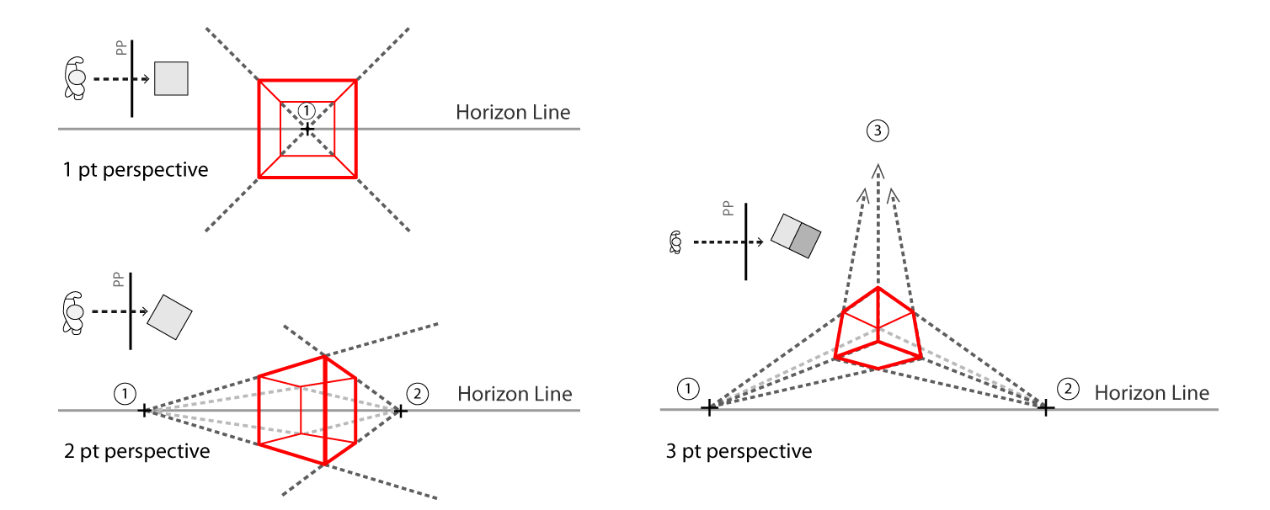

Slide 76
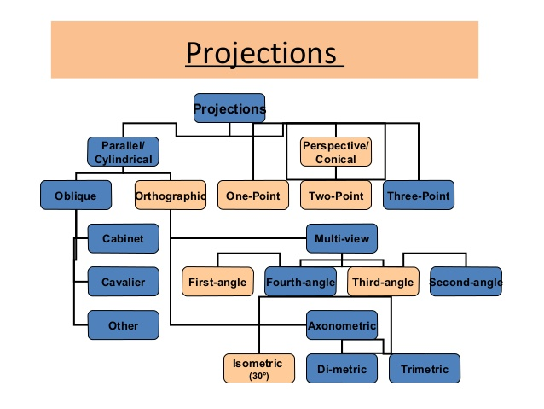

Slide 77
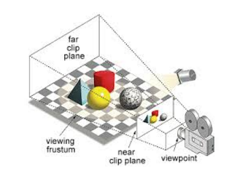
View Frustum

Slide 78
object space → world space → view space
The view matrix is used to transform vertices from world-space to view-space.
Typically concatenated with the object’s world and projection matricies so that vertices can be transformed from object-space directly to clip-space in the vertex program.
i.e. hand the mvp matrix to the vertex shader

Slide 79
MVP == P * V * M
M == T * R * S
v’ = MVP * v

Slide 80
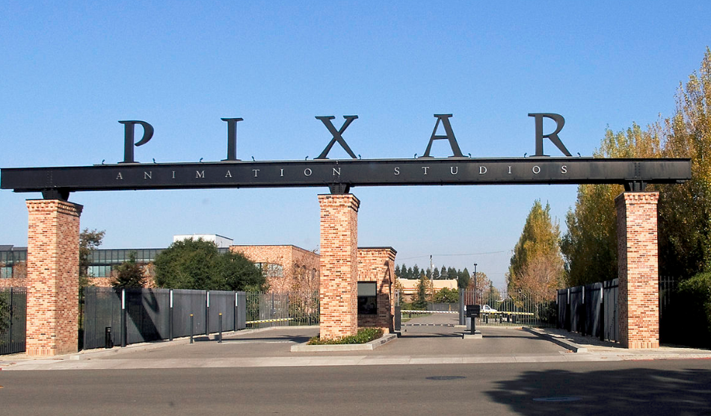

Slide 81
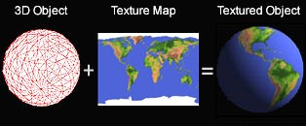
Texture Mapping

Slide 82
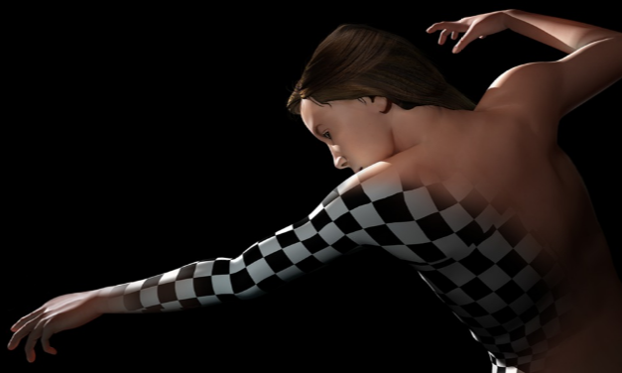

Slide 83
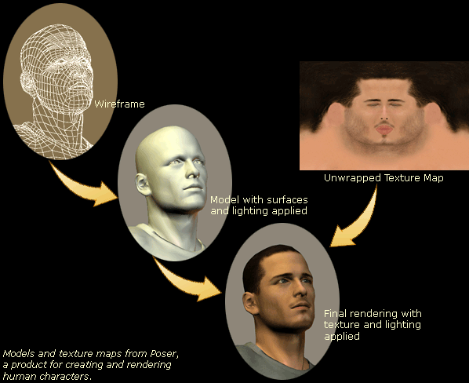

Slide 84
High frequency detail,
Wrap and map pixels to object
height mapping - a 2d map of delta’s from the height origin
bump mapping - perturb surface normals
normal mapping – an implementation of bump mapping
displacement mapping - displace the actual point
reflection mapping – image of local environment for faster reflections
specular mapping – 2d map of reflectivity deltas
occlusion mapping – pre-calculate – how exposed to ambient lighting am I?
mipmaps

Slide 85

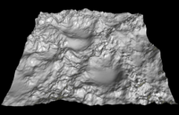
Height mapping

Slide 86

Bump Mapping

Slide 87

Normal Mapping

Slide 88

Displacement mapping

Slide 89

Reflection Mapping

Slide 90

Specular mapping

Slide 91

mipmaps
Say you have a 1024x1024 image texture mapped to a square
Now back the camera away until the entire square fits in a
single pixel. What color should that pixel be??

Slide 92
Compute object space location (x,y,z)
Use a mapping function to find (u,v)
Use corresponder functions to compute texels
Apply value transform
Modify illumination

Slide 93


Slide 94


Slide 95
Associate a texture map coordinate (u,v) with each vertex of the mesh
f(x,y,z) = (u,v)
Cylindrical mapping function
Spherical mapping function
Box mapping function
Planar projection
User specified

Slide 96
Spherical mapping
u = atan2(n.x , n.z) / (2*pi) + 0.5
v = (n.y * 0.5) + 0.5

Slide 97
Cylindrical
r*cos a, r*sin a, hz
0 < a < 2*pi
0 < z < 1
(u,v) = (a / (2*pi), z)

Slide 98
Planar
Put texture on a plane
Cover the object
P = (x,y,z)
(u,v) = (x,y)
Ie. parallel orthographic

Slide 99


Slide 100
Corresponder function
A level of indirection which allows for
Boundary conditions
Anti-aliasing
Mipmapping

Slide 101
Apply value transform
Replace or use blending function (alpha)

Slide 102
interpolation of texture coordinates
With perspective projections, you must consider the nonlinear transformation of the z-component from camera space to clip space

Slide 103

Perspective correct interpolation

Slide 104
2D graphics
Copy a given image to a specific location
blit
Write a string of text in a specified font at a given location
following a specified angle(or nonlinear path)
Draw simple geometric shape, maybe filled
Draw a line segment or curve with a specified pen

Slide 105

openGL, freeType, TrueType
https://en.wikipedia.org/wiki/TrueType
https://learnopengl.com/#!In-Practice/Text-Rendering

Slide 106
BitBLT or blit
CopyArea() and DrawImage() in java Graphics class
opengl
framebuffer objects
Get pointer to frambuffer via libSDL and do the work in cpu

Slide 107
Lines shapes arcs
Bresenham line drawing
Midpoint circle algorithm
Flood fill algorithm(s)
https://en.wikipedia.org/wiki/Flood_fill

Slide 108
Particle Systems
New particles are generated into the system.
Each new particle is assigned its individual attributes.
Any particles that have existed past their prescribed lifetime are extinguished.
The remaining particles are moved and transformed according to their dynamic attributes.
An image of the particles is rendered in the frame buffer, often using special purpose algorithms.

Slide 109
generation
Some element of randomness
Fix M + stdv new particles / frame
Or M + stdv new particles / screen area
Or M + stdv new particles / volume in model space

Slide 110
Typical Attributes
Position
Velocity
Mass
Size
Color
Transparency
Lifetime
Shape
Texture
Orientation
Material Properties

Slide 111
Extinction
IP TTL model
particle no longer contributes to
Scene above some m+stdv threshold
Time
Randomness in motion or extinction or both

Slide 112

Movement
particle’s position is found by simply adding its velocity vector to its position vector.
Modify by:
forces which are a function of position, v, t
gravity
mass attraction

Slide 113
Eval loop
for (i=0; i<nparticles; i++)
clear force accumulators
solve force equations
sum all forces
update

Slide 114


Slide 115


