Slide 1
Image processing-
Input is an image
Output is an enhanced image, or a
list of features or characteristics
Improve images
Detecting parts/orientation(classification)
Feature extraction
Computer vision
Pattern recognition

Slide 2
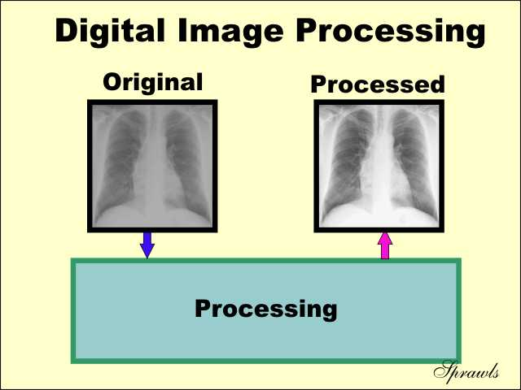

Slide 3
Use ideas of linear systems to provide a mathematical underpinning for
digital image processing.
Use linear functions on the discreet numbers which comprise
our image
Linear functions
f(ax + by) = af(x) + bf(y)

Slide 4
Lets us summarize a series of digital image processing steps
Image in
Image out
Op 1
Op 2
As a single, computationally efficient function

Slide 5
Convolution and filters
Create a new image by sliding a small box of values across the
matix of original values, combining them as we go to create a new image.
mask
image
3 5 2 2 1 0 3 5 8 1
1 3 4 3 2 1 1 1 1 1
0 1 1 2 5 3 4 6 2 1 0
3 4 2 2 1 2 1 2 1 0
1 4 3 4 5 5 5 4 3 2 1
1
1 1

Slide 6
3 5 2 2 1 0 3 5 8 1
1 3 4 3 2 1 1 1 1 1
0 1 1 2 5 3 4 6 2 1 0
3 4 2 2 1 2 1 2 1 0
1 4 3 4 5 5 5 4 3 2 1
1
1 1
1*1 + 1*3 + 1*7 + 1*1 = 12
Which is the upper left pixel value for the new image
Now slide the mask over one position and do it again

Slide 7
3 5 2 2 1 0 3 5 8 1
1 3 4 3 2 1 1 1 1 1
0 1 1 2 5 3 4 6 2 1 0
3 4 2 2 1 2 1 2 1 0
1 4 3 4 5 5 5 4 3 2 1
1
1 1
1*1 + 1*3 + 1*7 + 1*1 = 12
Which is the upper left pixel value for the new image
Now slide the mask over one position and do it again

Slide 8
3 5 2 2 1 0 3 5 8 1
1 3 4 3 2 1 1 1 1 1
0 1 1 2 5 3 4 6 2 1 0
3 4 2 2 1 2 1 2 1 0
1 4 3 4 5 5 5 4 3 2 1
1
1 1
1*1 + 1*3 + 1*7 + 1*1 = 12
Which is the upper left pixel value for the new image
Now slide the mask over one position and do it again

Slide 9
Mask size can be variable, and it can be 1d or 3d as well (or N-dimensional)
[1 0 2] [1 2 0 1 3 4 2 1 2 4 5 6 2 3 1]
Some thing you will likely notice:
Numbers get bigger as I have shown them
The output image/signal size is not the same as the input size

Slide 10
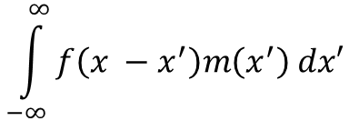
N = image length, M = mask length, output
Image length is N – M + 1
Add trailing rows/columns of zeros to normalize
So, in the real world:
g(x) =
f(x) is the (continuous) input function
g(x) is the (continuous) output function
m(x) is the (continuous) mask function

Slide 11
N = image length, M = mask length, output
Image length is N – M + 1
Add trailing rows/columns of zeros to normalize
So, in the real world:
g(x) =
f(x) is the (continuous) input function
g(x) is the (continuous) output function
m(x) is the (continuous) mask function

Slide 12
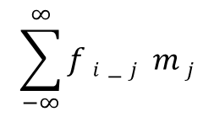
In our world:
g i
=

Slide 13
Edge detection
Fundamental tool of computer image processing and computer vision
General description of the process (duration-3:14):
https://www.youtube.com/watch?v=-pmUQ6RSejQ

Slide 14
Edge detection
discontinuities in image brightness are likely to correspond to
discontinuities in depth
discontinuities in surface orientation
changes in material properties
variations in lighting

Slide 15
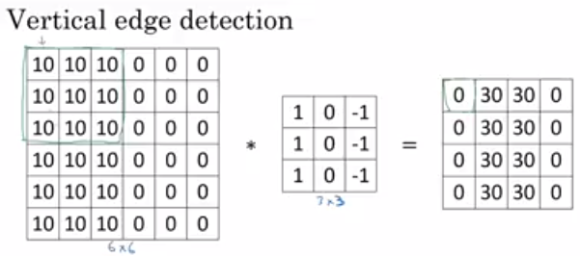
From the video:
https://www.youtube.com/watch?v=XuD4C8vJzEQ
Which you should watch at this point

Slide 16

Sobel operator

Slide 17
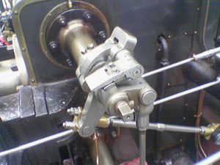
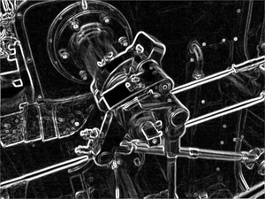
After sobel:

Slide 18
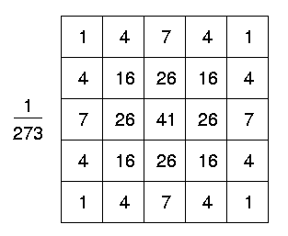
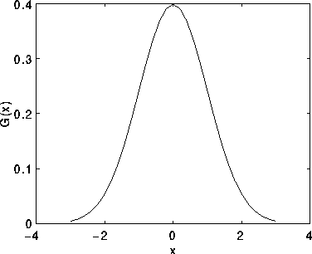
Gaussian

Slide 19
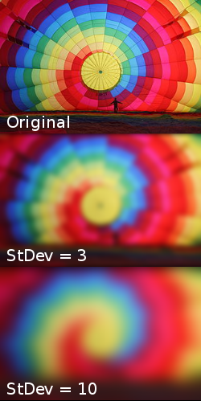
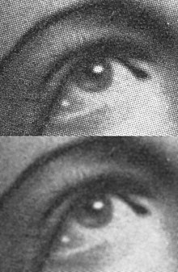
Effect of Gaussian – it's job is to blur, reducing image noise and detail

Slide 20
0.00000067 0.00002292 0.00019117 0.00038771 0.00019117 0.00002292 0.00000067
0.00002292 0.00078634 0.00655965 0.01330373 0.00655965 0.00078633 0.00002292
0.00019117 0.00655965 0.05472157 0.11098164 0.05472157 0.00655965 0.00019117
0.00038771 0.01330373 0.11098164 0.22508352 0.11098164 0.01330373 0.00038771
0.00019117 0.00655965 0.05472157 0.11098164 0.05472157 0.00655965 0.00019117
0.00002292 0.00078633 0.00655965 0.01330373 0.00655965 0.00078633 0.00002292
0.00000067 0.00002292 0.00019117 0.00038771 0.00019117 0.00002292 0.00000067
Another gaussian expressed as floating point numbers

Slide 21
By reducing detail the Gaussian will also likely
reduce the number of edges 'seen' by edge
detection operators... which is a good thing
if the image is noisy with redundant edges

Slide 22

Laplacian
Highlight regions of rapid intensity change
Look through: https://homepages.inf.ed.ac.uk/rbf/HIPR2/log.htm

Slide 23
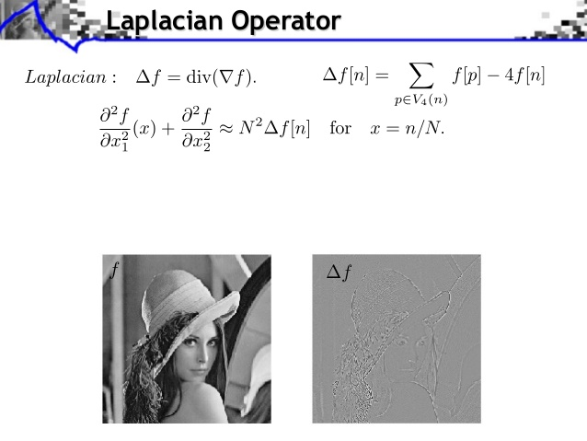

Slide 24
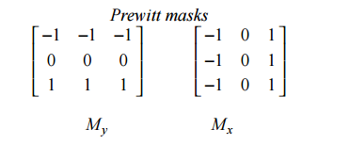
Prewitt

Slide 25
Prewitt

Slide 26

Calculates the gradient of the image intensity at each point
.

Slide 27
?
-1 -1 -1
-1 9 -1
-1 -1 -1

Slide 28
Edge Thinning
8 neighbor
for i in north south east west
do
Remove the point if{
if this point has no neighbor in direction i
the point is not the end of a line.
the point is isolated.
removing the point will not cause a disconnect of its neighbors
}

