Slide 1
Lighting/Shading models
The (a) goal is to create a comprehensive, realistic,
and flexible model of the role of light during our
perception
…and it has to be computable

Slide 2
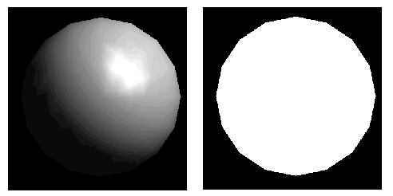
https://en.wikipedia.org/wiki/Spinning_Dancer

Slide 4
Level 0 model
objects are emissive
each polygon lights itself, but does not contribute light to the
surrounding environment (self-luminous)
each polygon has its own color
not affected by anything else – other objects, position, normal
Fast, unrealistic, sometimes useful, does not help with the 3D scam
Each object K has an intrinsic intensity Ki in the
range 0-1 for each of RGB

Slide 5
Emissive
I = Ki
I: intensity
Ki: object's intrinsic intensity, 0.0 - 1.0 for each of R, G, and B

Slide 6
Ambient lighting
A systemic, suffusing light source
Non-directional, light is reflected equally in all
directions from all surfaces
Intensity constant over polygon and unaffected by a
anything else – other object, position, normal
Viewer position does not matter
why you can still see at night – often a component of a more
comprehensive lighting model
Object K has ambient reflection coefficient Ka 0-1 for each of RGB.
I = IaKa where Ia is the intensity of the ambient light
(How is this different from self-illuminating?)

Slide 7
Ambient
I = IaKa
I: intensity
Ia: intensity of Ambient light
Ka: object's ambient reflection coefficient, 0.0 - 1.0 for each of R, G, and B

Slide 8
Some types of light sources
Sunlight/ directional light
light source is at “infinity”, rays are parallel and strike
in a single parallel direction with equal intensity
everywhere
Care only about color, intensity, and direction

Slide 9
Point light
Equal amounts of light in all directions
Position of light source, position of object, and distance between them all matter
Color, intensity, location, falloff function
Spot light
a point light which radiates in a cone
More light in the center of the cone with falloff toward
The edges of the circle as well

Slide 10
Diffuse reflection with a point light
I = Ip Kd cos(theta) or
I = Ip Kd(N' . L')
I: intensity
Ip: intensity of point light
Kd:diffuse reflection coefficient for the object, as rgb
N': normalized surface normal
L': normalized direction to light source
theta: angle between surface normal and light source

Slide 11
Ambient + point light diffuse
I = Ia Ka + Ip Kd(N' * L')

Slide 12
Specular Component
Ip cos^n(a)
Ip: intensity of point light
n: specular-reflection exponent
a = angle between light ray and reflected light ray
Intensity = Ambient term + Attenuation x (Diffuse term + Specular term)

Slide 13
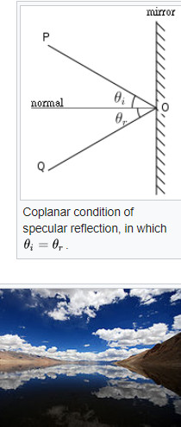

Slide 14
Specular Component
Ip cos^n(a)
Ip: intensity of point light
n: specular-reflection exponent
a = angle between light ray and reflected light ray
http://learnwebgl.brown37.net/09_lights/lights_specular.html
Intensity = Ambient term + Attenuation x (Diffuse term + Specular term)

Slide 15
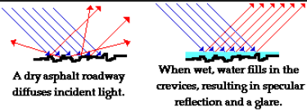

Slide 16

- Christina Vasilakis' SoftImage Owl
Self luminous

Slide 17
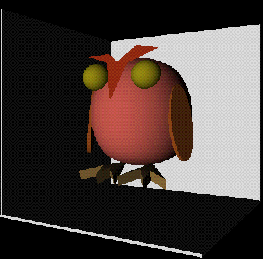
Directional from front

Slide 18
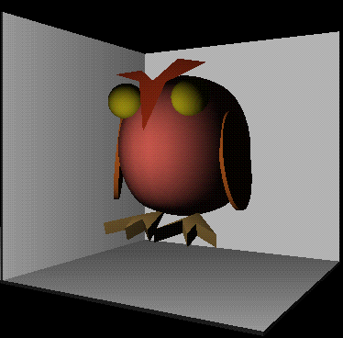
Point light from front

Slide 19
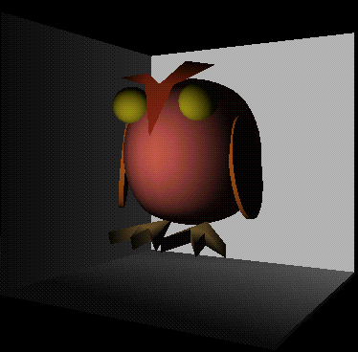
Spotlight in front, aimed at owl

Slide 22
Polygon material properties in openGL
ambientColor (R, G, B) - Contribution due to ambient light
diffuseColor (R, G, B) - Contribution due to directed, point, and spot lights
specularColor (R, G, B) - Contribution due to specularity, usually white
emissiveColor (R, G, B) - For objects that glow of their own accord, independent of light
transparency 0.0 - 1.0 - Alpha channel, for combining with pixels behind the object.
shininess 0.0 - 1.0 - Controls the contribution of the specular component

Slide 23
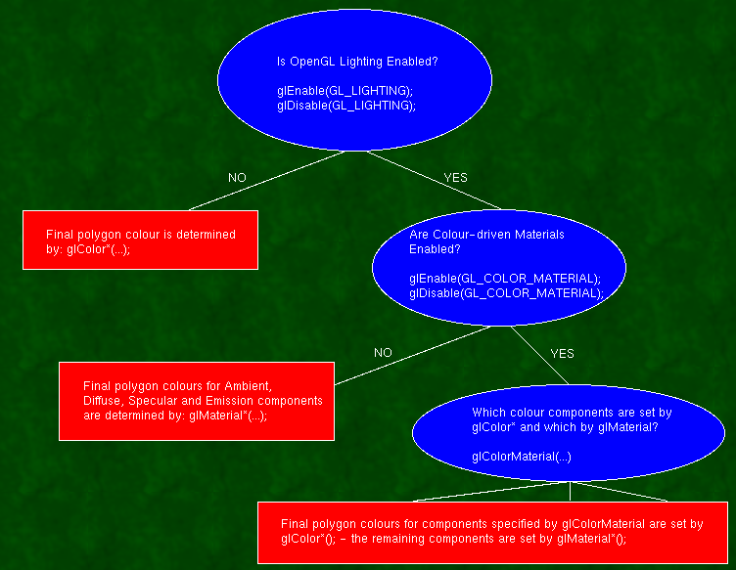
- sjbaker.org

Slide 24
glLight() – set (ambient, diffuse and specular), position, direction,
beam width and attenuation rate for each light
lights on: glEnable(GL_LIGHT_n)
lights off: glDisable(GL_LIGHT_n)
Only uses the alpha channel for diffuse color

Slide 25
The final polygon color is the sum of all four light components, each of which is formed by multiplying the glMaterial color by the glLight color (modified by the directionality in the case of Diffuse and Specular).

Slide 26
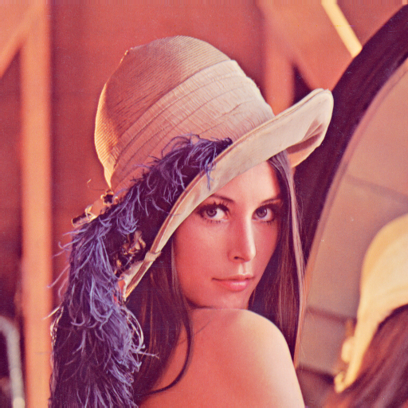

Slide 27
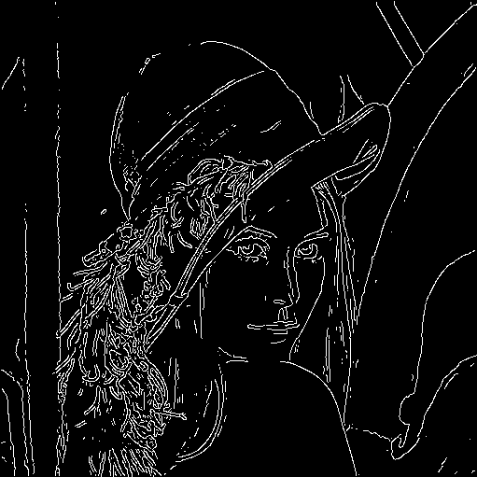

Slide 28
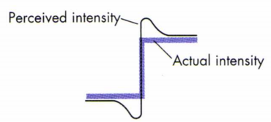

Slide 29
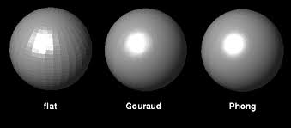

Slide 30
Continuous Shading of Curved Surfaces
H. Gouraud
computes the lighting at the corners of each triangle and linearly interpolates the resulting colors for each pixel

Slide 31
-
Localized phenomena get wrecked, see the spinning ball:
http://en.wikipedia.org/wiki/Gouraud_shading

Slide 32
Phong Shading
Bui Tuong Phong, University of Utah
Interpolate the surface normal, then apply the lighting
model at each pixel
More expensive

Slide 33
Texture Mapping
Can define other surface parameters besides color (we use color for all lighting)
Bump mapping – perturb surface normals
Transparency mapping – modulate opacity of a translucent object
Some lighting scattering techniques

Slide 34
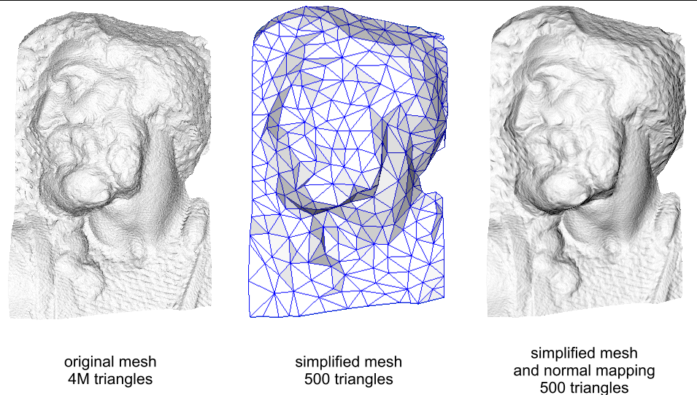
Bump mapping – add detail without adding polygons
(the triangle mesh game has its limits)

Slide 35
Perturb the surface normals before lighting
Height map to simulate surface displacement,
Apply deltas then calculate surface normal
Look up the height in the heightmap that
Corresponds to the position on the surface
Calculate the surface normal of the heightmap
Combine with the true surface normal
lighting

Slide 36
...or maintain a map of precalculated normals,
(instead of height)
often stored as RBG image
Bump mapping differs from a similar technique
called displacement mapping in that it does
not alter the actual surface (which the latter does).

Slide 37
Texture Mapping
Shading technique which maps a texture image to a surface in 3-space
Can add lots of detail
The cost is relatively small
Does not affect hidden surface removal

Slide 38
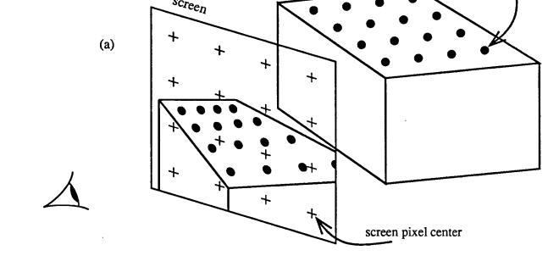

Slide 39
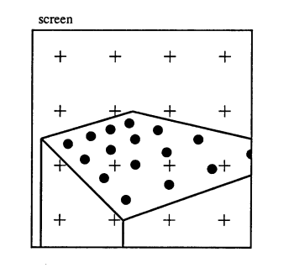

Slide 40
2d texture space
3d object space
Screen space
Correspondence between 2d texture space and 3d object space
Is called the parameterization of the surface

Slide 41
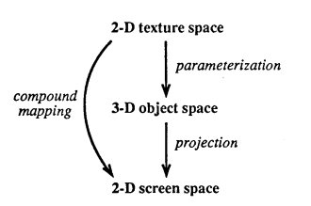

Slide 42
Once the compound 2D to 2D mapping is known,
the intermediate 3D space is ignored

Slide 43
Obvious method:
Define object x,y,z
and texture space coordinates (u,v) at each vertex
Linearly interpolate along edges from vertex to vertex
Then by scan line across, take the u,v’s back to the image

Slide 44
High frequency textures
Perspective foreshortening
Horizontal lines through vertices are weird

Slide 45
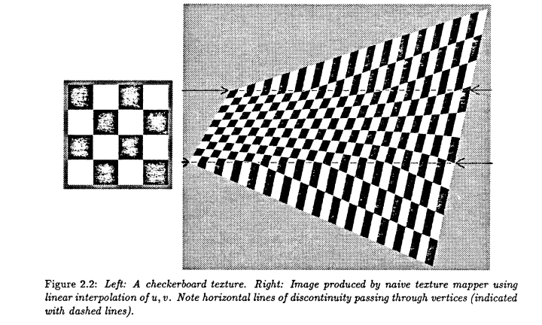
- Heckbert 1989

Slide 46
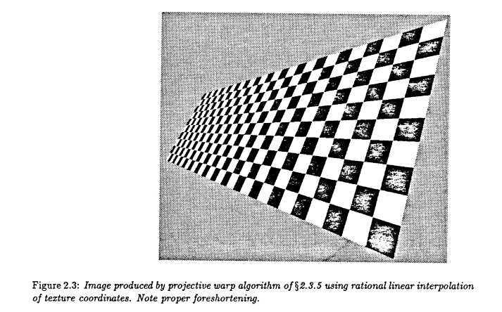
- Heckbert 1989

Slide 47
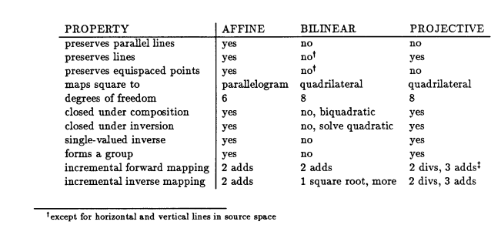

Slide 48
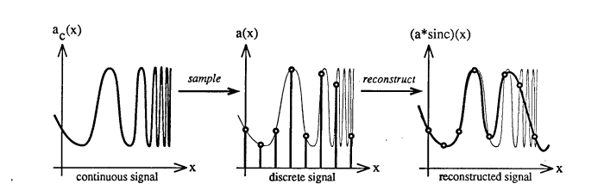

Slide 49
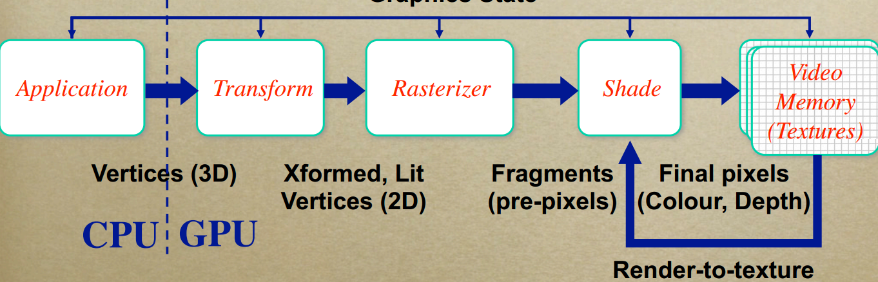
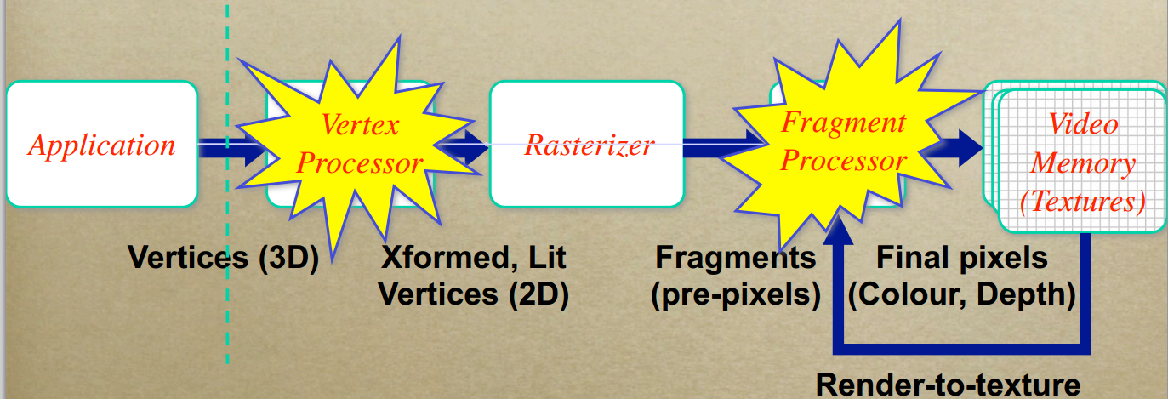
OpenGL fixed pipeline
Programmable pipeline
- Chris Handley

