Slide 1
Domoticz Plugin
TrafficLight
(using Tinkerforge Building Blocks)
By Robert W. B. Linn
27.05.2019

Slide 2
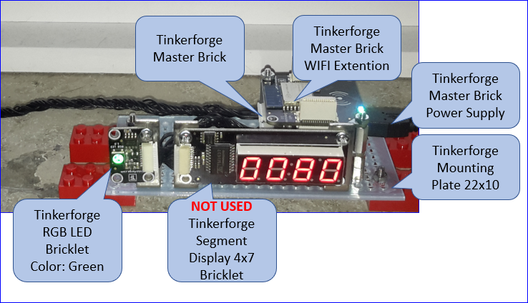
Prototype

Slide 3
Overview Hardware & Flow
WIFI
Extention
Master
Brick
Connect to Tinkerforge Master Brick via WiFi
Get Domoticz Traffic Light State
Set Tinkerforge RGB LED Bricklet Color
Update Domoticz Devices Traffic Light State Selector, Alert Indicator & State Info
Set Domoticz Traffic Light State
RGB LED
Bricklet
Raspberry Pi
Domoticz
Server
Domoticz Devices

Slide 4
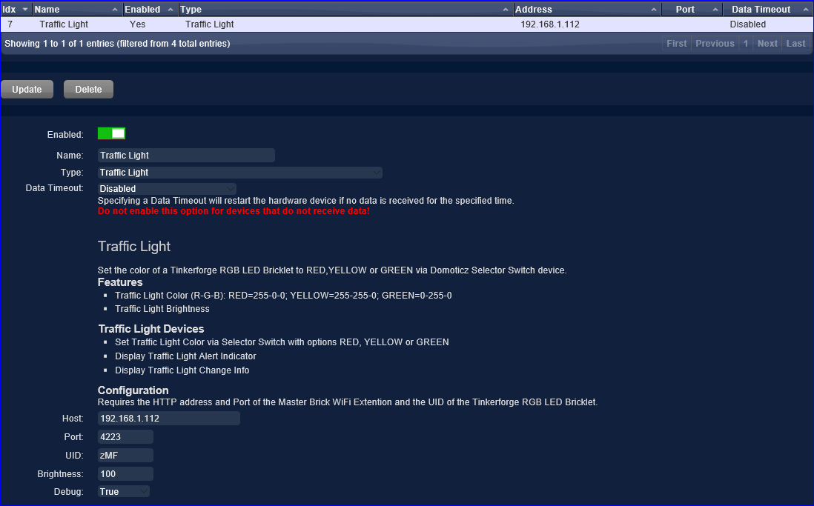
Domoticz – Add new Hardware Traffic Light
"""
<plugin key="TrafficLight" name="Traffic Light" author="rwbL" version="1.0.0">
<description>
<h2>Traffic Light</h2><br/>
Set the color of a Tinkerforge RGB LED Bricklet to RED,YELLOW or GREEN via Domoticz Selector Switch device.
<h3>Features</h3>
<ul style="list-style-type:square">
<li>Traffic Light Color (R-G-B): RED=255-0-0; YELLOW=255-255-0; GREEN=0-255-0</li>
<li>Traffic Light Brightness</li>
</ul>
<h3>Traffic Light Devices</h3>
<ul style="list-style-type:square">
<li>Set Traffic Light Color via Selector Switch with options RED, YELLOW or GREEN</li>
<li>Display Traffic Light Alert Indicator</li>
<li>Display Traffic Light Change Info</li>
</ul>
<h3>Configuration</h3>
Requires the HTTP address and Port of the Master Brick WiFi Extention and the UID of the Tinkerforge RGB LED Bricklet.
</description>
<params>
<param field="Address" label="Host" width="200px" required="true" default=“ip-address"/>
<param field="Port" label="Port" width="75px" required="true" default="4223"/>
<param field="Mode1" label="UID" width="75px" required="true" default="zMF"/>
<param field="Mode4" label="Brightness" width="75px" required="true" default="100"/>
<param field="Mode6" label="Debug" width="75px">
<options>
<option label="True" value="Debug" default="true"/>
<option label="False" value="Normal"/>
</options>
</param>
</params>
</plugin>
"""
Notes
<ADD>
Read plugin.py

Slide 5
Domoticz – Add new Hardware Traffic Light - Domoticz Log
The Domoticz Log after adding the new hardware. There are 3 new devices created and set to used.
2019-05-27 09:43:31.992 Status: (Traffic Light) Started.
2019-05-27 09:43:32.550 (Traffic Light) Debug logging mask set to: PYTHON PLUGIN QUEUE IMAGE DEVICE CONNECTION MESSAGE ALL
2019-05-27 09:43:32.550 (Traffic Light) 'DomoticzHash':'fccd39bb'
2019-05-27 09:43:32.550 (Traffic Light) 'HardwareID':'7'
2019-05-27 09:43:32.550 (Traffic Light) 'Database':'/home/pi/domoticz/domoticz.db'
2019-05-27 09:43:32.550 (Traffic Light) 'Version':'1.0.0'
2019-05-27 09:43:32.550 (Traffic Light) 'HomeFolder':'/home/pi/domoticz/plugins/TrafficLight/'
2019-05-27 09:43:32.550 (Traffic Light) 'DomoticzVersion':'4.10826'
2019-05-27 09:43:32.550 (Traffic Light) 'Name':'Traffic Light'
2019-05-27 09:43:32.550 (Traffic Light) 'Mode6':'Debug'
2019-05-27 09:43:32.550 (Traffic Light) 'DomoticzBuildTime':'2019-05-24 10:04:40'
2019-05-27 09:43:32.550 (Traffic Light) 'Mode4':'100'
2019-05-27 09:43:32.550 (Traffic Light) 'StartupFolder':'/home/pi/domoticz/'
2019-05-27 09:43:32.550 (Traffic Light) 'Port':'4223'
2019-05-27 09:43:32.550 (Traffic Light) 'Key':'TrafficLight'
2019-05-27 09:43:32.550 (Traffic Light) 'Language':'en'
2019-05-27 09:43:32.550 (Traffic Light) 'Address’:’ip-address'
2019-05-27 09:43:32.550 (Traffic Light) 'Author':'rwbL'
2019-05-27 09:43:32.550 (Traffic Light) 'UserDataFolder':'/home/pi/domoticz/'
2019-05-27 09:43:32.550 (Traffic Light) 'Mode1':'zMF'
2019-05-27 09:43:32.550 (Traffic Light) Device count: 0
2019-05-27 09:43:32.550 (Traffic Light) Creating new Devices
2019-05-27 09:43:32.551 (Traffic Light) Creating device 'State Selector'.
2019-05-27 09:43:32.552 (Traffic Light) Device created: Traffic Light - State Selector
2019-05-27 09:43:32.552 (Traffic Light) Creating device 'Alert Indicator'.
2019-05-27 09:43:32.553 (Traffic Light) Device created: Traffic Light - Alert Indicator
2019-05-27 09:43:32.553 (Traffic Light) Creating device 'Change Info'.
2019-05-27 09:43:32.554 (Traffic Light) Device created: Traffic Light - Change Info
2019-05-27 09:43:32.554 (Traffic Light) Pushing 'PollIntervalDirective' on to queue
2019-05-27 09:43:32.554 (Traffic Light) Processing 'PollIntervalDirective' message
2019-05-27 09:43:32.554 (Traffic Light) Heartbeat interval set to: 60.
2019-05-27 09:43:32.547 Status: (Traffic Light) Entering work loop.
2019-05-27 09:43:32.548 Status: (Traffic Light) Initialized version 1.0.0, author 'rwbL'

Slide 6
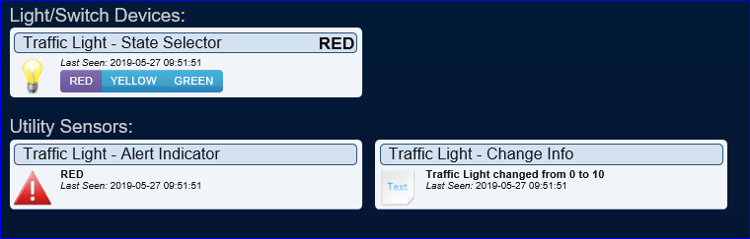
Domoticz Traffic Light - Devices
There are 3 new devices created, with an initial state & info, set to used and manually added to the dashboard.
The dashboard after setting the Traffic Light to RED via the State Selector Device.

Slide 7
Domoticz Traffic Light – State Changed from Off to RED
The initial state is Off.
The log shows changing the state to RED by pressing RED button on the State Selector Switch.
2019-05-27 09:51:50.997 Status: User: Admin initiated a switch command (13/Traffic Light - State Selector/Set Level)
2019-05-27 09:51:51.002 (Traffic Light) Processing 'onCommandCallback' message
2019-05-27 09:51:51.002 (Traffic Light) Calling message handler 'onCommand'.
2019-05-27 09:51:51.003 (Traffic Light) onCommand called for Unit 1: Parameter 'Set Level', Level: 10
2019-05-27 09:51:51.012 (Traffic Light) IP Connection - OK
2019-05-27 09:51:51.012 (Traffic Light) Traffic Light - State Selector-Traffic Light State New=10
2019-05-27 09:51:51.012 (Traffic Light) Traffic Light - State Selector-nValue=0,sValue=
2019-05-27 09:51:51.017 (Traffic Light) Traffic Light - State Selector-RGB LED Colors R-G-B:0-100-0
2019-05-27 09:51:51.018 (Traffic Light) RGB LED Brightness updated:100
2019-05-27 09:51:51.018 (Traffic Light - State Selector) Updating device from 0:'' to have values 2:'10'.
2019-05-27 09:51:51.030 (Traffic Light) Traffic Light - State Selector-nValue=2,sValue=10
2019-05-27 09:51:51.030 (Traffic Light - Alert Indicator) Updating device from 0:'No Alert!' to have values 4:'RED'.
2019-05-27 09:51:51.038 (Traffic Light) Traffic Light - Alert Indicator-nValue=4,sValue=RED
2019-05-27 09:51:51.038 (Traffic Light - Change Info) Updating device from 0:'' to have values 0:'Traffic Light changed from 0 to 10'.
2019-05-27 09:51:51.045 (Traffic Light) Traffic Light - Change Info-nValue=0,sValue=Traffic Light changed from 0 to 10
2019-05-27 09:51:51.148 (Traffic Light) TrafficLight Update: OK

Slide 8
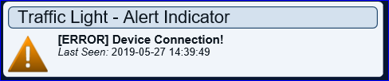
Domoticz Traffic Light – State Change Error
Example of an Error message triggered by changing a color by the Selector Switch and caused by the Master Brick not powered up. This results in a IP Connection failed error.
2019-05-27 14:48:37.140 (Traffic Light) onCommand called for Unit 1: Parameter 'Set Level', Level: 20
2019-05-27 14:48:37.101 Status: User: Admin initiated a switch command (13/Traffic Light - State Selector/Set Level)
2019-05-27 14:48:40.298 (Traffic Light) [ERROR] IP Connection failed
2019-05-27 14:48:40.299 (Traffic Light - Alert Indicator) Updating device from 3:'-[ERROR] Device Connection!' to have values 3:'[ERROR] Device Connection!'.
2019-05-27 14:48:40.307 (Traffic Light) Traffic Light - Alert Indicator-nValue=3,sValue=[ERROR] Device Connection!
2019-05-27 14:48:40.307 (Traffic Light) [ERROR] Device Connection!

Slide 9
Domoticz Traffic Light – Plugin Code Snippet onCommand
def onCommand(self, Unit, Command, Level, Hue):
try:
ipcon = IPConnection()
lb = BrickletRGBLED(Parameters["Mode1"], ipcon)
ipconnected = 0
try:
ipcon.connect(Parameters["Address"], int(Parameters["Port"]))
ipconnected = 1
except:
Domoticz.Debug("[ERROR] IP Connection failed")
if ipconnected == 0:
Devices[2].Update( nValue=3, sValue="[ERROR] Device Connection!")
return
oldtrafficlightstate = 0
if Devices[1].sValue != "":
oldtrafficlightstate = int(Devices[1].sValue)
newtrafficlightstate = Level
rgbvalue = lb.get_rgb_value()
lbbrightness = int(Parameters["Mode4"])
trafficlightcolor = "UNKNOWN"
trafficlightalert = 0
if newtrafficlightstate == 10: lb.set_rgb_value(lbbrightness, 0, 0); trafficlightcolor = "RED“; trafficlightalert = 4
if newtrafficlightstate == 20: lb.set_rgb_value(lbbrightness, lbbrightness, 0); trafficlightcolor = "YELLOW“; trafficlightalert = 2
if newtrafficlightstate == 30: lb.set_rgb_value(0, lbbrightness, 0); trafficlightcolor = "GREEN“; trafficlightalert = 1
Devices[1].Update( nValue=2, sValue=str(newtrafficlightstate) )
Devices[2].Update( nValue=trafficlightalert, sValue=trafficlightcolor )
Devices[3].Update( nValue=0, sValue="Traffic Light changed from " + str(oldtrafficlightstate) + " to " + str(newtrafficlightstate) )
ipcon.disconnect()
except:
if ipconnected == 1:
ipcon.disconnect()
Devices[2].Update( nValue=3, sValue="[ERROR] Check settings, correct and restart Domoticz")
see plugin.py

Slide 10
Domoticz Traffic Light – Set State via HTTP
Set the Traffic Light (idx=13) State to GREEN by setting the level to 30:
http://ip-address:8080/json.htm?type=command&param=switchlight&idx=13&switchcmd=Set%20Level&level=30
Resulting in HTTP response
{ "status" : "OK", "title" : "SwitchLight" }
The plugin onCommand function is triggered and the devices are updated.
Check the Domoticz Web-UI:
http://ip:8080/#/Dashboard
http://ip:8080/#/Log
The Traffic Light Levels can be set to:
10=RED,20=YELLOW,30=GREEN

