Slide 1
Big Mountain Resort Ski Ticket Price Recommendations
Wei Ruan
August 08, 2022

Slide 2
Identifying the Problem
Big Mountain Resort (BMR) added a new ski chair lift to better distribute visitors
The extra operation cost of this new lift is $1,540,000 per season
What are the prices of BMR’s tickets to cover the extra operation cost of the new chair lift and achieve $200,000 profit from this new chair lift in next ski season?

Slide 3
Solutions and Action Plan
Possible Solutions:
Reduce the operational costs in the Resort
Implement the new ticket prices to increase the revenue
Action Plan:
Identify the key features for the ticket price model
Calculate the new ticket prices based on the model and data of USA ski resorts
Data Source:
CSV files of the major ski resorts at the United States
CSV file of the information of the states of USA

Slide 4
Key Findings and Recommendations
Key Findings:
Fair market ticket price of BMR is $95.87, which is 18% higher than the current price $81.00
The top features affecting ticket prices are fast_quads, runs, vertical drop and snow making
The new lift supports $8.61more than the fair market ticket price, meaning the new ticket price is $104 for the next season
Closing one run will not affect the ticket price
Recommendations:
Implement the ticket price at $104 for the next season
Closing the least popular run to save the operational cost

Slide 5
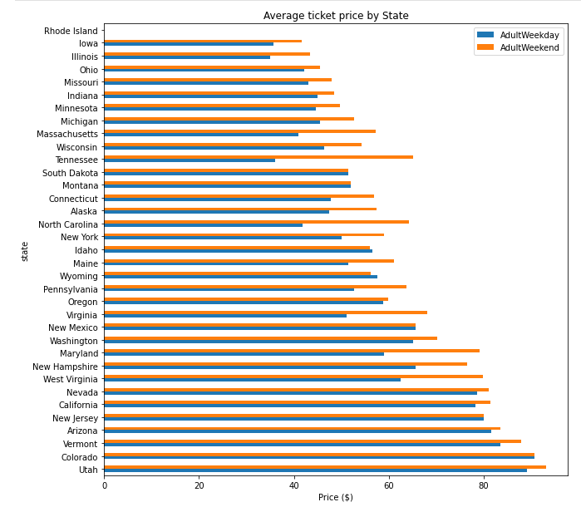
Modeling and Analysis
Average Ticket Price by State
BMR ticket price is $81 at top 1 of Montana. Montana’s average ticket prices are between $50-$60, whereas Utah, Colorado and Vermont average prices are over $80.

Slide 6
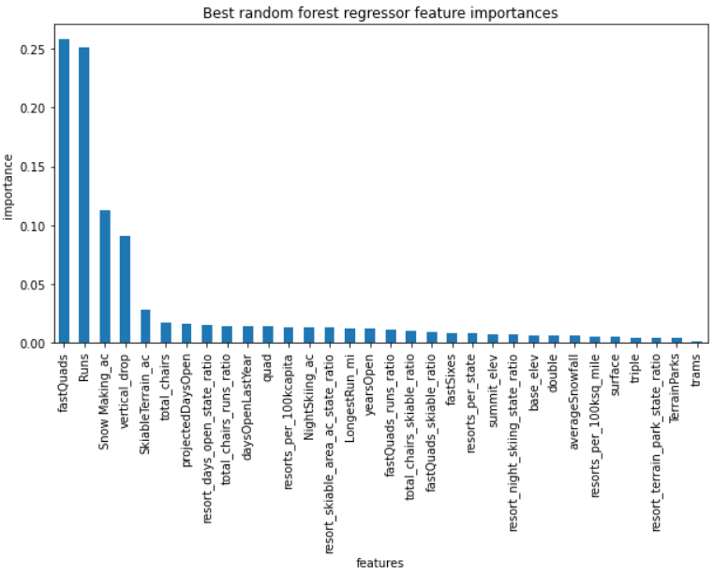
Modeling and Analysis
Features weighted strongest for ticket price:
Fast quads (0.26)
Runs (0.25)
Snow making (0.11)
Vertical Drop (0.09)

Slide 7
Modeling and Analysis
Less variability in calculations than those of linear regression model.
Linear Regression Model
Random Forest Model
Random Forest Model was the standard model moving forward.

Slide 8
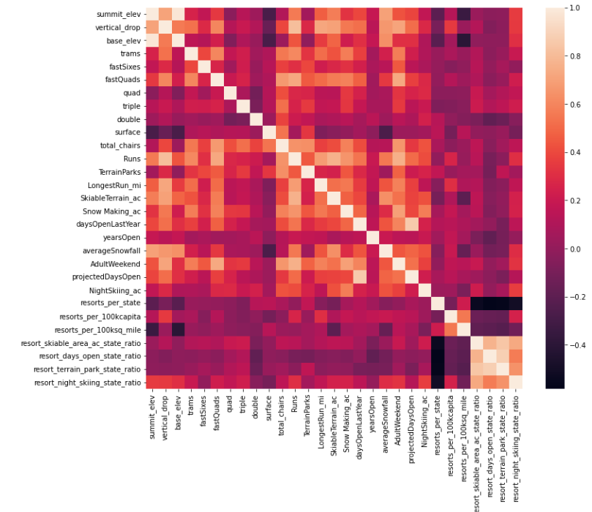
Summary and Conclusions
$1.54 million increase in operating costs for the new lift
Action Plan:
Identify key features
Calculate new ticket price
Top features of BMR affecting ticket value:
Fast quads
Runs
Snow making
Vertical drop
Skiable terrain
Total chairs
Projected days open
Trams
Recommendations:
Change ticket price to recommended $95.87+$8.61=$105 for the next season.
Closing the least popular run to save cost.
Random Forest
Model
Fair Market
ticket price:
$95.87

