Slide 1
Don’t Get Kicked!
Data Science Challenge
21 August 2022

Slide 2

The Problem
Can we predict whether a car purchased at auction is a lemon?

Slide 3

What’s a Lemon?
Vehicle “kicked” back to auction after purchase due to unexpected issues.

Slide 4
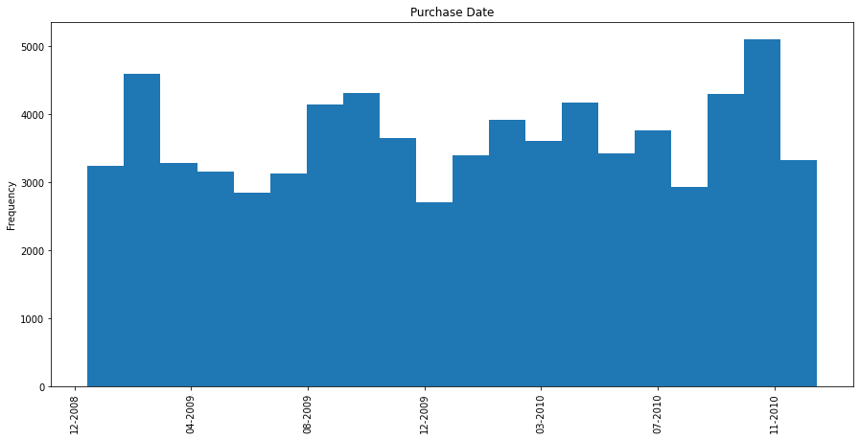
The Data
Purchase-level auction data from Jan 2009 to Dec 2010
Binary outcome for whether a purchase was an “avoidable bad buy”
32 Independent Variables, not all useful

Slide 5
Sampling Strategy
Data split into separate training, validation, and test sets at a 70-15-15 split, stratifying on target
Split | n False | n True
Train | 44,803 | 6,283
Validation | 9,601 | 1,347
Test | 9,602 | 1,346

Slide 6
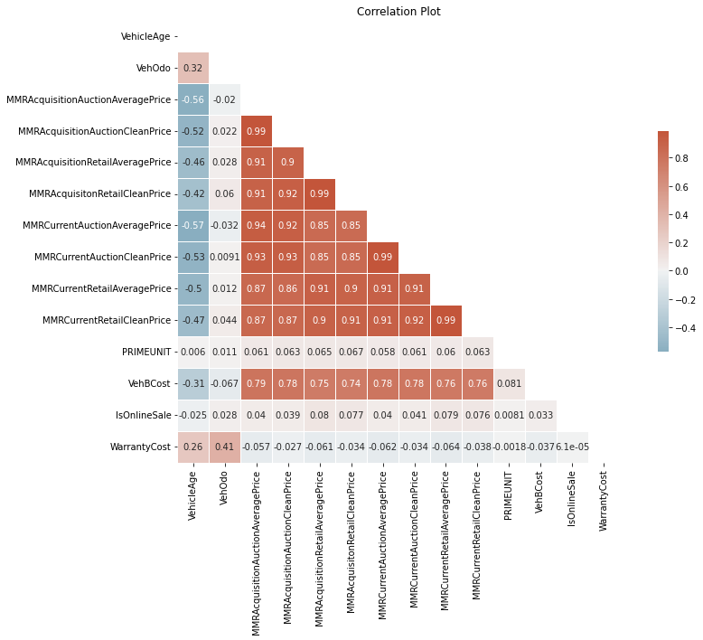
Numerical Features
We have quite a few numerical features, many of which are highly correlated with one another.
Market prices, especially, seem to be coupled tightly.

Slide 7
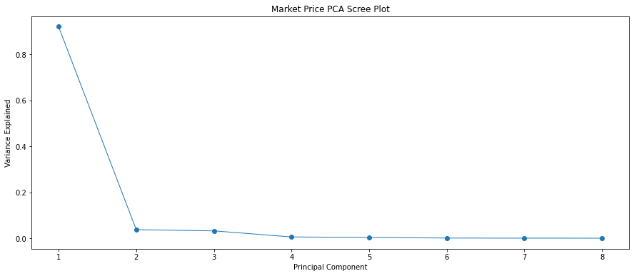
Solution: PCA
To address this multicollinearity, we will reduce our market features using Principal Component Analysis.

Slide 8
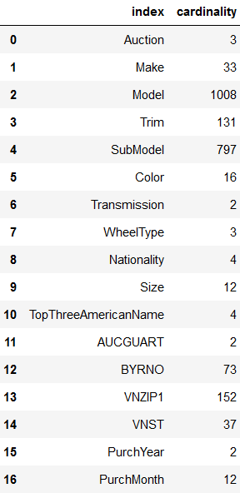
Categorical Features
Categorical features present their own issues. Many express high cardinality.
This causes issues with generalized encoding.

Slide 9
Solution: Smoothing
Limit categorical features to max 50 total levels and min 30 train observations
Interpret Model, SubModel as strings, reduce to words and limit vocabulary to top 50
Apply downstream regularization

Slide 10
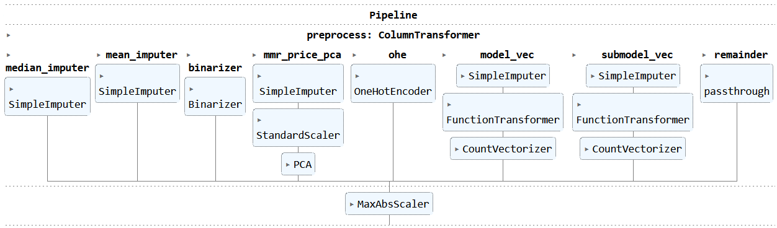
Full Pipeline

Slide 11
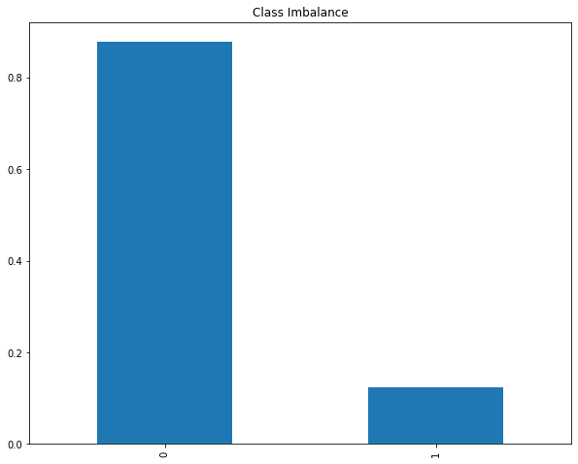
Class Imbalance
Our data contain mostly negative labels, which could bias our model towards the negative case.

Slide 12
Solution: Class Weights
Weigh our loss by inverse class occurrence during training, scaled to 1 to accommodate XGB.
Label | Weight
1 | 7.13
0 | 1

Slide 13
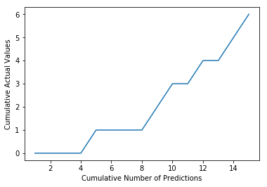
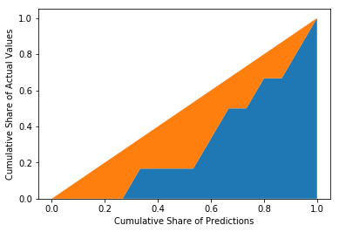
Evaluation Metrics
Binary Accuracy: what % do we correctly predict?
Precision: what % of our predicted lemons are actually lemons?
Recall: what % true lemons do we accurately predict?
AUC-ROC: captures trade-off between recall and false positives
Avg. Precision (AUC-PR): captures trade-off between recall and precision
Gini Index: Kaggle’s scoring measure; how well can we discriminate lemons?
Source: https://www.kaggle.com/code/batzner/gini-coefficient-an-intuitive-explanation

Slide 14
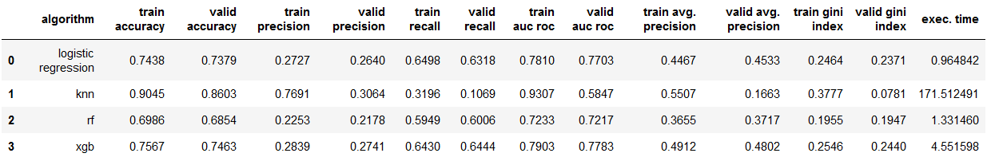
Time to Model
Logistic Regression
K Nearest Neighbors (KNN)
Random Forest
Extreme Gradient Boosting (XGB)

Slide 15
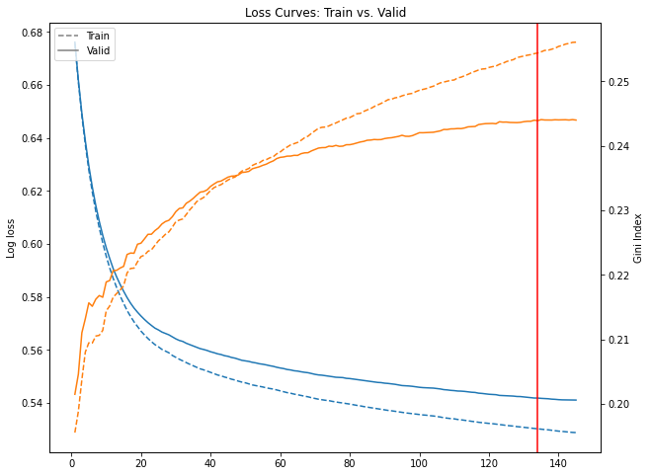
XGBoost in Depth
Learning rate: 0.1
Max depth: 3
Regularization: early stopping on gini index, patience of 10 epochs, tolerance of 0.01

Slide 16
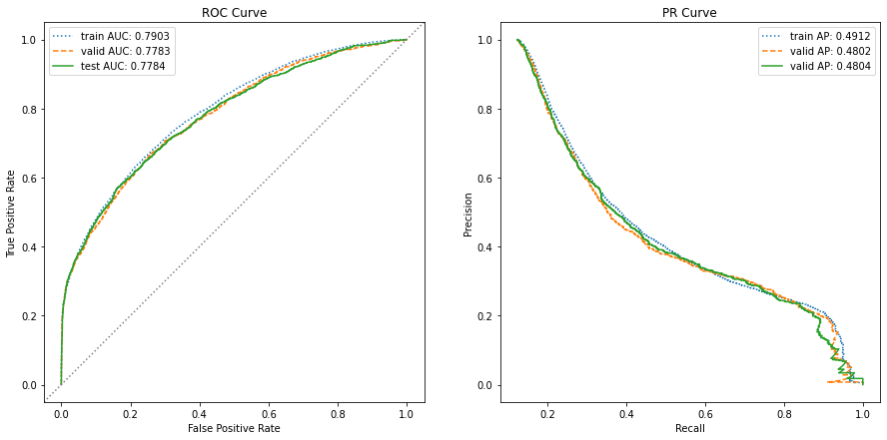
Evaluation: Does our Model Generalize?

Slide 17
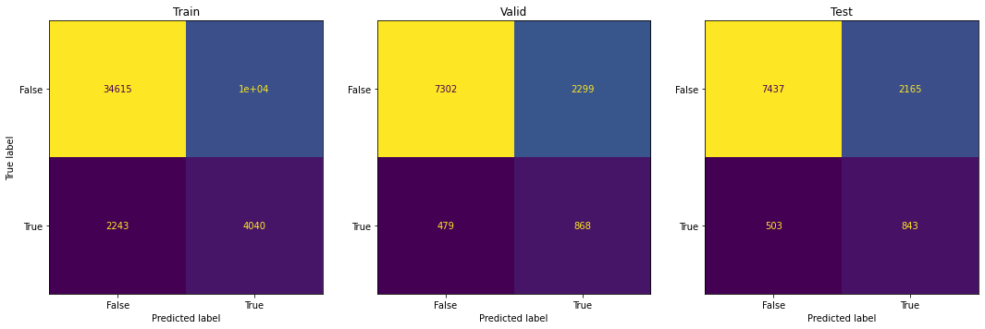

Summing it Up: Classification Ability

Slide 18
This Gini Index would place us in the:
86th Percentile
Prior to hypertuning

Slide 19

Next Steps
Hyperparameter Tuning: further optimize performance over a wider search space
Feature Importance Extraction: use SHAP, etc. to better explain predictions
Ablation Study: systematically eliminate preprocessing/modeling elements to improve parsimony
Cost Analysis: reduce predictions to $ costs

