Slide 1
A Simple Neutron-Physics Game
Robert Carlsen and Matthew Gidden

Slide 2
Open Source!
You can download the source code at https://github.com/rwcarlsen/reactor
Mac and Linux supported

Slide 3
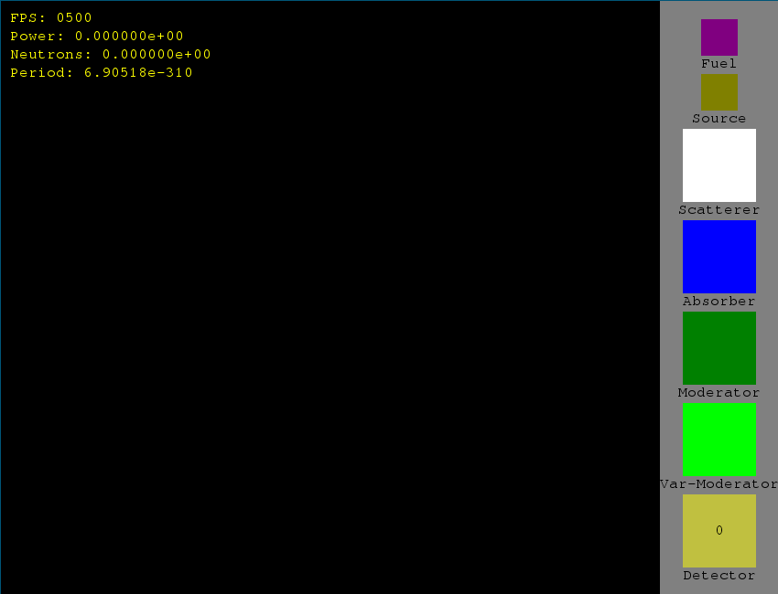
Main Screen

Slide 4
Features
Burnup
Energy-dependence
neutron speed/color
absorption probability
fission probability
Rouletting for wider power range
Low frame rate ⇒ roulette neutrons and increase weights
High frame rate ⇒ duplicate neutrons and decrease weights
Void coefficient

Slide 5
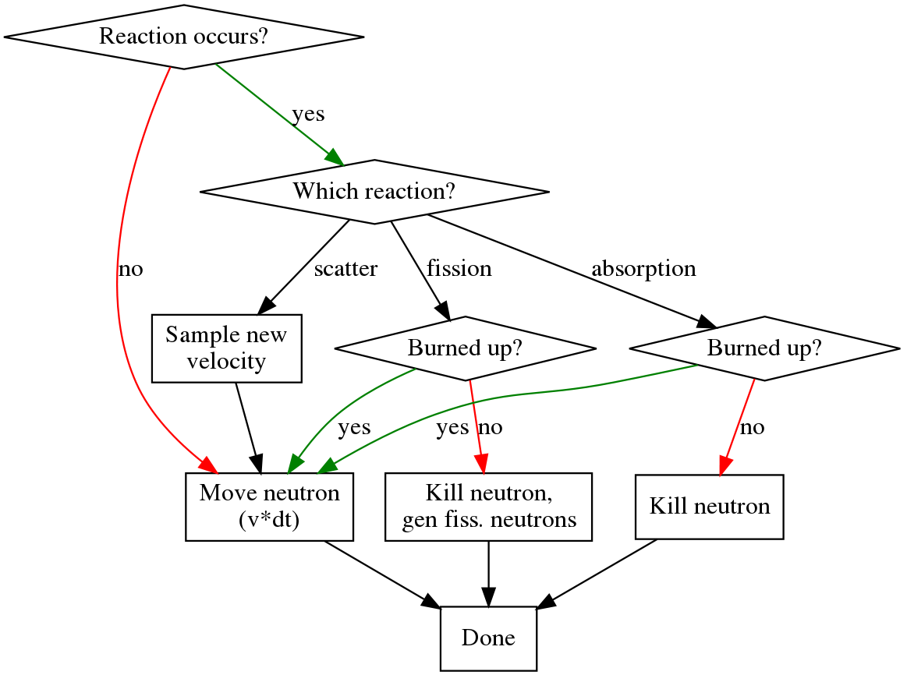
Neutron Transport
scatter
absorption
fiss. (p_{fiss}* v * dt)
no reaction
Notes:
Traditional monte-carlo mean free path sampling would provide challenges associated with handling burnup - because the cross section would be different for every pixel.
This technique accounts for interactions every time step - and dt is kept small by rouletting (approx 3 pixels/frame for fast neutrons)

Slide 6
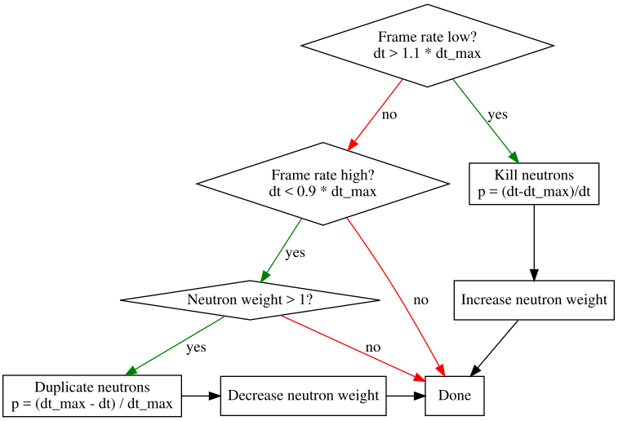
Rouletting
Enable longer excursions
Preserve physics

Slide 7
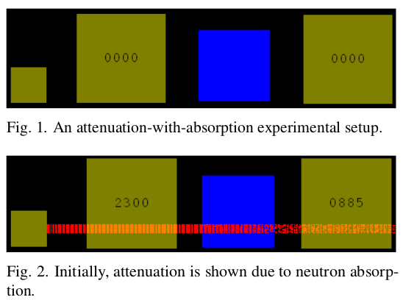
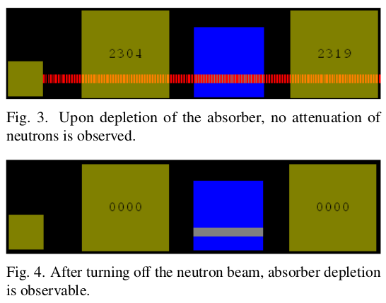
Absorber Attenuation and Burnup

Slide 8

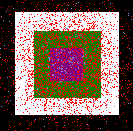
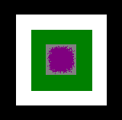
Super Critical Thermal Reactor
very non-uniform burnup

Slide 9

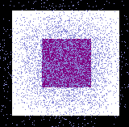
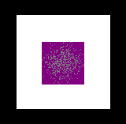
Super Critical Fast Reactor
requires bigger fuel
more uniform burnup

Slide 10
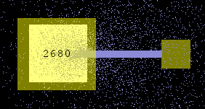
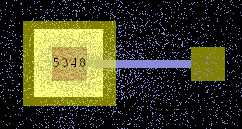
Subcritical Multiplication
plain scattering medium
(snapshots taken at steady state)
with fuel block added

Slide 11
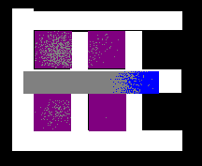
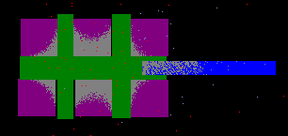
Playing with Criticality

Slide 12
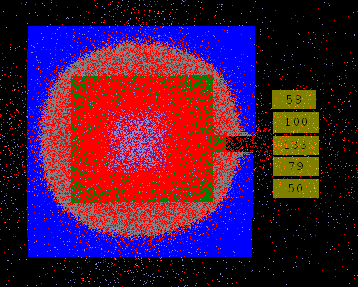
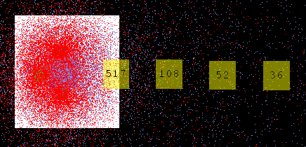
Detectors

Slide 13
Future Work
Ability to save, load, script geometries
Custom material properties
Better detectors
report flux-dependent quantities
energy-dependent
More realistic burnup - i.e. reactivity track burnup incrementally
Continuum of neutron energy colors
Challenge/objective oriented scenarios
Windows support
What would you like to see? Submit a patch at: https://github.com/rwcarlsen/reactor

