Slide 1

Verifying a Simplified Model of Neuronal Firing
Ryan Eaton
Winter Rotation
Laboratory of Marc Binder
Department of Physiology and Biophysics
University of Washington
3/31/2006

Slide 2
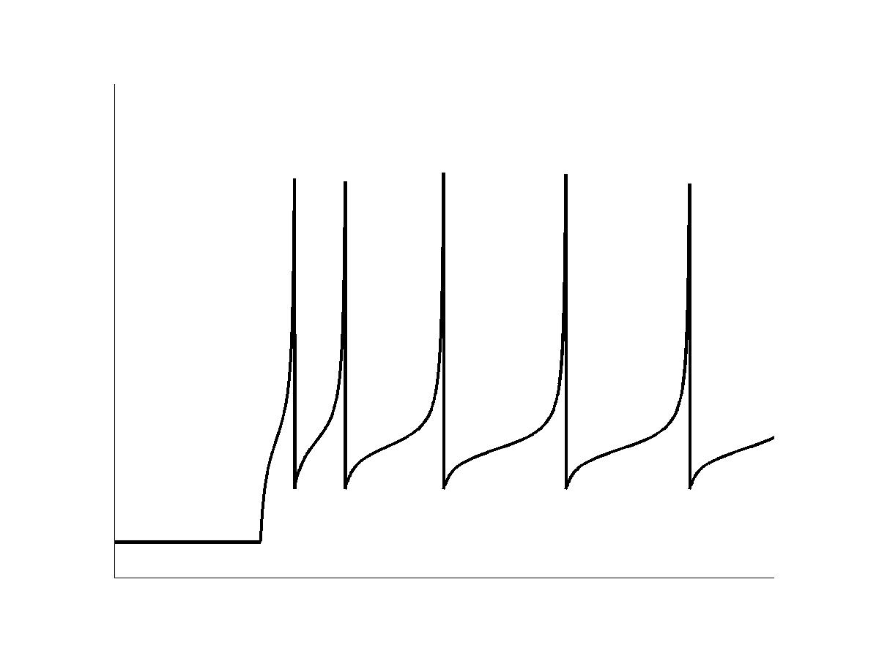
Significance
Neural spiking patterns are important in networks performing information processing in the brain
Conventional neural network models do not incorporate SFA
Mathematically simple units required (~10 FLOPS/ms)
Simple model reproduces cortical firing patterns (Izhikevich, 2003)
Can the model replicate a cortical neuron’s response to dynamic input?
Spiking Network Unit Output
Spiking Frequency Adaptation
Notes:
Significance Notes:
1) [read first point]
2) Conventional artificial neural network models are typically composed of integrate-and-fire elements that do not replicate spiking behavior of neurons.
3) To be physiologically plausible, artificial neural networks should incorporate units that reproduce observed firing patterns, especially spike frequency adaptation, a phenomenon demonstrated to be particularly important for information processing.
4) [Quickly describe figure]
In the figure, SFA can be seen by increasing interspike interval that occurs following the onset of the repetitive spiking train.
5) Neural nets are typically composed of many interconnected units so it is essential that the computational demands of each individual unit be kept to a minimum.
6) Three years ago Eugene Izhikevich of the Salk institute developed a simplified model of neuronal spiking that is capable of generating many of the firing patters observed in cortical neurons – including spike frequency adaptation.
7) His model is strikingly efficient, requiring only 13 floating point operations per ms of simulation time, as compared to other models that replicate such behavior, such as Hodgkin and Huxley which requires ~120 FLOPS per ms.
8) This project tests how well the model behavior compares to that of an actual cortical neuron by evaluating their selectivity to dynamic input.
To do this…

Slide 3
Project Overview
Obtained whole cell patch-clamp recordings from Rat Layer 2-3 cortical neurons
Injected identical white noise stimuli into the cortical neuron and the model.
Measured V_{rest}, V_{thr}, I_{thr} and minimum spiking frequency of a selected neuron
Compared dynamic response of the two with spike triggered averaging and covariance analysis.
Adjusted parameters of a simplified model to reproduce threshold spiking behavior
Notes:
Modes show common features of spike triggering stimuli.

Slide 4
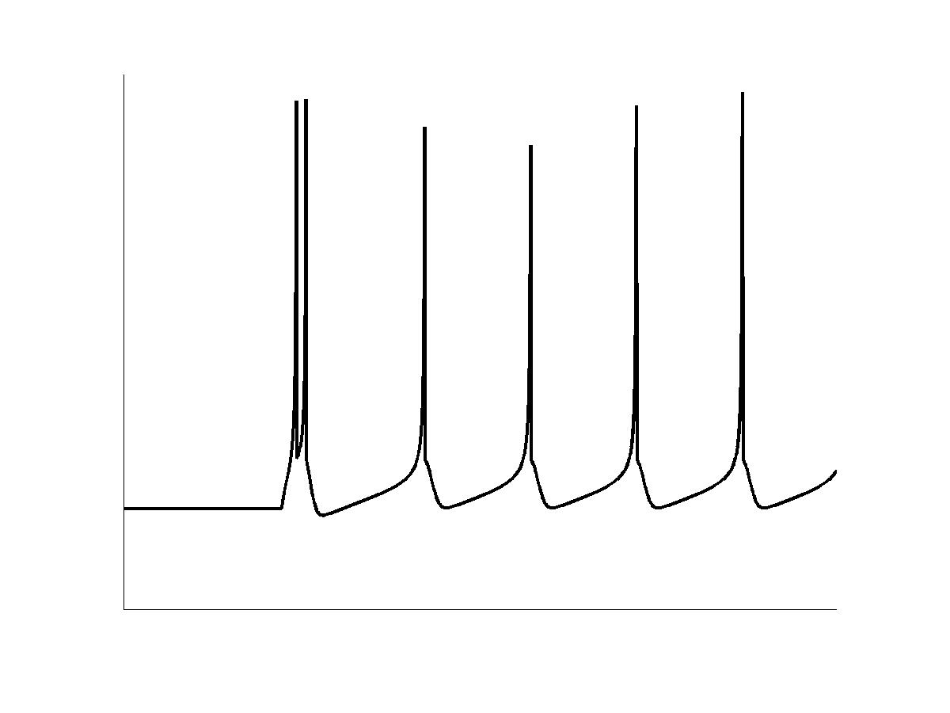
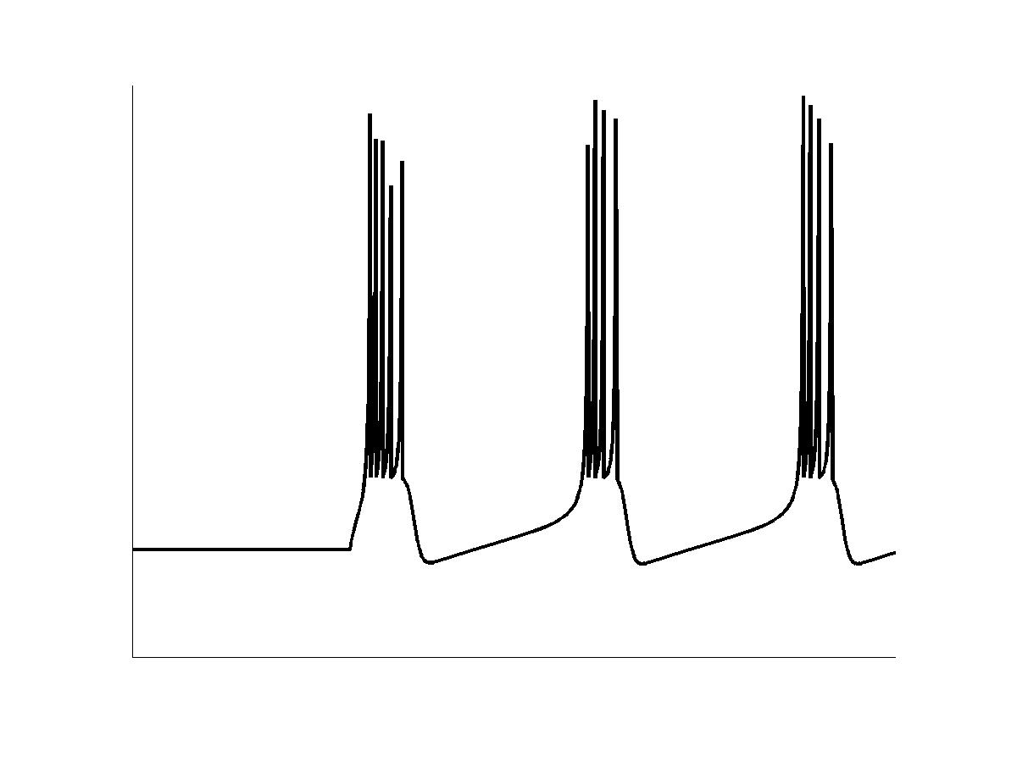
The Model
Cortical Firing Patterns
Izhikevich EM, (2003).
Voltage dynamics,v(t): Differential equation incorporating a quadratic function
Post spike recovery, z(t): First order diff. eq.
Dynamic variables are coupled.
Spike Frequency Adaptation
Intrinsic Bursting
System of four coupled differential equations.
System of two coupled diff. eqs. + hard reset.
Tonic Bursting
Notes:
The Izhikevich model reduces the accurate, but mathematically complicated, four variable system of Hodgkin and Huxley, to one of only two dynamical variables and a “hard reset” command that returns membrane potential to subthreshold levels after a spiking event.
In the HH model, one variable explicitly represents membrane potential while the other three govern channel states to modulate membrane conductance.
In the Izhikevich model, membrane potential V approximates the combined influence of Na+, K+ and Ca2+ currents and a recovery variable, z, describes the influence of slow, voltage dependent K+ currents shown to be responsible for spike frequency adaptation.
As shown in the three figures to the right, the Izhikevich model is capable of replicating an array of firing behaviors recorded from rat cortical neurons. These include spike frequency adaptation (described previously), intrinsic bursting (where rapid onset spiking is followed by tonic spiking) as well as tonic bursting (where groups of high frequency spikes are delivered at regular intervals).
Now that I’ve introduced you to the model, let’s have a look at how it works…

Slide 5
Izhikevich Model Dynamics
Nullcline Shape Determines Model Dynamics.
Notes:
Nullclines, the black curves of the parametric phase plot illustrate where each of the 2 variables are constant in time. Nullclines are shaped by equation parameters. (They are the resultant functions one solves when dV/dt and dz/dt are set equal to zero)
Intersections of nullclines are fixed points, shown in the figure as the red dot, where both of the variables are constant and the model, as a whole, remains in a steady-state. Here the red dot demonstrates resting potential.
In the animation that follows you can observe how application of a current stimulus shifts the location of the fixed points that changes the dynamics of the model. Threshold spiking is shown.
To fit the model, I adjusted nullcline shaping parameters so that corresponding fixed-points (resting potential and threshold) matched values measured from the cortical neuron.
Using this strategy, let’s now examine how well this model compares to the recorded neuron…

Slide 6
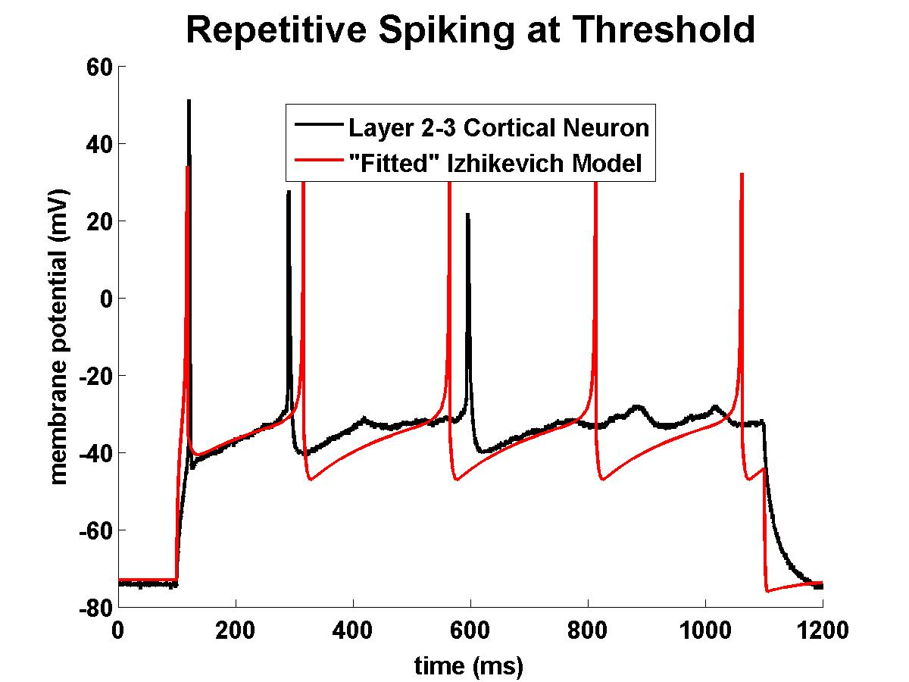
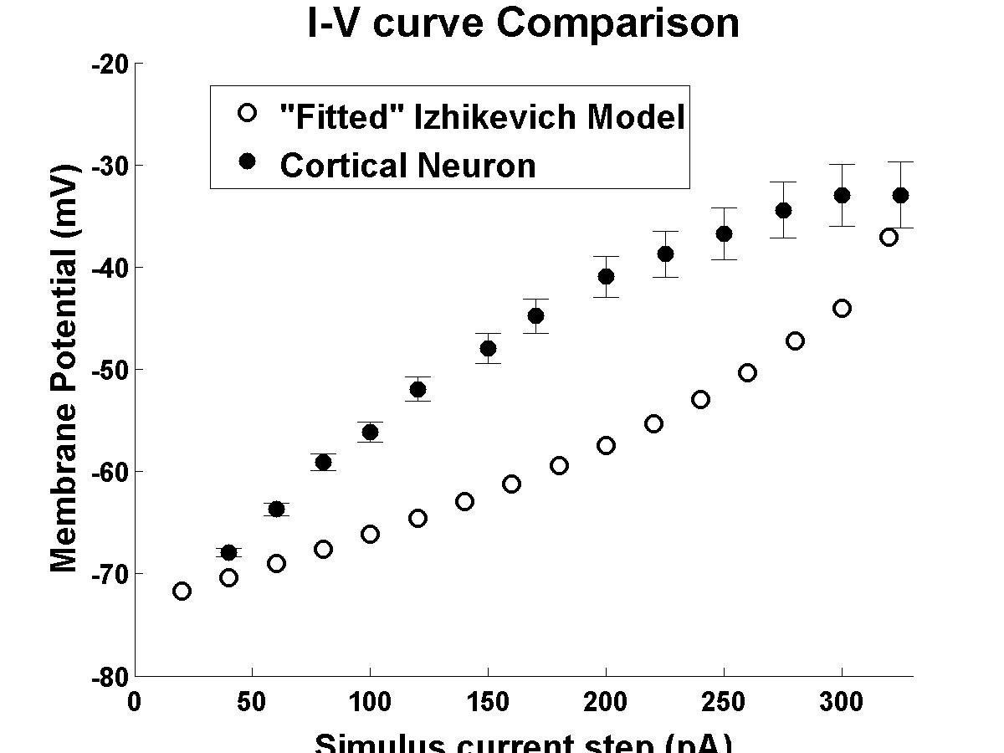
The Fit
Threshold for Repetitive Spiking
Passive Response
Optimized to replicate repetitive spiking at threshold
Limited degrees of freedom prevents accurate reproduction of sub-threshold and super-threshold response
Notes:
The Fit:
Voltage traces in the left figure illustrate how the Izhikevich model was optimized to replicate repetitive spiking at threshold.
Limited degrees of freedom in the model prevent accurate passive, and superthreshold response generation. By “degrees of freedom” I mean the number of parameters available for shaping the nullcline.
Once the model replicated the neuron’s response to steady stimuli, we could then introduce, and compare their responses to, dynamic stimuli – specifically, white noise, a stimulus that resembles the synaptic input a neuron would receive from other surrounding neurons in a network.
1. Uncertainty in voltage curve originated from series resistance of patch-pipet (estimate ~20 MOhms).
2. Explain that by limited degrees of freedom I mean the number of parameters available to shape the nullclines.

Slide 7
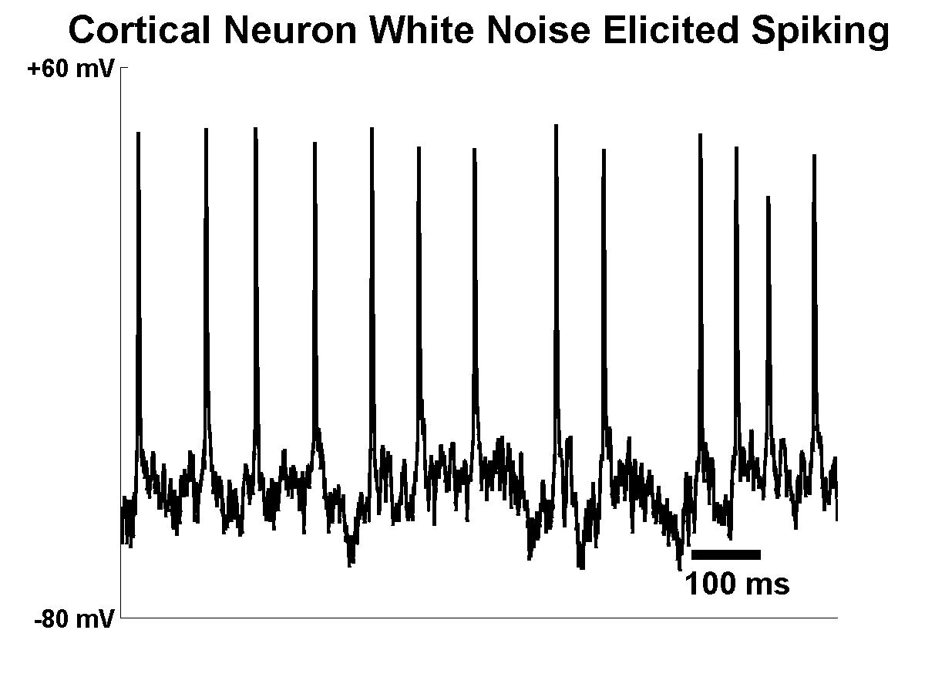
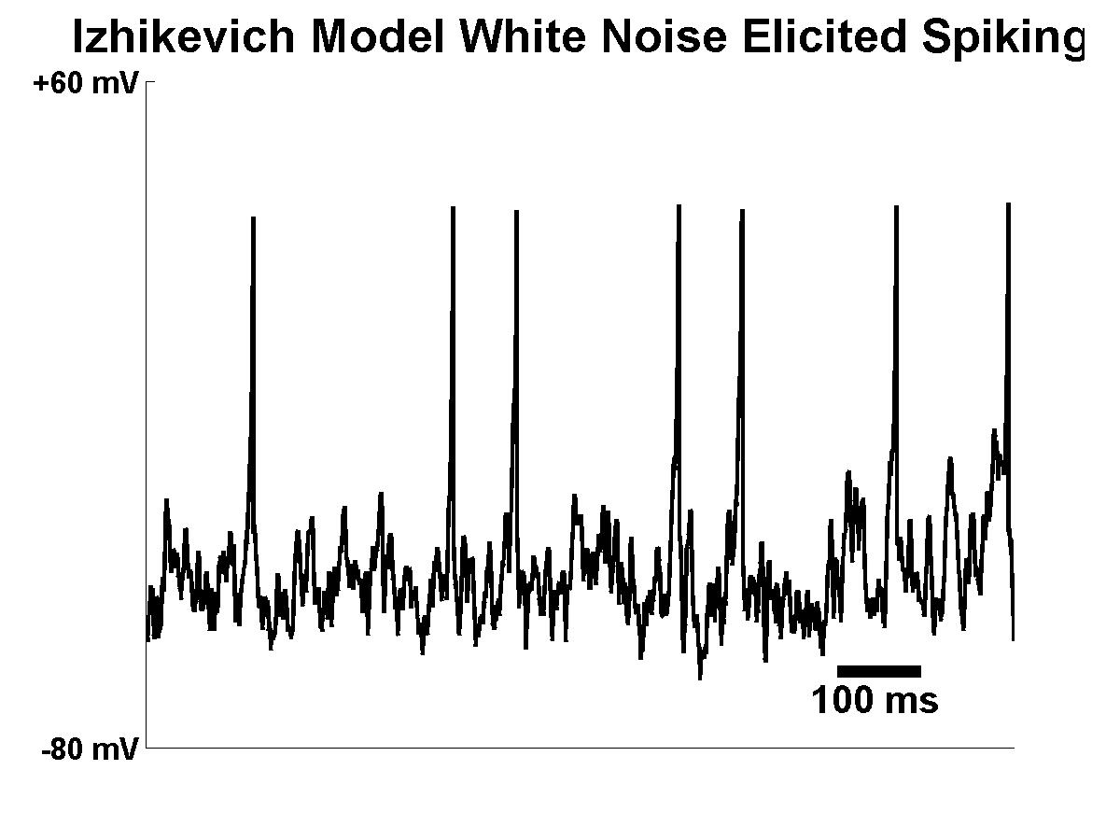
White Noise Injection
Rat Cortical Neuron
Stimulus: White noise signal superimposed on a current step.
In this window, all spike events generated by the model are present in the recording.
Additional spiking events in recording.
Suggests model captured some, but not all, of neuron spiking response.
Fitted Izhikevich Model
Notes:
White Noise Injection:
Here, the top trace illustrates the spiking response of a cortical neuron generated from a stochastically varying stimulus current.
The bottom trace illustrates spiking behavior of the model over the identical stimulus. The white noise stimuli were composed of a white noise signal super-imposed upon a current step.
[click to show alignment lines]
Notice that in this window, all spike events generated by the model are present in the recording. However, additional spiking events are present in the recording as well.
This suggests, that the model captured some, but not all of the neuron’s stimulus history dependence or spiking selectivity.

Slide 8
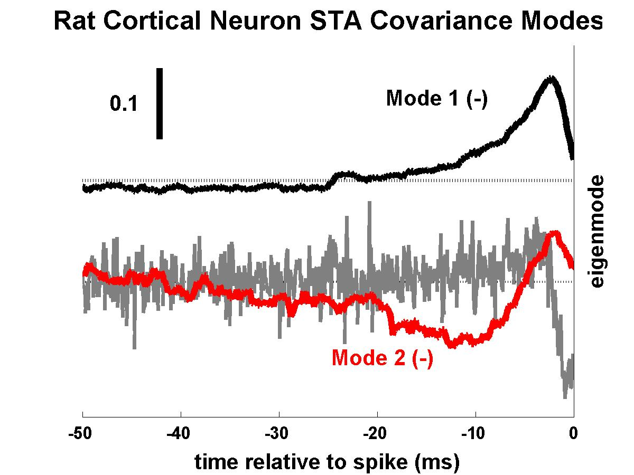
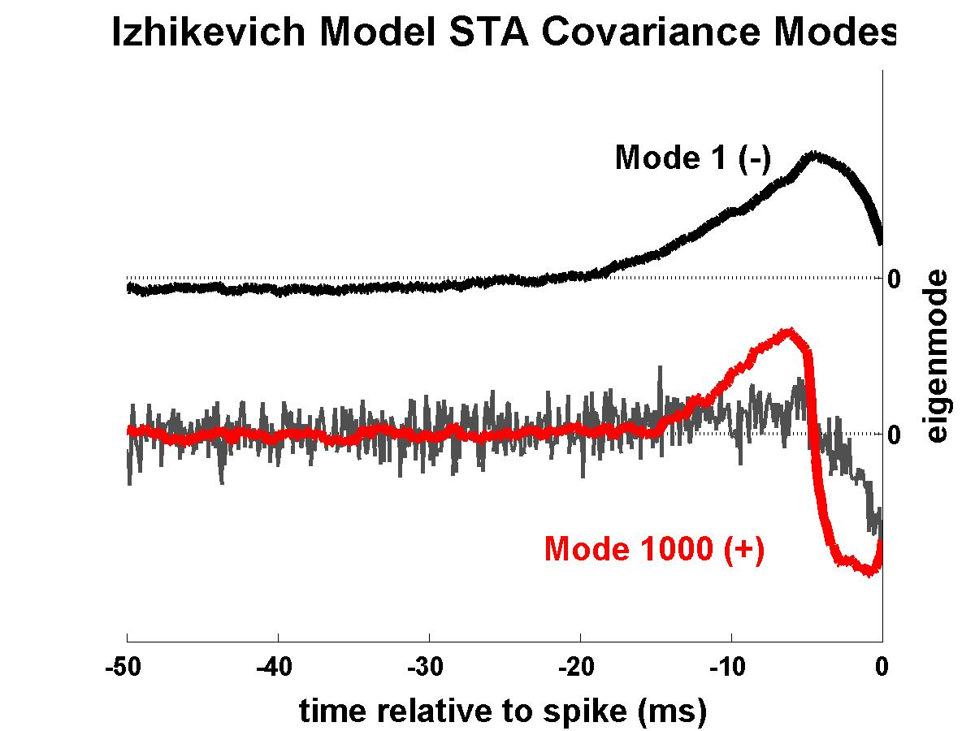
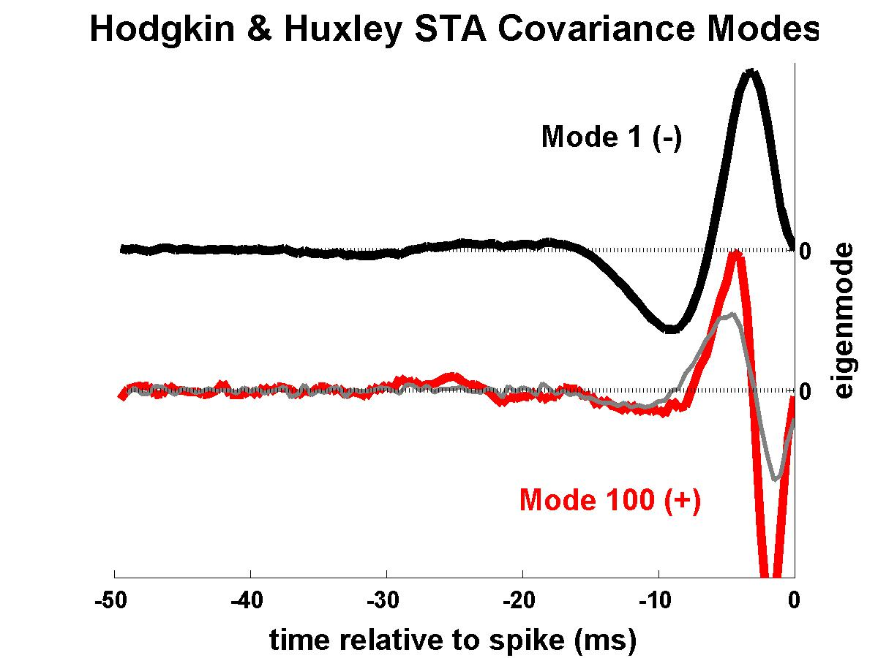
Stimulus Selectivity
Rat Cortical Neuron
Fitted Izhikevich (IZH) Model
Hodgkin & Huxley (HH) Model
Black, Red traces: two most prominent stimulus profiles that tend to elicit spikes in each stimulus ensemble (eigenmodes).
Gray trace: Time rate change of Mode 1.
Neuron and IZH Model have monophasic Mode 1 stim. profiles.
IZH Model and HH Model secondary modes resemble their corresponding Mode 1 derivatives.
Cortical Neuron secondary mode does not resemble Mode 1 derivative
Notes:
Stimulus Selectivity:
In these figures, the black and red traces illustrate the two most prominent stimulus profiles (or eigenmodes) that tend to elicit spikes in each stimlus ensemble.
By “most-prominent” I mean the eigenmodes that correspond to the two eigenmodes of the spike triggered average difference covariance matrix that have the greatest magnitude.
Each gray trace is the time rate change of mode 1 above it.
The figure to the left shows stimulus profiles of the rat cortical neuron. The center figure shows those for the Izhikevich model, and the figure to the right shows the preferred stimuli of the Hodgkin-Huxley Model.
Notice that the cortical neuron and the Izhikevich model have monophasic mode 1 stimulus profiles.
Another important feature to notice is that the mode 1 time derivatives of the IZH and Hodgkin Huxley models strongly resemble the secondary modes. The cortical neuron does not appear to have this property – that is, it does not show strong preference for differentiation.
The shared traits of the Izhikevich model suggests that the model exhibits hybrid selectivity between these two (apparent) extremes.

Slide 9
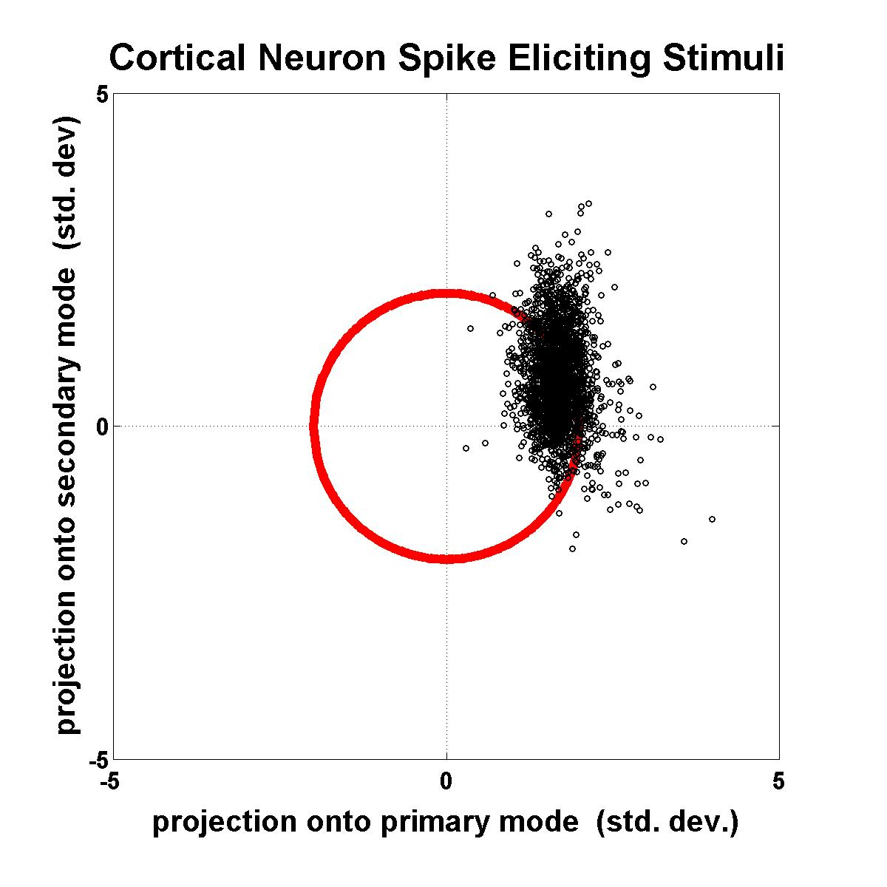
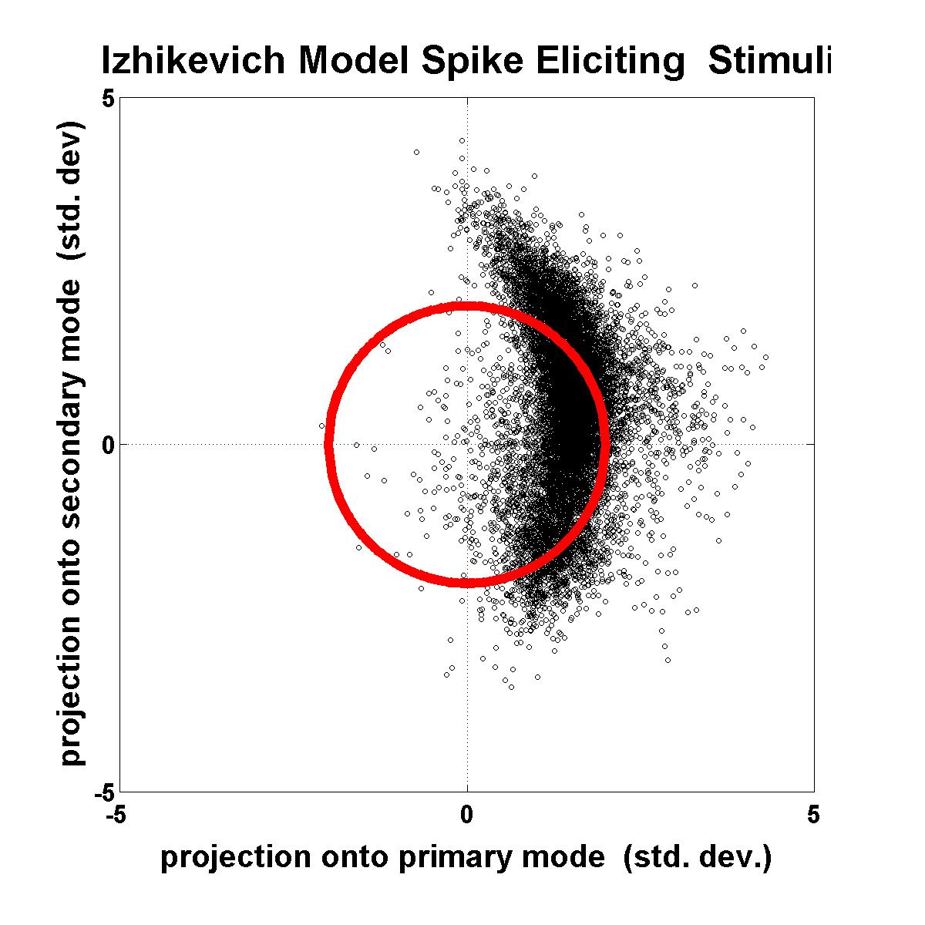
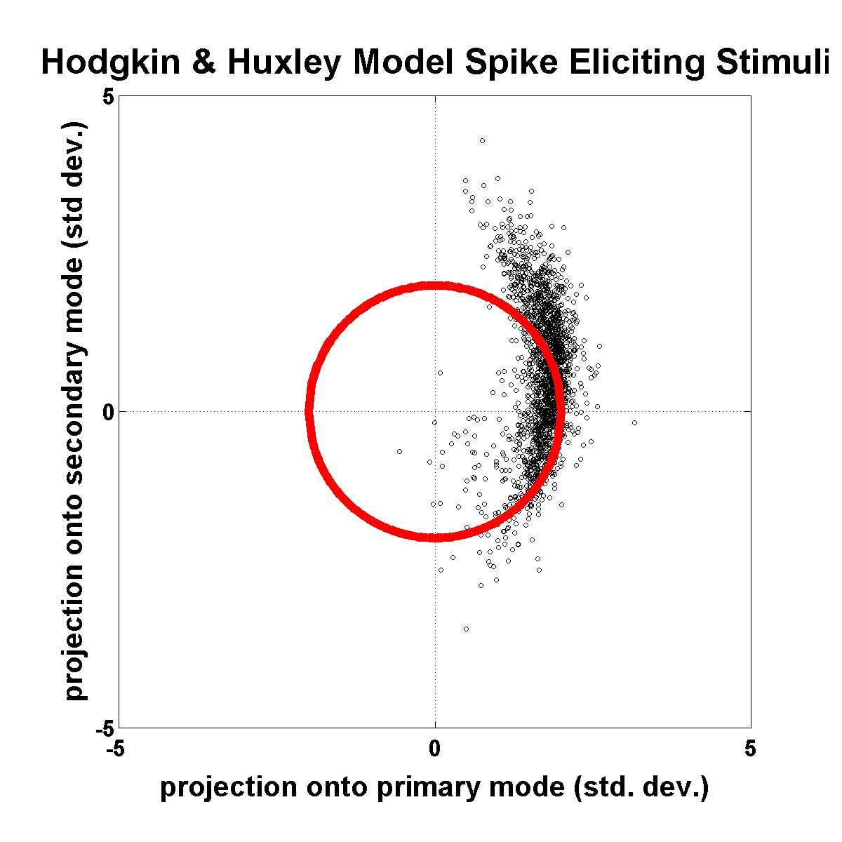
Projected Stimuli
The cortical neuron and the two models demonstrate strong stimulus selectivity as compared to chance (distributions shifted from center).
All three exhibit similar selectivity in mode 1
Cortical neuron shows more selectivity in its secondary mode.
Notes:
Projected Stimuli:
Additional insight into the nature and composition of spike eliciting stimuli can be gained from stimulus projection plots.
In these plots, each point represents a single stimulus that elicited a spike. Its location indicates the degree that the particular stimulus deviated from the spike triggered average in its primary and secondary modes. The further away from center that the a point lies, the stronger the features were in the spike-eliciting stimulus.
The axes of these plots are in units of standard deviation, due to the fact that the eigenmodes were extracted from a spike triggered average covariance difference matrix.
If these systems exhibited no stimulus selectivity, the distribution would lie concentrically about the origin and all projections of the stimulus ensemble would lie within a radius of two standard deviations from the prior stimulus distribution. Graphically, this is inside the red circle.
As before, the cortical neuron is on the left, the Izhikevich model is in the center, and the Hodgkin and Huxley is on the right.
The cortical neuron and the two models demonstrate strong stimulus selectivity as compared to chance. That is, the distributions are shifted from the origin and their centers are on the boundary of 2 standard deviations.
The cortical neuron and the two models exhibit similar selectivity for the mode 1 stimulus components.
The cortical neuron is more rigorously selective for its secondary mode component than the two models.

Slide 10
Conclusions
Izhikevich model can be fitted to replicate threshold dynamics of a cortical neuron.
IZH model exhibits primary mode stimulus selectivity very similar to that of the cortical neuron.
Like HH model, IZH model is less selective of its secondary mode than the cortical neuron.
IZH model replicates some, but not all, of the spiking response qualities of rat cortical neurons.
Future Directions
Employ a different (more conventional) fitting technique to match model to neuron
Explore why models tend to exhibit substantially different selectivity for their secondary modes.

Slide 11
Acknowledgments
Binder Lab:
Marc Binder Patch-Clamping Instruction/Encouragement
Randy Powers Project and Modeling Guidance, Surgery Instruction
Mickey Moritz Patch-Clamping, White Noise Analysis…much more
Paul Newman Laboratory Procedures
Mike Emery
Fairhall Lab:
Adrienne Fairhall White Noise Covariance Interpretation
Sungho Hong Modeling Insights
Barry Wark Hodgkin-Huxley Model Data
Fellow Classmate:
Grant Storey Transition into Binder Lab

Slide 12
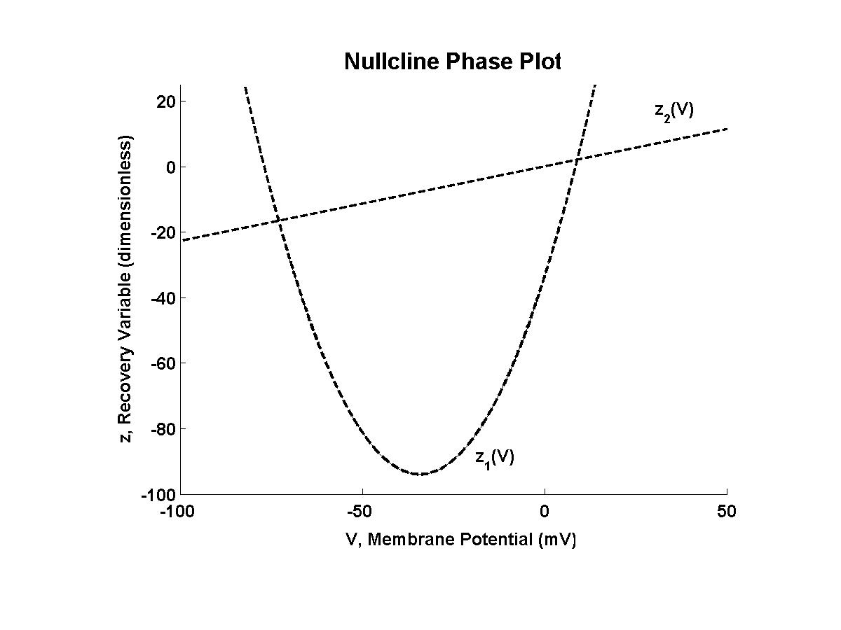
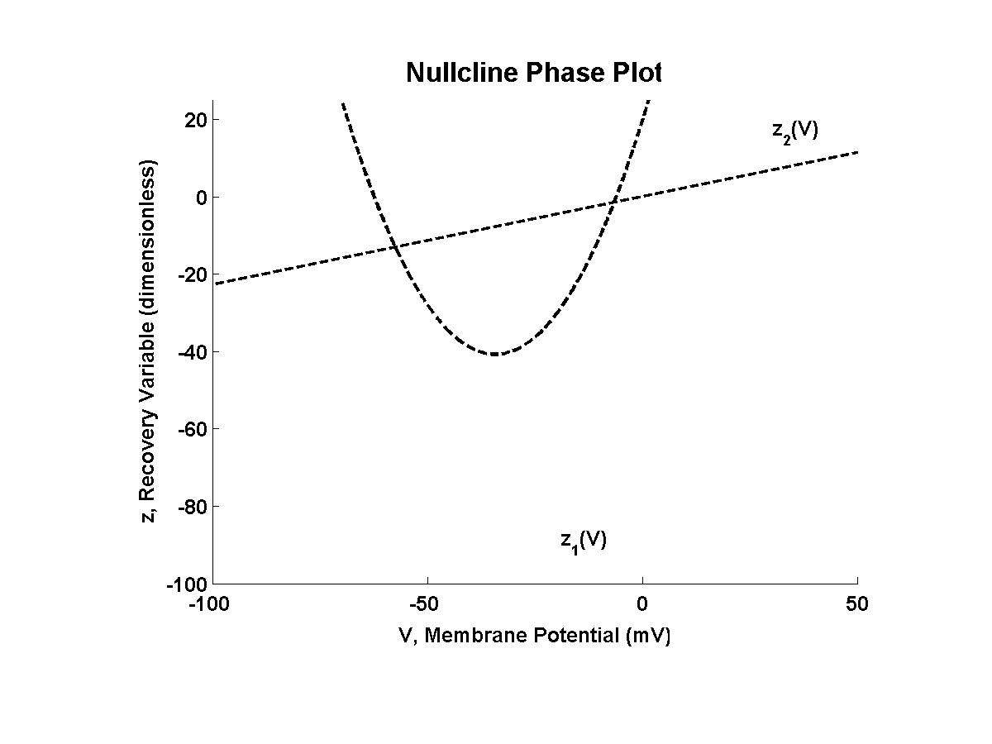
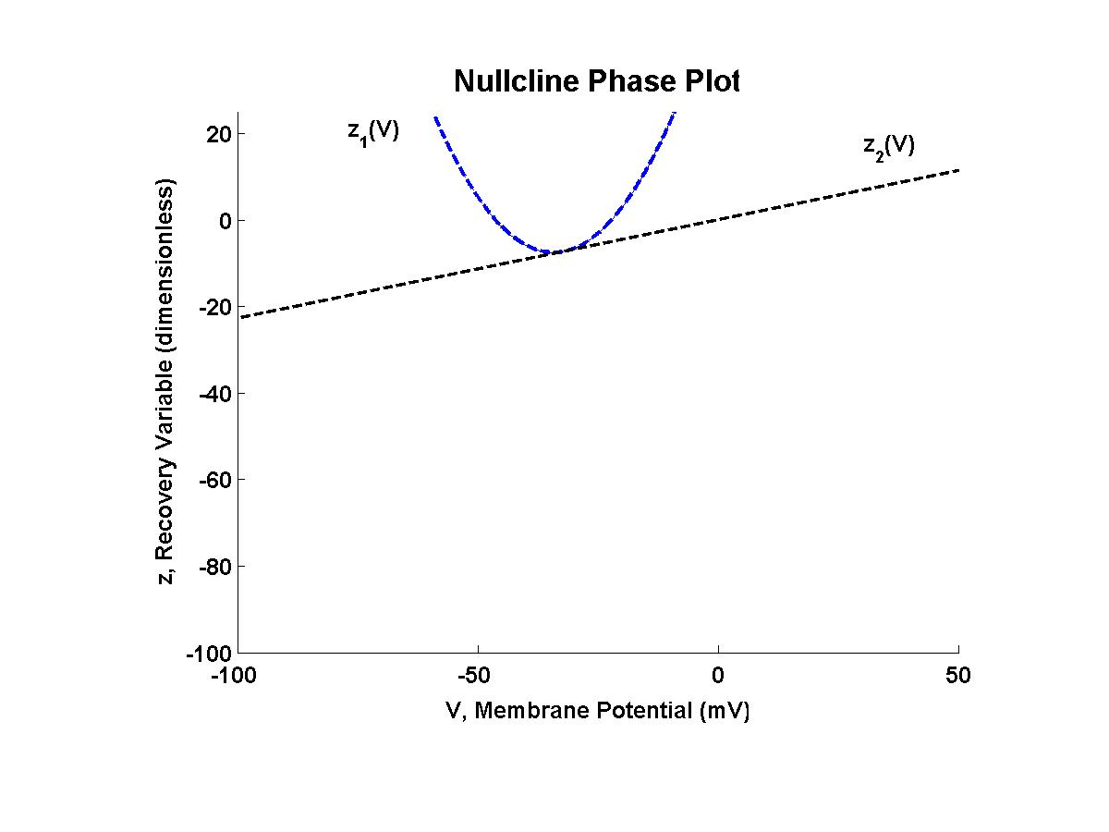
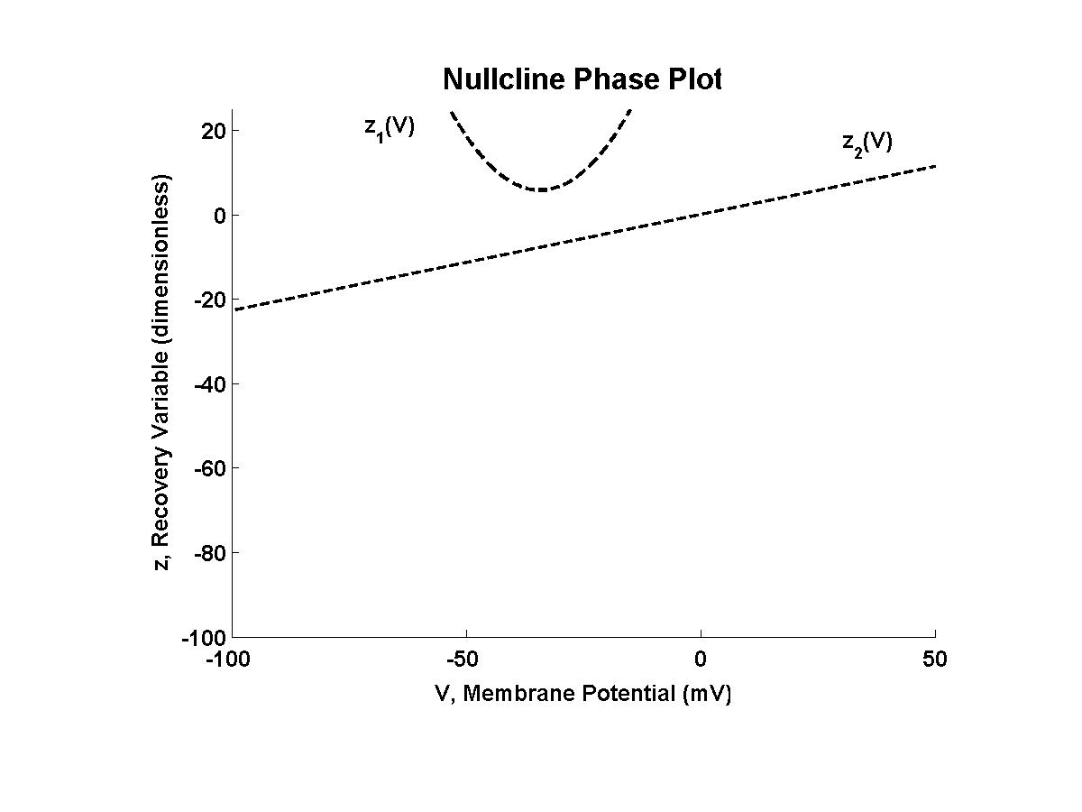
Geometrical Phase Plot Analysis
I_{stim} = 0 pA
I_{stim}= 150 pA
I_{stim} = 325 pA
I_{stim} = 350 pA
Two Variables⇒Two Nullclines
Fixed-points are nullcline intersections
At fixed-points, both dynamical variables are static.
Stable and unstable fixed-points
Stimulus current shifts parabolic nullcline upward
In this model, Fixed-points converge with increasing I_{stim}.
[Corresponding spike and
Stimulus animation]
Notes:
Izhikevich model comprised of two dynamic variables, membrane potential and a dimensionless recovery variable z, (analogous to Ca2+ currents that have been shown to govern spike frequency adaptation in biological neurons).
A simple model of 2 variables can be analyzed mathematically by phase plot analysis. In 2-D phase plots, one dynamic variable is plotted against the other.
The dashed lines depicted here are nullclines, the regions in which the dynamic variables are static

Slide 13
Fitting Strategy
Match resting potential and threshold dynamics of the cortical neuron
Five nullcline shaping parameters were optimized to produce:
Resting potential at V_{rest} = -73 mV when I_{stim}= 0 pA. (stable fixed-point)
Repetitive spiking onset at V_{thr} = -35 mV when I_{stim}= 325 pA. (unstable fixed-point)
Time constants were set to produce threshold spiking frequency.
Notes:
Specifically, the adjusted shaping parameters governed:
the location of the parabolic nullcline along the voltage axis.
the width of the parabolic nullcline
the “scale” of the parabolic nullcline with respect to the recovery variable z
the slope of the linear null cline
the parabolic nullcline vertical displacement for a given stimulus current.

