Slide 1
Simulating operant conditioning during free behavior with actor-critic reinforcement learning
Ryan Eaton
Project presentation
CSE/NeuBeh 528
June 8, 2009

Slide 2
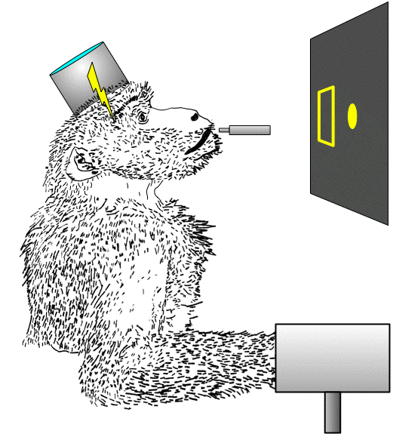
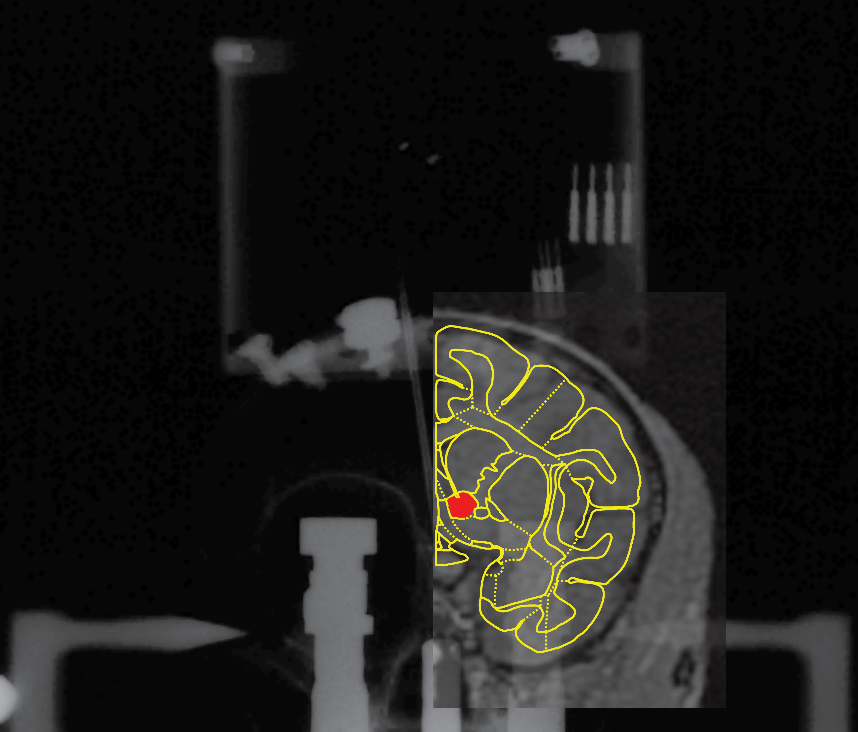
Locating a site that sustains intracranial self-stimulation
Trained animal on wrist step-tracking task.
Surgically implanted stimulating electrodes targeting mesolimbic pathway. MRI/x-ray co-registry to obtain stereotaxic coordinates.
Animal performed wrist step-tracking for sub-cortical brain stimulation in place of food rewards.

Slide 3
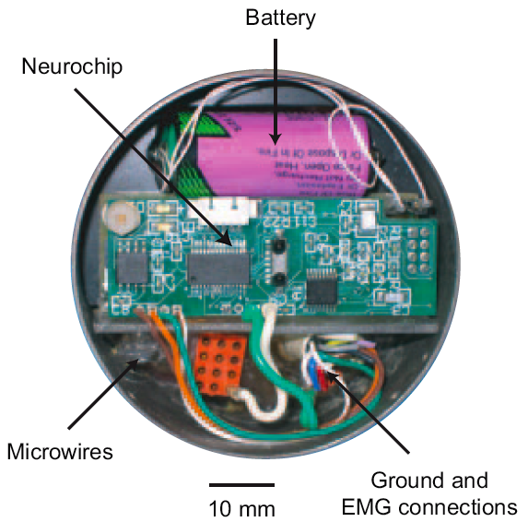
Neurochip conducts operant conditioning during free behavior
Neurochip records and discriminates:
  Cortical cell activity
  Electromyography
Can deliver activity-contingent stimulation
Stimulator can alternate between 5-minute on/off periods
Records and stimulates for 20+ hours.

Slide 4
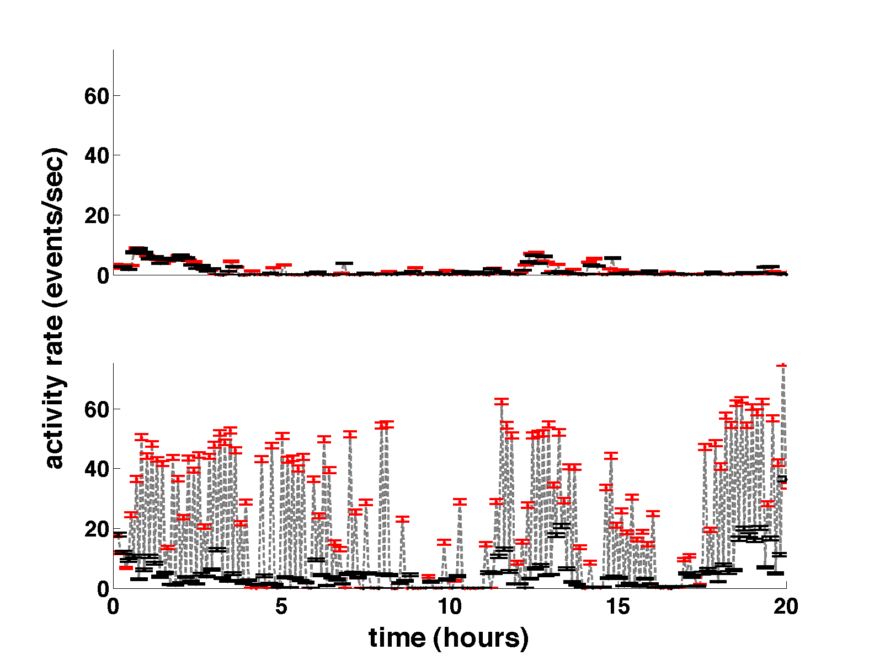
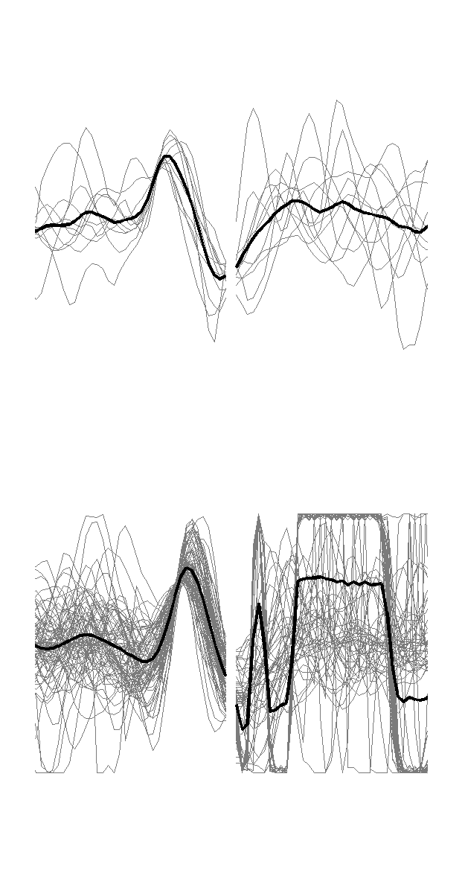
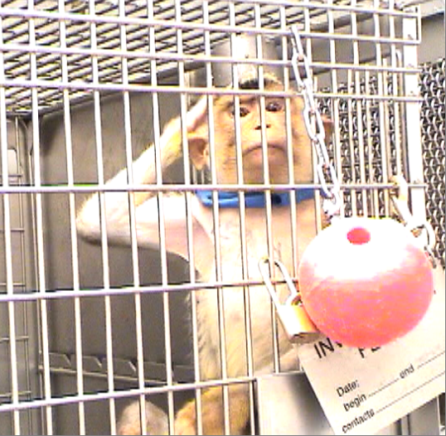

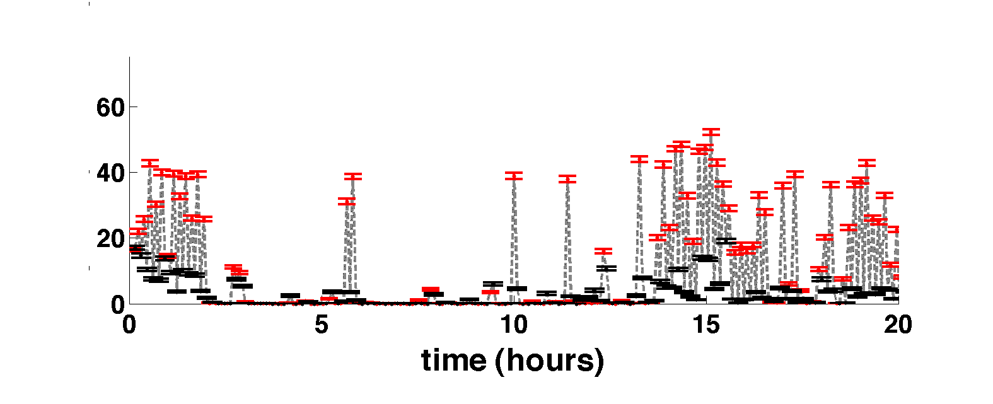
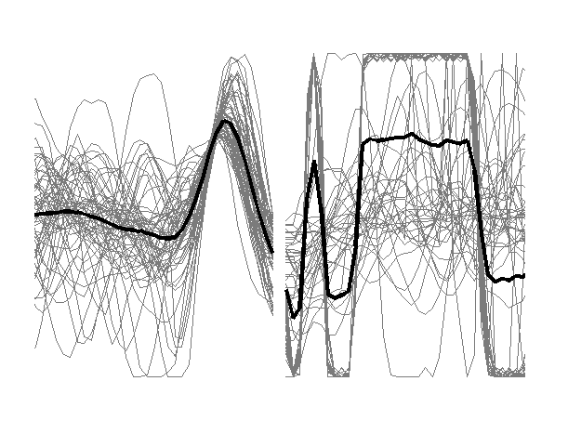
Muscle contraction during free behavior reinforced by contraction-contingent brain stimulation
Bicep
stim off
Bicep
stim on
time out
Tricep
stim on
time out
Figure 2. Top-left: Baseline session in which no stimulation was delivered during either pseudo “time-in” (red) or “time-out” (black) periods. Each data-point indicates mean EMG activity over 5 minutes. Middle and Bottom-left: contraction-contingent current pulses delivered to NAc during time-in periods only. Right: samples of EMG profiles that triggered stimulation over each 20-hour session (gray), and their averages (black).

Slide 5
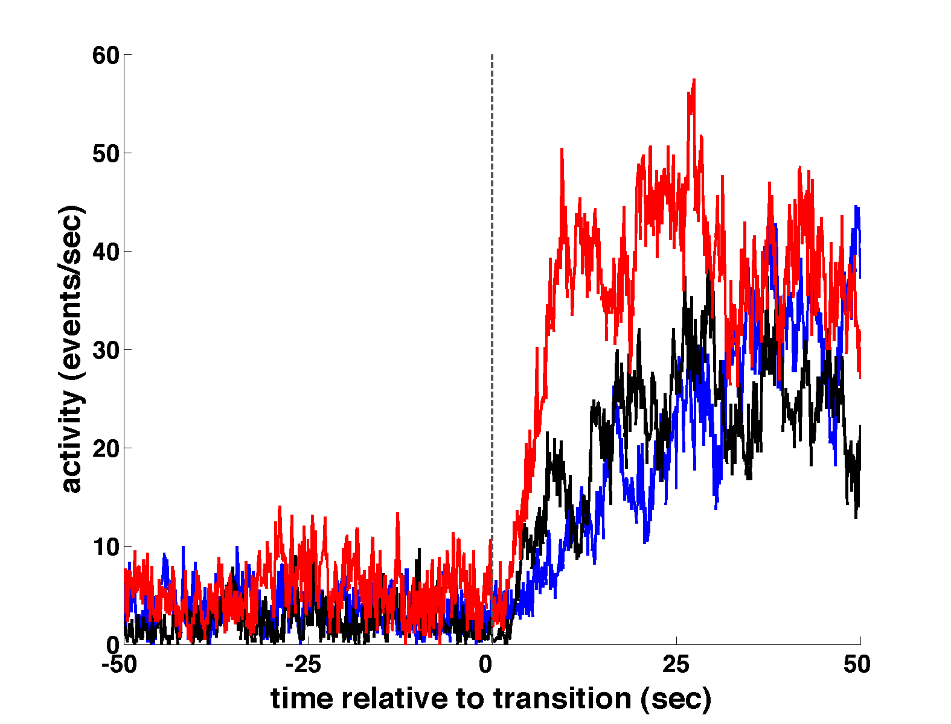
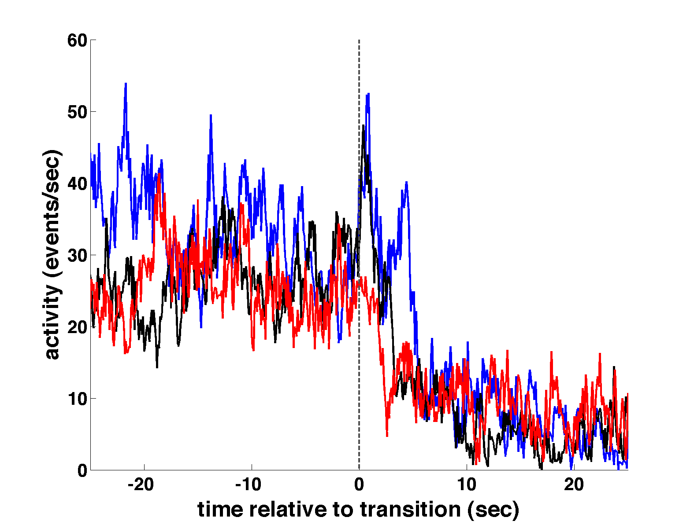
Learned associations during in-cage conditioning
OFF
ON
ON
OFF
Figure 3. Averages of bicep EMG rate for transition from stimulator off-to-on (left) and on-to-off (right). The off-to-on stimulator transitions above illustrate that muscle activity rose more rapidly in the average of the last third of the transitions (red) compared to the average profiles from the first third (blue) and middle third (black). This suggests the animal learned to associate biceps activity with reinforcing brain stimulation over the course of the 20-hour conditioning session. The initial third of on-to-off stimulator transitions show a transient increase in muscle activity immediately after end of reinforcement (arrow), characteristic of extinction behavior. This post-transition peak disappeared in the last third of the session.

Slide 6
Project Aim
Simulate contraction rates driving activity-contingent, behaviorally-reinforicing brain stimulation using actor-critic TD-learning
Examine simulation record for similar conditioning behaviors emitted by the freely-behaving primate
  acquisition of reinforcement availability schedule

Slide 7
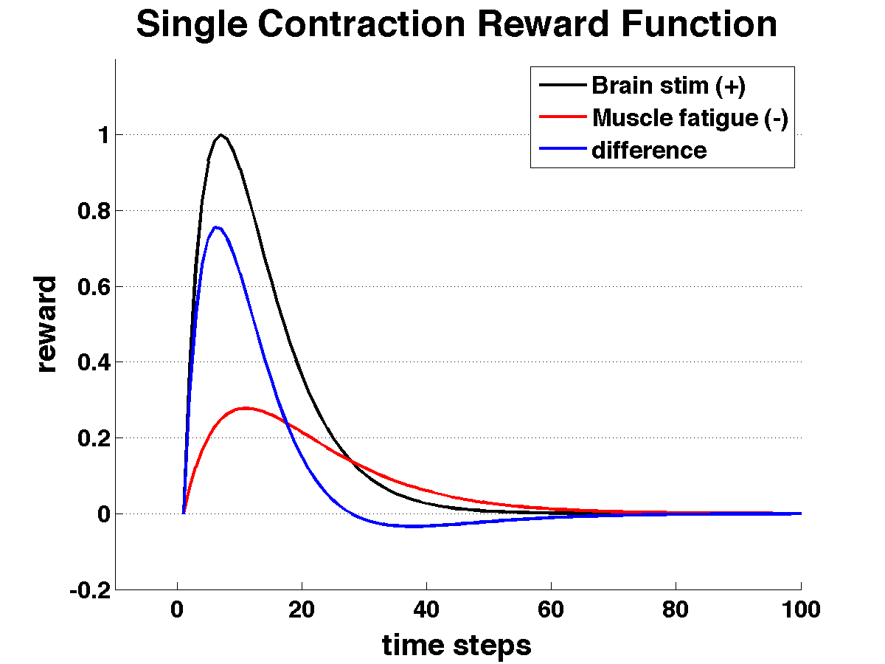
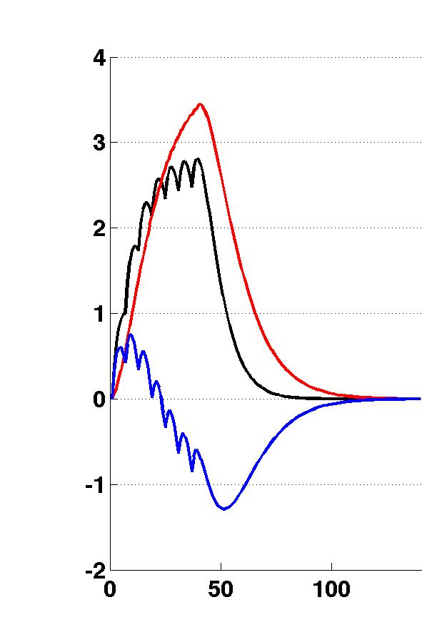
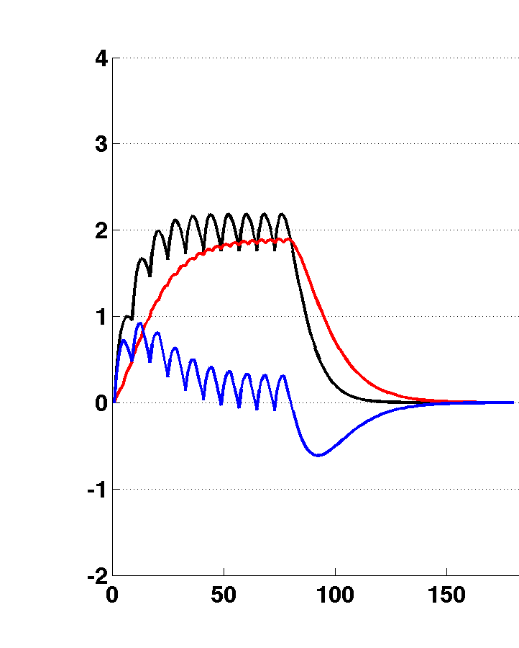
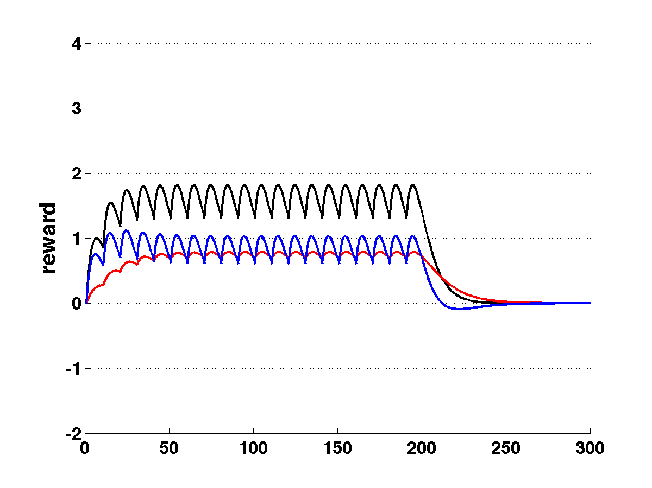
Reward function chosen to reinforce low frequency contraction bursts
Brain stim profile accumulates with each stimulation pulse
Muscle fatigue accumulates with each contraction
Brain stim. rate limited at 50 Hz.
Reward function: Brain stim. - muscle fatigue

Slide 8
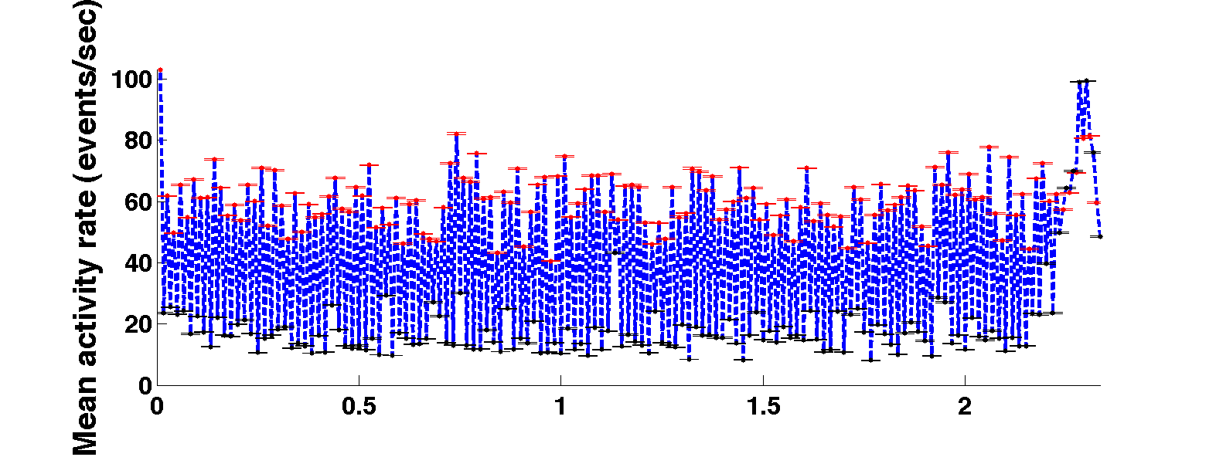
Contraction rates during simulated conditioning
140 one-minute episodes (2.5 hours), decisions made at 200 Hz.
Dramatically elevated contraction rates during time in periods.
Simulation does not contain “inactive” periods (i.e. sleep)

Slide 9
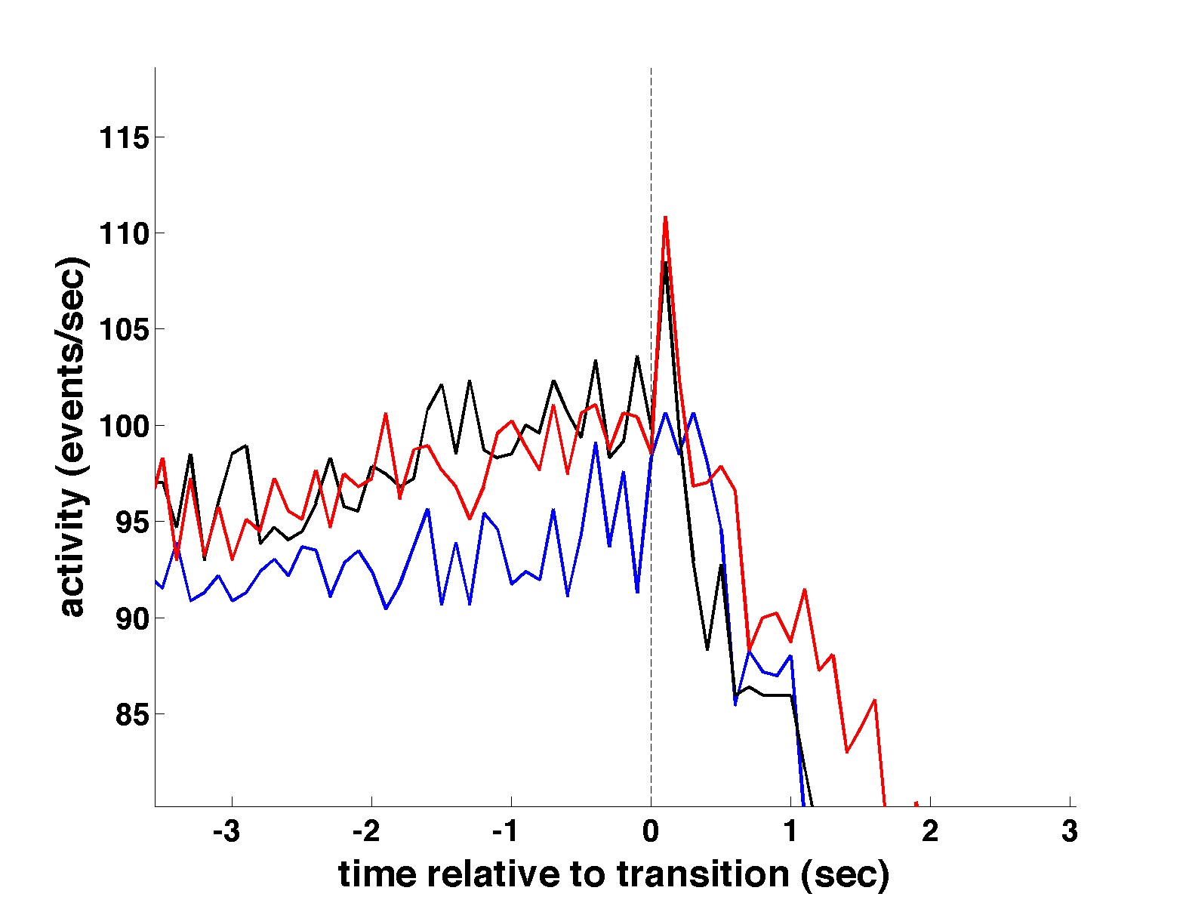
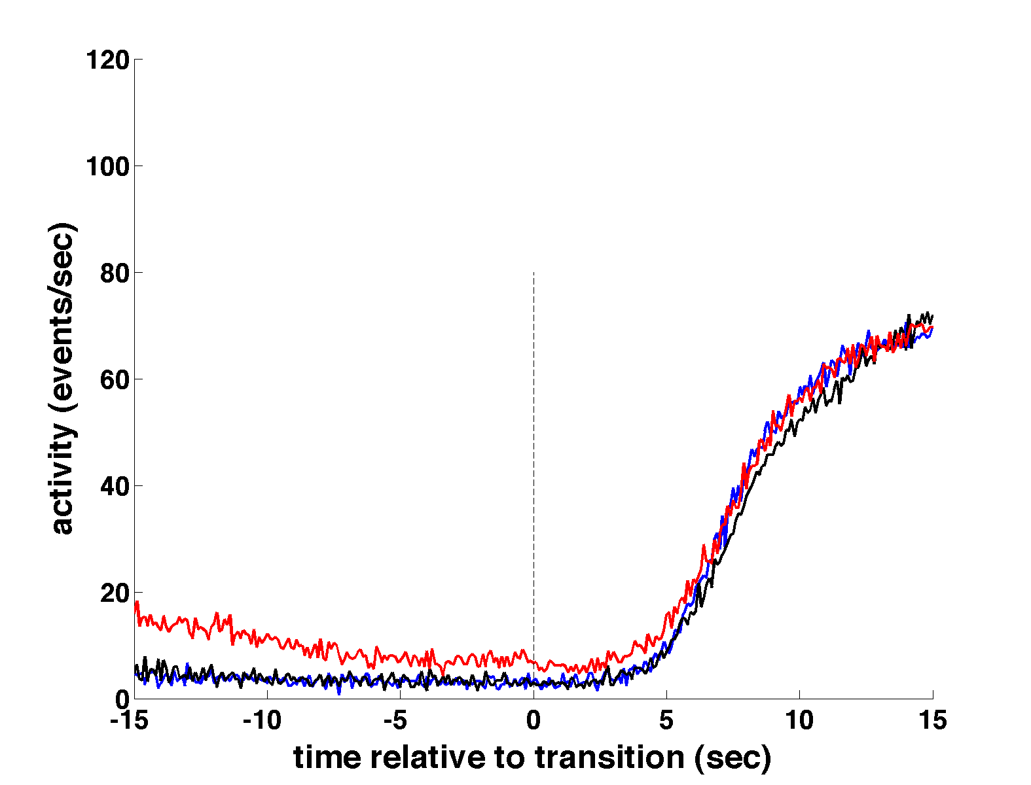
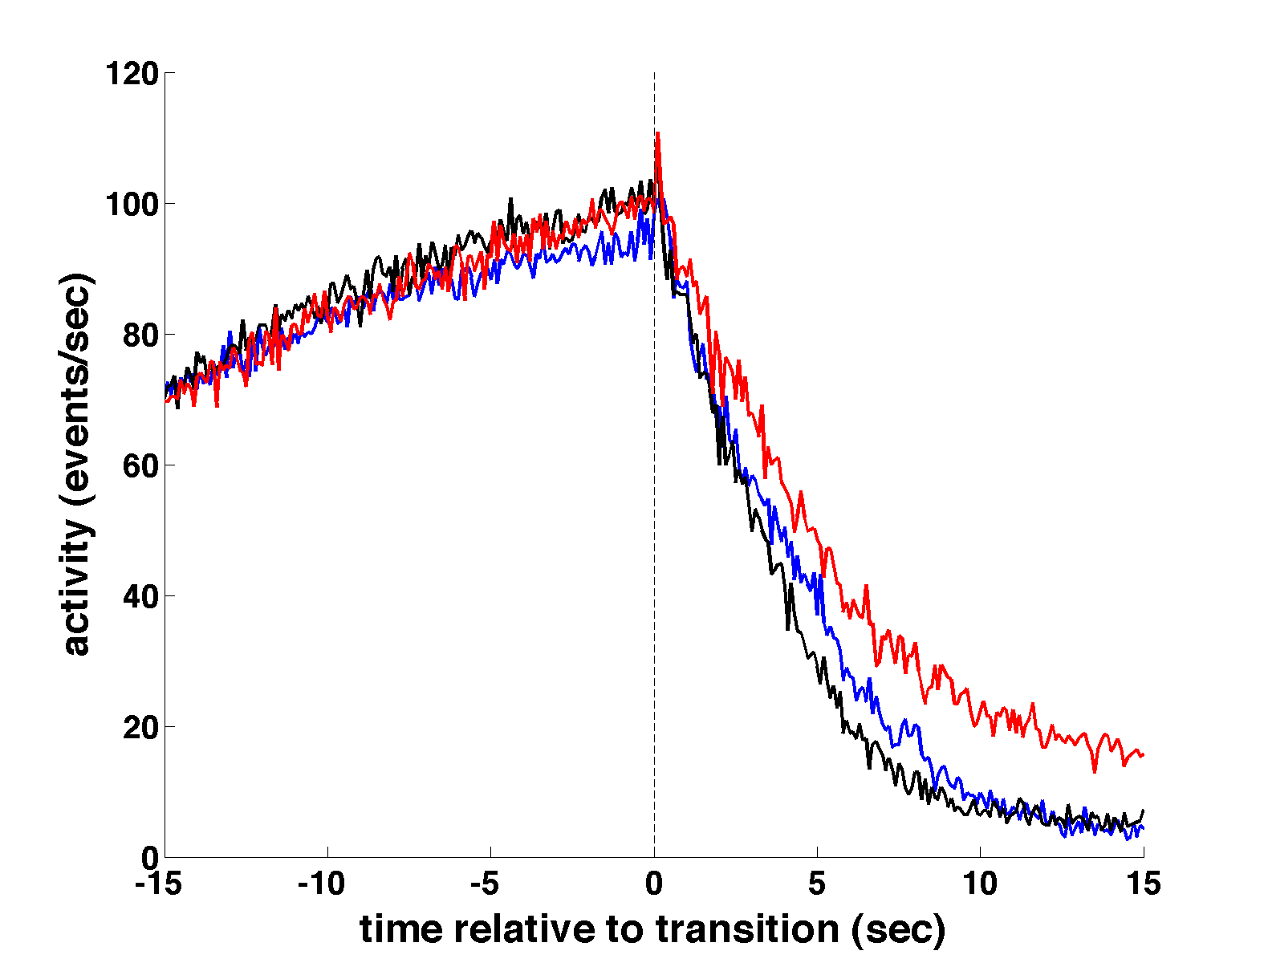
Simulated peri-transition rates partially resemble primate behavior
No appreciable change in rate of rise following time-out to time-in transitions
Well-defined post transition peak occurs after stimulator shut off.

Slide 10
End of Talk

