Slide 1


Slide 2
Developing Modern Cloud Applications
By: Chem Swift & Krishna Amilineni

Slide 3
RenWeb LMS
Tools and techniques for building modern cloud applications

Slide 4
How It Began
Brad Lee: ”If we budget for 2 developers, can we build an LMS by May 2016?”
Me: “What are the requirements?”
Brad: “We don’t have requirements yet but we want it to be tightly integrated with RenWeb”

Slide 5
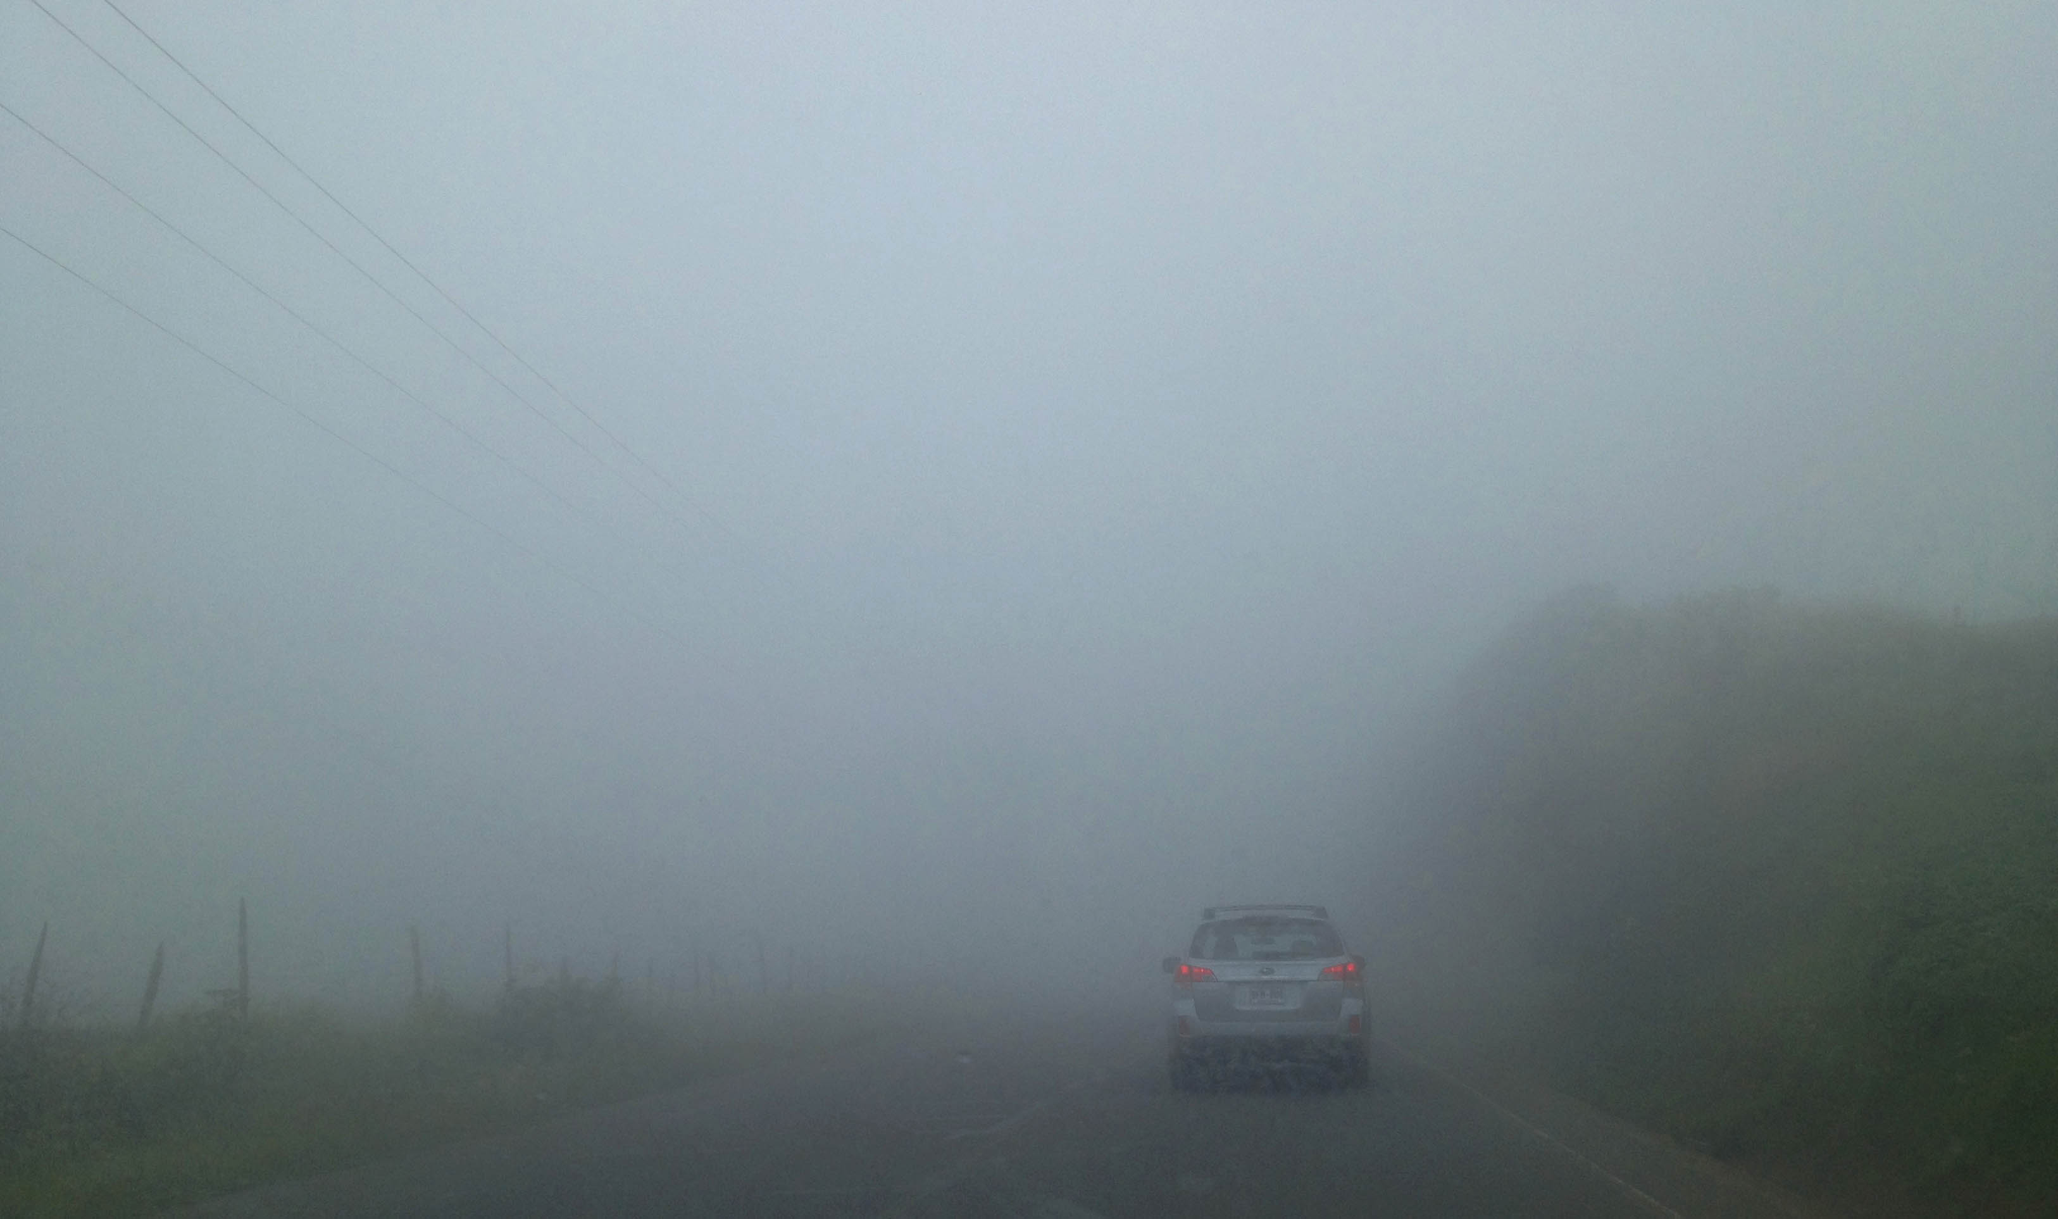
Proceed with Caution

Slide 6
Phase 1 – Minimum Feature Set
Academic Features: Quizzes, Discussion Groups, Units and Topics.
Social Features: Class Wall like Facebook, Chat System like Google Hangouts or Facebook Messenger, and an Assignment Calendar.
Productivity Features: Google Drive integration, Dropbox integration, Dashboards, & Notifications.

Slide 7
Business Domain
What problems are we trying to solve?

Slide 8
Core Components
Feed System (Needs to be near real-time)
File Management & Upload System
Real-time Chat System
We need a way to easily deploy these systems
How do we scale each component?
We need to enhance developer productivity
We need a system that the Infrastructure team can easily manage

Slide 9
Core Services Used to Build the System
Azure Blob Storage
Azure Service Bus (Queues & Topics)
Azure Functions
Azure Event Hubs
Azure DocumentDB
Azure Express Route
Firebase
Azure Service Fabric (State-full & Stateless Reliable Services)

Slide 10


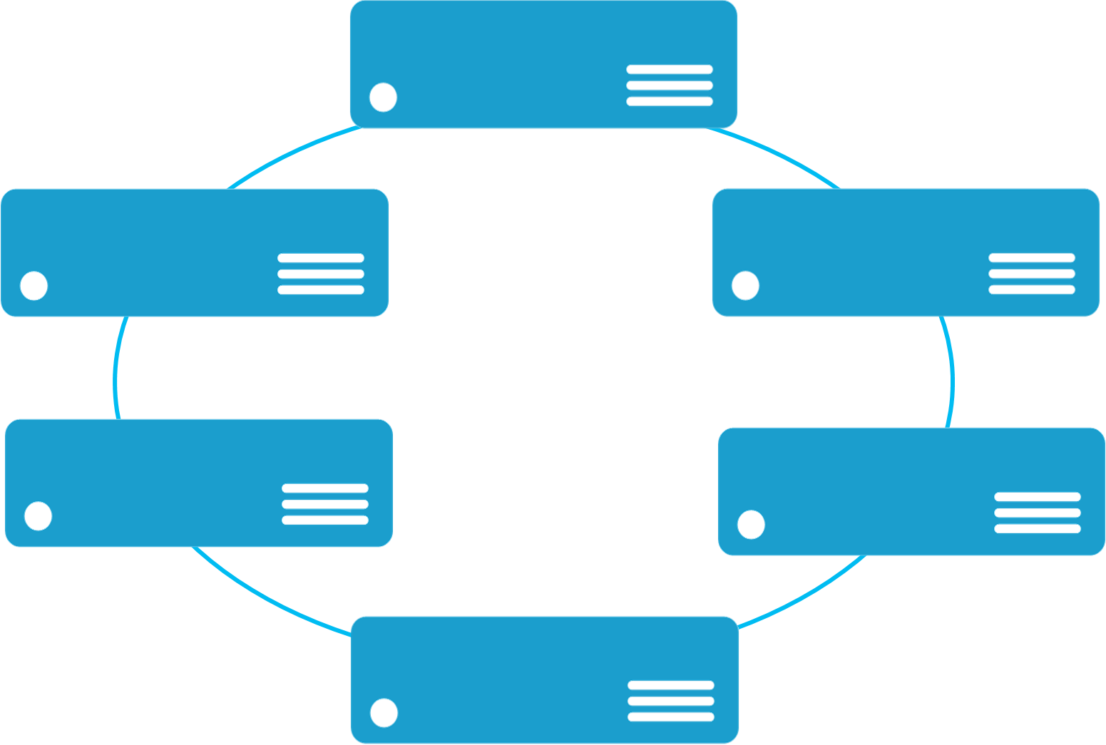


Monolithic application approach
Microservices application approach
A monolith app contains domain specific functionality and is normally divided by functional layers such as web, business and data
App 1
App 1
App 2
A microservice application separates functionality into separate smaller services.
Scales by cloning the app on multiple servers/VMs/Containers
Scales out by deploying each service independently creating instances of these services across servers/VMs/containers

Slide 11


web browser
or device
LMS Architecture
CDN
Service Fabric Cluster
LMS API Gateway
(stateless)
routing
services
15+ Microservices
AI
Events
aggregate
services
management
services
Academic
Accounting
Admissions
Attendance
Calendar
Chat
Document
Feed
Gradebook
Lesson

Slide 12
Service Fabric Demo

Slide 13
Summary
Taking abstract business requirements and breaking down the components.
Designing a system that’s reliable, scalable and fault tolerant.
Utilizing the correct technologies our technical challenges
Providing a system that is easy for Infrastructure team to manage.

Slide 14
Resources
Github Link: https://goo.gl/2iKMXA
Link to Service Fabric demos https://goo.gl/zLq0RN
See “Cloud Infrastructure” talk by Seth Connoly
Chem Swift: Chem.Swift@renweb.com
Krishna Amilineni: Krishna.Amilineni@renweb.com

Slide 15
Questions?

