Slide 1


Slide 2
Developing Modern Cloud Applications
By: Chem Swift & Krishna Amilineni

Slide 3
RenWeb LMS
Tools and techniques for building modern cloud applications

Slide 4
How It Began
Brad Lee: ”If we budget for 2 developers, can we build an LMS by May 2016?”
Me: “What are the requirements?”
Brad: “We don’t have requirements yet but we want it to be tightly integrated with RenWeb”

Slide 5

Proceed with Caution

Slide 6
Phase 1 – Minimum Feature Set
Academic Features: Quizzes, Discussion Groups, Units and Topics.
Social Features: Class Wall like Facebook, Chat System like Google Hangouts or Facebook Messenger, and an Assignment Calendar.
Productivity Features: Google Drive integration, Dropbox integration, Dashboards, & Notifications.

Slide 7
Business Domain
What problems are we trying to solve?

Slide 8
Core Components
Feed System (Needs to be near real-time)
File Management & Upload System
Real-time Chat System
We need a way to easily deploy these systems
How do we scale each component?
We need to enhance developer productivity
We need a system that the Infrastructure team can easily manage

Slide 9
LMS Demo

Slide 10
Core Services Used to Build the System
Azure Blob Storage
Azure Service Bus (Queues & Topics)
Azure Functions
Azure Event Hubs
Azure DocumentDB
Azure Express Route
Firebase
Azure Service Fabric (State-full & Stateless Reliable Services)

Slide 11
Azure Blob Storage
BLOB - Binary large object
Container - High level or root folder.
Supports up to 500TB per storage
Max size per blob block (per file) - 195GB

Slide 12
Azure Express Route
A secure private network between Azure & private data center
Bypasses the Internet enabling high throughput and low latency
Avoid security risks by not using the public Internet
Nearly 100 times faster than VPN. About 10GB/sec

Slide 13
Azure Service Bus (Queues & Topics)
Messages enter into queues reliably.
Topics: messages enter sequentially and exit in parallel
Load balance and observes queue length . Spin up resources as needed to share the load
Event Hubs: Massive ingestion capabilities. Hyper-scale to millions of clients concurrently

Slide 14
Azure Functions
Code + Events
Dynamic scaling : The Azure Functions platform will evaluate the traffic needs, based on the configured triggers, to decide when to scale up or down.
Resources are only consumed as needed by your running code.

Slide 15
Azure DocumentDB
Schemaless NoSQL Datastore
Fully Managed with provision capacity
Stored entities are JSON documents
Designed to scale into petabytes
Core Interface to DocumentDb is restful

Slide 16
Firebase
Scalable real-time backend.
Synchronizes application data between clients within milliseconds.
Data is stored as JSON
Integrates authentication with the users existing backend.
Seamless integration with AngularJS using three way data-binding.

Slide 17
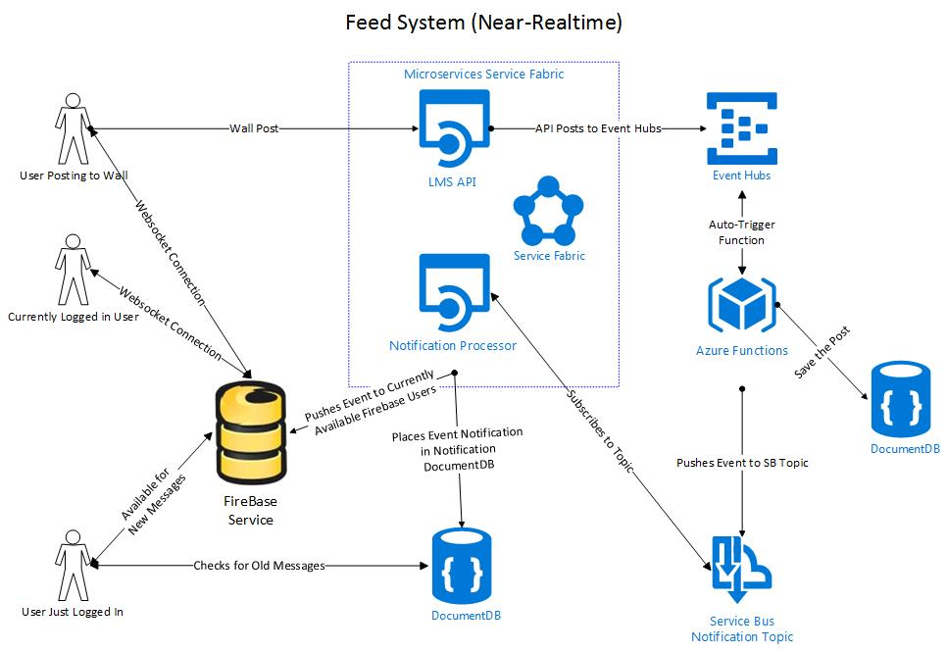
Feed Architecture

Slide 18
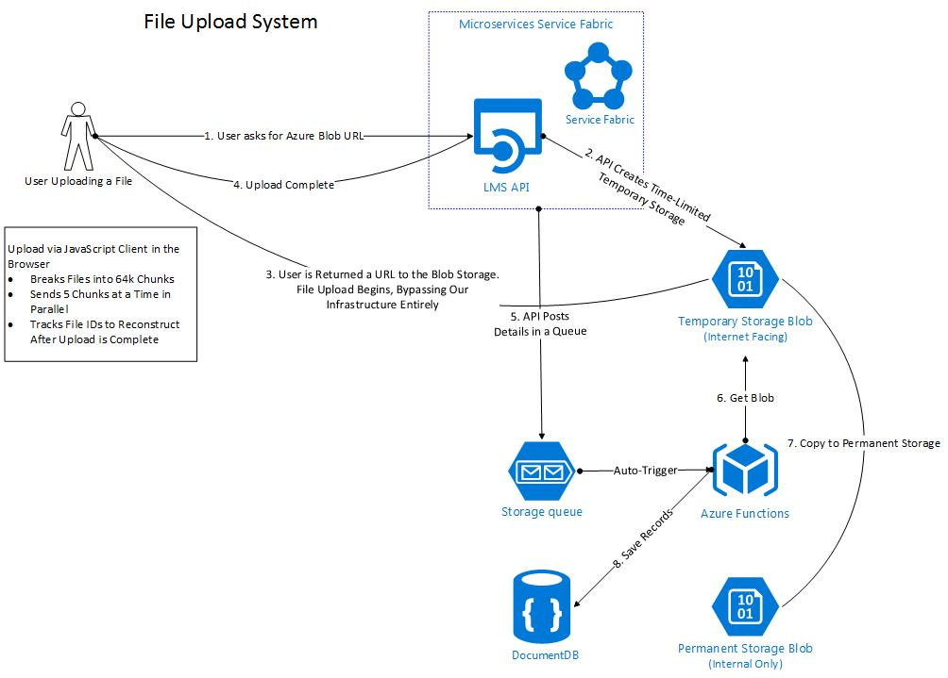
File Upload Architecture

Slide 19
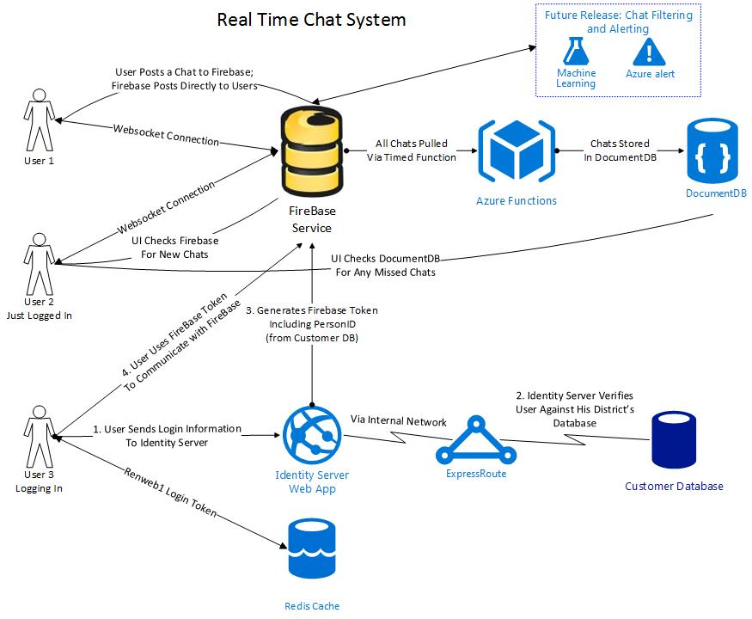
Architecture for Real Time Chat System

Slide 20
Azure Service Fabric
State-full & Stateless Reliable Services

Slide 21


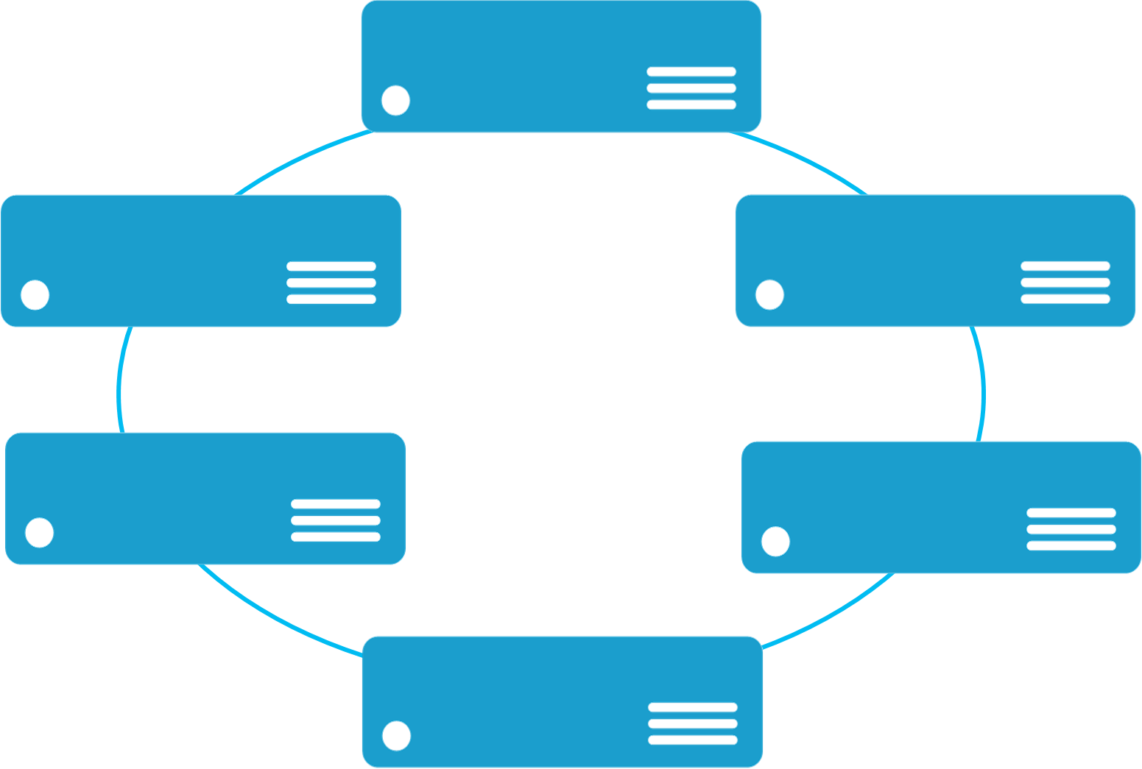


Monolithic application approach
Microservices application approach
A monolith app contains domain specific functionality and is normally divided by functional layers such as web, business and data
App 1
App 1
App 2
A microservice application separates functionality into separate smaller services.
Scales by cloning the app on multiple servers/VMs/Containers
Scales out by deploying each service independently creating instances of these services across servers/VMs/containers

Slide 22
LifecycleMgmt
Independent Scaling
Independent Updates
Always On Availability
Resource Efficient
Stateless/
Stateful
Public Cloud
On Premises
Private cloud
Other Clouds

Slide 23

Datacenter (Azure, On Premises, Other Clouds )
VM #2
Service Fabric
Your code, etc.
VM #3
Management to deploy your code, etc. (Port: 19080)
Service Fabric
VM #1
Your code, etc.
Service Fabric
VM #4
Load Balancer
Your code, etc.
Service Fabric
Your code, etc.
VM #5
App Web Request (Port: 80/443/?)
Service Fabric
Your code, etc.

Slide 24


web browser
or device
LMS Architecture
CDN
Service Fabric Cluster
LMS API Gateway
(stateless)
routing
services
15+ Microservices
AI
Events
aggregate
services
management
services
Academic
Accounting
Admissions
Attendance
Calendar
Chat
Document
Feed
Gradebook
Lesson

Slide 25
Service Fabric Demo

Slide 26
Summary
Taking abstract business requirements and breaking down the components.
Designing a system that’s reliable, scalable and fault tolerant.
Utilizing the correct technologies our technical challenges
Providing a system that is easy for Infrastructure team to manage.

Slide 27
Resources
Github Link
Link to Service Fabric demos https://goo.gl/zLq0RN
See “Cloud Infrastructure” talk by Seth Connoly

Slide 28
Questions?

