Slide 1
CSS3
Ronald Wedema (WERD)

Slide 2
Content
Separate content and makeup of webpages
Styling using CSS 3
Online resources
Live demo

Slide 3
Cascading Style Sheets
Layout and content seperated
Language that describes the style of HTML elements
CSS describes how HTML elements should be displayed
Dynamic CSS (Javascript)

Slide 4
CSS Syntax
Selector { attribute: value }
body { color: black}
body {
color: black;
background-color:red
}
h1, h2 { color: black}

Slide 5
Global Classes
CSS:
.right {text-align: right}
HTML:
<p class="right">
Paragraph aligned right
</p>
HTML:
<h1 class="right">
Header aligned right
</h1>

Slide 6
Classes
CSS:
div.rechts {text-align: right}
div {text-align: left}
HTML:
<div class="rechts">
Right aligned text
</div>
HTML:
<div>
Left aligned text
</div>

Slide 7
Pseudo-classes
selector:pseudo-class{ ... }
a:hover {font-size: 70%}
a:visited {text-align:center}

Slide 8
Unique elementen
CSS:
#konijn {text-align: right}
HTML:
<div id=”konijn”>
bla
</div>

Slide 9
block- vs in-line styles
block
div
p
h*
in-line
span

Slide 10
Link with HTML
Inline
<p style=”Style rules for this paragraph">
Internal
<head>
<style type="text/css">
<!—Style rules->
</style>
</head>
External
<head>
<link rel="stylesheet" type="text/css" href=”FileName.css">
</head>

Slide 11
Positioning: table
A table can have other tables
A table can have a header, footer and a body
A table has rows
A rows has columns
Rows + columns form cells
Cells can be joined
Use tables only for data, not for page layout!

Slide 12
Positioning: CSS
Top left screen (0, 0)
position:absolute;
t.o.v. first non-static element (or html)!
position:fixed;
t.o.v. browser window
position:relative;
t.o.v. relative to normal position
float: ...;
Align to ... side

Slide 13
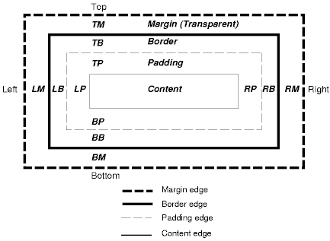
Positioning: CSS box
https://www.w3.org/TR/CSS2/images/boxdim.png
margin and padding transparant
margin = tm + lm + bm + rm (same for border, padding)

Slide 14
CSS validation
As with HTML, always validate your CSS styling!
https://jigsaw.w3.org/css-validator/
Chose CSS3!

Slide 15
Summary
Separate content from style using CSS
CSS syntax: selector {attribute: value}
Classes: global/pseudo
Unique: #
Positioning: CSS-box model
Validate

Slide 16
Live demo

Slide 17
Questions?

