Slide 1
Flask
Ronald Wedema (WERD)

Slide 2
Content
Build a dynamic website in Flask using HTML 5, CSS 3 and Jinja2
Take a limited set of user input files and upload these to the server
Using Python process the files
Create graphical figures representing the content of the files and show this on the website

Slide 3
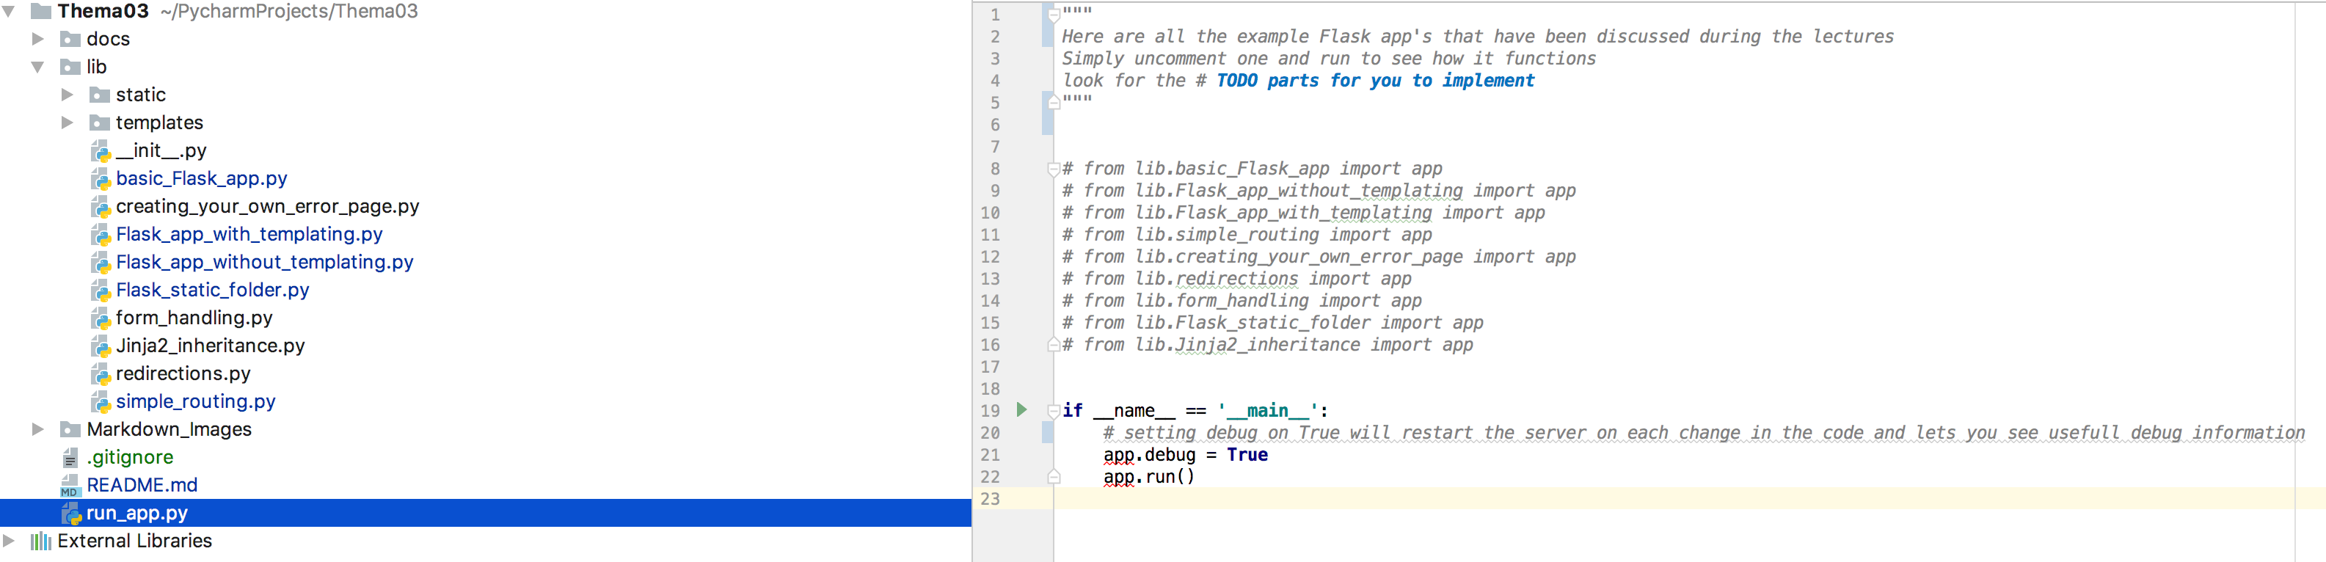
Flask app structure

Slide 4
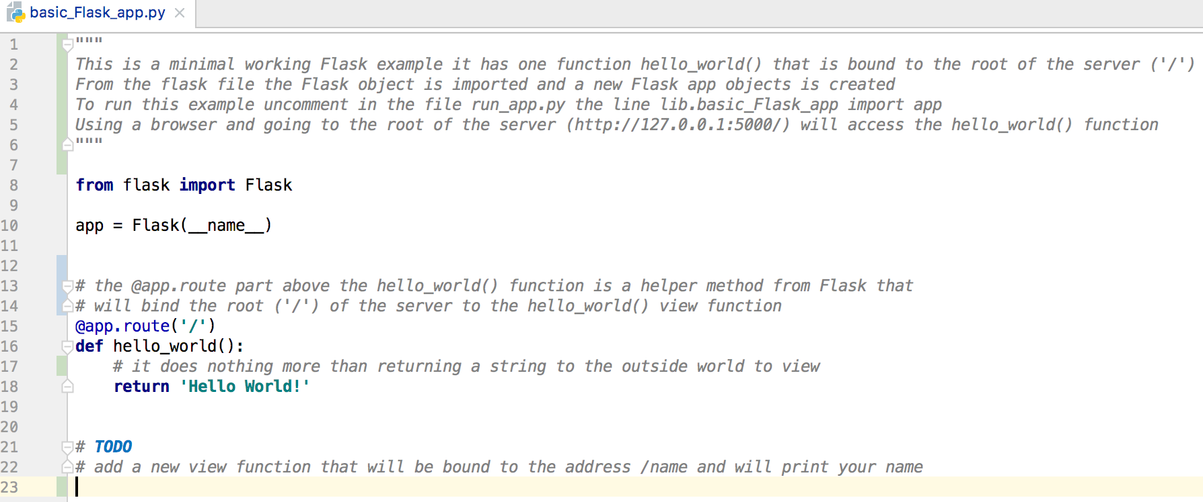
Flask backend

Slide 5


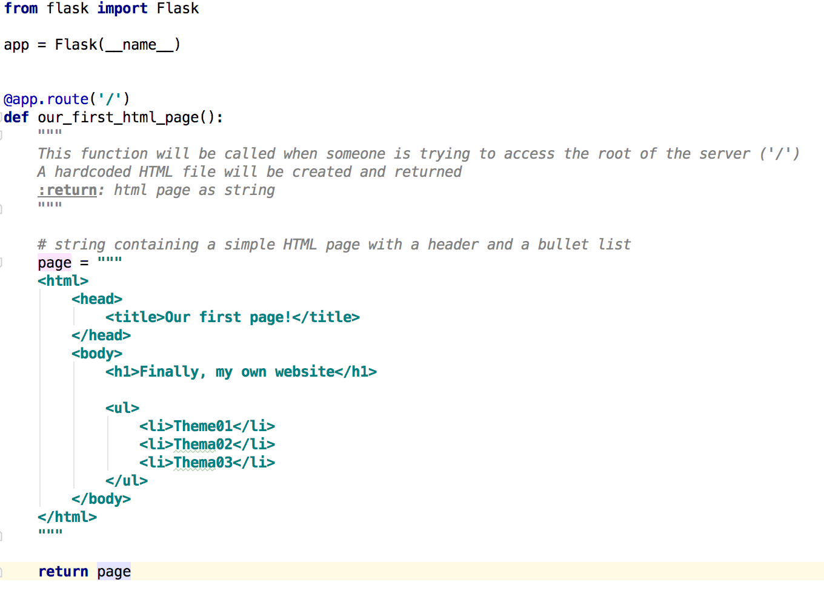



Flask HTML

Slide 6
FLASK + Jinja2
HTML syntax + variables, expressions
Insert variables from Python into HTML using placeholder:
Passed from Python
{{ variable }}
Use of statements (control logic): {% %}
Passed from Python
{% for item in iterable %}
{{ item }}
{% endfor %}

Slide 7
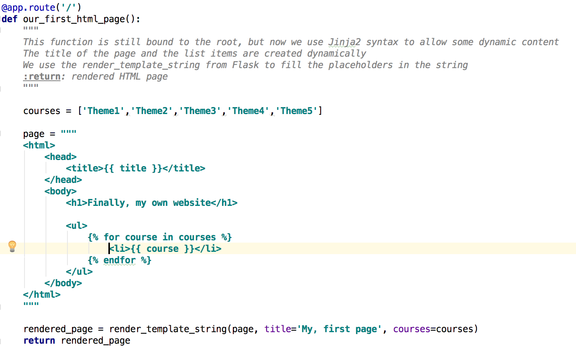
Flask HTML

Slide 8
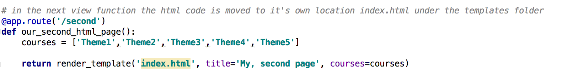
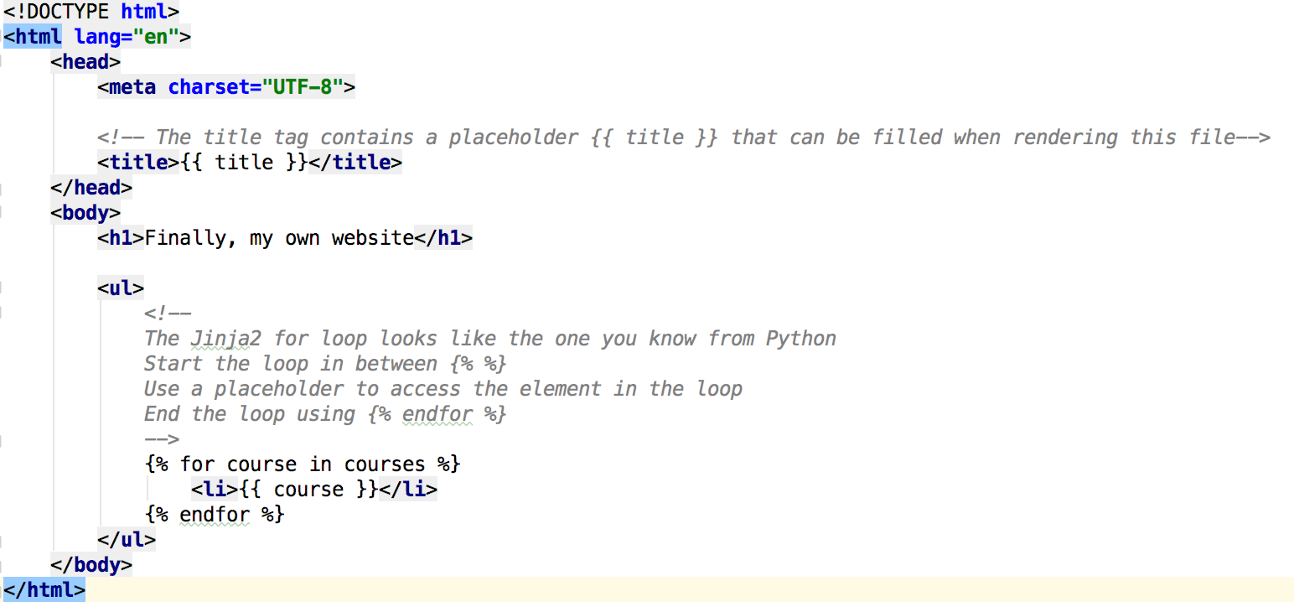
Flask + Jinja2 templating

Slide 9
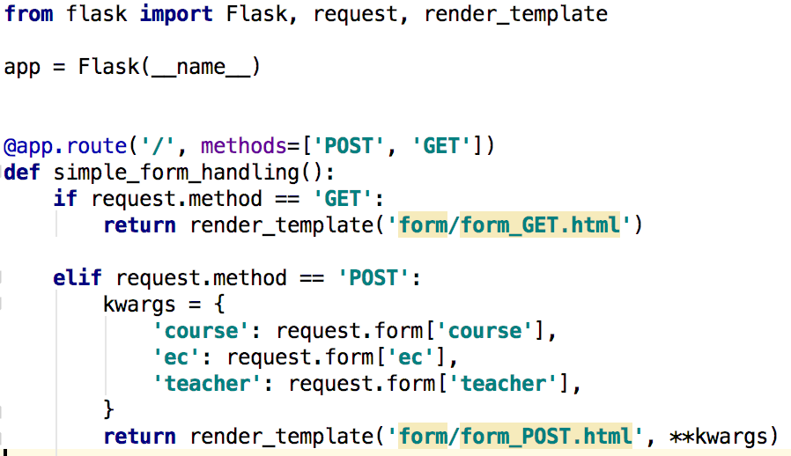
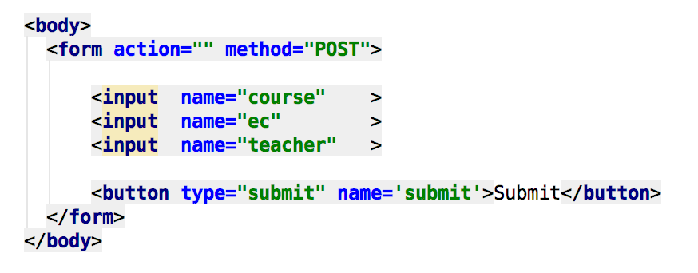
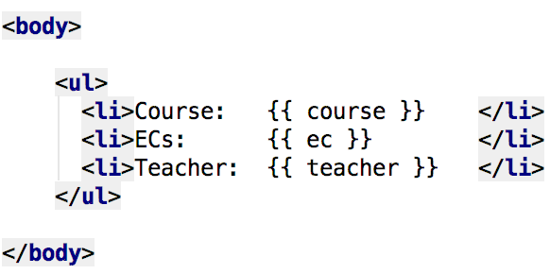
Flask forms

Slide 10
Resources
https://bitbucket.org/RonaldWedema/thema03
http://flask.pocoo.org/
http://jinja.pocoo.org/docs/2.10/

Slide 11
Summary
App structure, static and template folder
@app.route decorator
Flask can print simple HTML
Jinja2 can be used to have dynamic content using placeholders
Form handling (GET and POST)

Slide 12
Questions?

