Slide 1
HTML5
Ronald Wedema (WERD)

Slide 2
Content
Client/Server model
HTTP and HTML
What program to use for coding
Building blocks of websites
Minimal webpage
Online resources

Slide 3
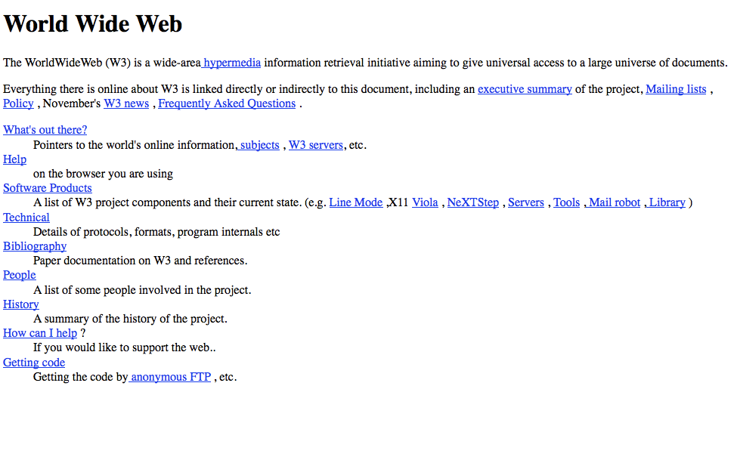
Websites
http://info.cern.ch/hypertext/WWW/TheProject.html

Slide 4
Client/Server
Web is build on top of HTTP (Hyper Text Transfer Protocol)
HTTP is used to communicate between client and server
https://commons.wikimedia.org/wiki/File:Client-server-model.svg#/media/File:Client-server-model.svg

Slide 5
Client request message
HTTP method (Most importantly: GET and POST)
URL
HTTP version
GET ~/rwedema/index.html HTTP/1.1
POST ~/rwedema/form_upload HTTP/1.1

Slide 6
Server response message
HTTP version
Status code
Body
HTTP/1.1 200 OK
<html>
<p1>Here is the webpage you wanted!</p1>
</html>

Slide 7
Status codes
1xx: informational
Request received, process continues
2xx: Succes
Action received understood and accepted
3xx: Redirection
Further action needed to complete request
4xx: Client error
Incorrect syntax or request cannot be fullfilled
5xx: Server error
Failed to respond to valid request

Slide 8
HTTP Headers
Define operating operating parameters
Request fields
Accept: allowed data formats
Accept-encoding: can it be compressed
Accept-language: accepted human language
Response fields
Allow: get or post
Retry-after: send message to try again after set time limit

Slide 9
(web)server
Apache
public_html <=> http://bioinf.nl/~username
Python Flask
Local machine, address depends on configuration

Slide 10
Open Office Writer
Just like MS Word
Also reads MS Word .doc

Slide 11
Don’t ever use this for programming!

Slide 12
Duh???
Use an EDITOR
vi
joe
Kate
nano
pico
notepad (++)
geany

Slide 13
HTML
Hyper Text Markup Language
Building blocks of a website
Tags: <tag> <\tag>
Attributen: <tag name = <\tag>
Values: <tag name = “value” <\tag>

Slide 14
Example tags and attributes
<p> This is a paragraph </p>
<a href=”http://www.google.nl”> google link</a>
<img src="smiley.gif" alt="Smiley face" height="42" width="42" />
Line enter <br />

Slide 15
Minimal (valid) HTML 5 page
<!DOCTYPE html> <html>
<head>
<meta charset="utf-8"/> <title>Page Title</title> </head>
<body> <h1>This is a Heading</h1> <p>This is a paragraph.</p> </body> </html>

Slide 16
HTML 5
Tags and attributes all lower case
Attribute values enclosed in (" ")
Close all tags <\tag>

Slide 17
Validation
Always validate the HTML page
via toolbar
via internet
https://html5.validator.nu/
Chose HTML5!

Slide 18
See
https://www.w3schools.com/html/default.asp
Home t/m paragraphs +
Links
Images
Lists
Blocks
Head
Layout
Charset

Slide 19
Summary
Client/server model
Web is build on the HTTP protocol
HTML is used to create webpages
HTML Tags ands attributes define the parts of a webpage
Always validate your webpage

Slide 20
Live demo
Minimal HTML 5 page
Some tags and attributes
Validation

Slide 21
Questions?

