Slide 1

aSynchronic code

Slide 2
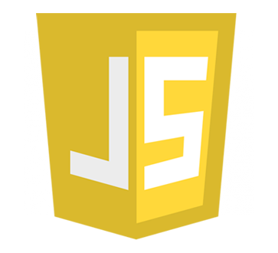
Javascript — single threaded, non-blocking, asynchronous, concurrent language

Slide 3
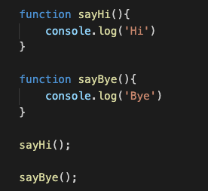
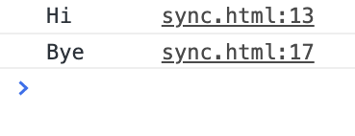
synchornous

Slide 4
Heap
Call Stack (first in first out)
primitive
obj
primitive
obj
fonction
fonction
fonction
fonction

Slide 5
synchornous

Slide 6
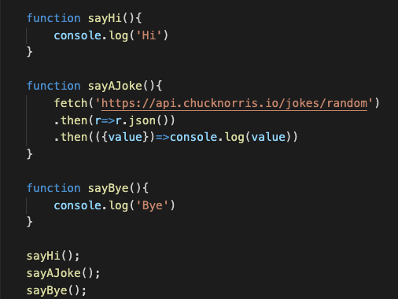
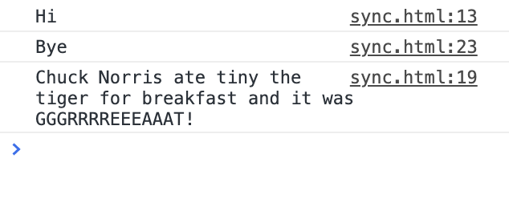
synchornous

Slide 7
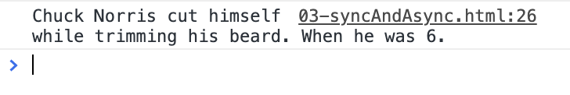
Call Stack (first in first out)
synchornous
fonction
fonction
fonction
Async will happen only after the stack is empty

Slide 8
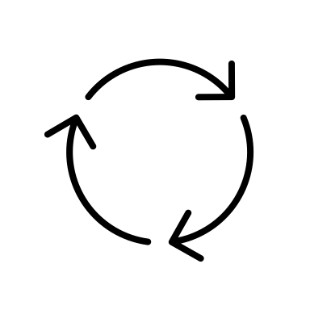
Call Stack (first in first out)
Web APIs
Callback queue
Async function
Event loop
CB

Slide 9
Call Stack (first in first out)
Web APIs
Async function
CB
Callback queue
Event loop

Slide 10
Call Stack (first in first out)
Web APIs
Async function
Callback queue
Event loop
CB

