Slide 1
The Core 4
ITIS 3300

Slide 2
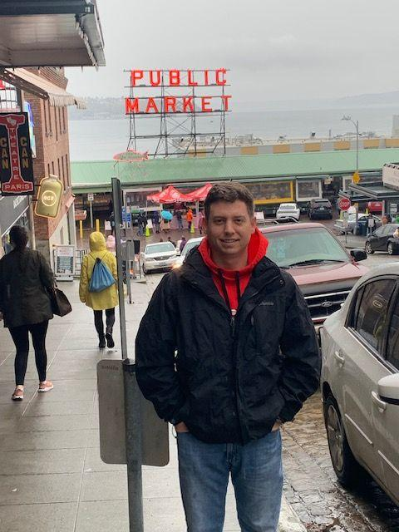
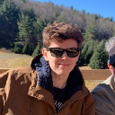
Team Members
Name: Carson Carmody Role: Web & Back End Development, JS, Bootstrap | Name: Tyler Niemonen Role: Team Leader, Web Development, UI/UX
Name: Jeff Pautrat Role: Front-end/UI UX | Name: Ryan Wegener Role: Back End Development, GitHub Lead

Slide 3
Project Description
The BasketBuddy grocery ordering system enables shoppers to remotely purchase groceries online, allowing them to shop around their busy lives or schedule. This project contains three distinctive parts: the web interface, mobile interface, and database to store grocery items. All three components will communicate to ensure that shoppers can browse items and submit or cancel orders effectively on either platform. BasketBuddy will synchronize across multiple devices, so that if a shopper begins their order on the website, they may continue on their phone. This underscores the importance of designing a single, consistent database that both platforms can connect to reliably.

Slide 4
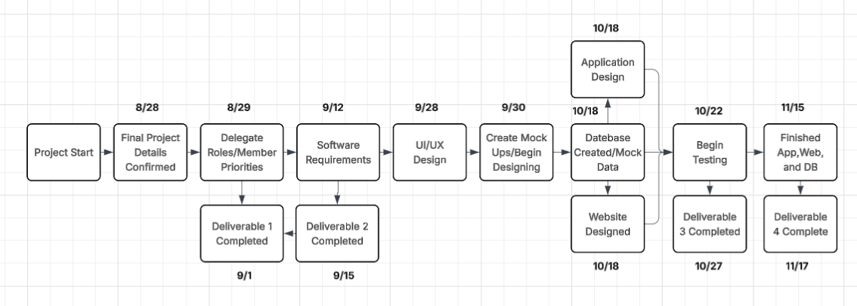
Project Schedule (PERT)

Slide 5
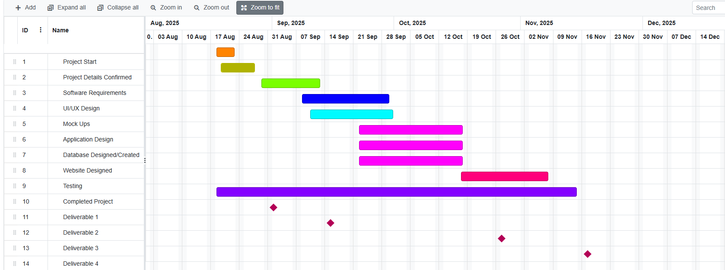
Project Schedule (GANTT)

Slide 6
Risk Management
Late Submissions:
Probability: Low
Impact: Significant
Monitoring: Members will monitor deadlines and communicate daily on the weekdays.
Mitigation: If the group ends up nearly making a late submission, we can meet and determine a better timeline that fits all of our schedules to prevent close calls in the future. Additionally, reassessing all deliverables and ensuring the project scope is still feasible for the timeline will enable future success.
Inadequate Deliverables:
Probability: Medium
Impact: Significant
Monitoring: Members will adhere closely to assignment rubrics and instructions.
Mitigation: The group can meet with the TA and discuss how we should more appropriately approach future assignments. This may include establishing project objectives or roles.
Schedule Conflicts:
Probability: High
Impact: Medium
Monitoring: Group members will ensure that they work with their jobs and personal life to ensure that there is adequate time for collaboration.
Mitigation: Coordinating specific times to meet virtually will allow us to more conveniently get together and finish an assignment.

Slide 7
Member Contribution
Team Member | Member’s Contributions | Contribution %
Carson Carmody | Created the project details & risk management sections. Assisted with the project schedule. | 25%
Tyler Niemonen | Created GANTT & PERT chart, built the project schedule, helped decide which languages we will utilize in the project. | 25%
Jeff Pautrat | Helped with formatting, editing and flow, provided insight to the schedule and things with risk management section, gave insight to topics on the document | 25%
Ryan Wegener | Assisted outlining project schedule and details, and decided on Python/Node.js and SQLite | 25%
Jakia Gary | Joined Late (9/1/25) | 0%

