Slide 1
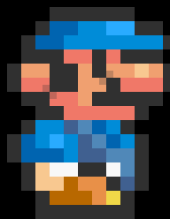
WUIGI
Reed Weichler

Slide 2
WHAT IS IT!?!?!?!??
Basically, it’s a Mario level editor/game
More specifically, it’s a ‘platformer’ style game
Obstacles, powerups, terrain and enemies that can be created in the level editor
Levels can be saved in files, and can be opened to edit at a later time or to play through

Slide 3
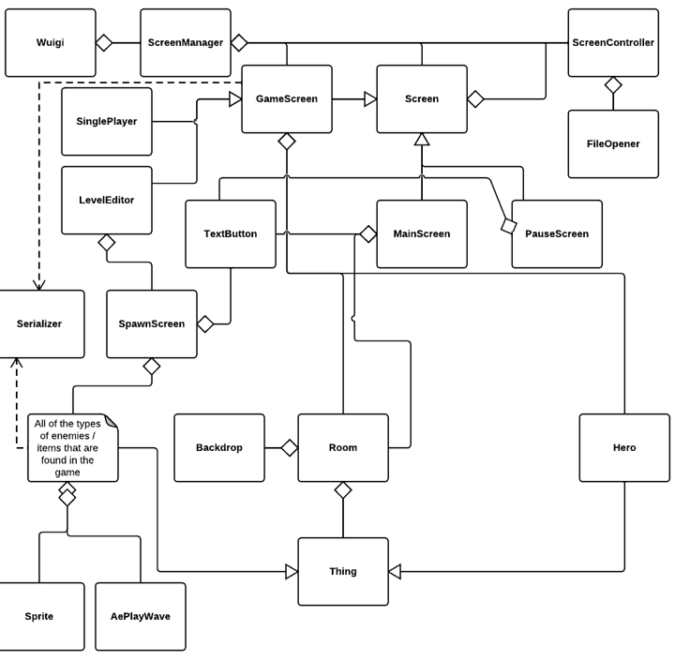

Slide 4
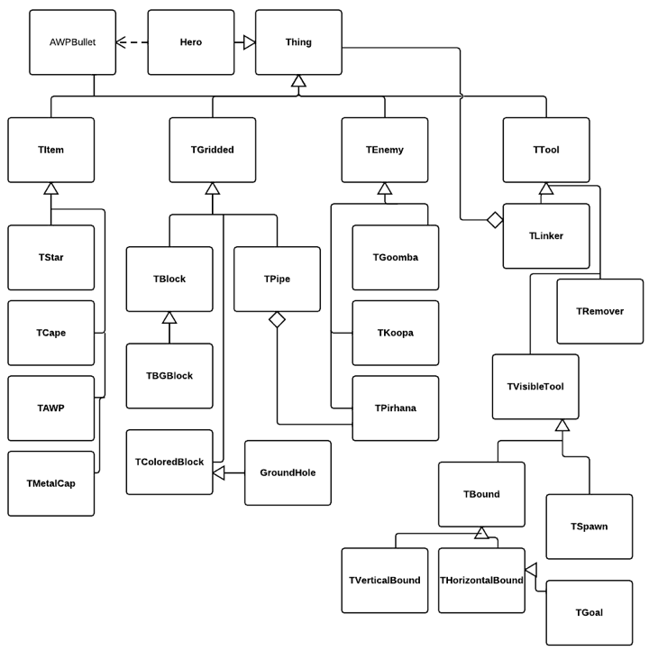

Slide 5
The toughest challenges
COLLISION HANDING (gravity, etc)
  Solution: A lot of trial and error, (plus different Point2D.Double’s for position, velocity and acceleration)
Saving and Opening levels
  Solution: Used the Serializable interface along with Writer.writeObject();
Online (ServerSockets, etc.)
  Solution: I gave up.

Slide 6
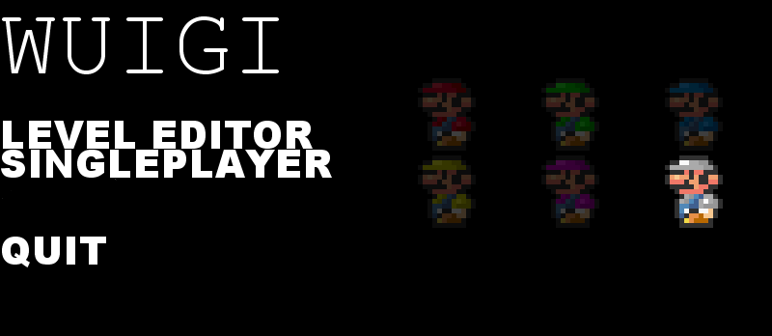
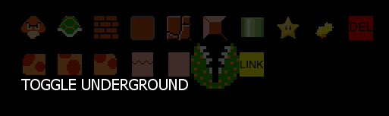
You can select the color of your dude here.
Press Q or SHIFT to bring this menu up.
Click on a tile to select it, the selected tile will get bigger to indicate that it’s selected

Slide 7
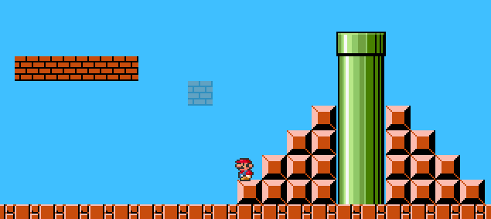
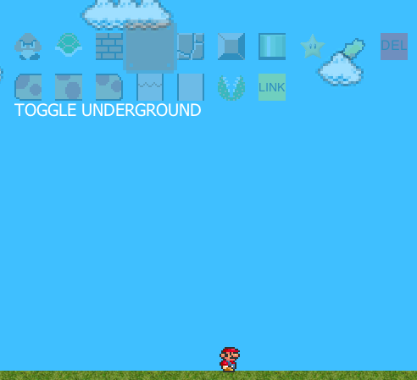
You can see a preview of where your tile is going to spawn (after you let go of SHIFT or Q), click to spawn it

Slide 8

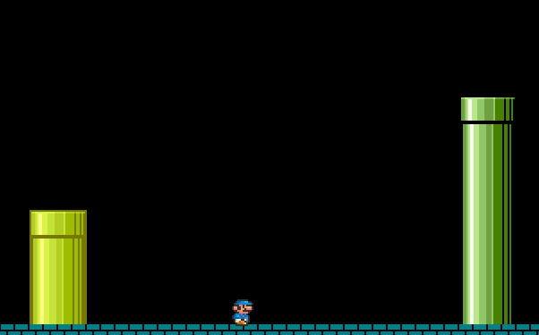
LINKING
1. Select that in the spawn menu
2. Click on pipe
3. Click on other pipe
Note: You’ll know something is linkable if it’s highlighted yellow

Slide 9
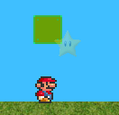

? Blocks
1. Select ^ that block in the spawn menu
2. Select item and drag it to the block, it will turn green if it can be put inside
3. :D

Slide 10

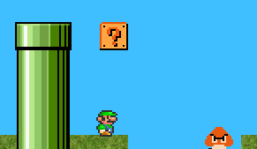
Holes
1. Select ^ that block in the spawn menu
2. Spawn it, things can now fall through the floor

Slide 11



POWER UPS
METAL HAT:
Gives you a metallic coating. If you are attacked, you don’t die, instead the coating comes off.
CAPE/CHEESE:
Lets you fly for a short period of time.

Slide 12



POWER UPS
STAR:
Makes you temporarily invincible. Anything that touches you dies.
SNIPER RIFLE:
Gives you 2 ammo, where you can use your mouse to shoot stuff.

Slide 13
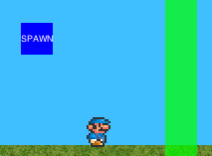
SPAWN / GOAL
This is where the hero will spawn in SinglePlayer
If touched in singleplayer, it will indicate that you beat the level

Slide 14
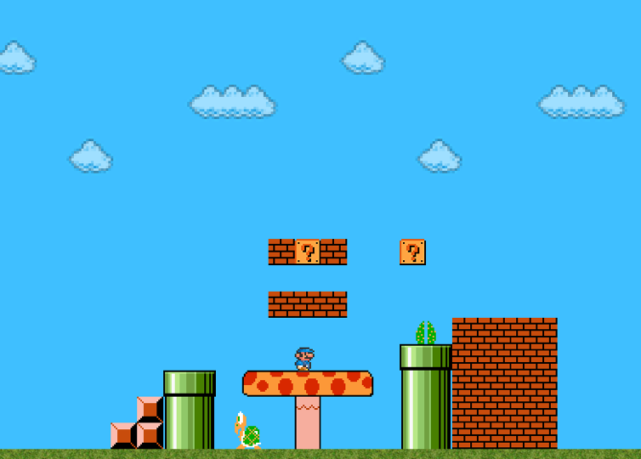
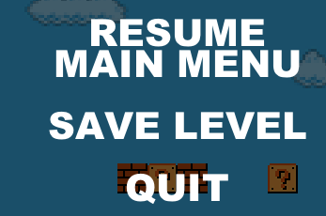
Saving
1. Make your awesome level.
2. Press ESC. You should be able to figure it out from there.

Slide 15
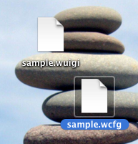
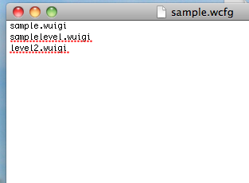
Multiple levels
1. Make a .wcfg file with the same name as the name of the first level in your multi-level pack
2. Open with notepad, and list the levels that should play, separated by enter. Yes, you even have to list the first level.

Slide 16

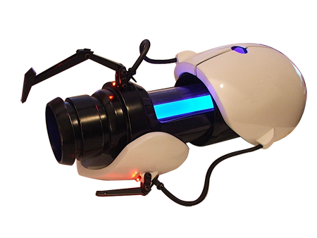
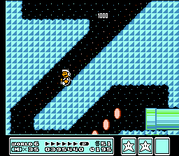
WHAT WOULD I DO IF I HAD MORE TIME!!?!?!!?
Add online capabilities
Add the portal gun
Add slopes

