Slide 1
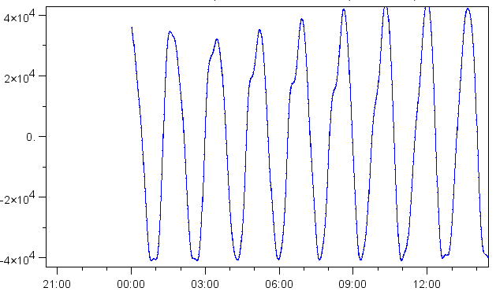
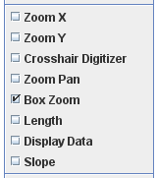
Starting Autoplot …
Right-click in plot area to show other interaction options.
Click and drag on plot to create a zoom box.
Drag on X- or Y-axes to zoom in that direction.
Move mouse over corner to show next or previous interval of data.

