Slide 1
Project Presentation
Presented by Robert Werthman

Slide 2
Table of Contents
Project Goal
Tools used
Completed requirements
How were the requirements completed
Not completed requirements
What went well
What did not go well
Known bugs
Future work

Slide 3
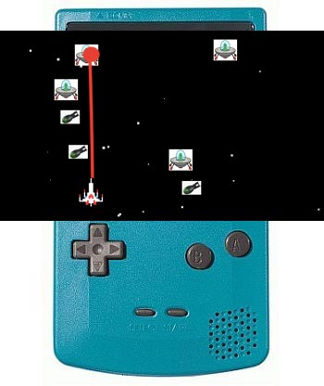
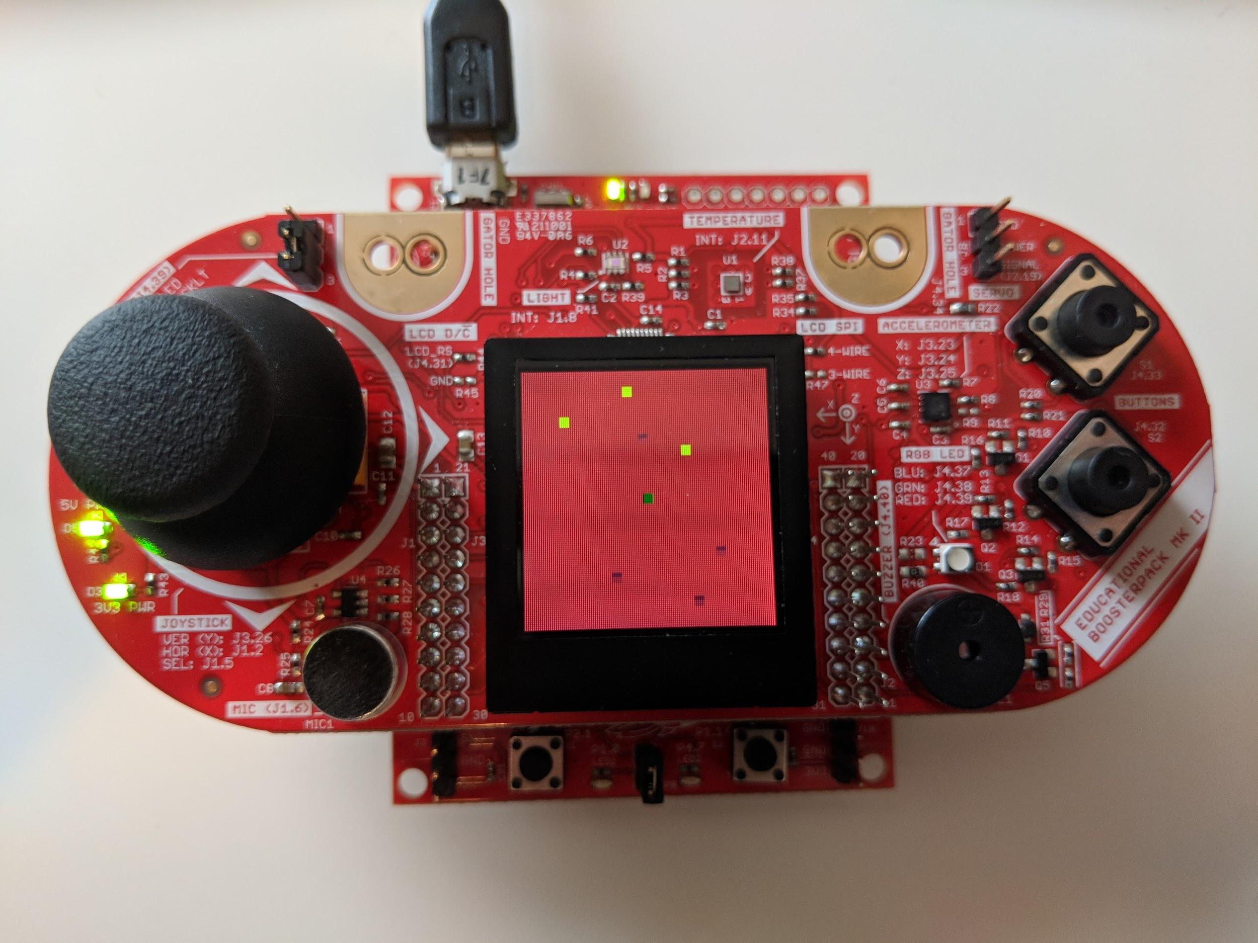
Project Goal
Make a playable game on a handheld device with buttons, sounds, and other sensors. There would be aliens, a spaceship, bombs, and bullets.
The original idea
The end result

Slide 4
Tools used
Hardware
TI MSP430F5529 Microcontroller
TI Educational Booster Pack
Language
C
IDE
Code Composer Studio
TI Code libraries
driverlib
grlib

Slide 5
Completed requirements
I want to be able to press a button that resets the game so I can start over.
I want to be able to press a button that shoots a bullet from the starship so I can shoot aliens and defend myself so I will not die and restart the game.
I want to be able to fly my starship around so that I will not run into the alien invaders and restart the game.
I want to be able to hear when I shoot the starship cannon so that I know when I hit an alien with the cannon.
I want the backlight to get brighter when the ambient light gets darker so that I can play the game in the dark.
Continued on next slide...

Slide 6
Completed requirements
I want the aliens to move to a different position every 500ms so that they aren’t too fast for me to shoot.
I want to the cannon bullets to change position every 200ms so that the aliens cannot outrun the bullets.
I want the spaceship to change position every 100ms so that I can outrun the aliens and my bullets.
I want the aliens to shoot at me so that I must keep paying attention to the screen and avoid their bullets.
I want the bullets to move at the same rate as the aliens so I move out of the way and survive for longer in the game.

Slide 7


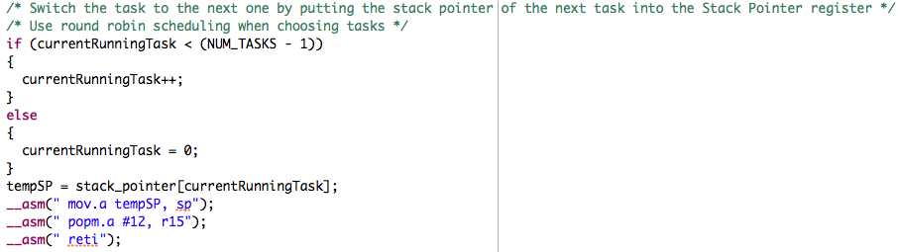
How were the requirements completed
Created a scheduler using a 1 millisecond timer interrupt
Each requirement was broken up into a task
Scheduler would run through each task
Saving the task context
Each task is a void function with infinite loop
Restoring the next task context

Slide 8
How were the requirements completed
Used semaphores to share the LCD controller
Semaphore had a queue to track order to who called the semapahore
Used timers and interrupts for button presses
Used analog to digital converter to control spaceship with joystick
Used pulse width modulation to create tones with buzzer and changed backlight

Slide 9
Not completed requirements
I want to be able to see able to see my score on the screen so that I can see how many aliens I have blown up.
I want to be able to log information from the system so I can debug my code.

Slide 10
What went well
Hardware worked as intended
The IDE was great to help debug

Slide 11
What did not go well
Figuring out how to use drivers for LCD and light sensor
Porting them to this microcontroller
Understanding bugs with drawing objects on the screen
Task starvation with the semaphore
Disabling interrupts when using semaphores and changing critical sections

Slide 12
Known bugs
Backlight flickers
Maybe the timeout with the light sensor controller or bad values
Objects are sped up on screen

Slide 13
Future Work
Levels of difficulty
More aliens and bombs
Game AI
Aliens avoid your bullets and shoot at you
Better graphics using bitmaps

