Slide 1
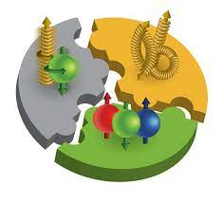
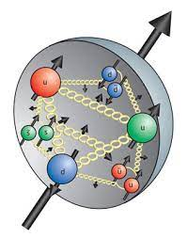
The proton spin puzzle: a surprisingly difficult problem
Richard Whitehill

Slide 2
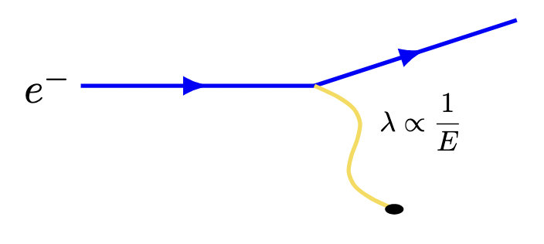
Motivations: development of quark model

Slide 3
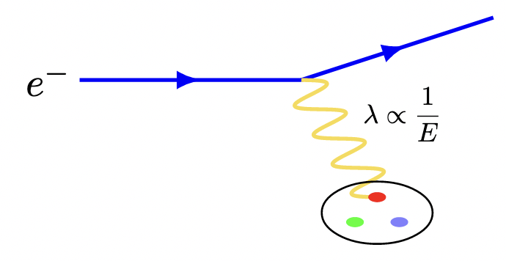
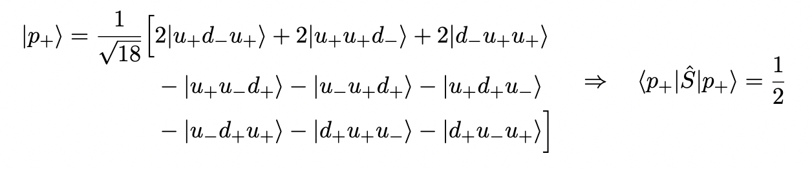
Motivations: development of quark model

Slide 4
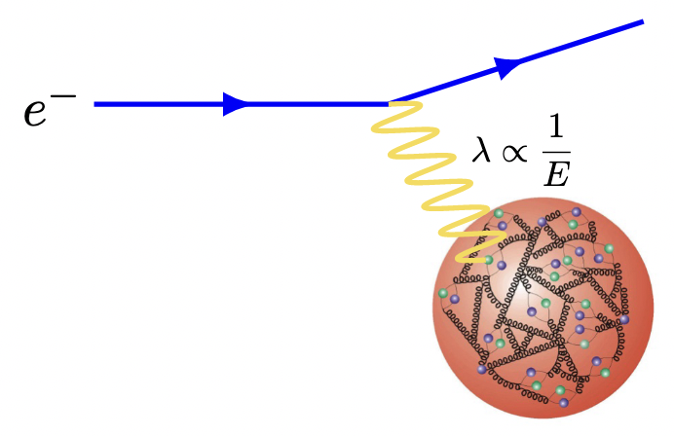
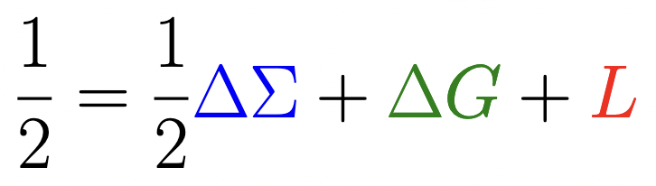
Motivations: development of quark model

Slide 5
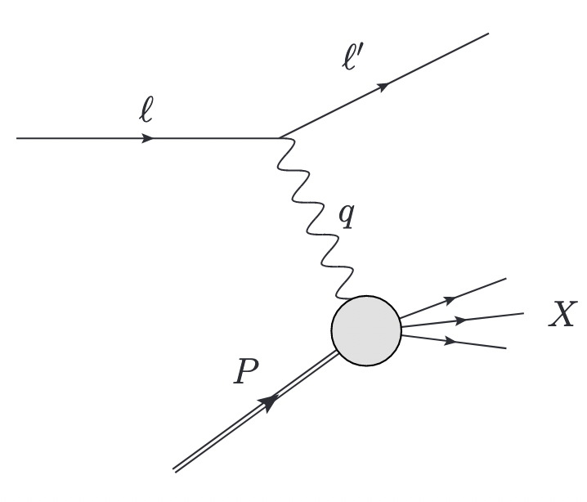
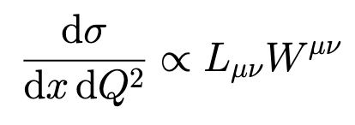

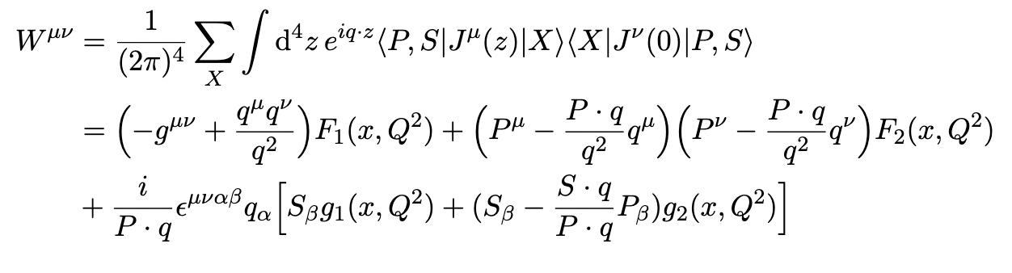

Formalism: DIS and structure functions

Slide 6
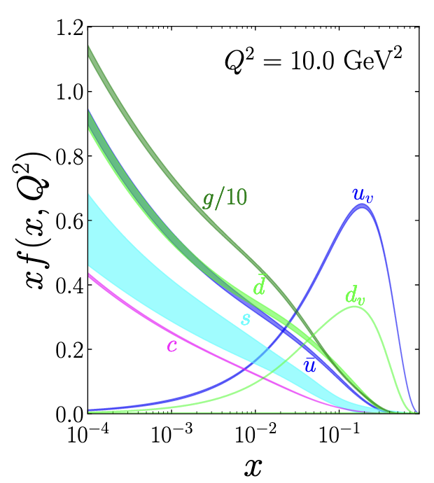
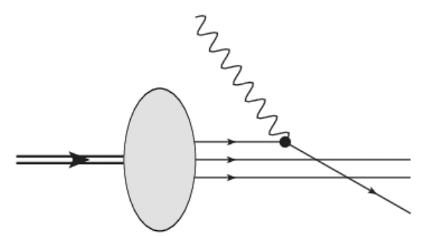
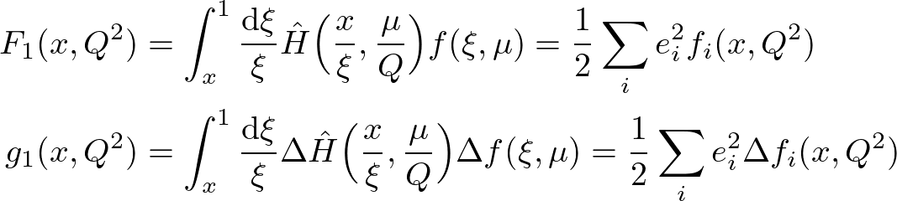
Formalism: parton distribution functions
Factorize DIS cross section

Slide 7
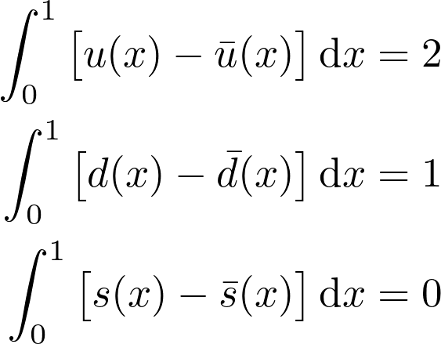
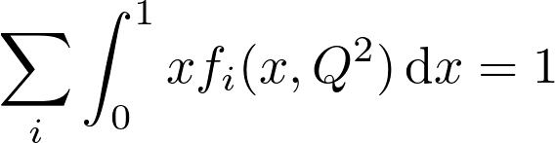
Sum rules
Some “facts” to be recovered from PDFs (model-independent)
Sum over parton momentum fractions is 1
Proton = uud
Proton has charge +1

Slide 8
Ellis-Jaffe (EJ) sum rule
Other sum rules are derived assuming a particular parton model
Note: this is the QCD corrected sum rule

Slide 9
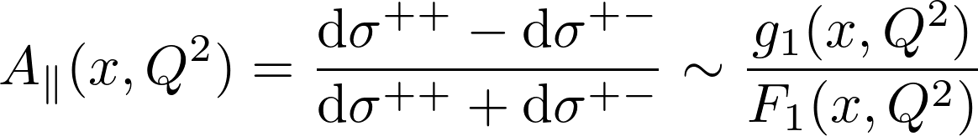
EMC determination of g1
EMC = European Muon Collaboration
Experimental check of EJ sum rule to determine validity of quark model
Measure asymmetry – extract g1, integrate over x, and compare …

Slide 10
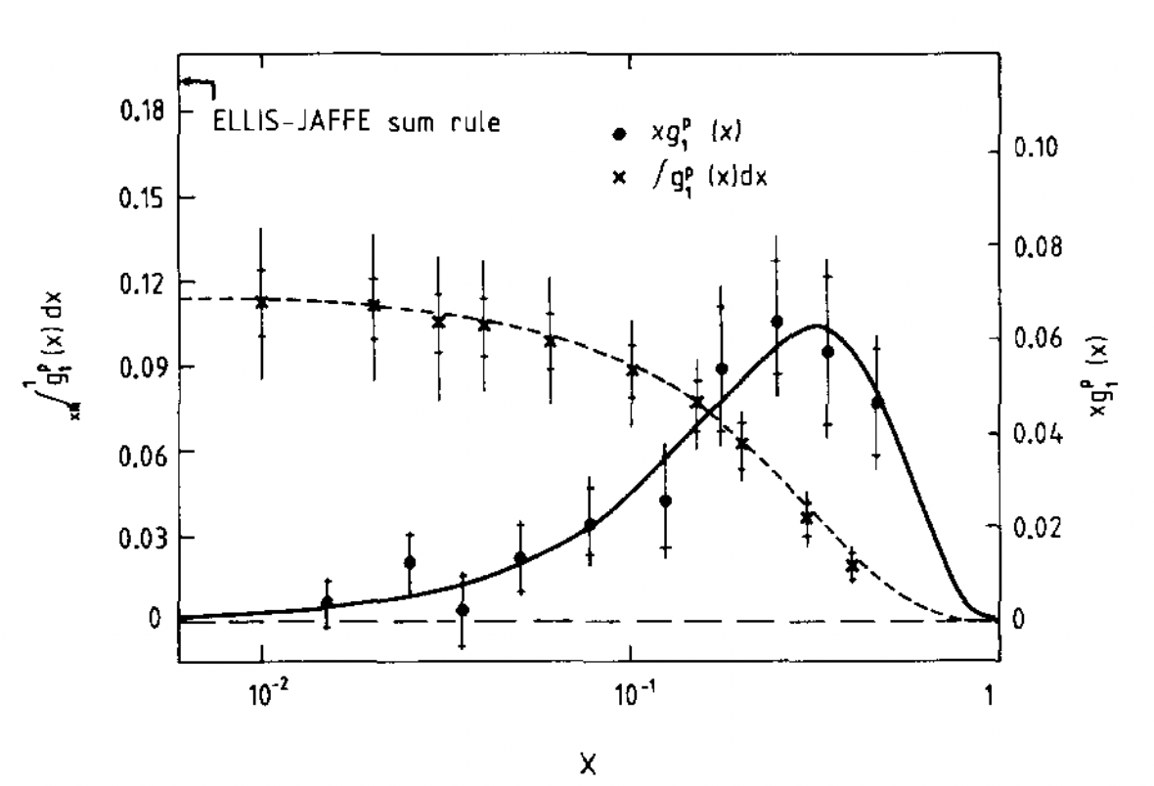
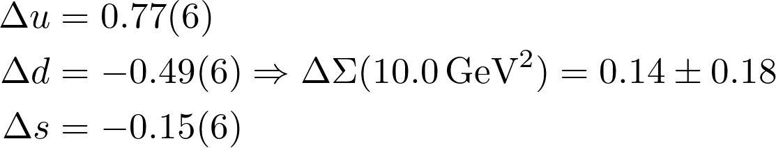
EMC results
Overall findings:
Poor agreement with EJ sum rule
Total quark spin contribution consistent with zero
Large negative strange polarization

Slide 11
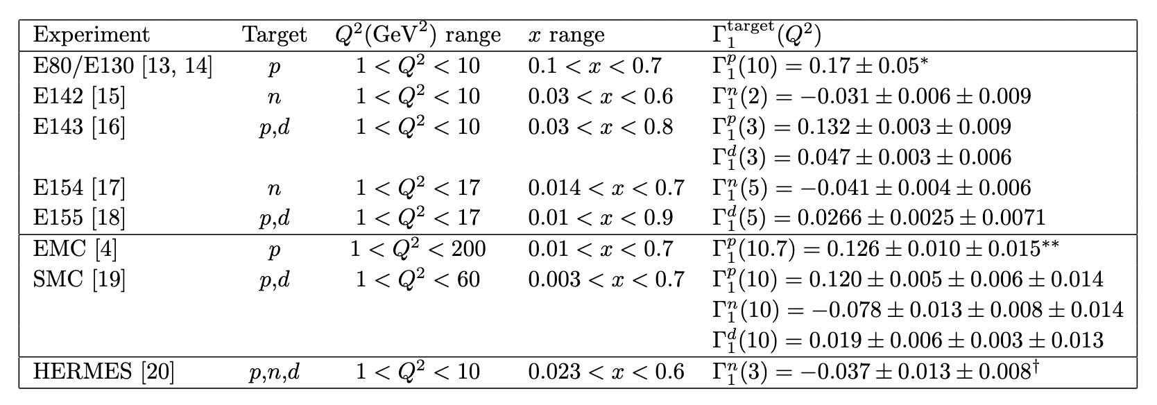
Verification of the EMC result
Other experiments (CERN, HERMES, SLAC) have confirmed the EMC result of the small quark spin contribution at precise confidence level

Slide 12
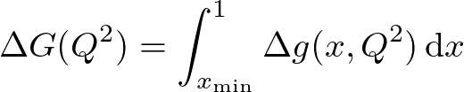
What does this mean?
Proton quark spin content is well established now
Only roughly 30% of the total proton angular momentum
Still not fully established how individual quarks contribute
Rest of angular momentum from gluon spin or in quark/gluon orbital angular momentum
Gluon spin:
Angular momentum of quarks and gluons contained in generalized parton densities (GPDs)

Slide 13
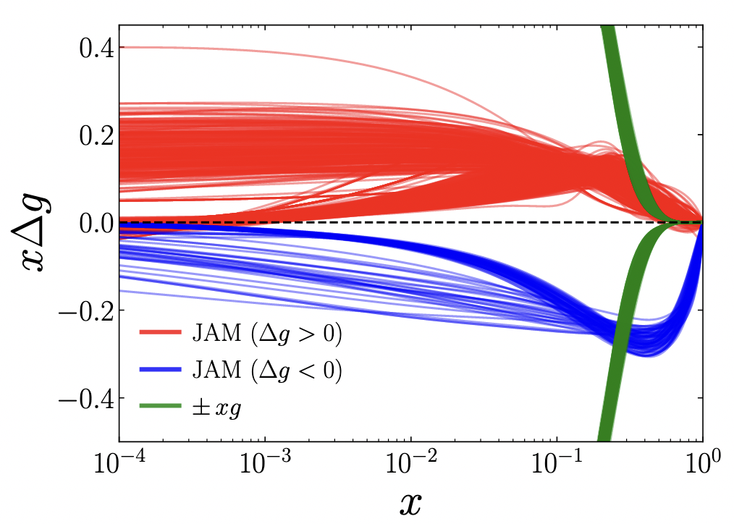
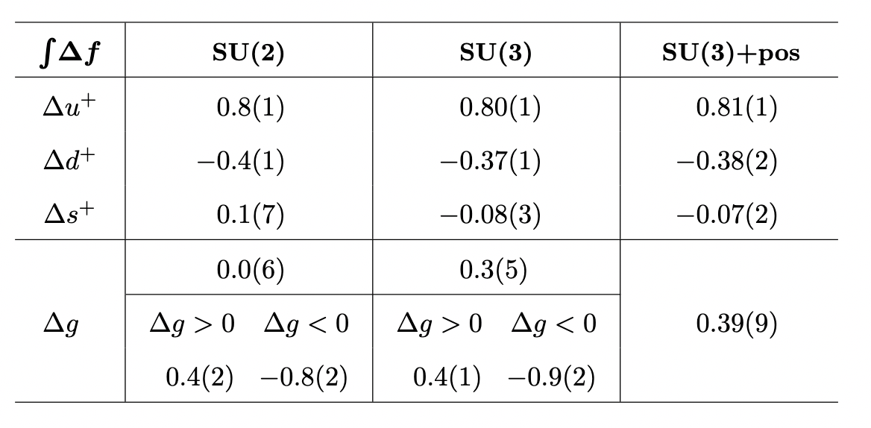
Gluon polarization – theory
This is a hot area right now
Lattice work indicates about 50% of spin budget allocated to gluons
Perturbative work has hit a bit of a snag recently

Slide 14
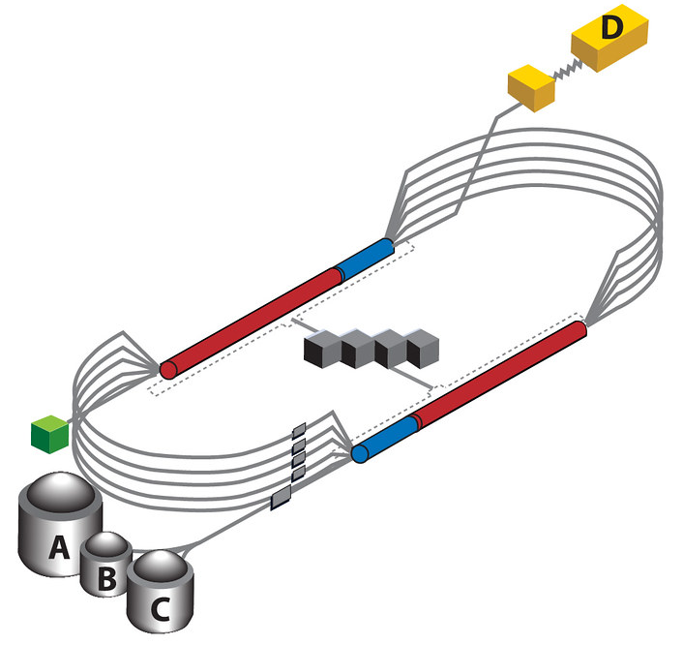
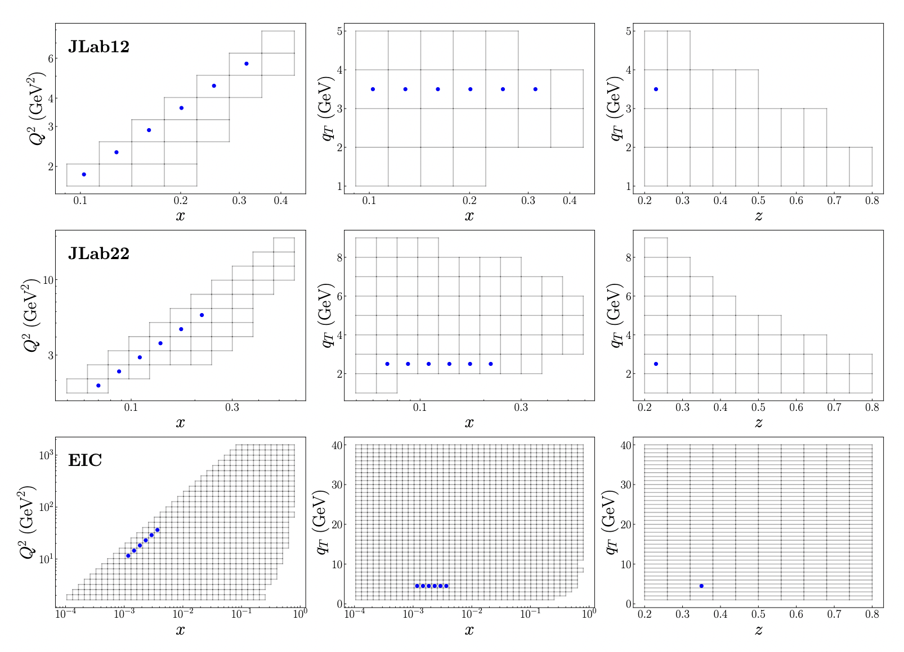
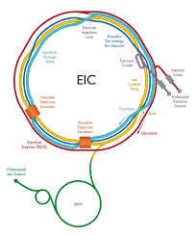
Gluon polarization – experiment
Future experiments will pin down gluon spin contribution precisely in the next couple decades

Slide 15
Summary
Modern accelerators/colliders give insight into proton substructure
EMC collaboration shattered expectation that quark spin dominates proton spin
Current work looking into gluon polarization and GPDs
Exciting progress to be made at EIC and JLab for DIS experiments in next few decades

