Slide 1
The Born Approximation in Nonrelativistic Quantum Scattering
Richard Whitehill

Slide 2
Why is scattering interesting?
Scattering has been one of the most fruitful methods by which we learn about fundamental particles and composite systems
Rutherford (basic atomic structure)
Deep inelastic scattering (confirmation of existence of quarks, nuclear structure)
Higgs (discovery of Higgs boson – mass in Standard model)
There are several facilities internationally dedicated to scattering experiments (large structures, expensive)

Slide 3
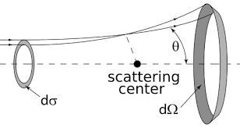
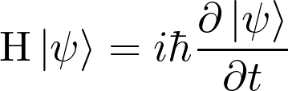
Motivation
Desired quantity: (differential) cross section
Classical: concrete particles interacting via potential
Quantum: wavefunction formalism

Slide 4
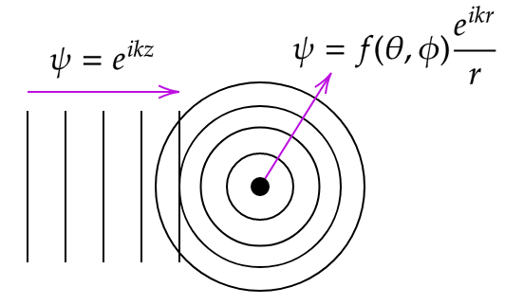
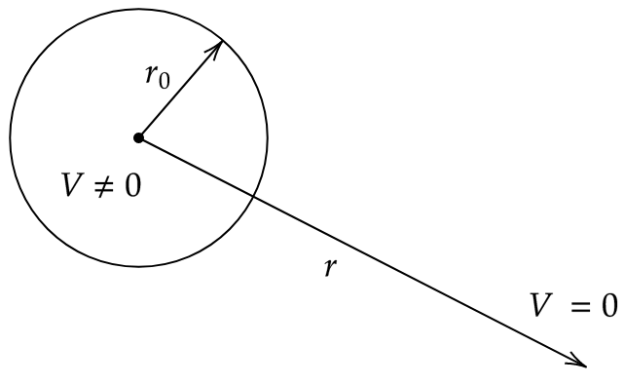
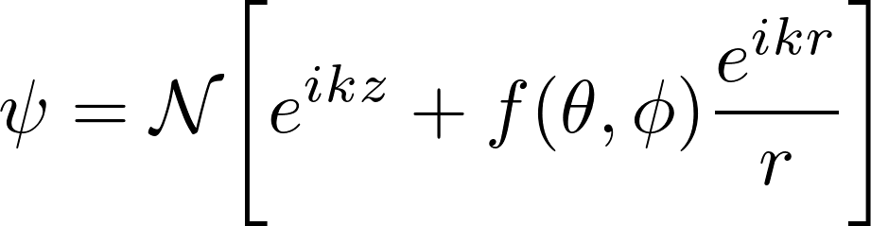
Wavefunction setup

Slide 5
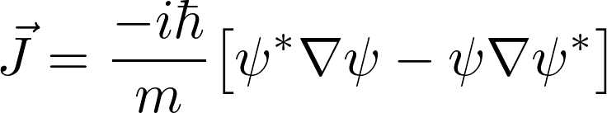
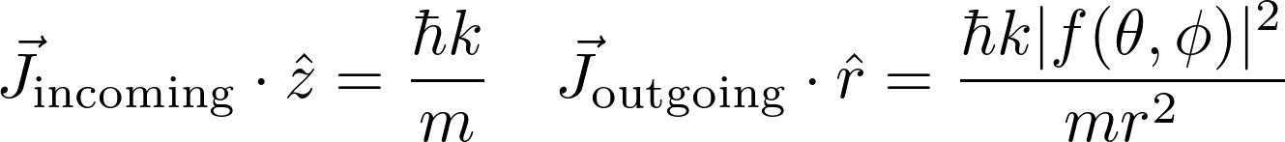
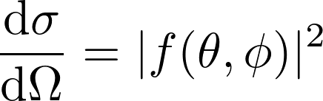
Wavefunction to differential cross section

Slide 6
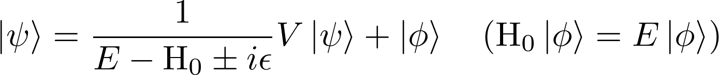
Setting up the problem
Hamiltonian = free particle + interaction potential as perturbation
Solution (kind of): Lippman-Schwinger equation

Slide 7
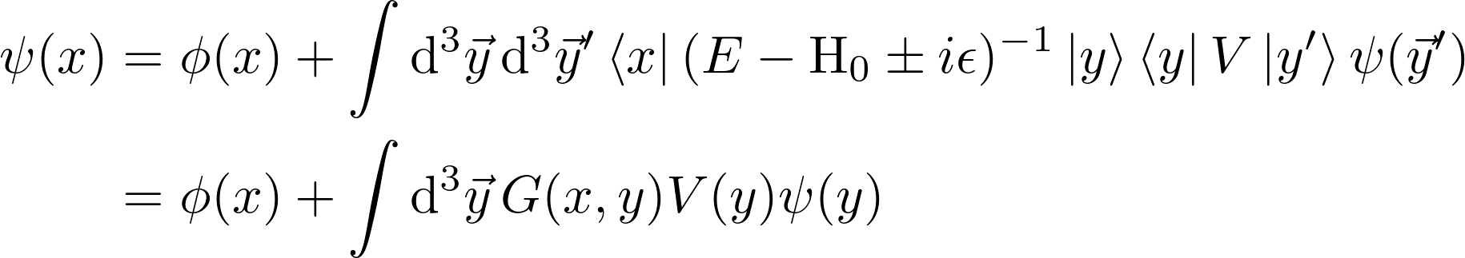
Wavefunction in position space
Insert complete set of position states (twice)
We now need determine the function G (potential is specified)

Slide 8
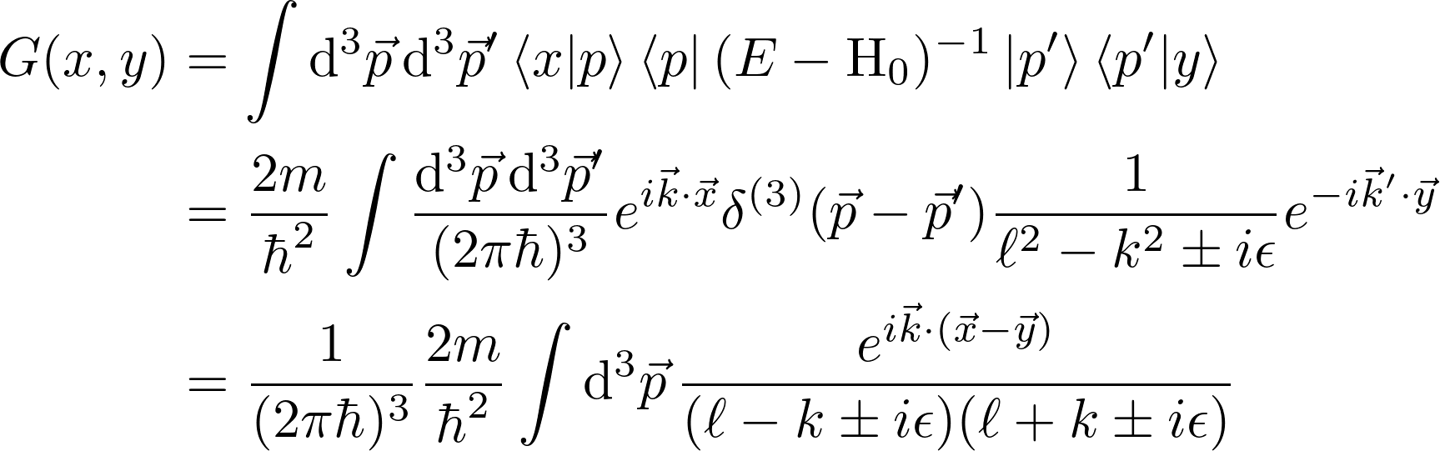
Determining the Green’s function (part 1)
Note:

Slide 9
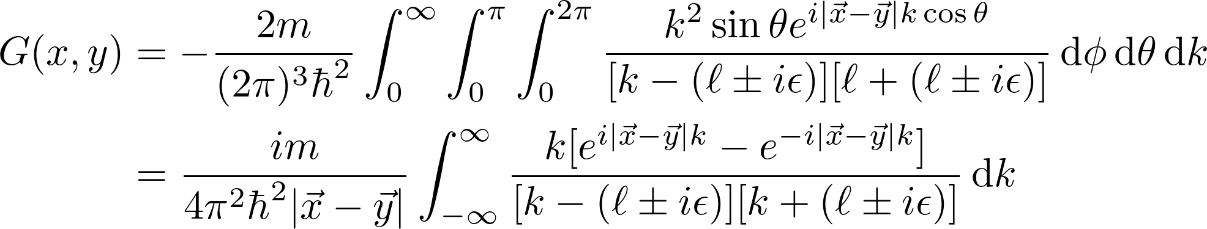
Determining the Green’s function (part 2)

Slide 10
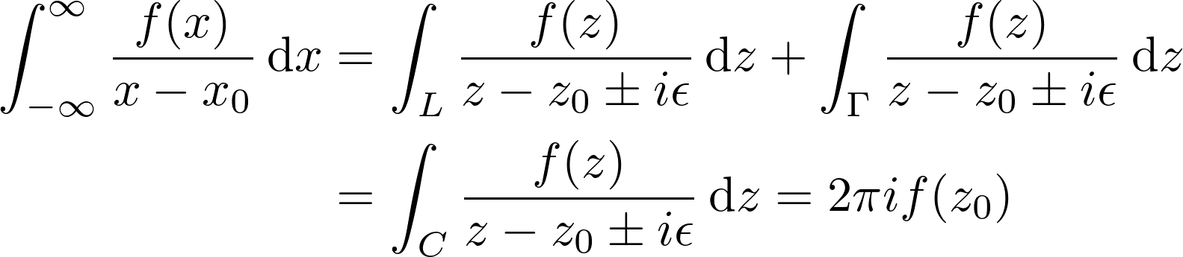
Determining the Green’s function (part 3)
At this point we have to choose how we want to shift the poles
Mathematically: influences what integration contour we choose
Need to enclose pole and choose proper ghost contour
Physically: “+” corresponds to outgoing waves and “-” corresponds to incoming waves
We care about outgoing waves so we choose “+”

Slide 11

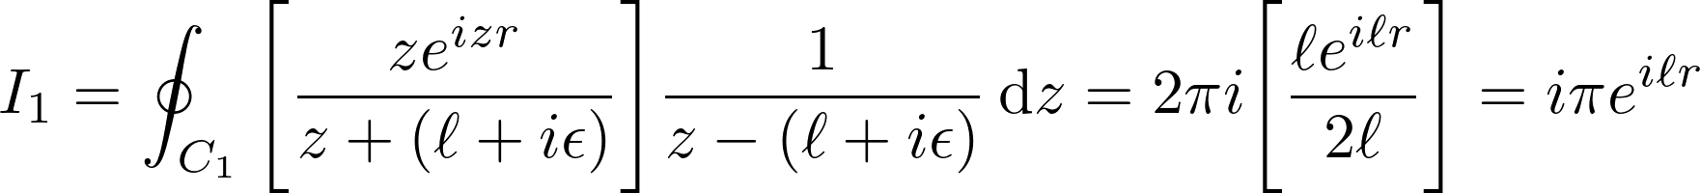
Determining the Green’s function (part 4)

Slide 12
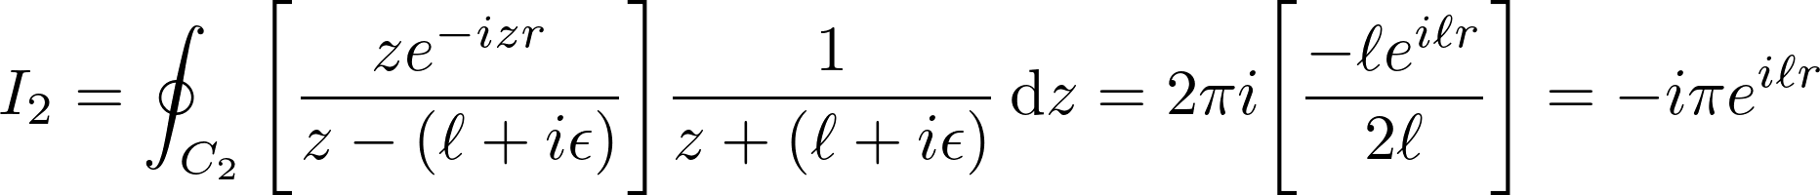

Determining the Green’s function (part 5)

Slide 13
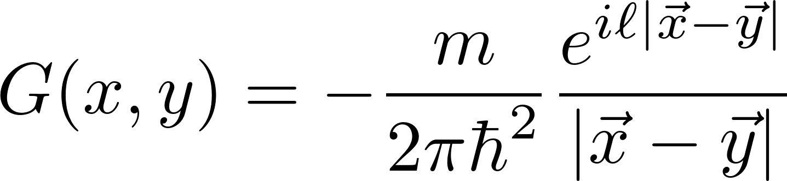
Determining the Green’s function (part 6)

Slide 14
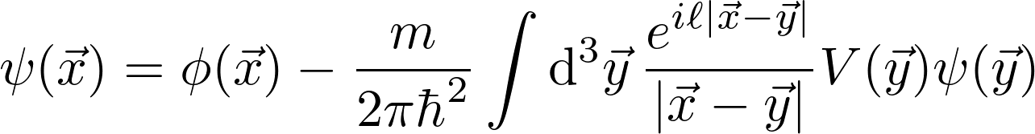
Final notes before the Born approximation
Having found the Green’s function we can write the integral form of the Schrodinger equation
This is still not incredibly useful – we can only calculate the wavefunction with this if we know what the wavefunction is a priori !

Slide 15
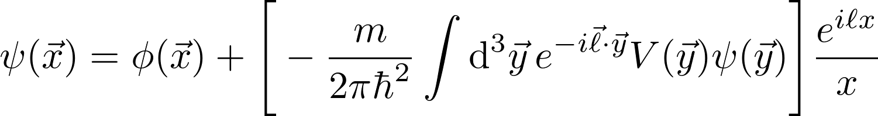
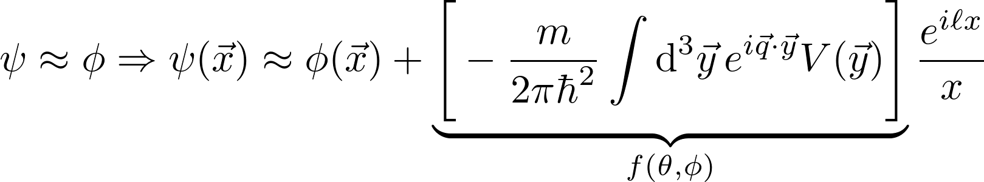
The first Born approximation
We care about the potential far from the interaction region
Now for the approximation: assume that the incoming wavefunction is not significantly altered after interacting with the target

Slide 16
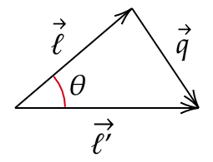

What is q?
Momentum transfer
Remember: wavenumber not changed but direction of propagation is

Slide 17
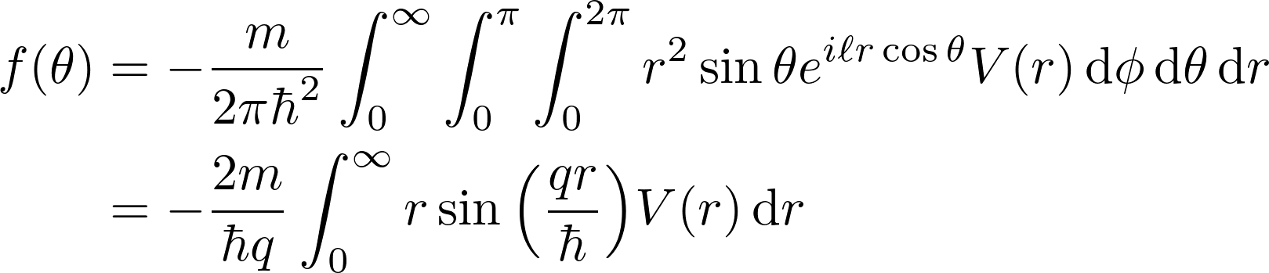
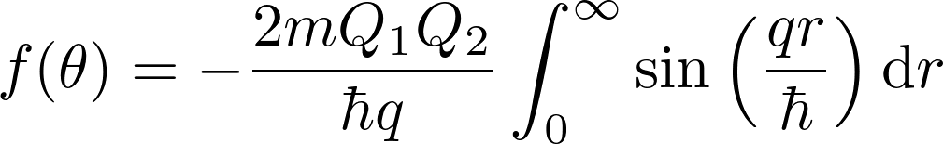
Interlude: Rutherford scattering (part 1)
Scattering amplitude for spherically symmetric potentials:
And now for the Coulomb potential

Slide 18
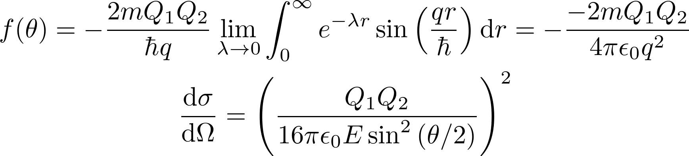
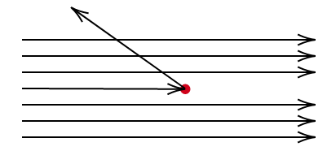
Interlude: Rutherford scattering (part 2)
Since that integral diverges, let’s play a clever mathematical trick

Slide 19
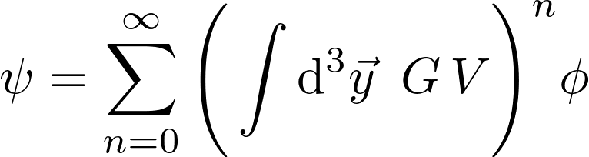
The Born series
Method of successive approximations

Slide 20
Final remarks
Born approximation provides way to calculate scattering amplitudes for cases where incoming particle energy is large, potential is weak
Continued succession of approximation leads to Born series
Analogous calculations in relativistic QFT similar in spirit/flavor (different because the governing equation is not the Schrodinger equation)

