Slide 1
Effect of Critic and User Scores on players in Video Games
Another Study by Patrick Walsh

Slide 2
Data
Data is from the video game sales dataset on Kaggle
Variables:
| Name | Platform | Year_of_Release | Genre | Publisher | NA_players | EU_players | JP_players | Other_players | Global_players | Critic_Score | Critic_Count | User_Score | User_Count | Developer | Rating
https://www.kaggle.com/datasets/gregorut/videogamesales

Slide 3
Theory of Data
Video games have increased total global players
Have not retained a total global player increase for titles as time goes on.
increase in user scores have increased consistently over time
total global players for a title do not increase consistently by year.

Slide 4
Argument to Explain
How does critic score relate to North American players?
How does User Score relate to/increase North American players?
Which video game maker benefits the most by critic and user scores?

Slide 5
Descriptive Statistics
Min. : 1 Length:16719 Length:16719 Length:16719 1st Qu.: 4180 Class :character Class :character Class :character Median : 8360 Mode :character Mode :character Mode :character Mean : 8360 3rd Qu.:12540 Max. :16719
Length:16719 Length:16719 Min. : 0.0000 Min. : 0.000 Class :character Class :character 1st Qu.: 0.0000 1st Qu.: 0.000 Mode :character Mode :character Median : 0.0800 Median : 0.020 Mean : 0.2633 Mean : 0.145 3rd Qu.: 0.2400 3rd Qu.: 0.110 Max. :41.3600 Max. :28.960

Slide 6
Decriptive Statistics, cont
Min. : 0.0000 Min. : 0.00000 Min. : 0.0100 Min. :13.00 1st Qu.: 0.0000 1st Qu.: 0.00000 1st Qu.: 0.0600 1st Qu.:60.00 Median : 0.0000 Median : 0.01000 Median : 0.1700 Median :71.00 Mean : 0.0776 Mean : 0.04733 Mean : 0.5335 Mean :68.97 3rd Qu.: 0.0400 3rd Qu.: 0.03000 3rd Qu.: 0.4700 3rd Qu.:79.00 Max. :10.2200 Max. :10.57000 Max. :82.5300 Max. :98.00

Slide 7
Coefficients: Estimate Std. Error t value Pr(>|t|) (Intercept) -0.7149775 0.0486996 -14.68 <2e-16 *** Critic_Score 0.0154849 0.0006921 22.37 <2e-16

Slide 8
Coefficients: Estimate Std. Error t value Pr(>|t|) (Intercept) 3.099e-01 1.072e-02 28.90 <2e-16 *** User_Count 4.065e-04 1.835e-05 22.15 <2e-16 ***

Slide 9


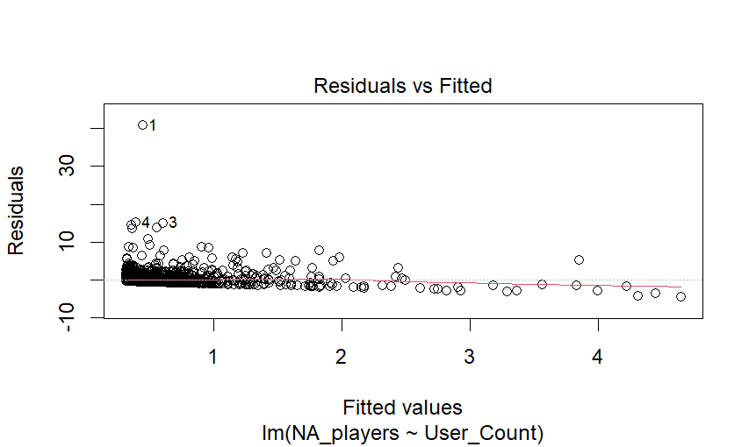
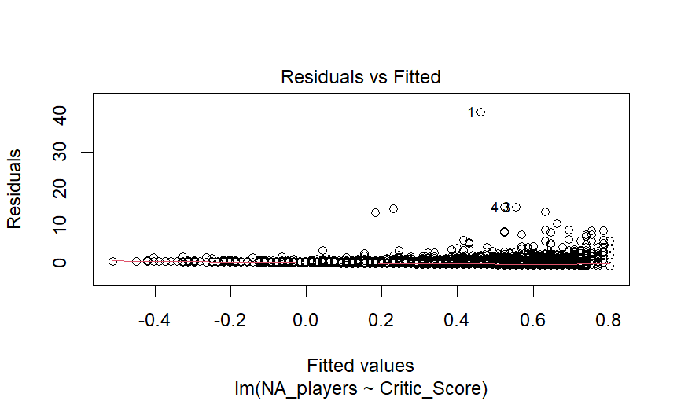
Owner
rwhiting1979 commented 2 days ago
Pull request successfully merged and closed
You’re all set—th branch can be safely deleted.
Add heading textAdd bold text, <Ctrl+b>Add italic text, <Ctrl+i>
Add a quote, <Ctrl+Shift+.>Add code, <Ctrl+e>Add a link, <Ctrl+k>
Add a bulleted list, <Ctrl+Shift+8>Add a numbered list, <Ctrl+Shift+7>Add a task list, <Ctrl+Shift+l>
Directly mention a user or teamReference an issue, pull request, or discussionAdd saved reply
Attach files by dragging & dropping, selecting or pasting them.Styling with Markdown is supported
Remember, contributions to this repository should follow our GitHub Community Guidelines.
ProTip! Add .patch or .diff to the end of URLs for Git’s plaintext views.
Reviewers
rwhiting1979
AssigneesNo one—
Labels
None yet
Projects
None yet
MilestoneNo milestone
Development
Successfully merging this pull request may close these issues.
None yet
Notifications
Customize
You’re receiving notifications because you authored the thread.
2 participants
Lock conversation
The graphs look awesome

