Slide 1


FACULTY OF COMPUTERS AND INFORMATION LUXOR UNIVERSITY
Artificial Intelligence Project

Slide 2
Pac-Man Maze
Youssif Mohamed
Rwida Gabber
Manal Sayed Ahmed

Slide 3
AGENDA
Problem Formulation
AI Algorithms
Project Execution

Slide 4
PROBLEM FORMULATION
Problem Definition
Agent Specification (PEAS )
Problem Formulation (Start State, Goal State ,Search space, Actions, Path Cost)
Task Environment

Slide 5
PROBLEM DEFINITION
Design a Pac-Man to navigate a maze with obstacles, optimizing for the shortest time and steps to reach the goal.

Slide 6
AGENT SPECIFICATION
-Performance: Successful arrival to the goal with the shortest path and time
-Environment: maze with walls, open paths, starting point(player) and goal(white point)
-Actuators: Move up, down, left, or right; algorithmic actions for pac-man-maze-solving.
-Sensors: mouse

Slide 7
PROBLEM FORMULATION
-Start state: Initial configuration of the maze with the pac-man at the starting point.
-Goal state: Pac-Man reaches the goal position in the maze
-Search space: Possible configurations of the agent in the maze and its potential actions.
-Actions: Up, Down, Left, Right.
-Path cost: 1 for each movement.

Slide 8
TASK ENVIRONMENT
-Fully observable
- Deterministic
- Static
- Discrete
- single agent.

Slide 9
AI ALGORITHMS
List The Algorithms Used To Solve The Problem
Comparison Between Used Algorithms In Solving The Problem (Based on your running represent: Time, Space, Optimality, Completeness)

Slide 10
ALGORITHMS USED TO SOLVE THE PROBLEM
1- BFS: Breadth First Search.
2- DFS: Depth First Search.
3- UCS: Uniform Cost Search.
4- Greedy Best First Search.
5- A*

Slide 11
ALGORITHMS COMPARISON
 | BFS | DFS | UCS | Greedy | A*
Completeness | Yes | Yes | Yes | Yes | Yes
Optimality | Yes | No | Yes | No | Yes
Time | O(b ^ d) | O(b ^ m) | O(b^1+[c/E]) | O(b ^ m) | O(b ^ d)
Space | O(b ^ d) | O(bm) | O(b^1+[c/E]) | O(b ^ m) | O(b ^ d)

Slide 12
PROJECT EXECUTION
Represent you project (Running, Code, Video/Screenshots, etc.)
Pacman-Maze.ipynb

Slide 13
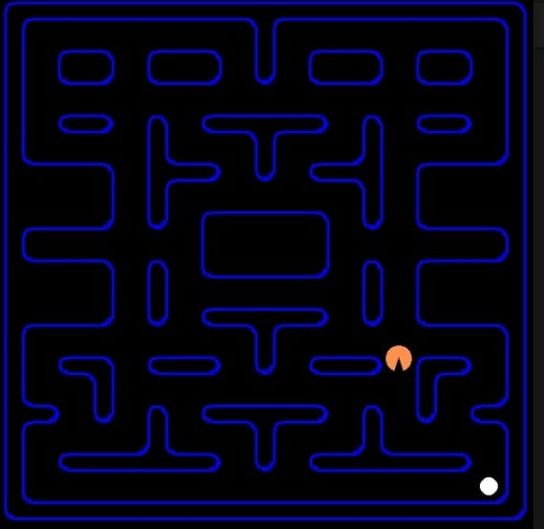
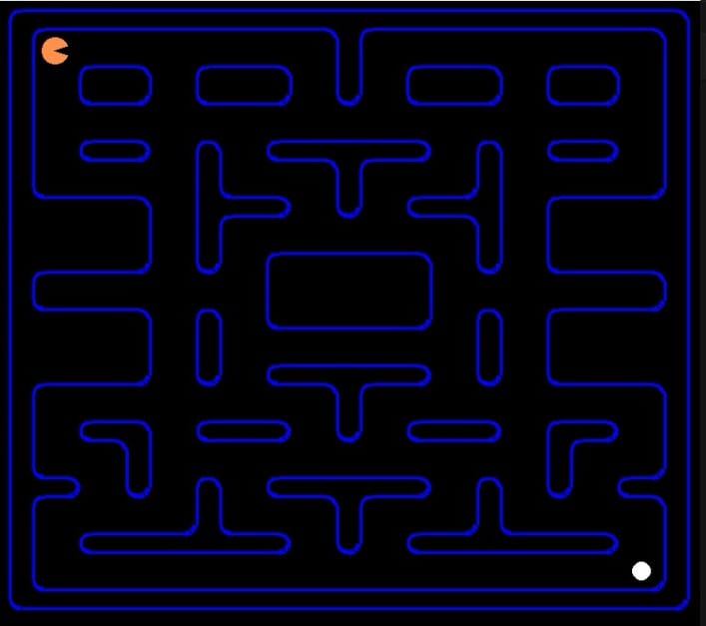
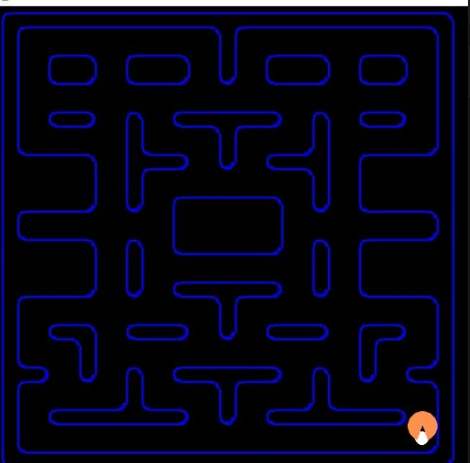
PROJECT REPRESENTATION

Slide 14
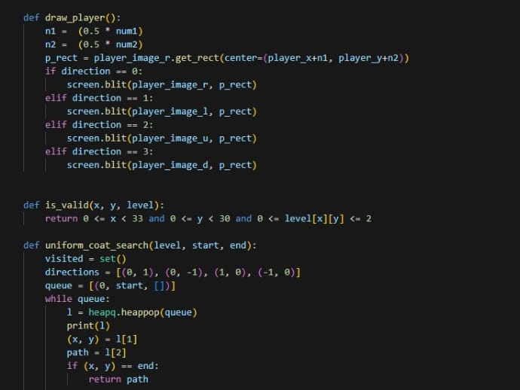
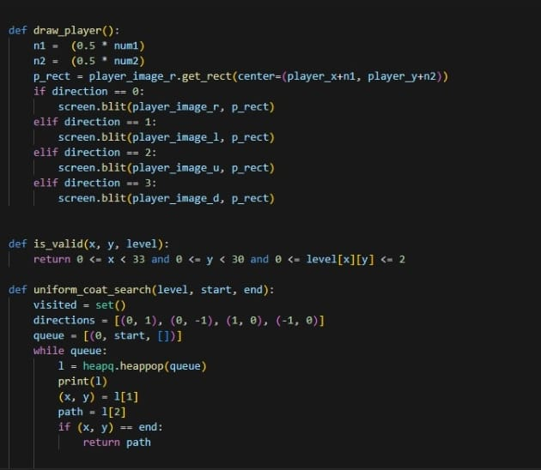
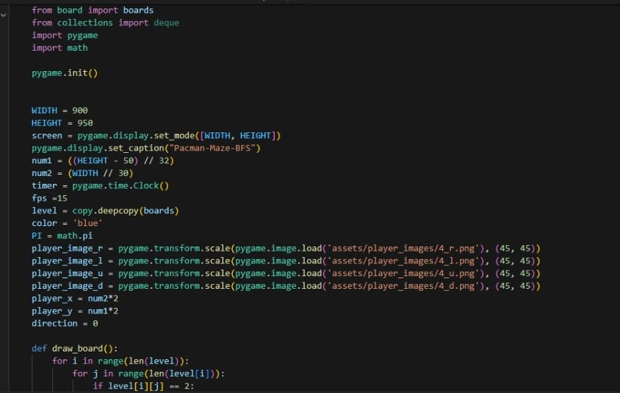
PROJECT REPRESENTATION

