Slide 1
Bridging Cultures
MEDIACOLLEGE AMSTERDAM × LBS KREATIVA GYMNASIET STOCKHOLM
A shared platform for games, photos and cultural discoveries
Amsterdam
Stockholm
Notes:
Welcome. This is the pitch for the full stack team: what we are building, how it works, and how we will get it done across three phases. About 1,130 km separate the two cities; the platform is the bridge.

Slide 2
One platform for the whole collaboration
23
2
4
40 h
students from two schools
cities, one shared site
modules to build
in three phases
Game developers, artists, media producers and full stack developers make games, a documentary and a website. Our team builds the website: the public face of the whole project.
Dutch and Swedish visual culture
Ready to hand over to next year
Bridging Cultures · Full stack team
Notes:
An Erasmus+ collaboration between Mediacollege Amsterdam and LBS Kreativa Gymnasiet in Stockholm. Around 23 students work together across in-person and online phases. Our job is the platform that ties it together, and it has to look polished, reflect both visual cultures, and be solid enough to hand over to the next cohort.

Slide 3
Four modules, one database
PUBLIC
STUDENTS AND PUBLIC
Game Showcase
Prikbord
A landing page per game with credits, media and a play or download link.
A shared feed of photos and messages, tagged by city or game, with reactions.
STUDENTS AND PUBLIC · STANDOUT
TEACHERS AND STUDENTS
AI Culture Companion
CMS
A city tag becomes three cultural facts and three caption suggestions.
Manage game pages, moderate posts and edit AI-generated content.
Bridging Cultures · Full stack team
Notes:
Three modules face the public and one is for admins. The AI Culture Companion is the most distinctive feature and where our AI skills come in. All four share one MySQL database.

Slide 4

From a city tag to a Culture Wall
1
2
3
4
5
A student posts a photo and tags it Amsterdam or Stockholm.
The Node.js backend sends the tag to the API with a project prompt.
The API returns JSON: three facts (weetjes) and three captions.
The student picks or edits a caption, then publishes.
The facts join the Culture Wall, which grows all project.
{ "city": "Stockholm",
"facts": [ "…", "…", "…" ],
"captions": [ "…", "…", "…" ] }
The API key stays on the server and never reaches the browser.
Bridging Cultures · Full stack team
Notes:
This is the flow end to end. The student stays in control: the AI suggests, the student picks or edits, and teachers can still moderate the facts in the CMS. The call to the AI API happens server-side in Node.js, so the key is never exposed on the client.

Slide 5
Technical architecture
Layer | Technology | Responsibility
Frontend | HTML + CSS | All public pages, responsive layout
Admin / CMS | PHP | Game pages, users, moderation, session login
Database | MySQL | Users, games, posts, comments, facts, one shared database
AI integration | Node.js + API | Called server-side only, key never on the client
File storage | Server filesystem | Uploaded images in /uploads, served as static files
No framework is required, but frameworks are allowed to simplify the work.
Bridging Cultures · Full stack team
Notes:
Node.js handles the API and the AI call, PHP handles the CMS with session-based authentication, and both talk to the same MySQL database. Images live in /uploads on the server. No framework is required, but we may use one.

Slide 6
A clickable prototype of all four modules
Game Showcase
Game cards with credits and badges, edited live from the CMS.
Prikbord
Photo feed filtered by city or game, with working reactions.
Culture Companion
Pick a city, get three facts and three captions, publish to the board and the Culture Wall.
CMS
Hide a post and it leaves the board. Approve or hide AI facts.
Sample data only. The AI answers are canned; the real call runs on the Node.js server.
Bridging Cultures · Full stack team
Notes:
This is the test site we built as a starting point: one HTML file with sample games, posts and facts. The CMS actions really change what the public sections show, so you can see the moderation flow. The AI responses are canned because the key must stay on the server.

Slide 7
Three phases, about 40 hours
Phase | When | Where | Focus | Deliverable | Hours
1 | 10–12 Nov* | Amsterdam | Setup, database, CMS skeleton, static pages | Static pages on a public URL, schema defined, basic design | ± 12
2 | 27 and 28 Jan, 3 and 4 Feb | Online | Bulletin board, AI integration, Culture Wall, testing | All four modules working, board live with real content | ± 22
3 | 20–22 Apr | Stockholm | Polish, bug fixes, pitch, postmortem | Written reflection: what worked, what did not, what we change | ± 6
*The brief says 10–12 Nov on page 1 and 11–13 Nov on page 4. To be confirmed with the teacher.
Notes:
Most of the work, about 22 hours, happens online in phase 2, so what we set up in Amsterdam has to make remote work easy. The phase 1 dates differ between two pages of the brief, so confirm them.

Slide 8
Suggested task split
ANNA-MARIA
RENS & DAIMIEN
BUSH “Konstantin”
Backend lead
CMS and PHP
Frontend
Node.js API, Claude integration, image upload, database schema
Admin panel, game pages, user login, moderation tools
Public HTML and CSS pages, responsive layout, Culture Wall display
OLLE
THIMOTHY
Bulletin board
AI and integration
Post flow, comments, tag filtering, reactions
Prompt engineering, facts database, caption UI, Culture Wall logic
**The brief lists Student D twice; the second is read here as E. The split is a starting point.
Notes:
The brief gives a possible split for five to seven students. In practice we overlap and help each other, but each of us needs to be able to articulate what we built individually. The brief lists Student D twice, so check the letters on the day.

Slide 10
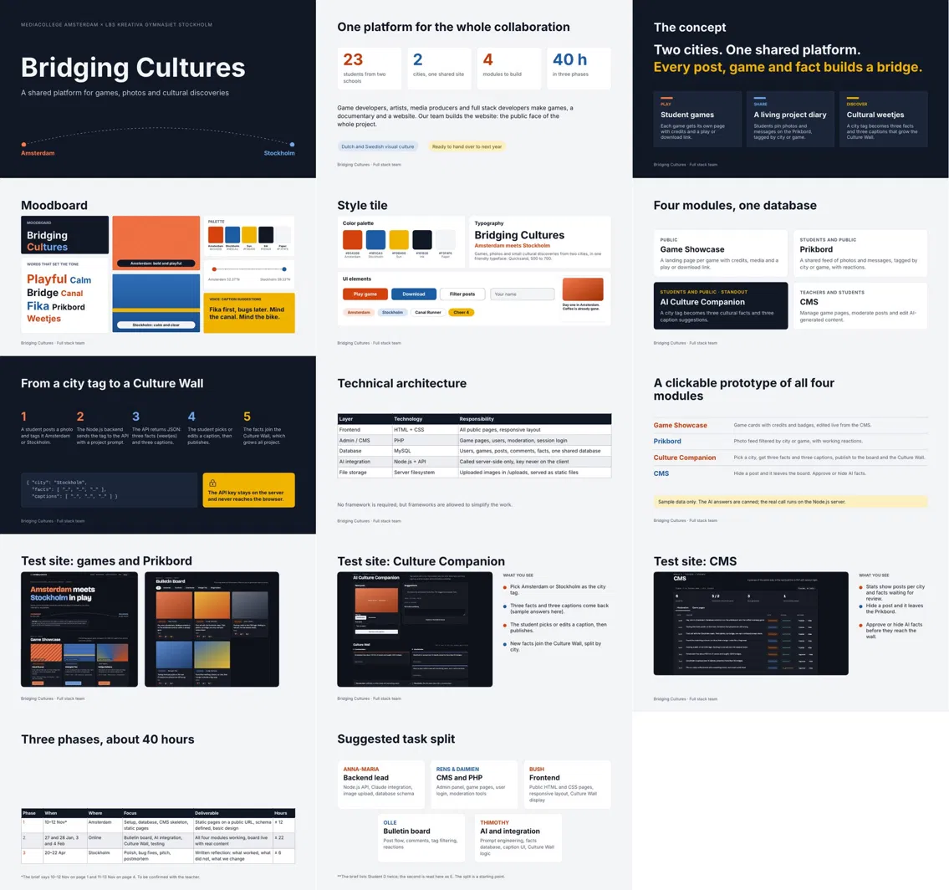
REFERENCE BOARD
Pitch
overview
The project concept, visual direction, modules and prototype in one view.
Bridging Cultures · Full stack team

