Slide 1
Getting Started with Spring Security 3.2
Rob Winch, Pivotal
@rob_winch

Slide 2
Agenda
Introductions
What’s new in Spring Security 3.2
Demo and live coding
Sneak peak at Spring Security 4

Slide 3

About Me
Open Source fanatic
Employed by Pivotal
Spring Security & Spring LDAP Project Lead
Committer on Spring Framework
Co-author of Spring Security 3.1 book
Twitter @rob_winch

Slide 4


$ curl -I
HTTP/1.1 301 Moved Permanently
Location:

Slide 5


















Slide 6


gopivotal.com
@gopivotal

Slide 7

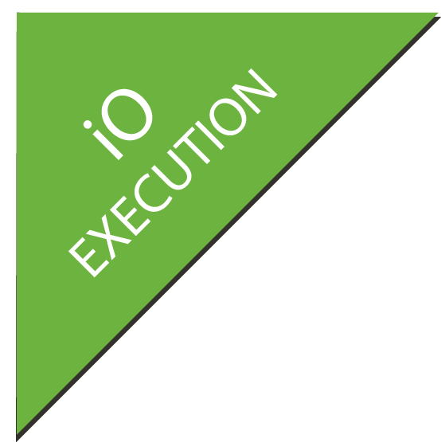















Why do Java Developers choose Spring today?
XD
BOOT
GRAILS
Stream, Taps, Jobs
Bootable, Minimal, Ops-Ready
Full-stack, Web
INTEGRATION
BATCH
BIG DATA
WEB
Big,
Fast,
Flexible
Data
Channels, Adapters,
Filters, Transformers
Jobs, Steps,
Readers, Writers
Ingestion, Export,
Orchestration, Hadoop
Controllers, REST,
WebSocket
Web,
Integration,
Batch
DATA
RELATIONAL
NON-RELATIONAL
CORE
FRAMEWORK
SECURITY
GROOVY
REACTOR

Slide 8
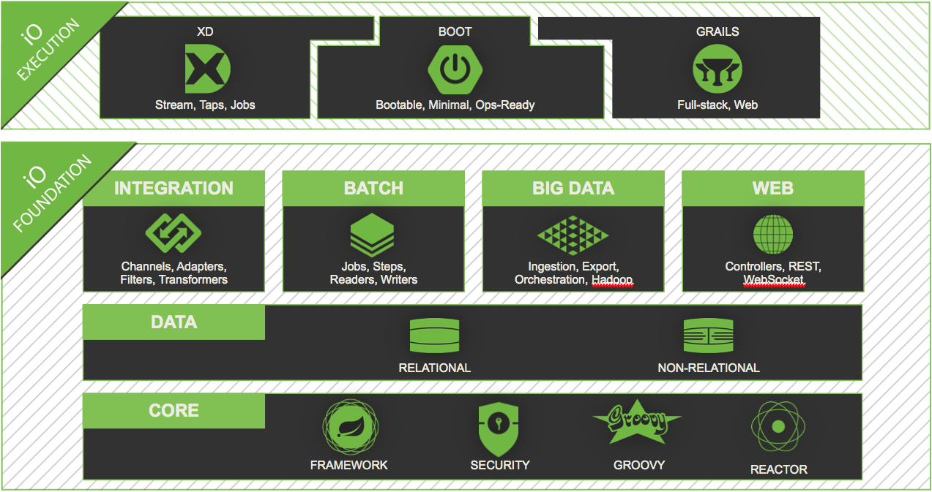

SPRING IO CORE:
Spring Security

Slide 9
What is Spring Security?
Comprehensive support for Authentication and Authorization
Protection against common attacks
Servlet API integration
Optional integration with Spring MVC
Portability

Slide 10
New in Spring Security 3.2
Servlet 3 and Servlet 3.1 integration
Concurrency Support
Spring MVC integration
CSRF protection
Security header integration
Java Configuration support

Slide 11

SPRING SECURITY
Notes:
Unsecured
Hello Security – Display username / logout
Custom Login Page
H2
CSRF
Clickjack
Sign up
JDBC w/ default schema
JDBC w/ custom schema
BCrypt
Custom Authentication
Access current user (@CurrentUser, HttpServletRequest)
@PostAuthorize
MessagePermissionEvaluator
Testing

Slide 12
Learn More. Stay Connected.
Source http://github.com/rwinch/gs-spring-security-3.2
http://spring.io/spring-security
Twitter: @SpringSecurity @SpringCentral @rob_winch

