Slide 1
Ford Motor Company - Monetization Platform
April 2018

Slide 2
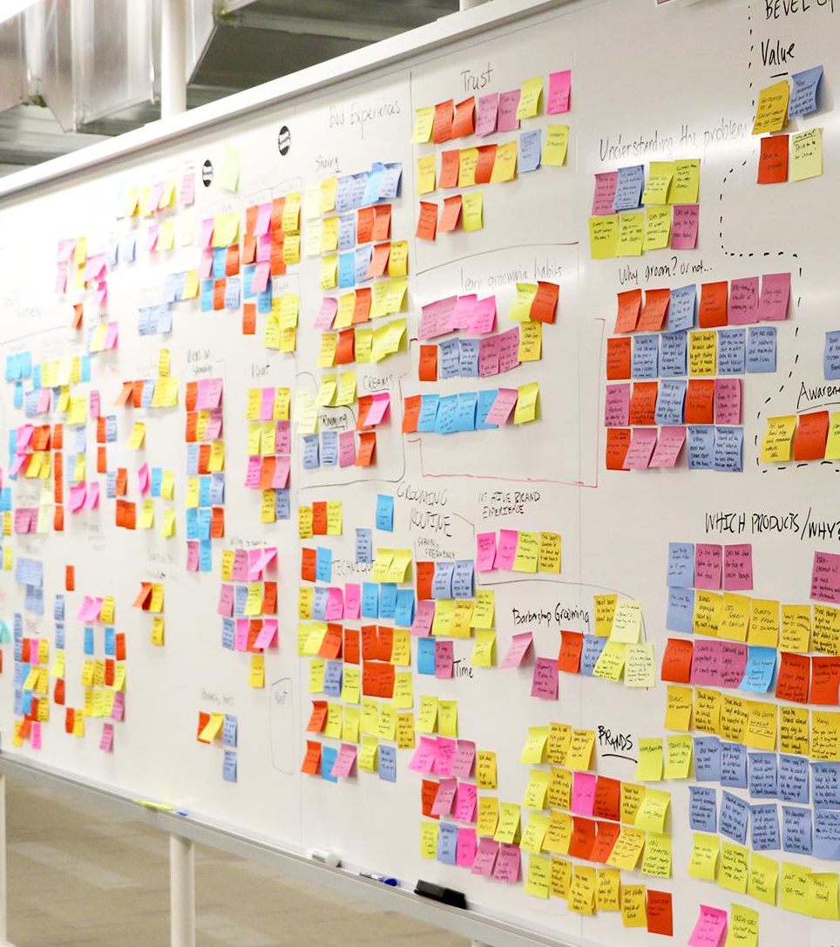
Agenda
Ford’s Monetization Platform – Key Drivers
Platform Features
Logical Architecture
Key Solution Features
Development Practices
Q+A

Slide 3

Key Drivers
Develop Business Capabilities that are required to execute its business model or fulfill its mission using people, process, and/or technology
Adaptable architecture, responsive to changes in business and technologies
Common solution for easier and holistic integration of business capabilities across the value stream globally
Reduce cost by reusing data, processes, services, and standards
Lifecycle
Discover / Manage
Support / Service
Market
Connected Consumer
Bill / Pay
Shop / Buy
Order / Fulfil
Use
Notes:
So we know what were moving away from. What models can we look to as examples of something to emulate? Netflix, The Gilt Groupe, and Twitter are examples of some of the recognized leaders in pioneering micro service architecture successfully. Their proof positive of the kind of innovation the scalability and the resiliency that we can achieve using micro services and a more practical level we can learn from patterns that have enabled these companies to employ micro service architecture successfully and in some cases directly benefit from code that they have made available to the open source community. I’ll give a few examples later on the presentation.
So these images can be inspirational, but they also give us some insight into some new challenges we might face in managing highly distributed micro service architectures.

Slide 4
Platform Features (Subscription Management Operations – Sumo)
Orchestration
Sumo orchestrates Subscription requests across multiple applications and platforms
Orchestration requires overcoming complex integration and sequencing challenges
Scalability
Ensure application is robust and can support high volume demands
Multiple micro-services for decoupling and handling load appropriately
Resiliency
Use of Message queues for Assured delivery
Retries in case of backend unavailability

Slide 5
Platform Features - Continued
Flexible Service Integration
Multiple endpoint supported for each Microservice e.g. Sync, Async
Configurable Workflow
Workflow steps can be configured externally
Seamless Event Monitoring
Status Tracking and Alerts and Notifications for critical errors
Caching
Caching for some network latent operations
Security
Supports OAuth2 using UAA and Azure AD

Slide 6
Logical Architecture
Channels
Backend Systems
B2C
B2B
Auto
Azure AD
SUMO
Vehicle
Pivotal Cloud Foundry
Caching
Reporting
Messaging
Billing
Order
Manager
Offer
Manager
Metering
Hystrix
Account
Manager
User
Subscription
Services
Provisioning
Services
Spring Cloud
Eureka
TCU
AZURE
Sumo DB
(Active)
Sumo DB
(Passive)
Messaging

Slide 7
Caching
Improved Processing Times
Implemented using Caching (Redis)
Data for Network intensive operations cached (Product Catalog Billing Platform)
Cache refreshed every 24 hours
Average Catalog interaction time reduced from an Avg of 5.7 secs to 0.52 seconds

Slide 8
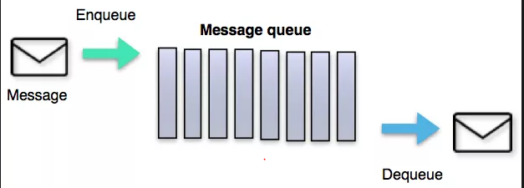

Resiliency
Assured Delivery
Implemented using Message queues (RabbitMQ)
Request queued up for later if a particular backend is down (e.g. DB, Billing, TCU)
Multiple configurable retries
Increases the probability of success manifold
Pivotal Cloud Foundry
Subscription Orchestration
Messaging
RETRY
SUMO DB
8

Slide 9
Configurable Workflow
Workflow configuration
Implementation of industry standard Pipelines
Step is independent plug-n-Play component of pipeline with a specific business function implementation
Each Step can be pre-configured/dynamically executed based on results in Pipeline
Ease of changes in the workflow dynamically
Product Catalog
Product Filtering
Vehicle Capability
Localization
9

Slide 10
Development Practices
TDD
Agile
Pair Programming
CI / CD
2 week Iterations
Daily scrums
IPMs
Retros
Techtros
Lot of Whiteboarding
Team follows Test Driven Development (TDD)
Ensures high quality of code with minimal defects
R0 , PEC, TT Releases : ZERO defects
Pair Programming
Peer Reviews
Ensures high level of collaboration
Continuous coverage in case someone is not available
Automated Build and Deploy Pipelines
Continuous Integration - Frequent Builds/ Deploys
Contract tests built into the pipelines
Automated pipelines ensure no manual intervention
Automated End to End Tests (Feature Tests) are built into the pipeline
Notes:
...and this is what an iteration looks like.

Slide 11
Questions ?

