Slide 1
Spring Boot…
Tweeting complete Spring applications since 2013
Rob Winch, Pivotal
@rob_winch

Slide 2

About Me
Open Source fanatic
Employed by Pivotal
Spring Security & Spring LDAP Project Lead
Committer on Spring Framework
Co-author of Spring Security 3.1 book
Twitter @rob_winch

Slide 3


$ curl -I
HTTP/1.1 301 Moved Permanently
Location:

Slide 4


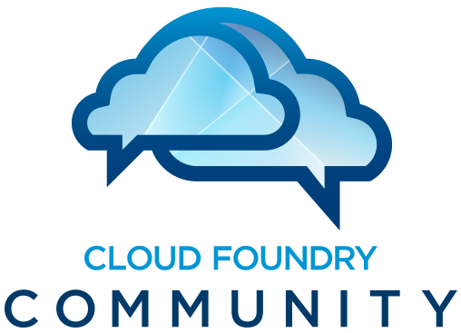















Slide 5


gopivotal.com
@gopivotal

Slide 6

















Why do Java Developers choose Spring today?
XD
BOOT
GRAILS
Stream, Taps, Jobs
Bootable, Minimal, Ops-Ready
Full-stack, Web
INTEGRATION
BATCH
BIG DATA
WEB
Big,
Fast,
Flexible
Data
Channels, Adapters,
Filters, Transformers
Jobs, Steps,
Readers, Writers
Ingestion, Export,
Orchestration, Hadoop
Controllers, REST,
WebSocket
Web,
Integration,
Batch
DATA
RELATIONAL
NON-RELATIONAL
CORE
FRAMEWORK
SECURITY
GROOVY
REACTOR

Slide 7
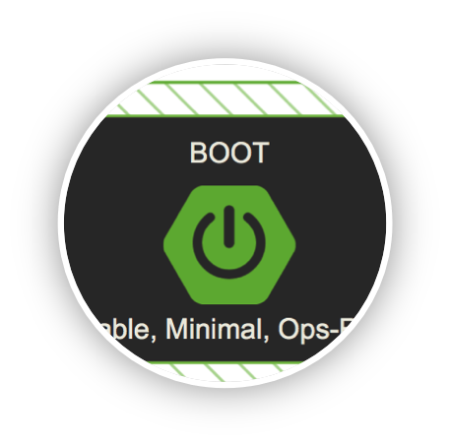
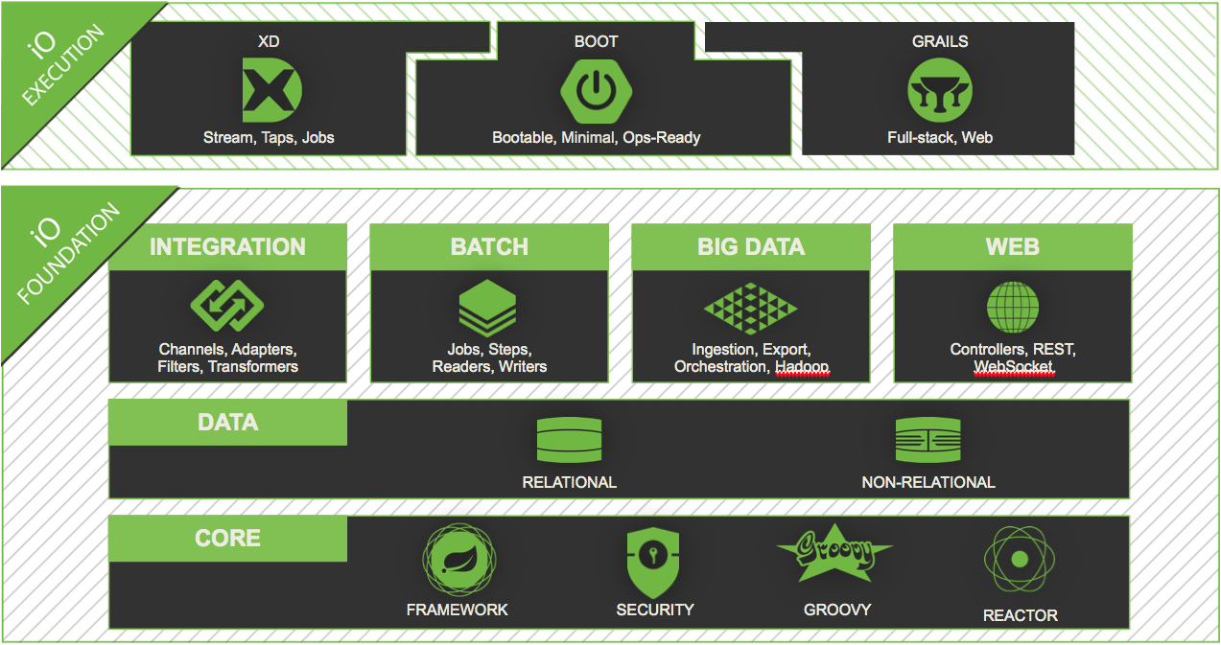
SPRING IO EXECUTION:
Spring Boot

Slide 8
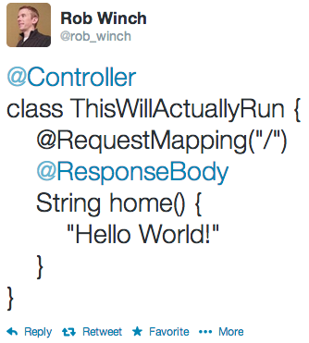
Notes:
This is just a rest endpoint…it became quite popular in the Java community…it was not popular for the poor person with the Twitter handle controller

Slide 9

app.groovy
SPRING BOOT
Notes:
Demo app.groovy
app.jar

Slide 10
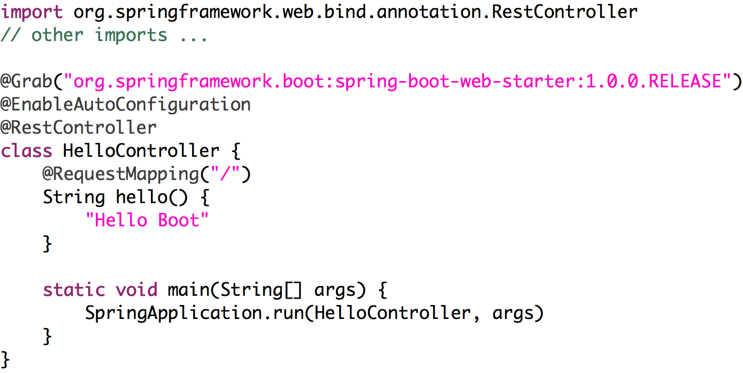
Notes:
12 minutes

Slide 11
Notes:
12 minutes

Slide 12
Notes:
12 minutes

Slide 13
Notes:
12 minutes

Slide 14
Notes:
12 minutes

Slide 15
Application.java
SPRING BOOT
Notes:
_x0010_

Slide 16
Learn More. Stay Connected.
Source https://github.com/rwinch/spring-boot-tcsa
http://spring.io/spring-boot
Twitter: @SpringBoot @SpringCentral @rob_winch

