Slide 1

Simplifying Spring
For Everyone

Slide 2


Slide 3


Slide 4


Slide 5
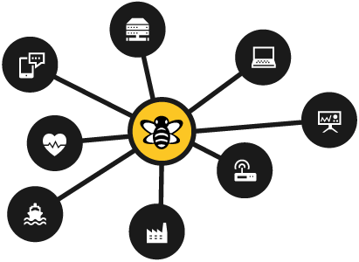
The Heart
Of Your IoT
Solution

