Slide 1

Developed by:
Ved Prakash Dubey
Rwishav Ghosh

Slide 2
Inspiration:
The recent surge in cases of covid-19 due to the second wave of the pandemic has created a crisis within the country. This calls for an analysis of how we've been handling the initial wave, how we are doing currently and what we can potentially do in the future. It is also important to make this information accessible to the people and that is what we aim to do.

Slide 3
Objective:
The aforementioned has been made possible by working with data obtained from API’s, analyzing it thoroughly, and creating vivid and impactful visualizations that are not only appealing to look at but are also important for drawing inferences.
This is has been neatly surmised into a web application with an appealing UI that your average user can use to get a grasp of the situation. We have also integrated a chatbot into our web app that updates the users on location specific pandemic data through simple conversation.

Slide 4
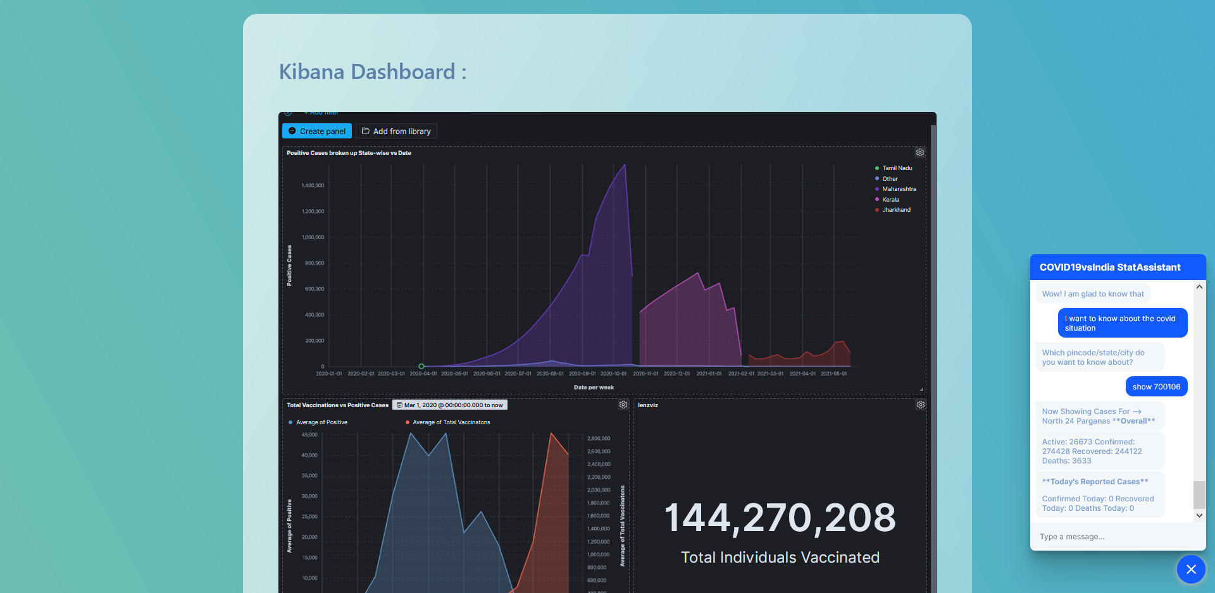
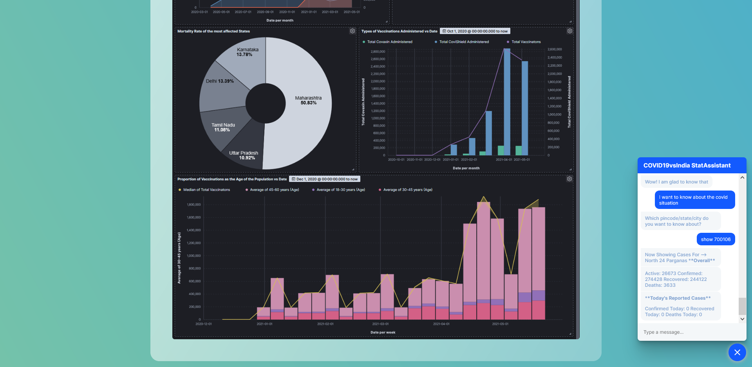
Dashboard:
We implemented Elastic-Kibana into out web app for stylish visualization of the data analysis done using Elasticsearch and ML Modelling

Slide 5
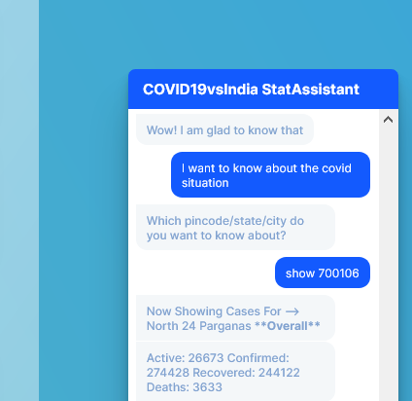
Chatbot:
We even managed to implement an interactive chat bot for ease of data access.
It was incorporated into the program using RASA and is very much capable of low level conversation even beyond its primary focus

Slide 6

Languages & Frameworks:
Python
HTML5
CSS3
JavaScript
Elastic Search
Kibana
Flask
Rasa

Slide 7
In Conclusion:
It has been a thrilling and pleasurable learning experience where we implemented numerous new features we had never worked with before.
Work progressed as planned for the most part except for a few minor hiccups like when we learnt Elastic-Kibana has compatibility issues with Google’s Chrome web browser.
We are grateful to have been able to participate in this event and are proud of what we accomplished irrespective of the results.

Slide 8
Thank You

