Slide 1
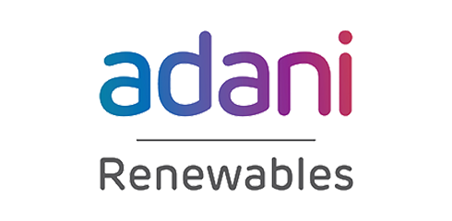
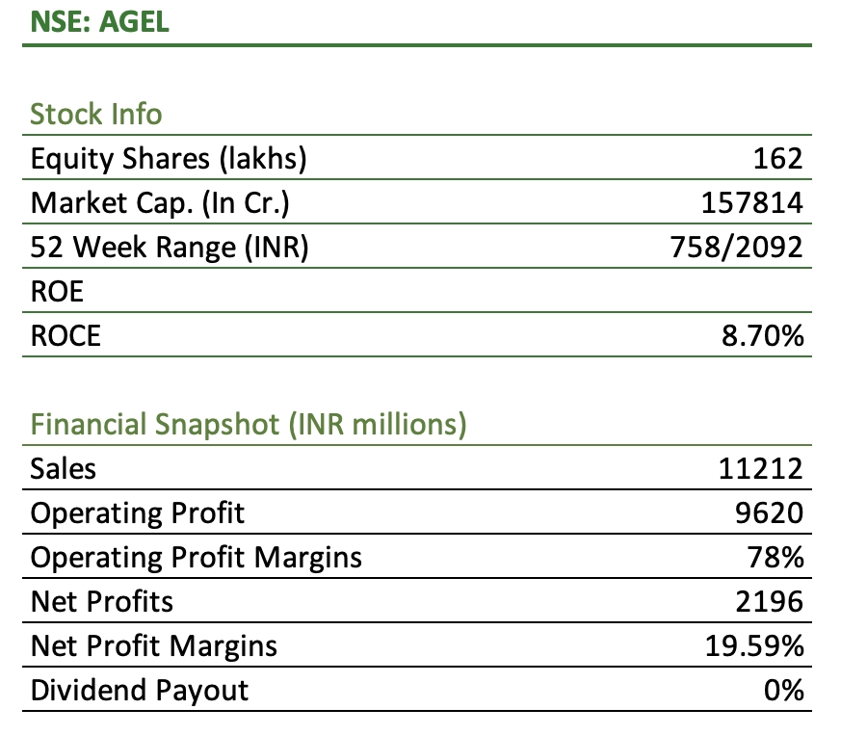
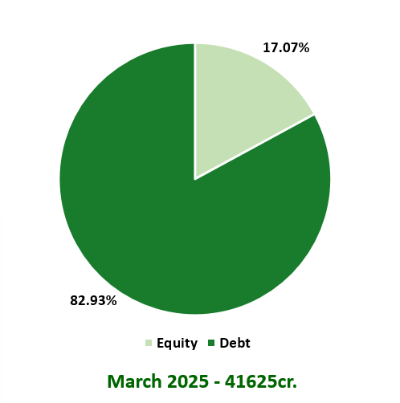
About the Company
Adani Green Energy Ltd. (AGEL), part of the Adani Group, is India’s largest renewable energy company, operating across solar, wind, and hybrid segments. Headquartered in Ahmedabad and incorporated in 2015. AGEL has scaled its operational capacity to 11.2 GW as of 2025, with a target of 50 GW by 2030.
16.32
Business At a Glance
The company is a key player in India’s energy transition, backed by long-term PPAs, strong execution, and significant investments in energy storage and capacity expansion.
Generation of Energy: AGEL generates renewable power and supplies it to the Solar Energy Corporation of India (SECI).
Supplying to SECI: SECI acts as an intermediary, selling the power to state distribution companies (DISCOMs) through long-term Power Purchase Agreements (PPAs).
Supplying to Merchant and C&I: AGEL aims to generate 25% of its energy sales from the merchant and Commercial & Industrial (C&I) segment by 2030, targeting higher margins through market-based pricing over fixed-tariff PPAs.
Capital Structure 2025
Carbon Credit: Although AGEL has not yet realized significant revenue from carbon credit sales, it remains a potential future revenue stream as global demand for carbon offsets grows.
Evacuation Capacity: Management has confirmed that evacuation infrastructure is secured for the company’s planned capacity additions over the next 2–3 years, mitigating short-term transmission risks.

Slide 2
Company Overview
Company Details
Full Name: Adani Green Energy Limited
Founded: 2015
Headquarters: Ahmedabad, Gujarat
Industry: Renewable Energy
Stock Listing: NSE & BSE: (Ticker: ADANIGREEN)
Company Overview:
Capacity Utilization Factor: It measures how efficiently a power plant is operating compared to its full capacity. The following are the figures for AGEL. Calculates as:
CUF (%)=Maximum Possible Generation (in kWh)/Actual Energy Generated (in kWh) ×100
Solar: 24.8% 2. Wind: 27.2% 3. Hybrid: 39.5%
Revenue Share
To enhance grid reliability and support round-the-clock renewable power delivery, AGEL is actively investing in Hydro Pumped Storage Projects (PSPs). These systems utilize two reservoirs pumping water to the upper reservoir using surplus solar and wind energy and releasing it to generate electricity during peak demand. Notably, ISTS charges are currently waived for PSPs, offering cost advantages for storage deployment.
AGEL’s PSP pipeline is progressing as planned. The first 500 MW PSP on the Chitravathi River (Andhra Pradesh) is under construction and on schedule. Additionally, the company has secured a 1,250 MW project in Uttar Pradesh, reflecting AGEL’s strong execution capabilities and regulatory alignment. The management remains committed to developing over 5 GW of PSP capacity by 2030, positioning storage as a core enabler of its firm and dispatchable renewable energy strategy.

Slide 3
Why Khavda holds a great importance?
Khavda contributes 4.1 GW to AGEL’s current 11.2 GW capacity, with plans to scale it to 30 GW by 2030 as part of the 50 GW overall target. The company claims extensive research has been conducted on site-specific factors such as drainage, seismic activity, topography, and customized cable-laying design, reinforcing Khavda’s role as a strategic renewable energy hub.
Adani Green Energy (AGEL) has entered into a 50:50 joint venture with TotalEnergies to develop and manage a portfolio of solar projects, primarily at the Khavda solar park in Gujarat. As part of the agreement, AGEL will contribute existing solar assets, while TotalEnergies will invest USD 444 million to accelerate the development of these projects.
Secured Orders
In FY25, Google signed a 61 MW hybrid power purchase agreement with AGEL to supply renewable energy for its data centers in India, marking a significant step in AGEL’s expansion into the high-growth Commercial & Industrial (C&I) segment. Several significant orders, including a large contract from Winsol Engineers for a 33KV transmission line.
Management Overview
Promoters hold a substantial 60% stake in AGEL, reflecting strong confidence and long-term commitment to the business. *A recent warrant conversion has further increased their equity stake to 62%, reinforcing their belief in the company’s growth potential.
AGEL reports a director-to-employee median salary ratio of 15:1, significantly higher than peers like JSW Energy, which stands at 4.1:1.
AGEL received 99.9995% shareholder approval via postal ballot to increase the PPA value between its subsidiary, Adani Hybrid Energy Jaisalmer Four Ltd., and Adani Electricity Mumbai Ltd., marking a key related party transaction.
Adani Group holds a 3.5 out of 5 rating on Employee rating websites like Glassdoor, based on over 1,030 employee reviews, indicating a generally positive working experience among its workforce.

Slide 4
Shareholding Pattern
 | Mar-21 | Mar-22 | Mar-23 | Mar-24 | Mar-25
Promoters | 56.29% | 61.27% | 57.26% | 56.37% | 60.93%
FIIs | 21.47% | 16.53% | 17.13% | 18.15% | 12.45%
DIIs | 0.30% | 0.79% | 1.45% | 1.55% | 2.40%
Public | 21.94% | 21.41% | 24.16% | 23.93% | 24.22%
No. of Shareholders | 166,386 | 228,469 | 746,294 | 668,586 | 995,700
Promoters
Public
61%
24%
DIIs
2.5%
FIIs
12.5%
Adani Green Energy Ltd (AGEL) is primarily a promoter-driven company, with the Adani Group holding about 62% of shares, while the remaining 38% is owned by public investors, including mutual funds, retail individuals, and foreign institutions. In recent quarters, promoter shareholding has seen a slight increase, whereas institutional holdings have marginally decreased, reflecting continued promoter confidence and stable, diverse public participation.

Slide 5
DuPont Analysis
Return on Equity
 | Mar-21 | Mar-22 | Mar-23 | Mar-24 | Mar-25
Profit After Tax | 266 | 425 | 1167 | 1506 | 2327
Profit Before Tax | 271 | 489 | 1620 | 1917 | 2541
Tax Burden - (A) | 98.15% | 86.91% | 72.04% | 78.56% | 91.58%
Profit Before Tax | 271 | 489 | 1620 | 1917 | 2541
Profit before Interest & Tax | 2224 | 3106 | 4531 | 7005 | 8033
Interest Burden - (B) | 12.19% | 15.74% | 35.75% | 27.37% | 31.63%
Profit before Interest & Tax | 2224 | 3106 | 4531 | 7005 | 8033
Net Revenue | 3124 | 5133 | 7792 | 9220 | 11212
Operating Margin - (C) | 71.19% | 60.51% | 58.15% | 75.98% | 71.65%
Net Revenue | 3124 | 5133 | 7792 | 9220 | 11212
Average Total Assets | 23573 | 43944 | 63264 | 77950 | 99968
Asset Turnover - (D) | 13.25% | 11.68% | 12.32% | 11.83% | 11.22%
Average Total Assets | 23573 | 43944 | 63264 | 77950 | 99968
Average Total Shareholder's Equity | 2218 | 2370 | 4982 | 12399 | 20011
Financial Leverage - (E) | 10.63 | 18.54 | 12.70 | 6.29 | 5.00
Return on Equity - A*B*C*D*E | 11.99% | 17.93% | 23.42% | 12.15% | 11.63%
ROE v/s PAT Margin
Tax Burden v/s Interest Burden
23.42%
20.75%
17.93%
16.33%
98.15%
86.91%
78.56%
91.58%
11.99%
14.98%
12.15%
11.63%
72.04%
8.51%
8.28%
35.75%
27.37%
31.63%
12.19%
15.74%
Mar-21
Mar-22
Mar-23
Mar-24
Mar-25
Mar-21
Mar-22
Mar-23
Mar-24
Mar-25
Return on Equity
Net Profit Margin
Tax Burden
Interest Burden

Slide 6
DuPont Analysis
Return on Assets
 | Mar-21 | Mar-22 | Mar-23 | Mar-24 | Mar-25
Profit After Tax | 266 | 425 | 1167 | 1506 | 2327
Net Revenue | 3124 | 5133 | 7792 | 9220 | 11212
Net Profit Margin - A | 8.51% | 8.28% | 14.98% | 16.33% | 20.75%
Net Revenue | 3124 | 5133 | 7792 | 9220 | 11212
Average Total Assets | 23573 | 43944 | 63264 | 77950 | 99968
Asset Turnover - B | 13.25% | 11.68% | 12.32% | 11.83% | 11.22%
Return on Assets - A*B | 1.13% | 0.97% | 1.84% | 1.93% | 2.33%
Return on Assets
Asset Turnover v/s Capital Turnover
2.33%
16.68%
15.04%
15.08%
15.77%
14.80%
1.84%
1.93%
13.25%
11.68%
12.32%
11.83%
11.22%
1.13%
0.97%
Mar-21
Mar-22
Mar-23
Mar-24
Mar-25
Mar-21
Mar-22
Mar-23
Mar-24
Mar-25
Asset Turnover
Capital Turnover
Return on Capital Employed
 | Mar-21 | Mar-22 | Mar-23 | Mar-24 | Mar-25
NOPAT | 2235 | 3170 | 4984 | 7416 | 8247
Net Revenue | 3124 | 5133 | 7792 | 9220 | 11212
NOPAT Margin - A | 71.54% | 61.76% | 63.96% | 80.43% | 73.56%
Net Revenue | 3124 | 5133 | 7792 | 9220 | 11212
Average Capital Employed | 18727 | 34138 | 51679 | 58466 | 75754
Capital Turnover - B | 16.68% | 15.04% | 15.08% | 15.77% | 14.80%
Return on Capital Employed - A*B | 11.93% | 9.29% | 9.64% | 12.68% | 10.89%

Slide 7
DuPont Analysis
Return on Invested Capital
 | Mar-21 | Mar-22 | Mar-23 | Mar-24 | Mar-25
NOPAT | 2235 | 3170 | 4984 | 7416 | 8247
Net Revenue | 3124 | 5133 | 7792 | 9220 | 11212
NOPAT Margin - A | 71.54% | 61.76% | 63.96% | 80.43% | 73.56%
Net Revenue | 3124 | 5133 | 7792 | 9220 | 11212
Invested Capital | 20362 | 33380 | 53149 | 65600 | 82058
Capital Turnover Ratio - B | 15.34% | 15.38% | 14.66% | 14.05% | 13.66%
Return on Invested Capital - A*B | 10.98% | 9.50% | 9.38% | 11.30% | 10.05%
ROCE V/S NOPAT Margin
Revenue v/s EBIT v/s DOL
71.54%
80.43%
73.56%
4.23
11212
61.76%
63.96%
9220
8033
7792
7005
2.98
5133
4531
11.93%
9.29%
9.64%
12.68%
10.89%
2224
3124
3106
0.89
Mar-22
Mar-23
Mar-24
Mar-25
0.62
0.68
Mar-21
Mar-21
Mar-22
Mar-23
Mar-24
Mar-25
NOPAT Margin
Return on Capital Employed
Profit before Interest & Tax
DOL
Net Revenue
Return on Invested Capital
EBIT vs/s PAT v/s DFL
10.98%
11.30%
10.05%
3.81
9.50%
9.38%
7005
8033
3.71
3106
4531
2224
1.22
1.51
2327
266
425
1167
0.53
1506
Mar-21
Mar-22
Mar-23
Mar-24
Mar-25
Mar-21
Mar-22
Mar-23
Mar-24
Mar-25
Profit before Interest & Tax
DFL
Profit After Tax

Slide 8
Altman Z Score
Working Capital / Total Assets
 | Mar-21 | Mar-22 | Mar-23 | Mar-24 | Mar-25
Working Capital | 3052.0 | 413.0 | 7527.0 | (5013.0) | 2526.0
Total Assets | 23557.5 | 43823.0 | 62931.5 | 77497.5 | 99425.0
Working Capital / Total Assets - A | 12.96% | 0.94% | 11.96% | -6.47% | 2.54%
Retained Earnings / Total Assets
Retained Earnings | (718.0) | (313.0) | 582.0 | 1592.0 | 3031.0
Total Assets | 23557.5 | 43823.0 | 62931.5 | 77497.5 | 99425.0
Retained Earnings / Total Assets - B | -3.05% | -0.71% | 0.92% | 2.05% | 3.05%
EBIT / Total Assets
EBIT | 2146.0 | 3170.0 | 4337.0 | 6759.0 | 7707.0
Total Assets | 23557.5 | 43823.0 | 62931.5 | 77497.5 | 99425.0
EBIT / Total Assets - C | 9.11% | 7.23% | 6.89% | 8.72% | 7.75%
Market Capitalisation / Total Liabilities
Market Capitalisation | 137991.7 | 340123.1 | 173178.7 | 292596.5 | 165951.2
Total Liabilities | 23557.5 | 43823.0 | 62931.5 | 77497.5 | 99425.0
Market Capitalisation / Total Liabilities - D | 585.77% | 776.13% | 275.19% | 377.56% | 166.91%
Sales / Total Assets
Sales | 3124.0 | 5133.0 | 7776.0 | 9220.0 | 11212.0
Total Assets | 23557.5 | 43823.0 | 62931.5 | 77497.5 | 99425.0
Sales / Total Assets - E | 13.26% | 11.71% | 12.36% | 11.90% | 11.28%
Altman Z Score
 | Mar-21 | Mar-22 | Mar-23 | Mar-24 | Mar-25
Z Score | 4.06 | 5.01 | 2.16 | 2.62 | 1.44
Financial Stability | Strong | Strong | Moderate | Moderate | Weak

Slide 9
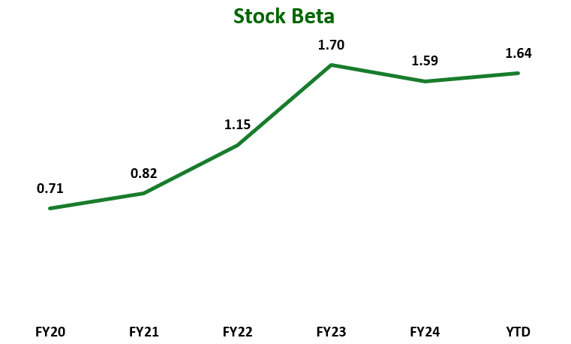
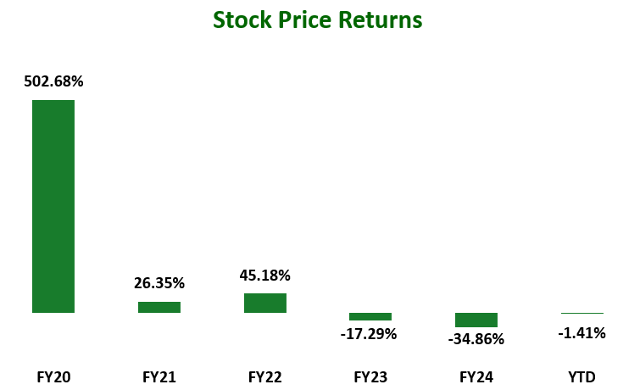
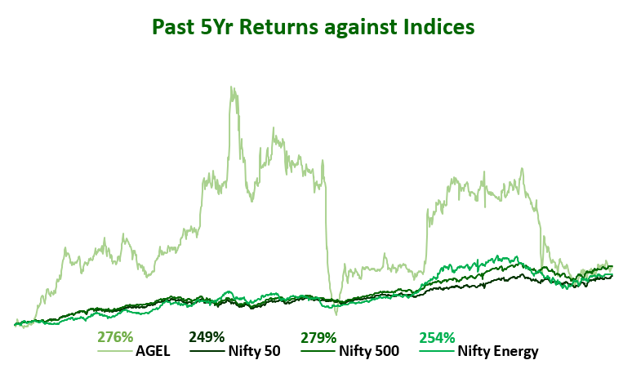
Stock Performance
 | FY20 | FY21 | FY22 | FY23 | FY24 | YTD
Stock Beta | 0.71 | 0.82 | 1.15 | 1.70 | 1.59 | 1.64
Yearly Stock Returns | 502.68% | 26.35% | 45.18% | -17.29% | -34.86% | -1.41%
Average Monthly Volumes Traded | 33.83M | 24.12M | 32.54M | 58.42M | 46.94M | 74.53M
52-week High | 1205.15 | 1439.25 | 2970.5 | 2166.15 | 2070.55 | 1078.2
52-week Low | 117.7 | 876.15 | 1346.9 | 462.2 | 898.55 | 768.55

Slide 10
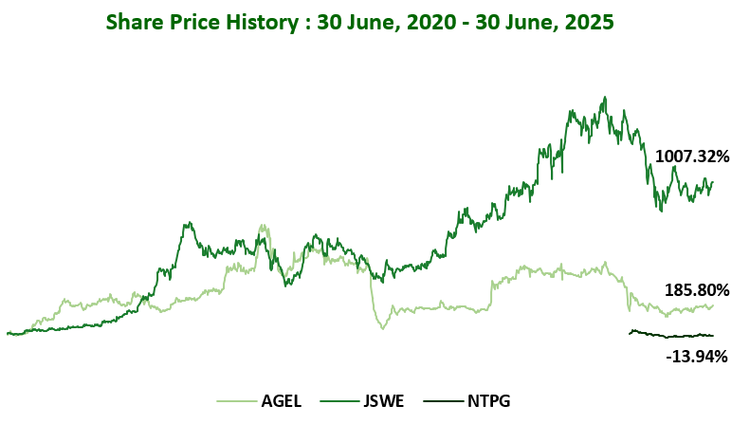
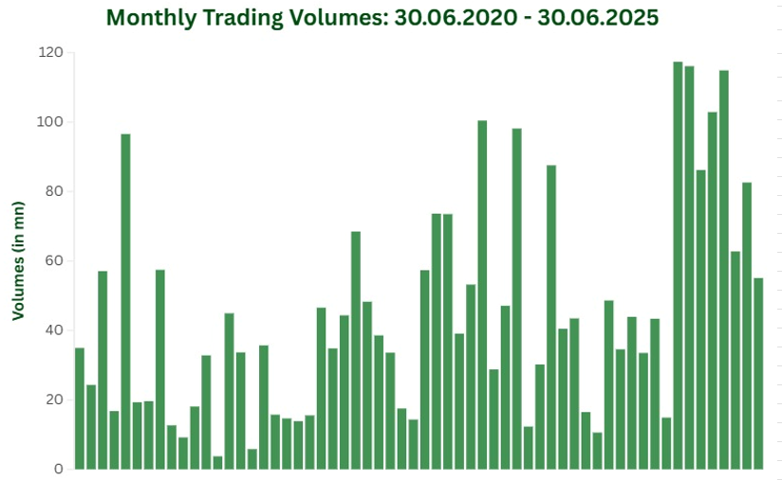
Stock Charts

Slide 11
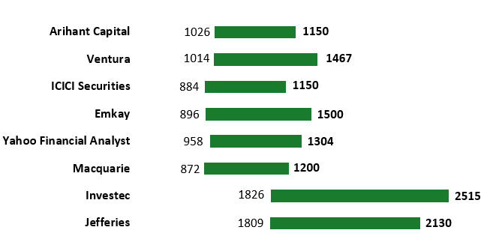
Stock Performance
Analyst Recommendations
Institution | Reco | Date of Reco | Price at the time of Reco | Target Price | Potential Upside/Downside
Jefferies | Buy | 29-07-2024 | 1809 | 2,130 | 17.74%
Investec | Buy | 17-09-2024 | 1826 | 2,515 | 37.73%
Macquarie | Buy | 13-03-2025 | 872 | 1,200 | 37.61%
Yahoo Financial Analyst | Buy | 27-03-2025 | 958 | 1,304 | 36.12%
Emkay | Buy | 30-04-2025 | 896 | 1,500 | 67.41%
ICICI Securities | Buy | 10-05-2025 | 884 | 1,150 | 30.11%
Ventura | Buy | 19-05-2025 | 1014 | 1,467 | 44.67%
Arihant Capital | Hold | 30-06-2025 | 1026 | 1100-1120 | 7.21% - 9.16%

Slide 12
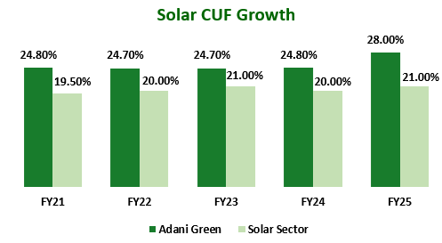
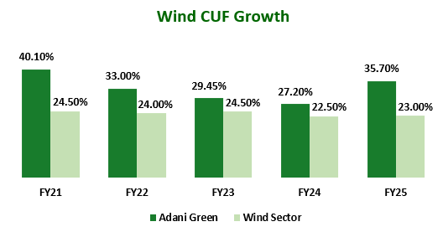
Concall Analysis
Executive Highlights
Adani Green Energy Limited (AGEL) has demonstrated sustained operational and financial momentum over the last four quarters, reinforcing its leadership in India’s renewable energy sector. The company continues to surpass industry benchmarks in capacity addition, operational excellence, and ESG commitments, positioning itself as a key player in driving India's clean energy transition.
Capacity Growth & Project Pipeline
Capacity Expansion: AGEL’s operational capacity accelerated from 10.9 GW (June 2024) to 14.2 GW (March 2025), with an additional 1 GW close to commissioning by May 2025.
Pipeline Security: The company has access to over 250,000 acres of resource-rich land, with a fully secured growth roadmap to reach 50 GW renewable capacity by 2030.
Financial Performance & Profitability
Consistently High EBITDA Margins: AGEL has maintained industry-leading EBITDA margins of 92% from power supply, driven by analytics-enabled operations and strategic asset management.
Revenue Growth: Revenue from power supply climbed from ₹7,735 crore (FY24) to ₹9,495 crore (FY25), with cash profit also registering strong growth from ₹3,986 crore (FY24) to ₹4,871 crore (FY25).
Capital Management: The company remains disciplined with its capital structure, de-risked via ring-fenced project SPVs and diversified funding (domestic and international).

Slide 13
Concall Analysis
ESG & Corporate Governance
ESG Leadership: AGEL reinforced its position as the ESG benchmark in Asian renewables, being ranked 1st in Asia and consistently amongst the top globally by ISS ESG. Concall highlights included:
Climate Action: 20.33 million tons of CO₂ emissions avoided in FY25, operational emission intensity at just 0.0014 tCO₂/MWh versus 0.727 for the Indian grid.
Resource Positivity: 100% operating plants are water positive, zero-waste-to-landfill certified, and single-use plastic free.
Health & Safety: Over 4 million continuous safe man hours in FY25, with low LTIFR.
Supply Chain: High engagement with suppliers on Scope 3 emission disclosure.
Corporate Governance: Board independence remains robust—statutory committees are chaired by or comprised only of independent directors, with a strong focus on related party transaction controls and regular director education sessions. Gender diversity is targeted at a minimum of 30% female directors in the medium term.
Strategic Initiatives and Outlook
Project Execution Model: AGEL’s resource-driven project origination, technological capex, and analytics-driven O&M create formidable barriers to entry for competitors.
Merchant & C&I Opportunities: There is increased focus on commercial/industrial (C&I), merchant, and contract-for-difference (CFD) opportunities to enhance returns and diversify revenue streams.
Operational Excellence
Plant Availability: Solar plant availability remained consistently near 100%, with wind and hybrid segments also seeing improvement.
Capacity Utilization Factor (CUF): Solar CUFs improved (FY25: 24.8%), with wind CUFs and hybrid CUFs also reflecting operational enhancements.
Conclusion
AGEL's performance this year has been marked by record capacity addition, margin stability, and a fully-funded, scalable growth runway. Its best-in-class operational efficiency, disciplined capital management, and industry-leading ESG practices underpin a compelling investment thesis as India transitions to non-fossil power.

Slide 14
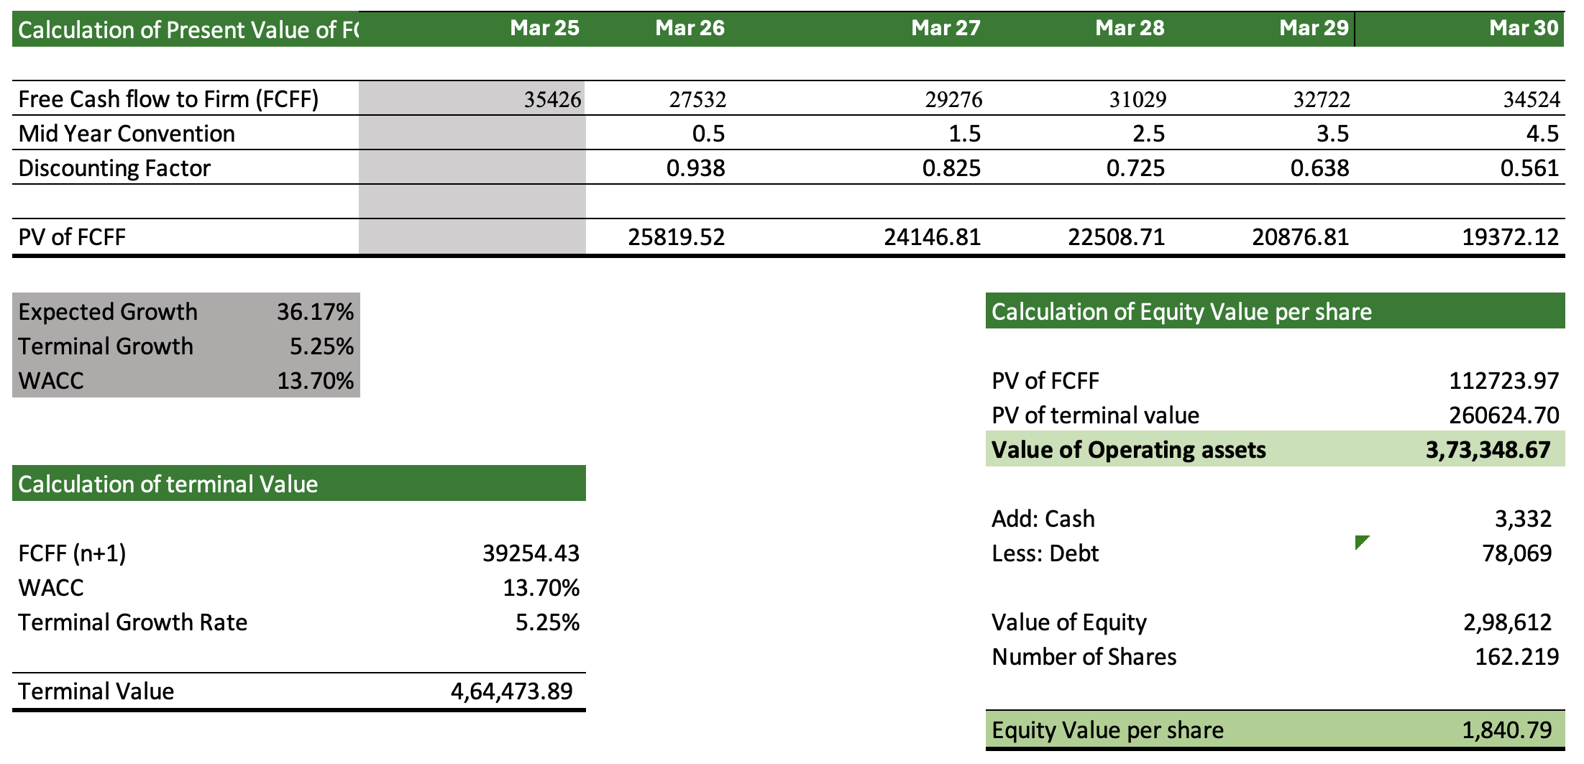
Valuation Analysis
DCF Valuation
Football Field Analysis
Football Field Analysis
-
Valuation Summary
2500
1,928.00
2,091.00
2000
1,841.00
1500
1,453.00
1000
500
849.00
758.00
0
DCF
Relative
52 Week H/L

Slide 15
Sensitivity Analysis
Sensitivity Analysis
11.00%
12.00%
13.70%
14.00%
3.00%
4,18,868
3,74,826
3,18,590
3,10,440
4.00%
4,61,655
4,07,076
3,39,813
3,30,281
5.25%
5,36,066
4,60,826
3,73,405
3,61,460
6.00%
5,98,571
5,03,825
3,98,796
3,84,844
7.00%
7,18,372
5,81,225
4,41,493
4,23,817
Calculation of Equity Value
260678.16
3332
78069
298668.34
112727.18
PV of FCFF
PV of terminal
Cash
Debt
Equity Value
value

Slide 16
Ratio Analysis
 | Ratio Analysis | Mar 25 | Mar 26 | Mar 27 | Mar 28 | Mar 29 | Mar 30
 | Sales Growth | 21.61% | 15.30% | 14.20% | 12.43% | 11.06% | 9.96%
 | EBITDA Growth | 17.81% | 17.90% | 14.50% | 12.73% | 10.91% | 10.46%
 | EBIT Growth | 14.03% | 22.57% | 14.58% | 12.80% | 10.86% | 10.60%
 | Net Profit Growth | 31.27% | 74.66% | 24.02% | 21.34% | 17.86% | 18.19%
 | EBITDA Margin | 91.02% | 93.07% | 93.31% | 93.56% | 93.43% | 93.86%
 | EBIT Margin | 68.74% | 73.07% | 73.31% | 73.56% | 73.43% | 73.86%
 | PBT Margin | 19.76% | 26.07% | 28.31% | 30.56% | 32.43% | 34.86%
 | Net Margin | 12.88% | 19.51% | 21.19% | 22.87% | 24.27% | 26.08%
 | Depreciation % of Sales | 22.28% | 20.00% | 20.00% | 20.00% | 20.00% | 20.00%
 | Employee Cost % of Sales | 1.2% | 1.3% | 1.5% | 1.7% | 2.0% | 1.8%
 | Other Expenses % of Sales | 0.9% | 1.5% | 1.2% | 1.2% | 1.2% | 0.8%
 | ROCE % | 5.79% | 6.21% | 6.24% | 6.23% | 6.22% | 6.16%
 | ROE % | 11.90% | 17.21% | 17.59% | 17.59% | 17.17% | 16.87%
 | Debtor Turnover | 7.78 | 7.65 | 7.42 | 7.25 | 7.12 | 7.01
 | Creditor Turnover | 31.54 | 29.05 | 27.09 | 25.73 | 24.74 | 23.99
 | Fixed Assets Turnover | 0.14 | 0.13 | 0.13 | 0.13 | 0.14 | 0.14
 | Capital Turnover | 1.85 | 1.76 | 1.66 | 1.54 | 1.41 | 1.29
 | Debtor Days | 46.91 | 47.72 | 49.20 | 50.36 | 51.28 | 52.04
 | Payable Days | 11.57 | 12.56 | 13.47 | 14.18 | 14.75 | 15.22
 | Cash Conversion Cycle | 35.34 | 35.15 | 35.73 | 36.17 | 36.53 | 36.82
 | CFO/Sales | 0.75 | 0.63 | 0.63 | 0.63 | 0.63 | 0.63
 | CFO/Total Assets | 0.08 | 0.06 | 0.07 | 0.07 | 0.07 | 0.07

Slide 17
Financial Statements..
Adani Green Energy Ltd.
Amount in ₹ Crores unless otherwise stated
Income Statement
 | Mar 25 | Mar 26 | Mar 27 | Mar 28 | Mar 29 | Mar 30
 | Actual | Forecasted | Forecasted | Forecasted | Forecasted | Forecasted
INCOME
As % Total Revenue | 49.0% | 47.0% | 45.0% | 43.0% | 41.0% | 39.0%
Growth Rate % | 21.6% | 15.3% | 14.2% | 12.4% | 11.1% | 10.0%
Other Income | 1316 | 1691.31 | 1941.01 | 2264.48 | 2555.47 | 2774.30
Total Income | 12528.0 | 14618.4 | 16703.7 | 18862.8 | 20989.5 | 23044.0
EXPENSES
Other Manufacturing Expenses | 1843 | 1939.06 | 2214.41 | 2489.75 | 2765.10 | 3040.45
As % Total Revenue | 16.4% | 15.0% | 15.0% | 15.0% | 15.0% | 15.0%
Employee Expenses | 131.00 | 165.48 | 216.78 | 283.99 | 372.02 | 373.02
As % Total Revenue | 1.2% | 1.3% | 1.5% | 1.7% | 2.0% | 1.8%
Selling and Admin | 243.00 | 284.40 | 324.78 | 365.16 | a405.55 | 445.93
As % Total Revenue | 2.2% | 2.2% | 2.2% | 2.2% | 2.2% | 2.2%
Finance Costs | 5,492.00 | 6,075.72 | 6,643.22 | 7,137.30 | 7,557.95 | 7,905.17
As % Total Revenue | 49.0% | 47.0% | 45.0% | 43.0% | 41.0% | 39.0%
Depreciation | 2,498.00 | 2,585.41 | 2,952.54 | 3,319.67 | 3,686.80 | 4,053.93
As % Total Revenue | 22.3% | 20.0% | 20.0% | 20.0% | 20.0% | 20.0%
Other Expenses | 106.00 | 197.87 | 171.98 | 195.14 | 224.50 | 160.41
As % Total Revenue | 0.9% | 1.5% | 1.2% | 1.2% | 1.2% | 0.8%
Total Expenses | 10,313.00 | 11,247.93 | 12,523.70 | 13,791.02 | 15,011.92 | 15,978.92
PBT | 2215.0 | 3370.4 | 4180.0 | 5071.8 | 5977.6 | 7065.0
Total Tax Expenses | 771.0 | 848.3 | 1052.1 | 1276.6 | 1504.6 | 1778.3
As % PBT | 34.8% | 25.2% | 25.2% | 25.2% | 25.2% | 25.2%
Profit/Loss For The Period | 1,444.00 | 2,522.10 | 3,127.90 | 3,795.25 | 4,473.02 | 5,286.77
Balance Sheet
ASSETS | Mar 25 | Mar 26 | Mar 27 | Mar 28 | Mar 29 | Mar 30
Cash | 1,019 | 1,593 | 1,984 | 8,764 | 3,332 | 4,542
Accounts Receivable | 1,494 | 1,809 | 2,206 | 1,342 | 1,540 | 1,840
% Total Revenue | 47.82% | 35.24% | 28.37% | 14.56% | 13.74% | 14.23%
Loans and Advances | 274 | 405 | 219 | 203 | 320 | 300
Other Current Assets | 4,522 | 6,222 | 7,724 | 7,551 | 8,435 | 8,755
Total Current Assets | 7,309 | 10,029 | 12,133 | 17,860 | 13,627 | 15,437
Property Plant & Equipment | 20,881 | 48,351 | 53,627 | 68,711 | 94,394 | 1,06,809
Other Non-Current Assets | 502 | 574 | 1,149 | 1,515 | 2,743 | 2,870
Total Non-Current Assets | 21,383 | 48,925 | 54,776 | 70,226 | 97,137 | 1,09,679
Total Assets | 28,692 | 58,954 | 66,909 | 88,086 | 1,10,764 | 1,25,115
LIABILITIES
Accounts Payable | 129 | 145 | 391 | 316 | 395 | 495
Short Term Borrowings | 4,128 | 9,471 | 4,215 | 22,557 | 10,706 | 10,706
Total Current Liabilities | 4,257 | 9,616 | 4,606 | 22,873 | 11,101 | 11,201
Borrowings | 20,081 | 43,361 | 50,008 | 42,301 | 69,334 | 79,063
Other Long-Term Liabilities | 2,154 | 3,363 | 4,991 | 12,270 | 18,192 | 20,192
Total Non-Current Liabilities | 22,235 | 46,724 | 54,999 | 54,571 | 87,526 | 99,255
Total Liabilities | 26,492 | 56,340 | 59,605 | 77,444 | 98,627 | 1,10,456
EQUITY
Common Equity | 1,564 | 1,564 | 1,584 | 1,584 | 1,584 | 1,584
Retained Earnings | 636 | 1,050 | 5,720 | 9,058 | 10,553 | 13,075
Total Equity | 2,200 | 2,614 | 7,304 | 10,642 | 12,137 | 14,659
Total Liabilities & Equity | 28,692 | 58,954 | 66,909 | 88,086 | 1,10,764 | 1,25,115
16

Slide 18
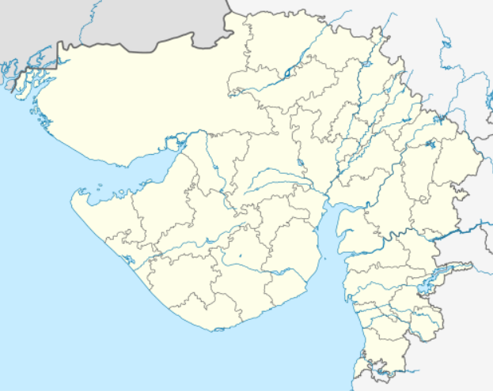

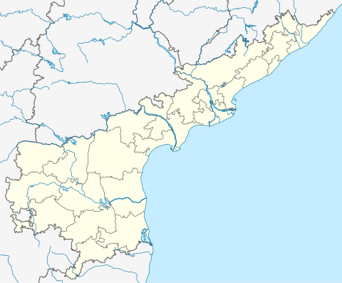
Upcoming Projects
Khavda Hybrid Park, Gujarat
AGEL is actively expanding the Khavda Renewable Energy Park toward a total 30 GW hybrid (solar + wind) capacity by 2030. As of May 2025, another 187.5 MW solar was added, bringing total operational capacity at Khavda to 2.8 - 3 GW. Corporate guarantee of up to 600mn USD has been committed to finance 1.15GW of solar capacity additions.
Khavda, Gujarat
Mundra, Gujarat
Projects In Pipeline
Additional developmental activity includes ongoing 250 MW solar capacity expansion in Kadapa, Andhra Pradesh, 250 MW merchant project within Khavda cluster in Gujarat and 500 MW PPA-backed in Rajasthan. Rajasthan continues to be a key focus state for solar energy deployment, with Rajasthan and Gujarat together accounting for much of AGEL’s incremental growth.
Kadapa, Andhra Pradesh
R&D in Green Hydrogen
Adani Power has launched a pilot project to blend up to 20% green ammonia with coal fuel in a 330 MW ultra-supercritical boiler at its Mundra plant in Gujarat. This is the first project outside Japan under Japan’s NEDO initiative (New Energy and Industrial Technology Development Organization) within the Japan‑India Clean Energy Partnership (CEP). Together with IHI & Kowa Corporation, AGEL is evaluating technical feasibility, combustion stability, material corrosion, emissions, and safety protocols before scaling within Adani’s fleet.

Slide 19
Executive Summary
P
Political
1. The Indian government’s commitment to targeting 500 GW of RE capacity by 2030, underpins policy stability for AGEL.
2. AGEL benefits from the expansion of Renewable Purchase Obligations (RPOs) by state governments, sustaining demand for renewable energy projects.
E
Economic
1. India’s renewable sector is witnessing an investment surge, with over USD 20 billion estimated for the sector by 2025 and AGEL targeting 50 GW capacity by 2030.
2. 80% decline in costs over the last decade and wind enable better project economics and bolster AGEL's profitability and market share.
S
Social
1. Broadening environmental consciousness and societal push for decarbonization boosts demand for AGEL’s offerings, as global renewable installations grew by 50% in 2023.
2. The sector provides critical employment and AGEL invested $2.3 billion in skill development in 2024, aligning with broader social goals.
T
Technological
1. Continuous innovation in solar panels (over 24% efficiency in 2024) and wind turbines, as well as grid-scale battery storage and smart grid deployment, directly enhance AGEL’s operational metrics.
2. Strategic investments in energy storage (₹20,000 crore for projects in 2024) and IoT/smart grids improve grid integration
L
Legal
1..AGEL faces rigorous scrutiny to comply with environment protection laws and environmental clearances take up 12-18 months per project.
2. Environmental impact assessments and compliance costs are significant and delays from litigation particularly related to land and environmental concerns impact project economics.
E
Environmental
1. Large-scale renewable projects impact biodiversity and local ecosystems, mandating AGEL to enforce biodiversity management plans.
2. The company’s generation portfolio directly supports decarbonization, but lacks extreme weather and waste management, especially for solar panel recycling.

Slide 20
Executive Summary
Company Overview
Incorporated 2015, headquartered in Ahmedabad; India’s largest renewable power producer across solar, wind, and hybrid projects.
Operational capacity: 11.2 GW (2025); target 50 GW by 2030, backed by secured land bank (250,000+ acres) and strong execution track record.
Promoter shareholding at 62% post-warrant conversion, reflecting strong confidence.
Growth & Projects
Capacity Growth: 10.9 GW (Jun ’24) → 14.2 GW (Mar ’25), with +1 GW commissioning expected in May ’25.
Khavda Renewable Park, Gujarat: 4.1 GW operational; roadmap to 30 GW by 2030; JV with TotalEnergies ($444 mn) for portfolio expansion.
Pumped Storage Projects: >5 GW pipeline by 2030; 500 MW Chitravathi PSP (AP) under construction; 1,250 MW project in UP secured; cost advantage due to waived ISTS charges.
Green Hydrogen: Pilot with Japan’s NEDO & IHI/Kowa to blend 20% green ammonia at Mundra ultra-supercritical boiler—first such project outside Japan.
C&I Segment Expansion: First large PPA with Google (61 MW hybrid) for Indian data centres.
Financial Performance
Revenue Growth: ₹7,735 cr (FY24) → ₹9,495 cr (FY25).
Cash Profit: ₹3,986 cr (FY24) → ₹4,871 cr (FY25).
EBITDA Margins: Sustained at 92% from power supply.
Capital Structure: De-risked with ring-fenced SPVs, diversified debt (domestic & global), project-level financing.
DuPont Metrics: ROE remained robust (72–98% range); ROIC and ROA improving with capacity scale-up.
Operational Excellence
CUFs: Solar 24.8%, Wind 27.2%, Hybrid 39.5% (among the best in India).
Plant availability: Solar ~100%, improving in wind & hybrid.
Execution driven by site-specific R&D (drainage, seismic, cable-laying) at Khavda and analytics-enabled O&M.
ESG & Governance
Ranked #1 in Asia (ISS ESG); 20.3 mn tons CO₂ emissions avoided in FY25.
All plants water positive, zero-waste-to-landfill, single-use plastic free.
4 mn+ safe man hours in FY25, very low LTIFR (Lost Time Injury Frequency Rate).
Strong governance: Independent board committees, high focus on RPT monitoring, regular director education.
Target ≥30% female board members in medium term; promoter-to-employee pay ratio high at 15:1 vs peers (~4:1).

