Slide 1

Advanced Git – Beyond the Basics
Presented by Allan Kim Eriksen

Slide 2
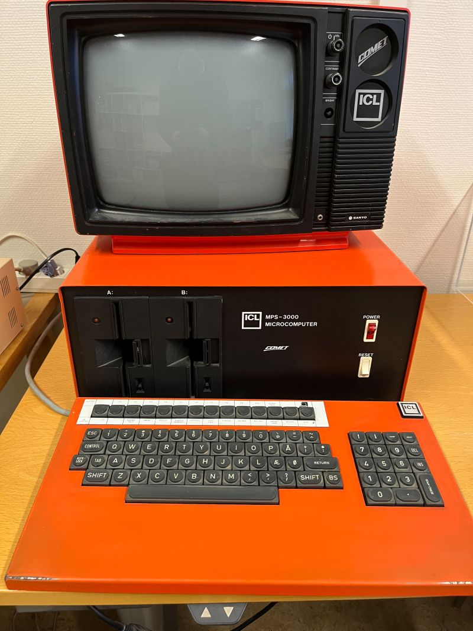
Allan Kim Eriksen
Working with computers since 1982.
First computer was a Danish ICL Comet.
COMAL-80
Piccoline, Commodore 64/128, Olivetti…
Working in NOVAX since 1998.

Slide 3
Tracking Changes in Non-Code Files
Setup: Version control for encrypted Setup Builder scripts (NonCode.zip).
Scripts (.sbp/.sbi) are binary; use textconv to extract readable text.
Request to lindersoft.com: command-line switch added to export text-only in 2016.
Configure in .git/config:
[diff "sbdiff"]
textconv = cscript.exe d:/Script/GitSetupBuilderScript2.vbs
Add .gitattributes in script folder:
*.sbp diff=sbdiff
Textconv only affects display; blobs remain unchanged.

Slide 4
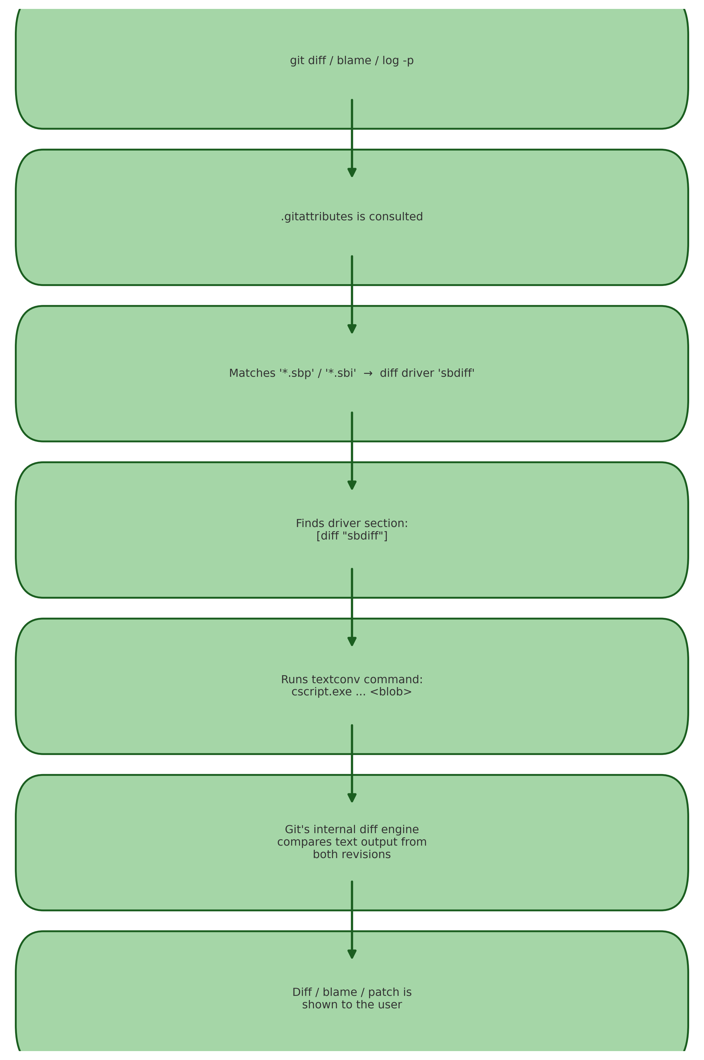

Slide 5
Finding When a Bug Was Introduced
Assume git blame is insufficient if failure location unknown.
Use `git bisect start` marking HEAD as 'bad' and a known good commit.
Checkout commits and test code (e.g., run or inspect Program.cs).
If a commit cannot compile or isn't relevant, use `git bisect skip`.
Continue marking good/bad until culprit commit found.
Once found, `git bisect reset` to exit bisect mode and return to HEAD.
Branch from bad commit, fix error (e.g., open in editor, correct code), commit & merge to master.

Slide 6
Recovering Code from Deleted Branches
Scenario: Committed on detached HEAD (e.g., under bisect without branch).
Use `git log --grep="16"` or `git log -S"2 + 3" -- Program.cs` to search for specific commit or code snippet.
Checkout a new branch at the lost commit SHA from `git reflog`:
`git reflog` → find SHA → `git checkout -b rescuebranchname <SHA>`
The reflog entries are kept for 90 days as defaut.

Slide 7
Using Beyond Compare with Git
Beyond Compare excels at comparing directories and files.
Configure workspace:
`git config diff.tool bc`
`git config difftool.bc.path "c:/Program Files/Beyond Compare 5/BComp.com"`
Run directory diff: `git difftool HEAD~1 --dir-diff` (changes in last commit).
To view specific commit: `git difftool HEAD~3..HEAD~2 --dir-diff` shows diff for one commit.
Global config in ~/.gitconfig:
[diff]
tool = bc
[difftool "bc"]
path = c:/Program Files/Beyond Compare 5/BComp.exe
Optional merge tool: set `[merge] tool = bc` and `[mergetool "bc"] path = ...`.

Slide 8
Moving Committed Work to a New Branch
Setup bare remote repo:
`mkdir remoterepos` → `cd remoterepos` → `git init --bare` (no working dir).
Add remote: `git remote add origin "d:/MeetUp/remoterepos"` → `git push -u origin master`.
Lets block commits on master branch by using a ”hook”.
Attempt to push from master; receive error due to hook.
Create feature branch: `git switch -c newbranch` → `git push -u origin newbranch`.
On master: undo last commit: `git reset --soft HEAD~1` → changes in workspace → `git restore .`.
Work continues on newbranch, create PR, merge back to master.

Slide 9
Writing Custom Git Commands
Sometimes comparing local vs remote branches is cumbersome.
Create alias in .git/config:
`[alias]`
`unpushed = log --branches --not --remotes --no-walk --oneline`
Now `git unpushed` lists local commits not yet pushed.
Tab completion: type `git un` + [Tab] to expand to `git unpushed`.

