Slide 1


CodeRAG
An AI Expert for your C# Codebase
Rasmus Wulff Jensen

Slide 2

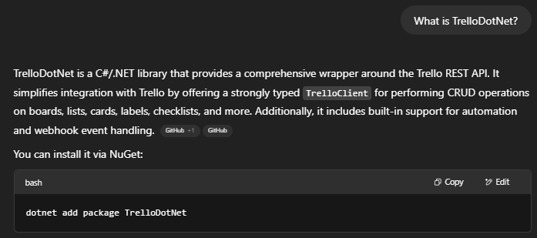
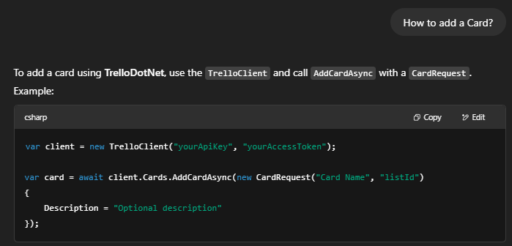
AI is good at C# … if it know it… else it is not!)
👍
👎👎👎

Slide 3
Let’s do something about that!
Demo

Slide 4
Secondary slides and technical info beyond the 5 min. intro

Slide 5





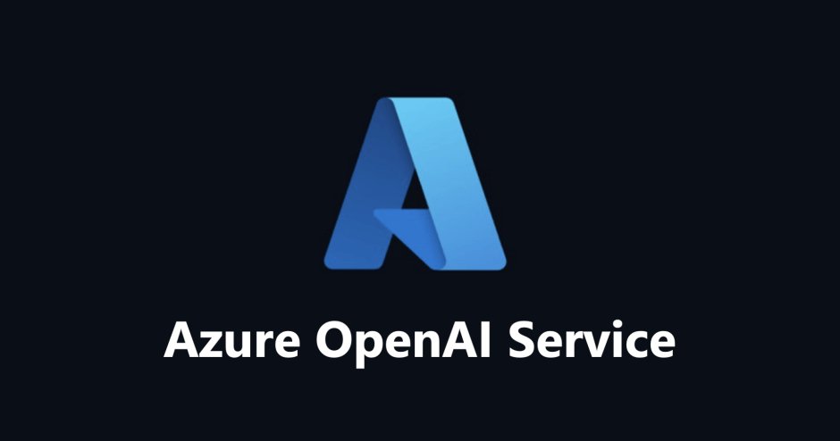
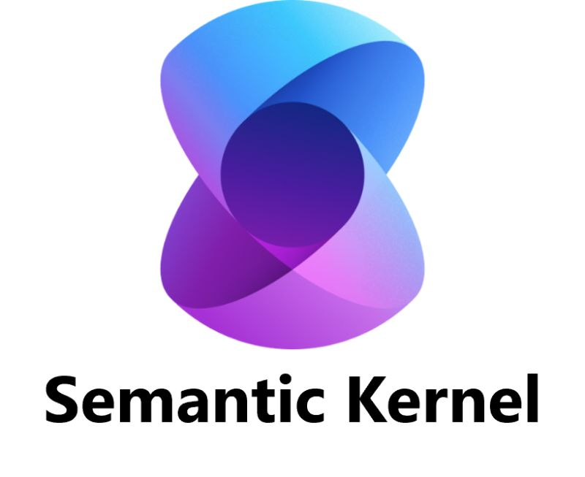


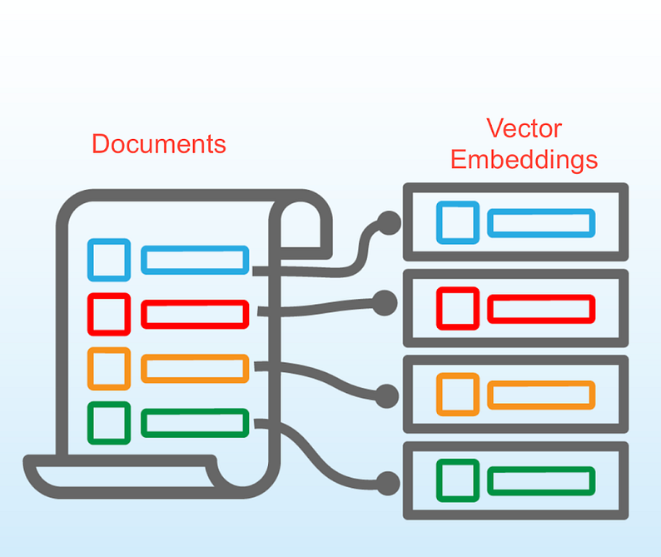


Architecture
CodeRag
Your Code and Documentation
Vector Store
Chat
Structured
Output
Function
Calling
Embeddings

Slide 6
Finalized Setup (Planned)
An AI Chatbot
(Self-Provisioned or SAAS)
[Optional / Internal / External]
GitHub App
(Self-Provisioned or SAAS)
[Optional]
Custom Integrations
(Self-Provisioned or SAAS)
A Web-Based Workbench
(Self-Provisioned or SAAS)
Code-RAG MCP Layer
(Self-Provisioned or SAAS)
Azure Open AI (Self-Provisioned or SAAS)
Azure SQL Vector Store
(Self-Provisioned or SAAS)

Slide 7
Pitch

Slide 8

Step 0 - Evaluation
Does it have?
Inline Documentation (XML Summaries)?
External Documentation (Wiki)?
An expert that help
…with Usage (Internal/External)?
…with Reviews?
You have a C# Git Code Repository?

Slide 9
What if we made AI Help with filling these boxes?
Inline Documentation
External Documentation
An expert that help
…with Usage (Internal/External)
…with Reviews

Slide 10
Step 1 – Prepare Code-Rag for your Code
[Mandatory]
A Web-Based Workbench
Source Code
(Local or GitHub)
Azure SQL Vector Store
(Self-Provisioned or SAAS)
Code-RAG
Azure Open AI (Self-Provisioned or SAAS)

Slide 11
Step 2 – Create / Improve Inline Docs
[Optional but strongly recommended]
List all Code-Entities that miss inline Docs
AI Suggested Inline Docs based on RAG Vector Store
Human Evaluation / Correction
Commit Changes
Re-Index Vector Store
A Web-Based Workbench
Least to Most complex:
Enums
Interfaces
Classes
Methods
Human Workload depend
on how many previous
boxes was checked

Slide 12
Step 3 - Create / Enhance Docs Wiki
[Optional but strongly recommended]
List all Code-Entities that miss wiki entry
AI Suggested Wiki Entry based on RAG Vector Store
Human Evaluation / Correction
Commit Changes
Re-Index Vector Store
A Web-Based Workbench
Least to Most complex:
Enums
Interfaces
Classes
Methods
Human Workload depend
on how many previous
boxes was checked

Slide 13
You now have an AI Assistant on your codebase
Azure SQL Vector Store
(Self Hosted or SAAS)
An AI Chatbot
(Self-Provisioned or SAAS)
[Optional / Internal / External]
Code-RAG
Azure Open AI
(Self-Service or SAAS)

Slide 14
You now have an AI Reviewer for new code added via Pull Requests
Azure SQL Vector Store
(Self Hosted or SAAS)
GitHub App
(Self Hosted or SAAS)
Code-RAG
Azure Open AI
(Self-Service or SAAS)

