Slide 1


Accenture job simulation summary

Slide 2


Today's agenda
Project Recap
Problem Definition
The Analytics Team
Process Overview
Data Insights & Visualizations
Conclusion & Recommendations

Slide 3

This project is focused on analyzing content performance and user reactions across various content categories. The main task involved data cleaning, merging multiple datasets, and deriving key insights to support decision-making.
Project Recap

Slide 4
What problem are we solving?
The primary goal is to identify the top 5 performing content categories based on total scores, as well as to gain deeper insights into user sentiment and reaction patterns that can be leveraged to optimize future content strategies.
Problem

Slide 5



The Analytics team

Slide 6
Process
1
Data Preparation: Cleaned and merged datasets from different sources.
Scoring Metrics: We calculated total scores for different content categories to determine top performers.
2
Exploratory Data Analysis: We explored sentiment trends, reaction types, and performance across content types.
3
4
Visualization: Created visual representations of the insights to aid in understanding.

Slide 7
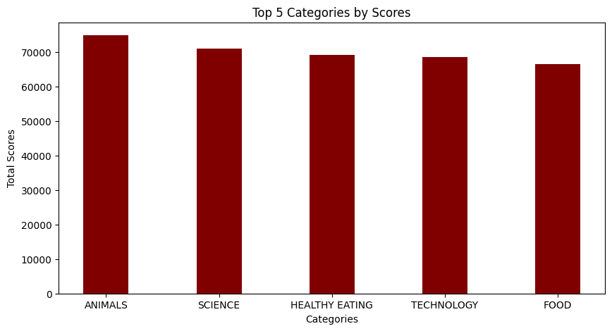

Insights
Top 5 Categories by Total Scores
The graph shows the top 5 categories (ANIMALS, SCIENCE, HEALTHY EATING, TECHNOLOGY, and FOOD) based on total scores.
These are the highest-performing categories based on user engagement, suggesting these are key areas to focus on.

Slide 8
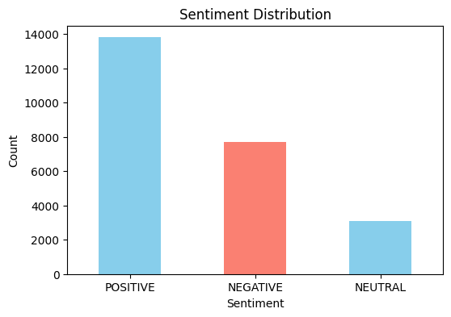
Sentiment Distribution
We analyzed overall user sentiment (Positive, Negative, Neutral).
Key Insight: The majority of user reactions were positive, followed by a significant portion of negative reactions.

Slide 9
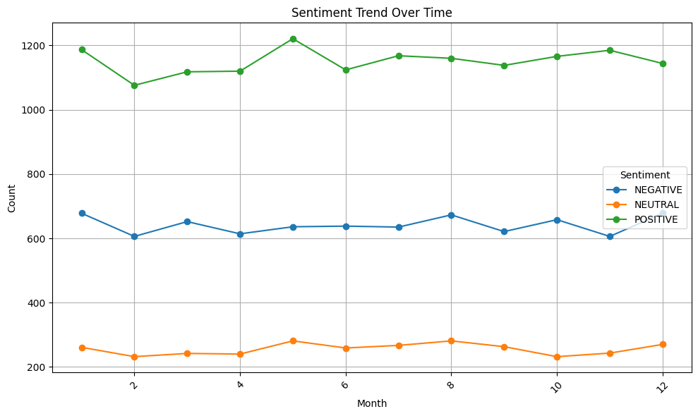
Sentiment Over Time
We tracked how sentiments evolved over time.
Key Insight: Positive sentiment remained stable over the months, while negative sentiment had some minor fluctuations.

Slide 10
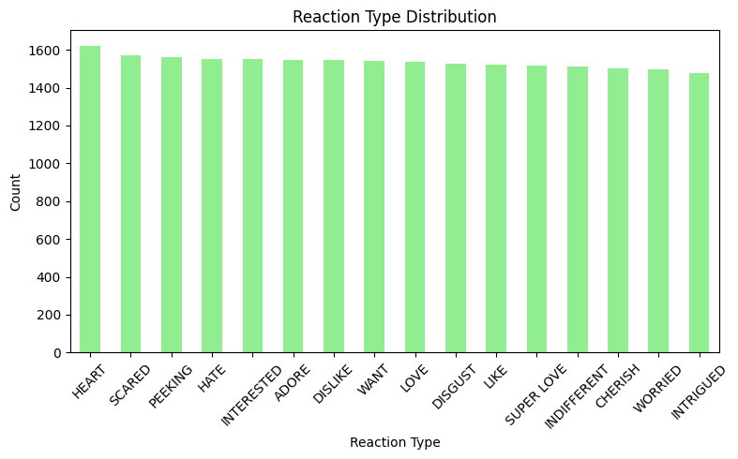
. Reaction Type Distribution
Analyzed the distribution of various reaction types.
Key Insight: The reactions are quite evenly distributed, with some reactions like “HEART” and “SCARED” slightly more frequent.

Slide 11
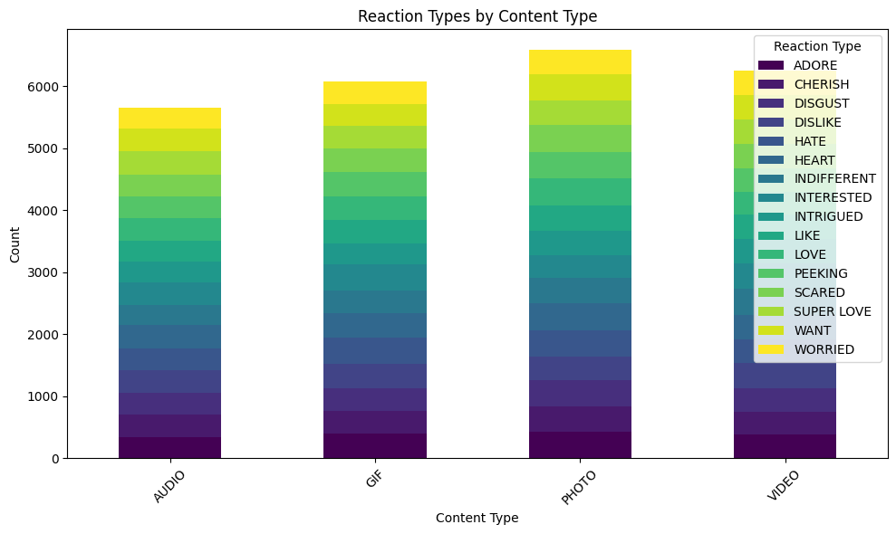
Reaction Types by Content Type
We investigated how users reacted to different types of content (Audio, GIF, Photo, Video).
Key Insight: Photo and Video content types garnered the most diverse reactions, while Audio content had a more limited reaction range.

Slide 12
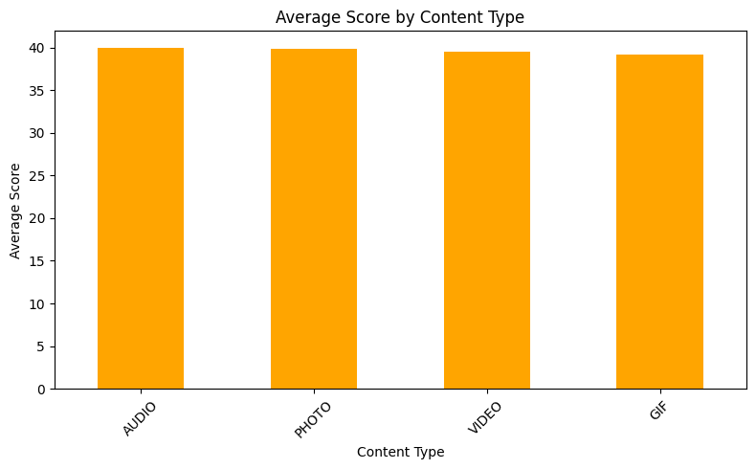
Average Score by Content Type
We calculated the average score for each content type.
Key Insight: All content types performed similarly, with slightly higher scores for Video and GIF content.

Slide 13

Key Takeaways:
Focus on high-performing categories such as ANIMALS, SCIENCE, and TECHNOLOGY to boost engagement.
Content types like Photos and Videos receive the most diverse user reactions, offering opportunities to further optimize these formats.
Maintaining a balance between positive and negative sentiment is crucial for sustaining user engagement.
Summary

Slide 14
Thank you!
ANY QUESTIONS?

