Slide 1
Target Intoduction

Slide 2
Outline topic
What Big Data Is
Is Big Data just Hype
Some uses of Big Data
The Challenges of Big Data
Privacy

Slide 3
2,500,000,000,000,000,000 (two point five quintillion)
A) Number of Wings Bob and Doug have eaten this year at Wegman’s.
B) Number of times the phrase “right sourcing” has been used this year within Vanguard
C) Number of bytes of data created in a single day.

Slide 4
2,500,000,000,000,000,000
2.5 quintillion bytes (roughly 2.5 exabytes)
90% of the world’s data has been created in the last 2 years.
Experts believe that number will double every 40 months (Harvard Business Review, October 2012)

Slide 5
Discuss aspects of data
What makes big data different from regular data?
4 V’s
Volume
Velocity
Variety
Veracity
Notes:
Volume – 2.5 quintillion bytes daily
Velocity – 1 TB of trading data during each trading day; 100 sensors in cars
Variety – Video, text, pictures, you tube, twitter, facebook, etc.
Veracity – Uncertainty of Data

Slide 6
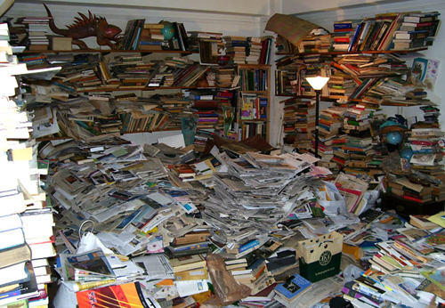
Big Data is Messy
Big Data is messy data
Notes:
A typical big dataset is a collection of facts and measurement, collected for no scientific purpose, using an ad hoc procedure. Riddled with errors and marred with gaps. The data was initially saved for a specific purpose that may make sense in an application, but not in any other way – participant status to use a Vanguard Term.

Slide 7

Big Data Doesn’t Fit The Scientific Method
Big Data doesn’t exactly fit the scientific method
Notes:
Scientists like to confirm specific hypotheses, and to gradually assemble what they learned into causal stories and eventually mathematical theories. Typically, big data highlights correlation not causation – for example, looking through data sets you could make a correlation between rates of high-seas piracy and atmospheric temperatures. Do pirates bring global warming?

Slide 8

Where the data lives
The good Big Data is protected.
Notes:
Major corporations and big governments are often the gatekeepers of the most powerful datasets. They care very much how the data is used. Very few people want the IRS to share their tax returns. Authors of books and papers copyright their material, which can make it difficult to aggregate.

Slide 9
Big Data Hype
Is Big Data just Hype?
Big Data is short for the same statistics marketers have always used
Data has been exponentially increasing in volume, velocity and variety since the advent of the computer. No change of state has occurred.
No kidding more data is being digitized, it is a by-product of the internet and cheap computing storage.
Insert graph of storage costs.
Notes:
Big Data was used in the formation of this company. Jack Bogle did not go out and say

Slide 10
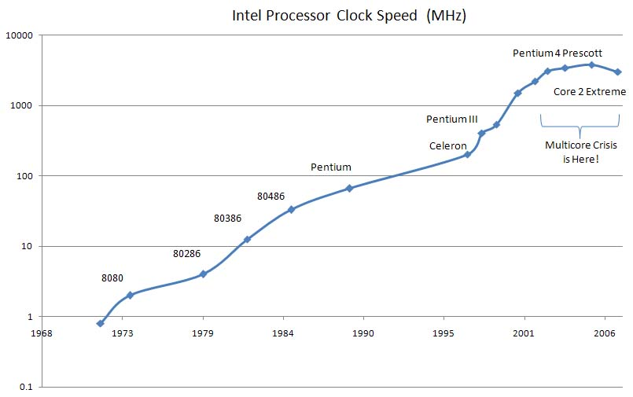
Processor Speed Slowdown

Slide 11
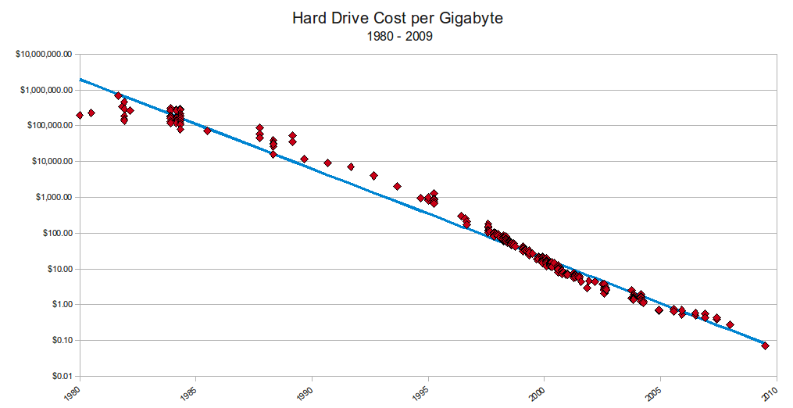
Storage Costs Continue to Fall
Notes:
Over $100,000 per gigabyte in 1980 – down to .10 per gigabyte in 2010
From http://www.mkomo.com/cost-per-gigabyte

Slide 12
What has changed?
2002 Doug Cutting and Mike Cafarella started building a Web crawler and searcher, called Nutch, that they wanted to scale up to crawl and search the entire Web (several billion pages at the time).
it wasn't until 2003, when Google published papers on its data processing infrastructure that solved the same problems, that "the route became clear," as Cutting put it.

Slide 13
Hadoop
two principal parts:
the Hadoop Distributed File System (HDFS)
HDFS makes it easy to store large files. It optimizes for transfer speed over latency, which is what you want when you are writing files with billions of records (Web pages, in the original use case). You don't need to alter the files once they are written, because the next crawl will rewrite the whole file anew (no update)
MapReduce.
MapReduce enables you to operate on the contents of a file in parallel by having an independent process read each chunk (or "block") of the file.
With HDFS and MapReduce, the speed of analysis scales to the size of the cluster: A well-written job can run twice as fast on a cluster that is twice as big.

Slide 14
Facebook
2.5 billion content items shared per day (status updates + wall posts + photos + videos + comments)
2.7 billion Likes per day
300 million photos uploaded per day
100+ petabytes of disk space in one of FB’s largest Hadoop (HDFS) clusters
105 terabytes of data scanned via Hive, Facebook’s Hadoop query language, every 30 minutes
70,000 queries executed on these databases per day
500+terabytes of new data ingested into the databases every day

Slide 15
Google Books Project
http://books.google.com/ngrams
Notes:
Google has scanned 30 million books – about 1 in 4 ever written. Two authors came up with a way to harness all of that information that does not violate the copyright and gives some insight how our language has changed over time.

Slide 16
Uses of Big Data
Healthcare: 20% decrease in patient mortality by analyzing streaming patient data
The cost to sequence a genome has dropped dramatically thanks to Big Data processing - from $95 million in 2001 to $5,700 in 2013.
Telco: 92% decrease in processing time by analyzing networking and call data
Utilities: 99% improved accuracy in placing power generation resources by analyzing 2.8 petabytes of untapped data
Banking: Payment fraud detection and investigation

Slide 17
Privacy – What We Know About
New York City – Domain Awareness System
Joint Venture with Microsoft
Installed over 3000 cameras throughout Manhattan (roughly 88 cameras per square mile)
Records and stores license plate numbers
Cameras identify shapes and sizes
Can track people within seconds using descriptions such as "someone wearing a red shirt".
Can transmit to officers on the scene video 30 seconds before the 911 call was received.

Slide 18
Privacy – What We Don’t Know
Prism (Edward Snowden)
NSA collects phone records from Verizon and AT&T on a daily basis.
NSA reportedly has direct access to the data at
Microsoft
Yahoo
Google
Facebook
PalTalk
Skype
AOL
Apple

Slide 19
Conclusion
“With great power comes great responsibility…”
-Voltaire
Notes:
With Big Data, great discoveries could be made using correlation. However, in the words of our founder – more data does not equal wisdom.

