Slide 1

Notes:
Photo by SHVETS production from Pexels
Start session by asking two questions

Slide 2

Should not run reports from a OLTP production database
Notes:
Photo by krakenimages on Unsplash
We know you should never report from production database

Slide 3
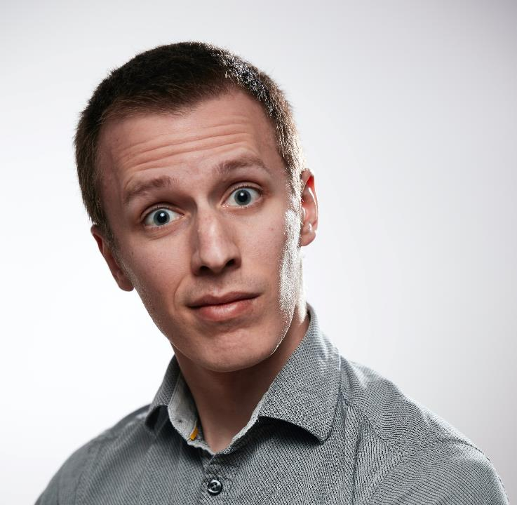
Testing database backups is vital.
Notes:
Photo by Ludovic Migneault on Unsplash
Testing the database backup is good idea to keep your job.

Slide 4

Notes:
Photo by Ann H from Pexels
Why are these statements true or correct?

Slide 5

The Curse
Notes:
Photo by Gabriella Clare Marino on Unsplash

Slide 6
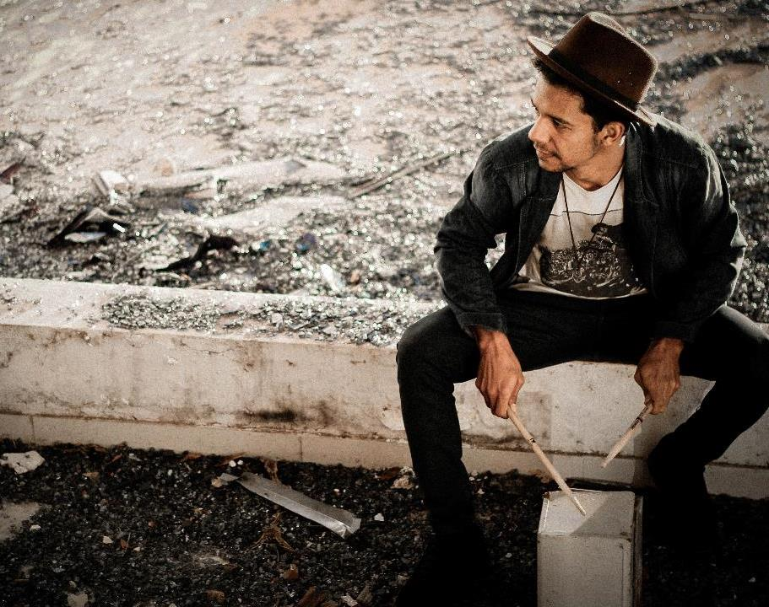
The
Drumming game
Notes:
Inspired by - Made to Stick by Chip Heath & Dan Heath
https://dr-biz.com/story-on-communication-tappers-and-listeners/
Elizbeth Newton 1990
"Overconfidence in the communication of intent: Heard and Unheard Melodies: Phd Diss Standford University 1990
https://en.wikipedia.org/wiki/Curse_of_knowledge
Photo by Allef Vinicius on Unsplash

Slide 7
Two groups
Tappers
Listeners

Slide 8
Tappers
Notes:
Each tapper was given 25 well known songs to tap out eg
Happy Birthday,
Merry Christmas,
Star Spangled Banner

Slide 9
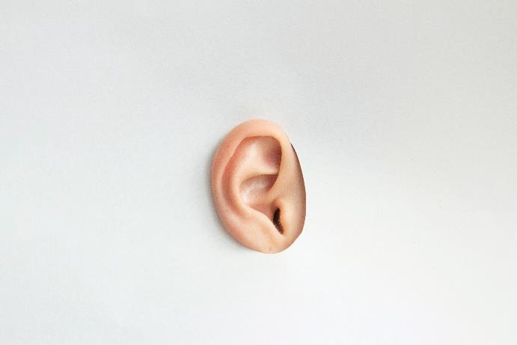
Listeners
Notes:
A listener was paired with each tapper, to listen to the tapper tap out the tune. Simple as that.

Slide 10
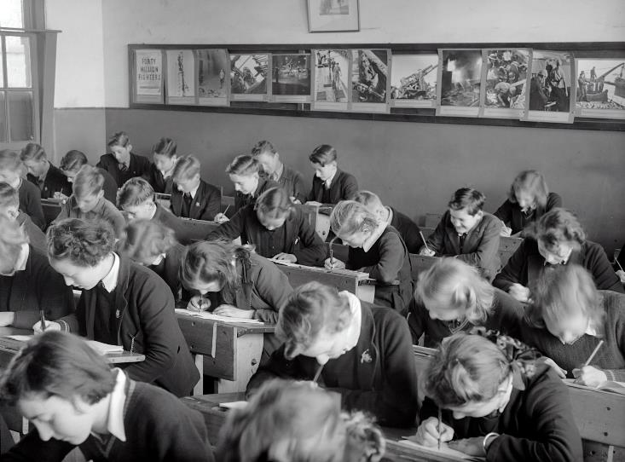
Quiz time
Notes:
Photo by Museums Victoria on Unsplash

Slide 11
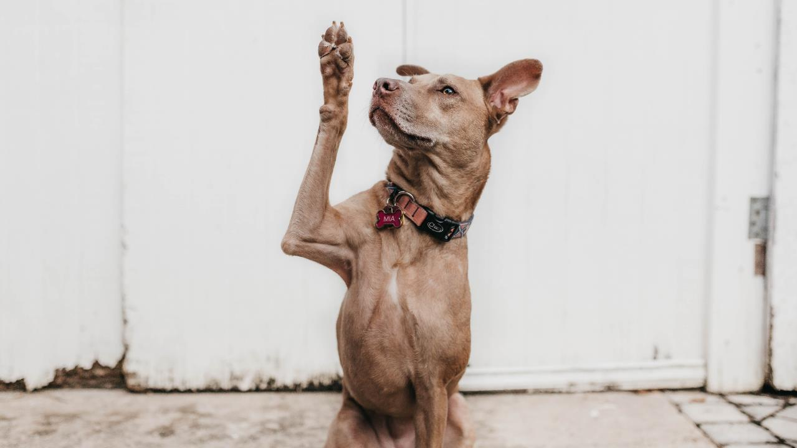
Notes:
How often did the listeners guess the tune?

Slide 12
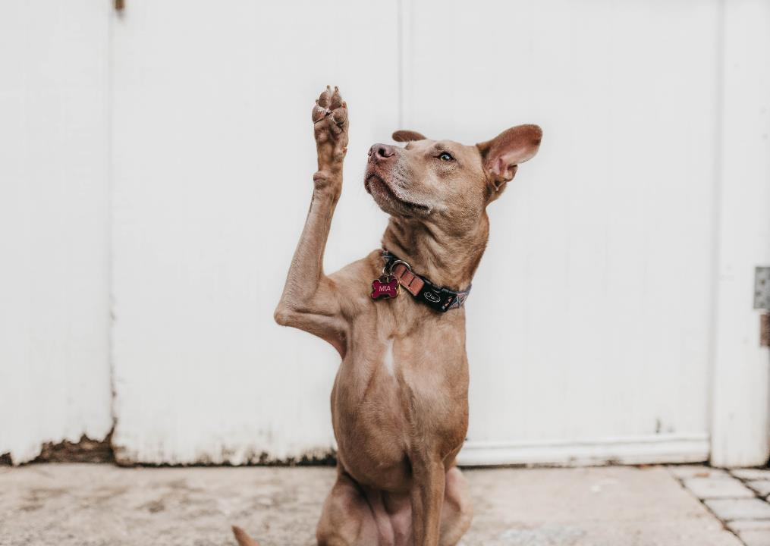
>75% of the time
Notes:
How often did the listeners guess the tune?

Slide 13
>50% of the time
Notes:
How often did the listeners guess the tune?

Slide 14
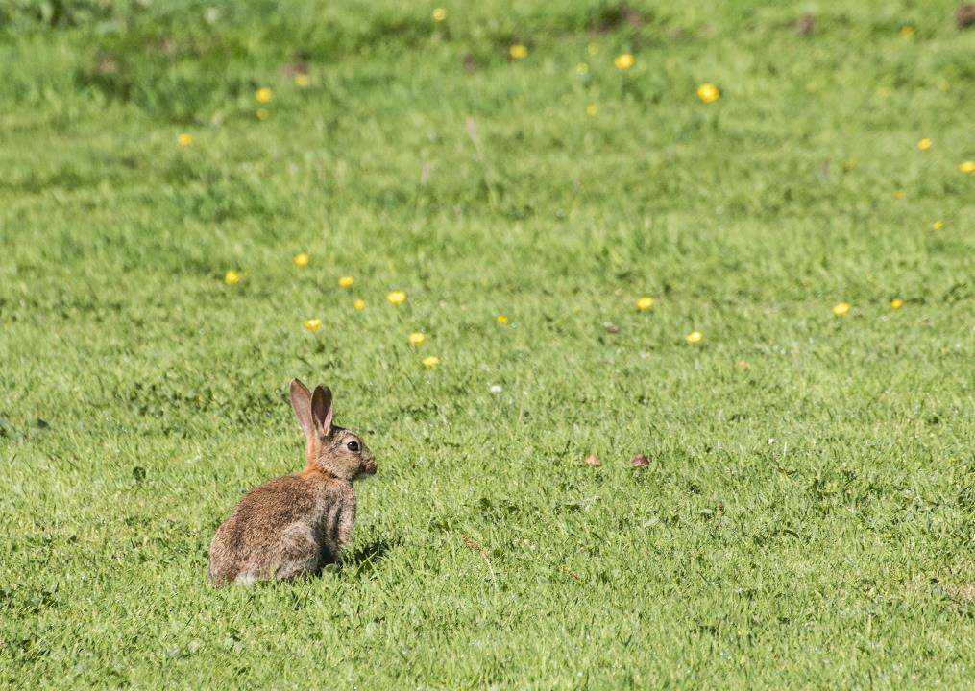
>25% of the time
Notes:
How often did the listeners guess the tune?
Photo by Dean Ward on Unsplash

Slide 15
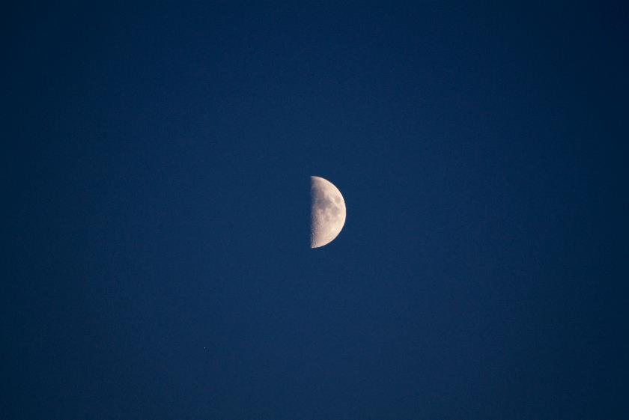
Tappers predicated listeners would guess the tune
50%
of the time.
Notes:
Photo by Edge2Edge Media on Unsplash

Slide 16

Repeated
120
times
Notes:
Photo by Mitchell Luo on Unsplash

Slide 17
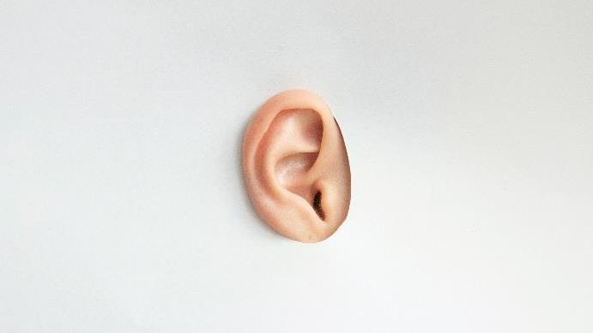
Listeners correctly guessed the tune
Notes:
How often did the listeners correctly guess the tune?

Slide 18

Notes:
Photo by Tony Hand on Unsplash
times out of 120 attempts
Success rate of 2.5 %

Slide 19
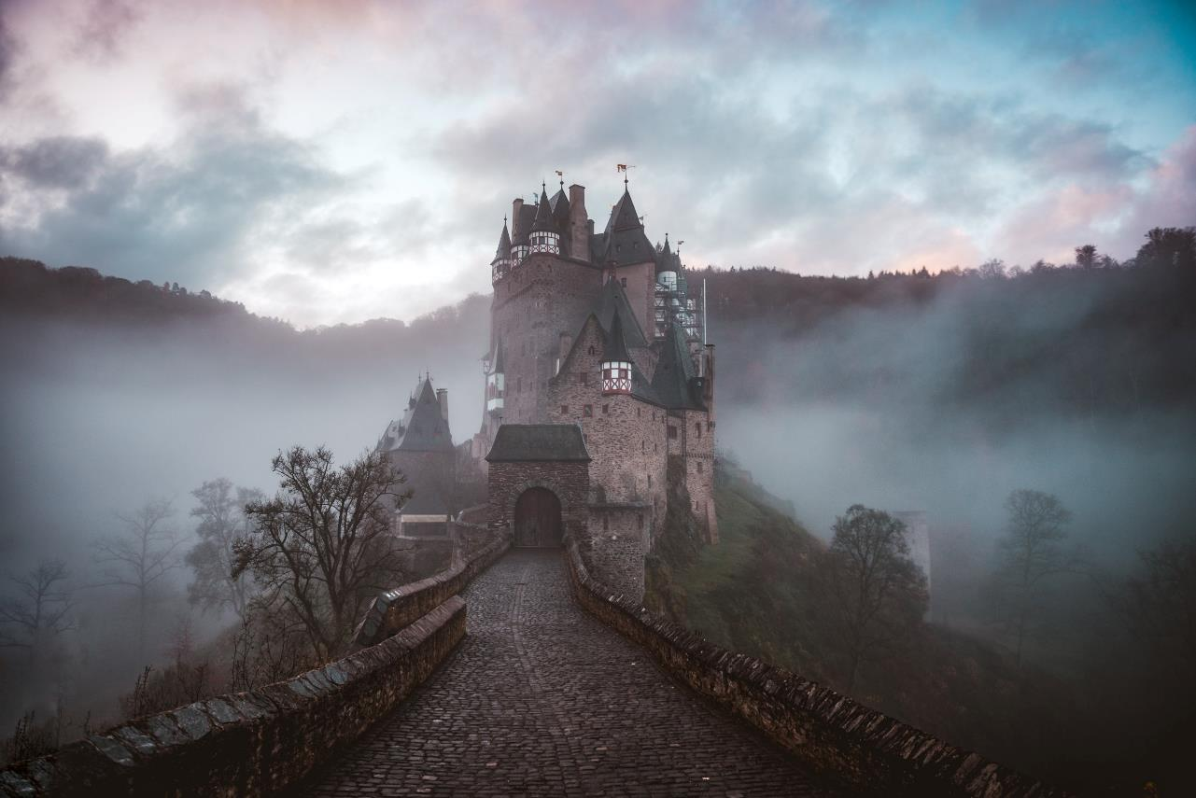
Curse
of
knowledge
Notes:
https://www.journals.uchicago.edu/doi/abs/10.1086/261651
The Curse of Knowledge in Economic Settings: An Experimental Analysis
Photo by Cederic Vandenberghe on Unsplash

Slide 20


We all know?
Notes:
Photo by Kelly Sikkema on Unsplash

Slide 21

“….that‘s what I do read books and know things….”
Notes:
Photo by Susan Q Yin on Unsplash
We are all information workers, we read books, blog posts, listen to podcasts

Slide 22
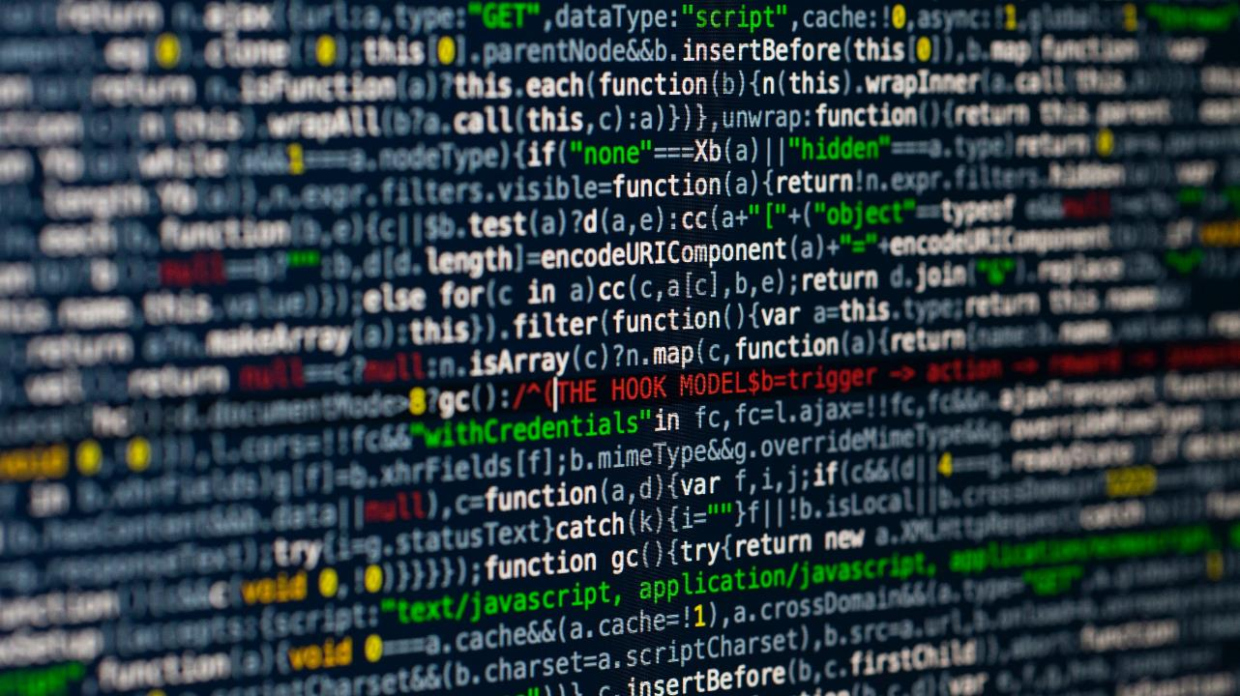
Notes:
Photo by Markus Spiske on Unsplash
Not everyone knows what you know

Slide 23
Tapper
Notes:
I feel very much like a tapper

Slide 24
Listener
Notes:
I need to learn to see and understand as a listener does

Slide 25
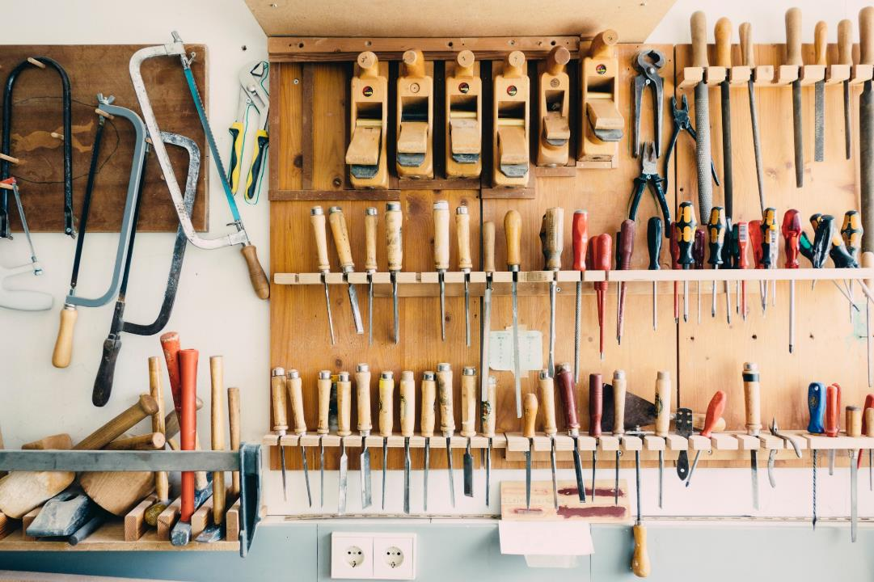
Notes:
Photo by Barn Images on Unsplash

Slide 26
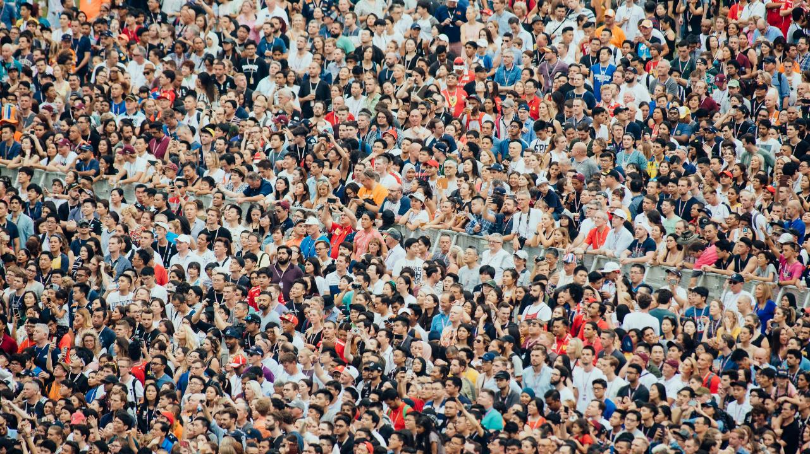
Notes:
Photo by CHUTTERSNAP on Unsplash
Start with who are you speaking to, who is your audience

Slide 27
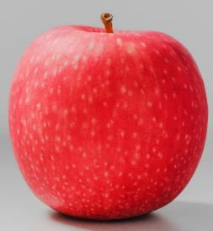
Notes:
Photo by an_vision on Unsplash

Slide 28


Notes:
Photo by an_vision on Unsplash

Slide 29
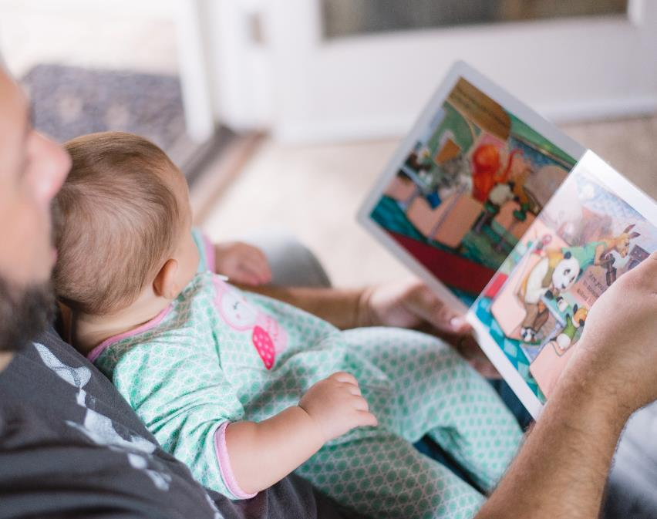
“What unites people?... Stories. There's nothing more powerful in the world than a good story.”
Tyrion Lannister
Game of Thrones
Notes:
Photo by Picsea on Unsplash

Slide 30
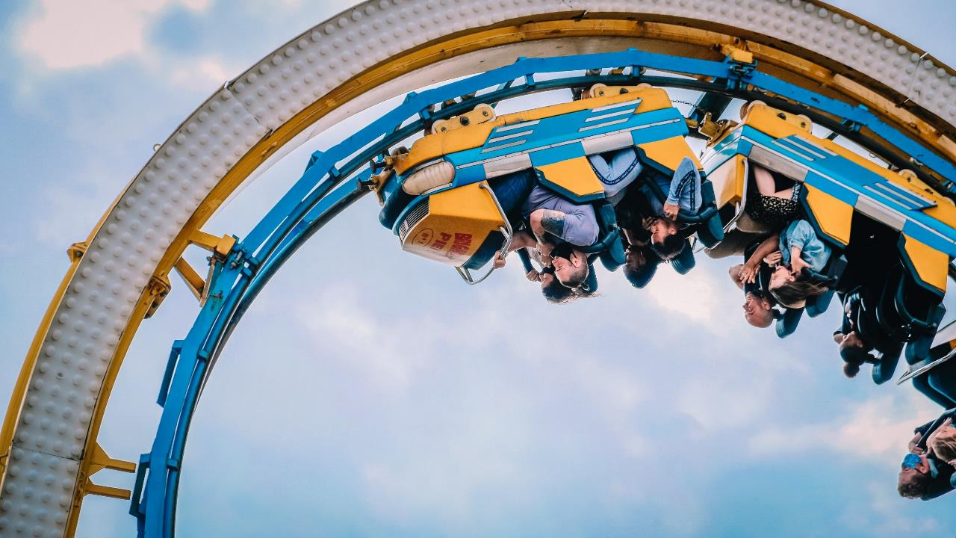
That movie was a roller coaster ride of emotions

Slide 31
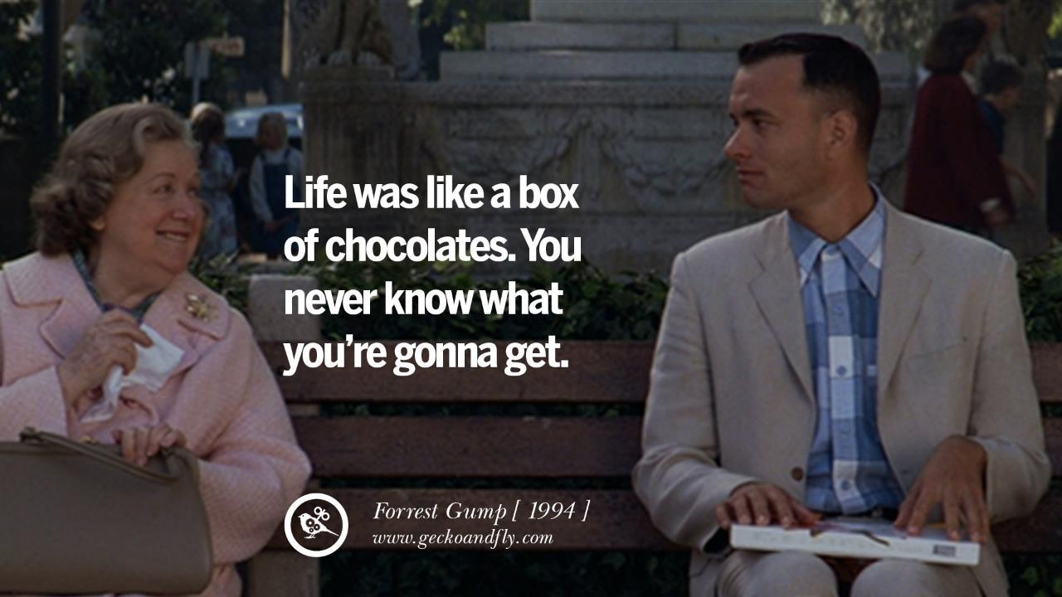

Slide 32
K
I
S
S

Slide 33
K
I
S
S
- Keep

Slide 34
K
I
S
S
- Keep
- It

Slide 35
K
I
S
S
- Keep
- It
- Short

Slide 36
K
I
S
S
- Keep
- It
- Short
- Simple

Slide 37
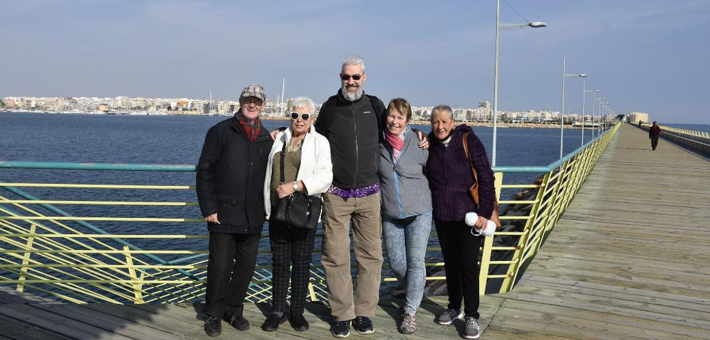

Slide 38
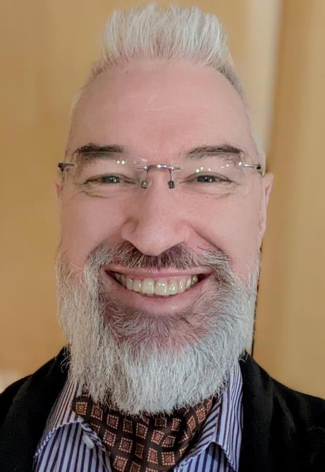




Robert French
Data Shepherd, Data Plumber,
Data Dance Teacher
In Sunny Glasgow Scotland
rwlp.french@gmail.com
@SqlBobScot
https://www.linkedin.com/in/rwlpfrench/
http://www.sqlbob.uk/

