Slide 1


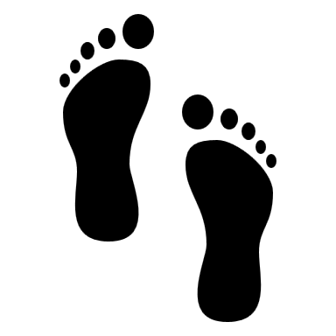
Run Km
Swim Km
Walk Km

