Slide 1


Slide 2
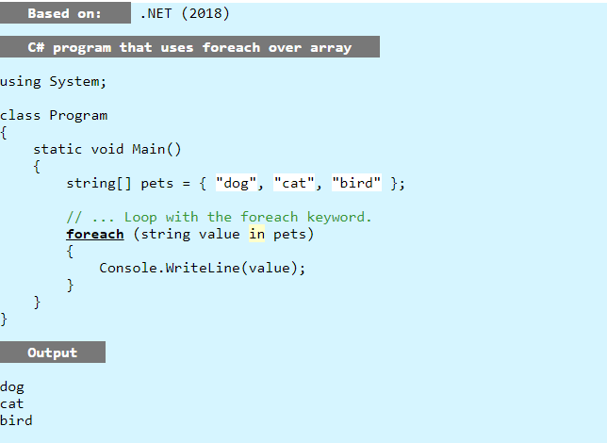
Looping over a set of records one by one is easy in C#

Slide 3
Lets get some records from a table ☺
Using obviously a cursor!
That’s a good idea…….?

Slide 4
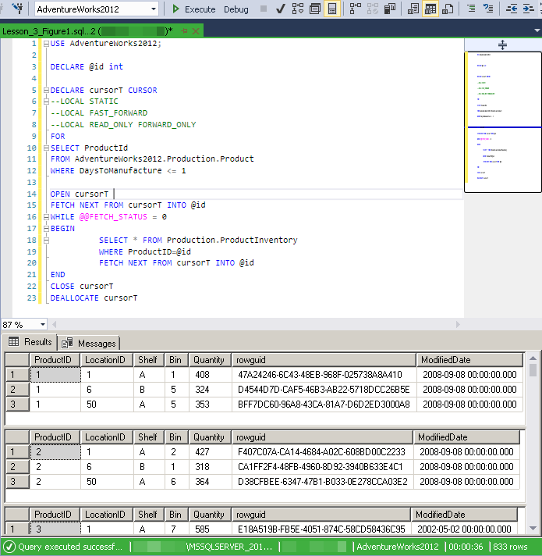
Query returns 833 records
how long will it take?

Slide 5
Multiple choice
1 second
30 seconds
55 seconds
3 minutes
20 minutes

Slide 6
Multiple choice
1 second
30 seconds (approx.)
55 seconds
3 minutes
20 minutes

Slide 7
833 records return in 36 seconds.

Slide 8


Good?
Or
Bad?

Slide 9
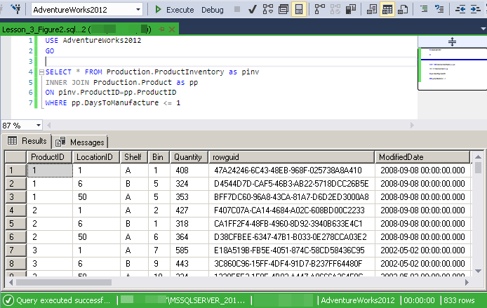
Query returns 833 records
how long will it take?

Slide 10
Multiple choice
1 second
30 seconds
55 seconds
3 minutes
20 minutes

Slide 11
Multiple choice
1 second (less than)
30 seconds
55 seconds
3 minutes
20 minutes

Slide 12
Damn these pesky selects and joins
833 records return in >1 second.

Slide 13
Good?
Or
Bad?

Slide 14
Simple Specification
Calculate the ‘total’ amount for each row in [Sales].[SalesOrderHeader] table.
Calculation
Total Amount = [SubTotal] + [TaxAmt] + [Freight]
Place value for Total Amount into field [Sales].[SalesOrderHeader].[TotalAmt]

Slide 15
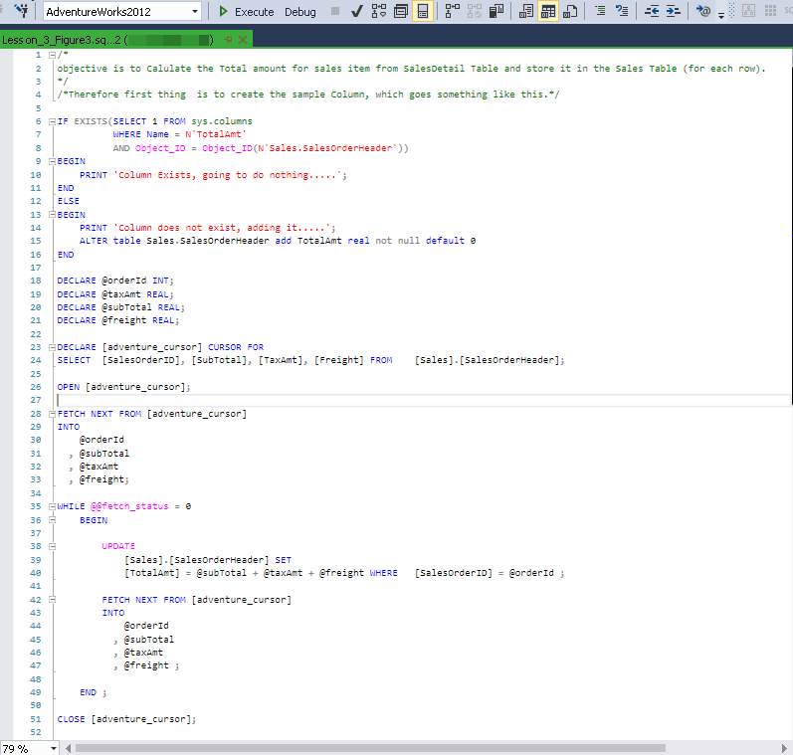

Slide 16
Simple Specification
Change to 31,465 records
Multiple choice
1 second
15 seconds
30 seconds
55 seconds
3 minutes
20 minutes

Slide 17
Simple Specification
Change to 31,465 records
Multiple choice
1 second
15 seconds
30 seconds
55 seconds
3 minutes
20 minutes

Slide 18
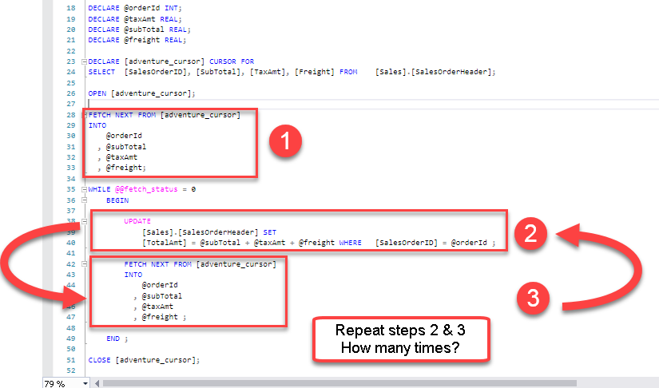
Why so long?

Slide 19
Same single action repeated for
EVERY
SINGLE
ROW
RBAR ©
Row By Agonizing Row

Slide 20
Why is Select better than a cursor?

Slide 21


Slide 22

£60 of pennies
£10,000 in pound coins

Slide 23
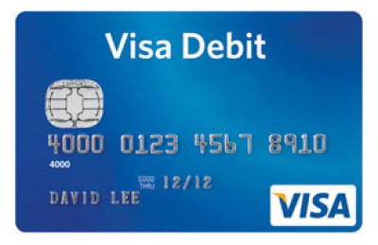
Or use a debit card? What's easier?

Slide 24
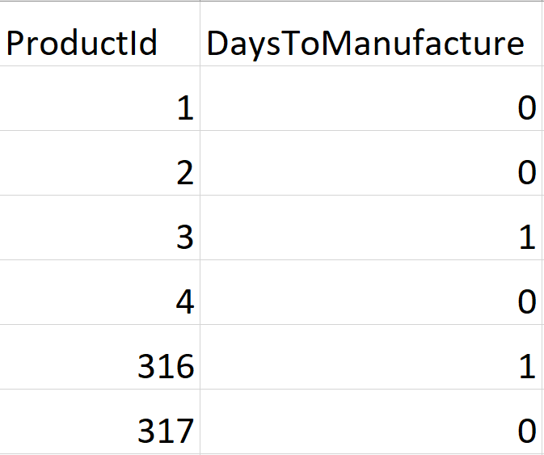
Do action on this record
Do action on this record
Do action on this record
Do action on this record
Do action on this record
Do action on this record

Slide 25
This takes a LONG !!!
15 seconds ++++
So slow, so sad

Slide 26

What can we do different?

Slide 28
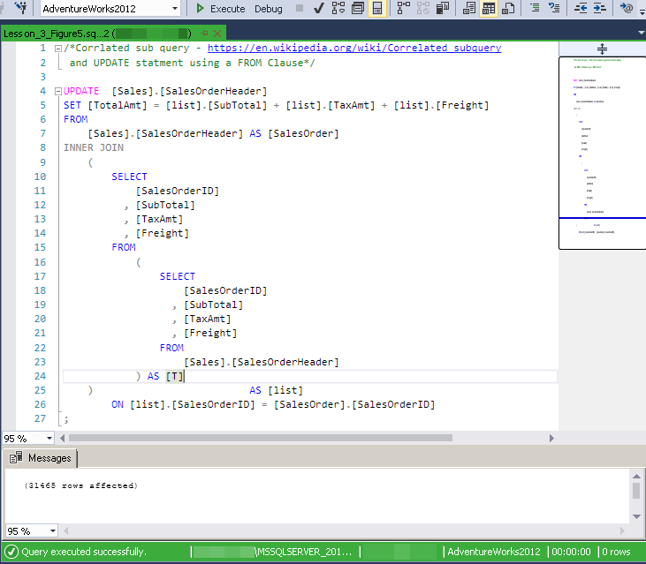
Correlated sub query (complicated)
Less than 1 second to run

Slide 29
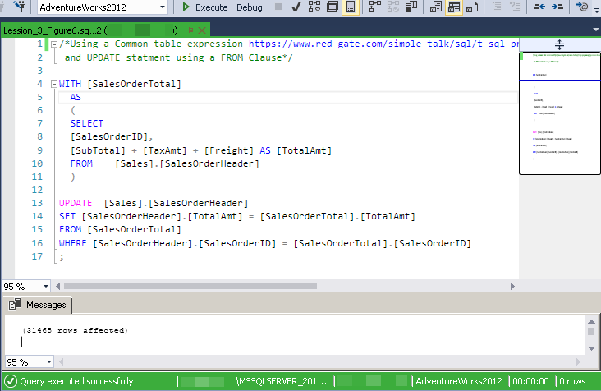
Common Table Expression
Less than 1 second to run

Slide 30
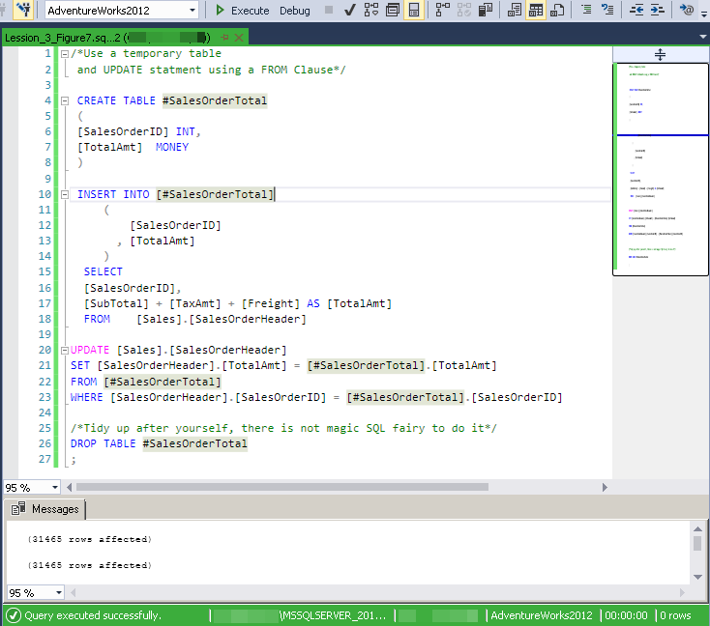
Use Temporary Table
Less than 1 second to run

Slide 31
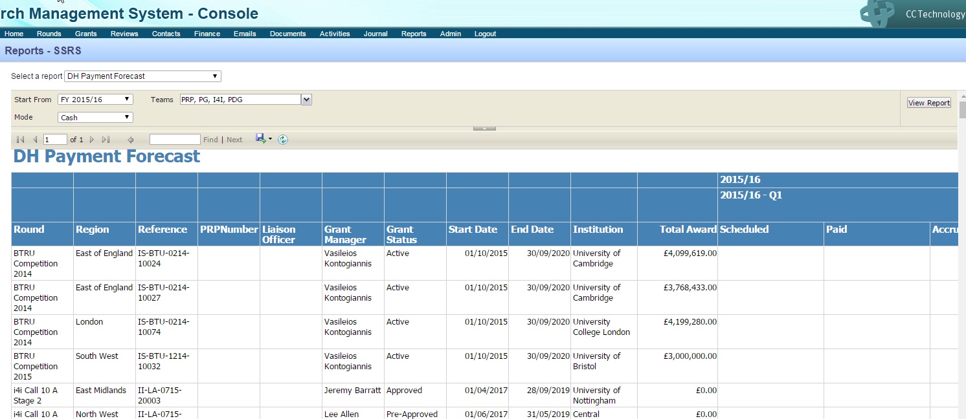
Example
CCF report DH Payment Forecast timing out when running.
In particular when running for multiple teams.

Slide 32
Parameter set 1
StartFrom | 01/04/2014 00:00
Team | IRS
Mode | 2
UserID | FFE5E71F-A68E-4B33-BC78-A53900BE720A
Parameter set 2
StartFrom | 01/04/2014 00:00
Team | PRP,PG
Mode | 2
UserID | FFE5E71F-A68E-4B33-BC78-A53900BE720A

Slide 33
Parameter set 3
StartFrom | 01/04/2014 00:00
Team | PRP,GRP2,RISC,PG,RfPB,RDS,IRS,HICF,GRP1,I4I,PDG
Mode | 2
UserID | FFE5E71F-A68E-4B33-BC78-A53900BE720A

Slide 34


Slide 35


