Slide 1

TSQL Windows Functions
Photo by Dmitri Popov on Unsplash

Slide 2
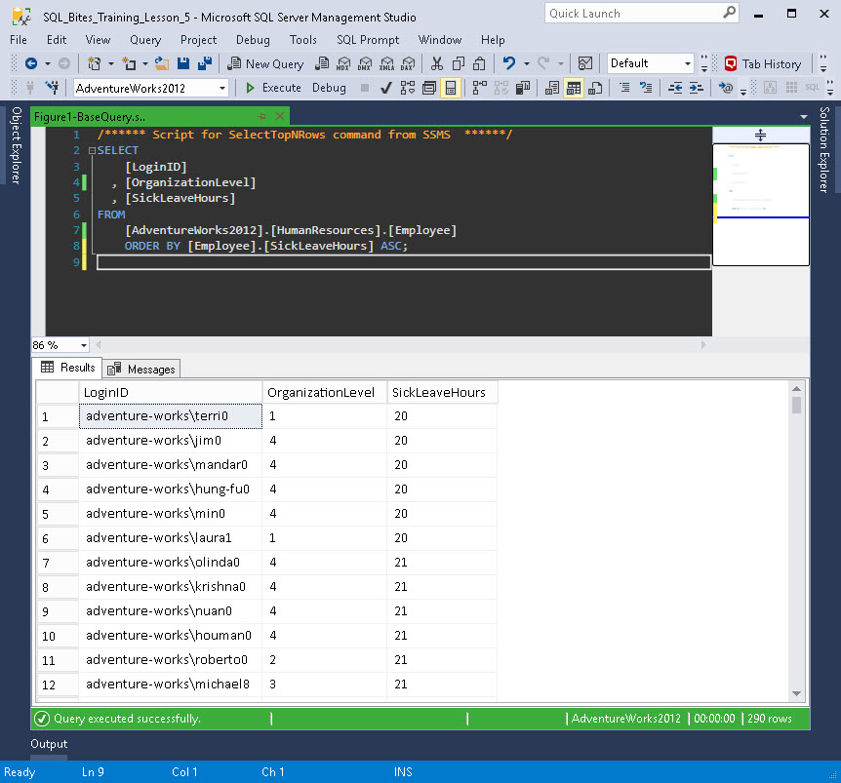
Figure 1 - List of all the employee's records ordered by [SickLeaveHours] in ascending order

Slide 3
The Query
USE [AdventureWorks2012];
SELECT
[Employee].[LoginID]
, [Employee].[OrganizationLevel]
, [Employee].[SickLeaveHours]
, ROW_NUMBER()
OVER (
PARTITION BY [Employee].[OrganizationLevel]
ORDER BY [Employee].[SickLeaveHours]
) AS [RowNumber]
FROM [HumanResources].[Employee];
Notes:
Query1

Slide 4
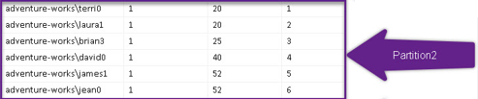
Partition by
Apply windows function to this group of data (in this case where[Employee].[OrganizationLevel] [Employee].[OrganizationLevel] = 1 )
Partition by = Group/set of data
OrganizationLevel
RowNumber

Slide 5
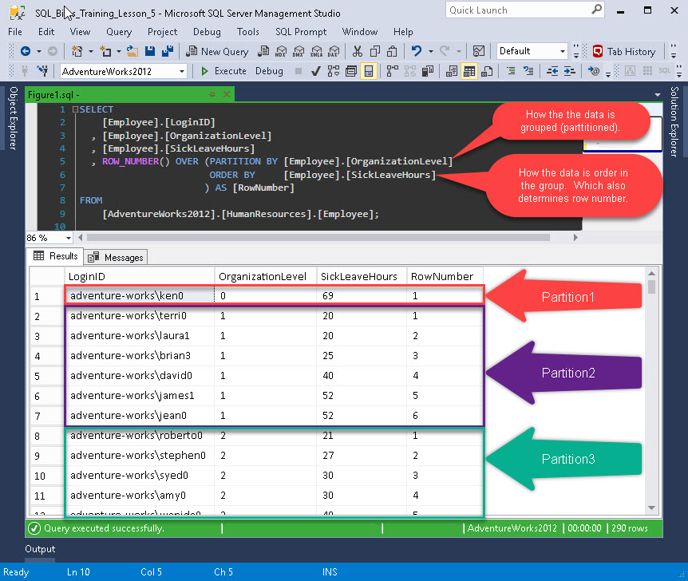
The dataset

Slide 6
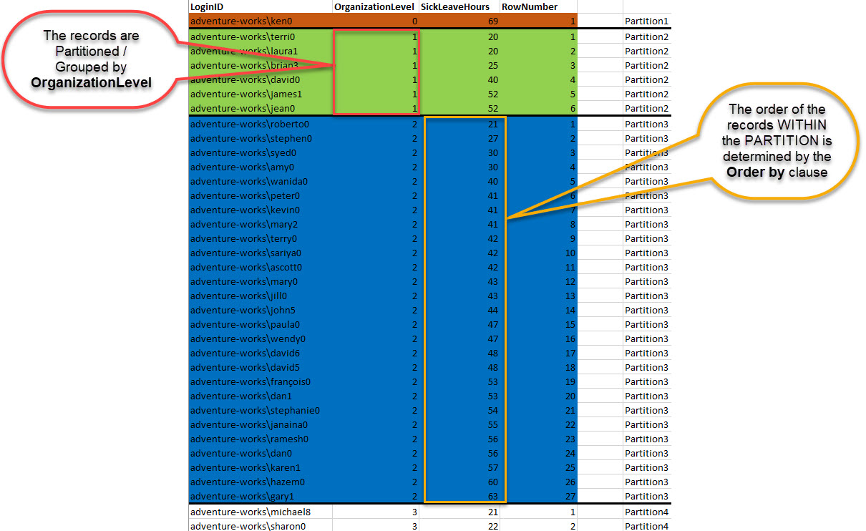
Dataset (colour coded)

Slide 7
Lets build a query part 1
SELECT TOP (100) PERCENT
[SalesOrderHeader].[OrderDate]
, [SalesOrderHeader].[CustomerID]
, [SalesOrderHeader].[TotalAmt]
/*cast the date to a suitable format to allow sorting*/
, CAST(FORMAT([SalesOrderHeader].[OrderDate], 'yyyy’)
+ FORMAT([SalesOrderHeader].[OrderDate], 'MM') AS NVARCHAR(6)) AS [YearMonth]
FROM [AdventureWorks2012].[Sales].[SalesOrderHeader]
WHERE [SalesOrderHeader].[CustomerID] = 11501
ORDER BY [SalesOrderHeader].[OrderDate]
Notes:
LetsBuildQueryPart1

Slide 8
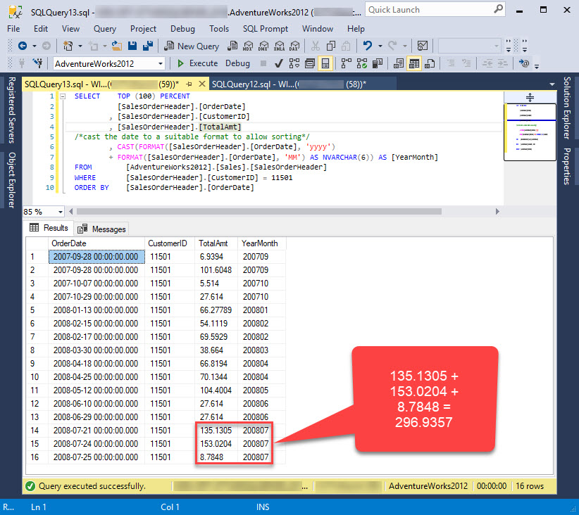

Slide 9
Lets build a query part 2
;
WITH [Step1]
AS
(
SELECT TOP (100) PERCENT
[SalesOrderHeader].[OrderDate]
, [SalesOrderHeader].[CustomerID]
, [SalesOrderHeader].[TotalAmt]
/*cast the date to a suitable format to allow sorting*/
, CAST(FORMAT([SalesOrderHeader].[OrderDate], 'yyyy') + FORMAT([SalesOrderHeader].[OrderDate], 'MM') AS NVARCHAR(6)) AS [YearMonth]
FROM [AdventureWorks2012].[Sales].[SalesOrderHeader]
WHERE [SalesOrderHeader].[CustomerID] = 11501
ORDER BY [SalesOrderHeader].[OrderDate]
)
SELECT [Step1].[CustomerID]
, [Step1].[YearMonth]
, SUM([Step1].[TotalAmt]) AS [Monthly_Total]
FROM [Step1]
GROUP BY
[Step1].[CustomerID]
, [Step1].[YearMonth]
Notes:
LetsBuildQueryPart2

Slide 10
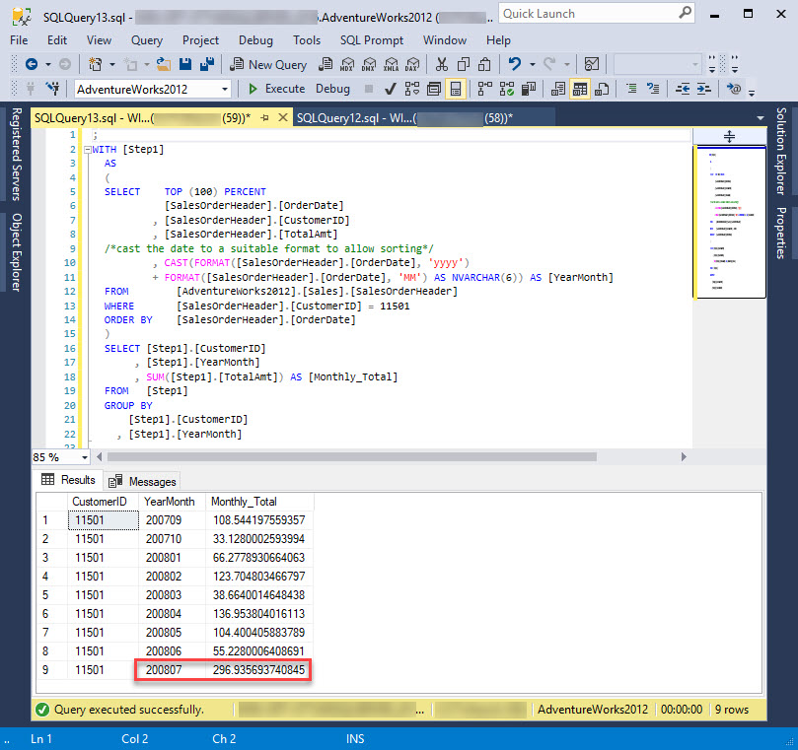

Slide 11
Lets build a query part 3
;
WITH [Step1]
AS
(
SELECT TOP (100) PERCENT
[SalesOrderHeader].[OrderDate]
, [SalesOrderHeader].[CustomerID]
, [SalesOrderHeader].[TotalAmt]
/*cast the date to a suitable format to allow sorting*/
, CAST(FORMAT([SalesOrderHeader].[OrderDate], 'yyyy') + FORMAT([SalesOrderHeader].[OrderDate], 'MM') AS NVARCHAR(6)) AS [YearMonth]
FROM [AdventureWorks2012].[Sales].[SalesOrderHeader]
WHERE [SalesOrderHeader].[CustomerID] = 11501
ORDER BY [SalesOrderHeader].[OrderDate]
) , [Step2] AS
( SELECT [Step1].[CustomerID]
, [Step1].[YearMonth]
, SUM([Step1].[TotalAmt]) AS [Monthly_Total]
FROM [Step1]
GROUP BY
[Step1].[CustomerID]
, [Step1].[YearMonth])
SELECT
[Step2].[CustomerID]
, [Step2].[YearMonth]
, [Step2].[Monthly_Total]
, LEAD ([Step2].[Monthly_Total]) OVER (ORDER BY [Step2].[YearMonth]) AS [LeadValue]
, LAG ([Step2].[Monthly_Total]) OVER (ORDER BY [Step2].[YearMonth]) AS [LagValue]
FROM [Step2]
Notes:
LetsBuildQueryPart3

Slide 12
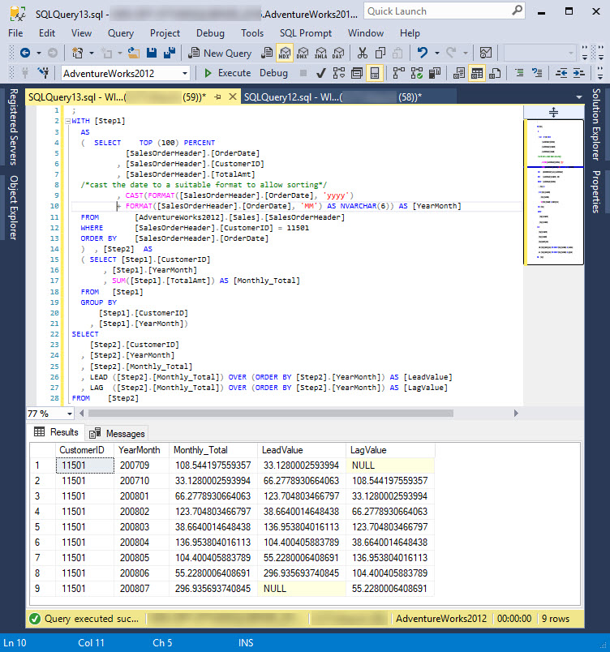

Slide 13


Slide 14
First_Value()
Last_Value()

Slide 15
Lets build a query part 4
;
WITH [Step1]
AS
(
SELECT TOP (100) PERCENT
[SalesOrderHeader].[OrderDate]
, [SalesOrderHeader].[CustomerID]
, [SalesOrderHeader].[TotalAmt]
/*cast the date to a suitable format to allow sorting*/
, CAST(FORMAT([SalesOrderHeader].[OrderDate], 'yyyy')
+ FORMAT([SalesOrderHeader].[OrderDate], 'MM') AS NVARCHAR(6)) AS [YearMonth]
FROM [AdventureWorks2012].[Sales].[SalesOrderHeader]
WHERE [SalesOrderHeader].[CustomerID] = 11501
ORDER BY [SalesOrderHeader].[OrderDate]
)
, [Step2] AS
(
SELECT [Step1].[CustomerID]
, [Step1].[YearMonth]
, SUM([Step1].[TotalAmt]) AS [Monthly_Total]
FROM [Step1]
GROUP BY
[Step1].[CustomerID]
, [Step1].[YearMonth]
)
SELECT
[Step2].[CustomerID]
, [Step2].[YearMonth]
, [Step2].[Monthly_Total]
, FIRST_VALUE([Step2].[Monthly_Total]) OVER (PARTITION BY [Step2].[CustomerID] ORDER BY [Step2].[YearMonth]) AS [First_Value]
, LAST_VALUE ([Step2].[Monthly_Total]) OVER (PARTITION BY [Step2].[CustomerID] ORDER BY [Step2].[YearMonth]) AS [Last_Value]
FROM [Step2]
Notes:
LetsBuildQueryPart4

Slide 16
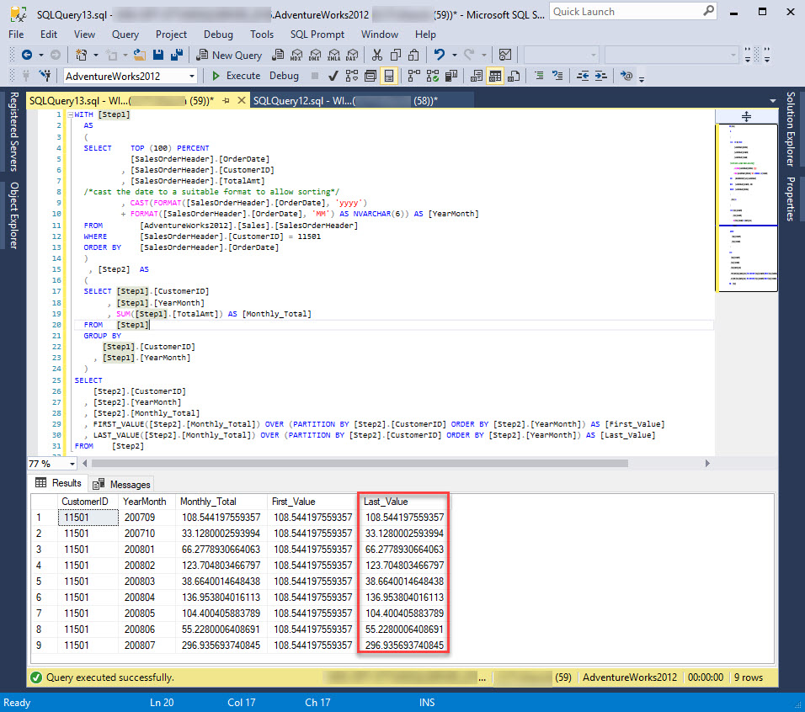

Slide 17

Oh dear ‘Last_Value’ is not correct

Slide 18


Slide 19


Slide 20
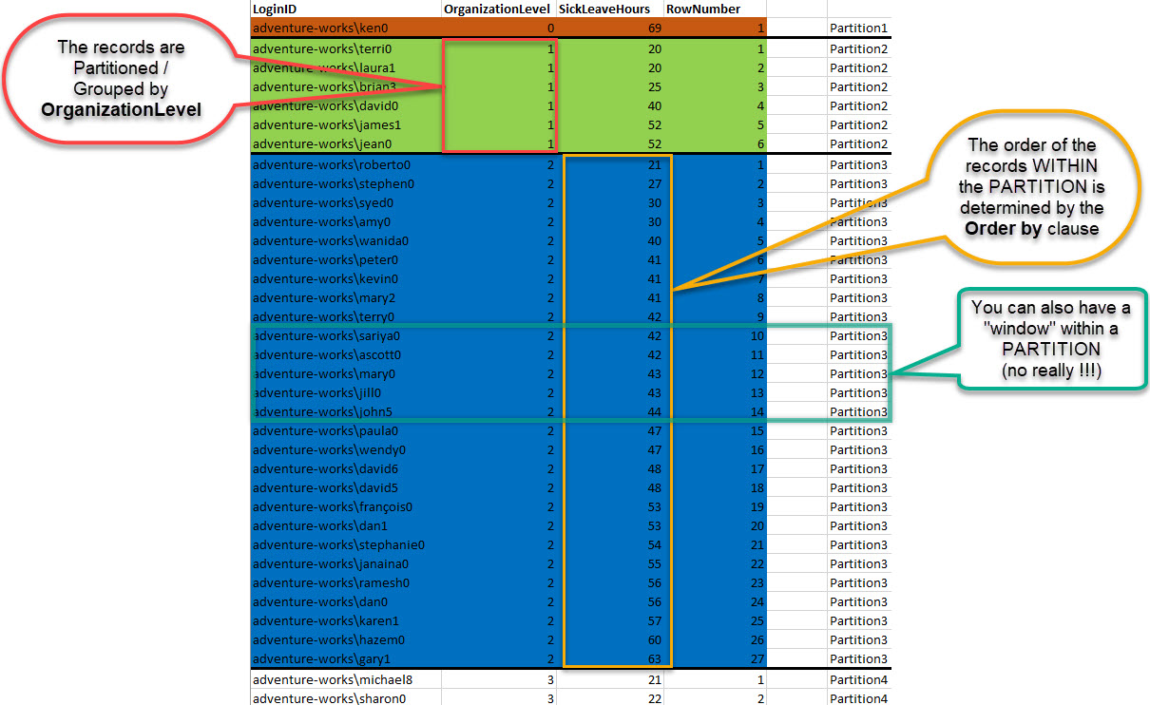

Slide 21
Change this
, LAST_VALUE([Step2].[Monthly_Total])
OVER (PARTITION BY [Step2].[CustomerID]
ORDER BY [Step2].[YearMonth]) AS [Last_Value]
To this
, LAST_VALUE([Step2].[Monthly_Total])
OVER (PARTITION BY [Step2].[CustomerID] ORDER BY [Step2].[YearMonth]
ROWS BETWEEN UNBOUNDED PRECEDING AND UNBOUNDED FOLLOWING) AS [Last_Value]

Slide 22
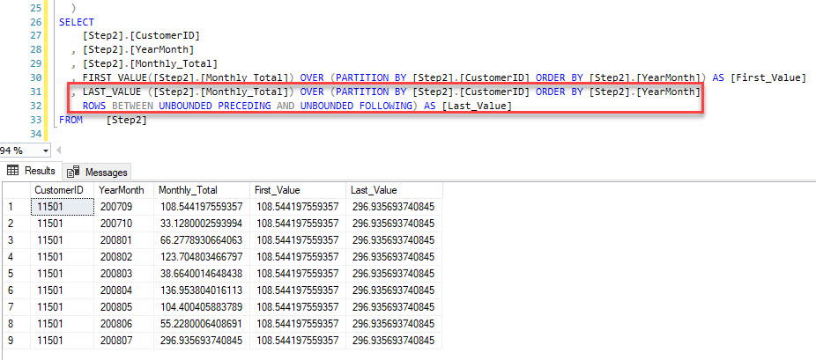
Results Set

Slide 23

Windows in Windows

Slide 24


Slide 25
Some key phrases
Term | Used for
Rows | Positional operator used to define the frame
RANGE | Logical operator used to define the frame. Not fully supported. The default if ROWS is not specified
UNBOUNDED PRECEDING | The first row of the partition
UNBOUNDED FOLLOWING | The last row of the partition
CURRENT ROW | The row where the calculation is being performed
FOLLOWING | The rows after the current row
PRECEDING | The rows before the current row
Notes:
https://www.red-gate.com/simple-talk/sql/t-sql-programming/introduction-to-t-sql-window-functions/

Slide 26
Example usage
ROWS BETWEEN UNBOUNDED PRECEDING AND UNBOUNDED FOLLOWING
ROWS UNBOUNDED PRECEDING
ROWS BETWEEN UNBOUNDED PRECEDING AND 3 PRECEDING
ROWS BETWEEN UNBOUNDED PRECEDING AND 4 FOLLOWING

Slide 27


Slide 28
Lets build a query part 5
;
WITH
[Step1]
AS (SELECT [SalesOrderHeader].[OrderDate]
, [SalesOrderHeader].[TotalAmt]
/*cast the date to a suitable format to allow sorting*/
, CAST(FORMAT([SalesOrderHeader].[OrderDate], 'yyyy') + FORMAT([SalesOrderHeader].[OrderDate], 'MM') AS NVARCHAR(6)) AS [YearMonth]
FROM [AdventureWorks2012].[Sales].[SalesOrderHeader])
,
[Step2]
AS (SELECT [Step1].[YearMonth]
, SUM([Step1].[TotalAmt]) AS [Monthly_Total]
FROM [Step1]
GROUP BY [Step1].[YearMonth])
SELECT [Step2].[YearMonth]
, [Step2].[Monthly_Total]
FROM [Step2]
ORDER BY [Step2].[YearMonth];
Notes:
LetsBuildQueryPart4 – removed customer filter

Slide 29
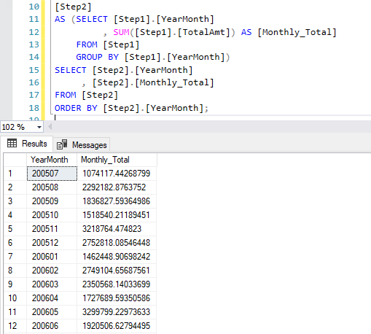
Results Set

Slide 30
Lets add a

Slide 31
Lets build a query part 6
;
WITH
[Step1]
AS (SELECT [SalesOrderHeader].[OrderDate]
, [SalesOrderHeader].[TotalAmt]
/*cast the date to a suitable format to allow sorting*/
, CAST(FORMAT([SalesOrderHeader].[OrderDate], 'yyyy') + FORMAT([SalesOrderHeader].[OrderDate], 'MM') AS NVARCHAR(6)) AS [YearMonth]
FROM [AdventureWorks2012].[Sales].[SalesOrderHeader])
,
[Step2]
AS (SELECT [Step1].[YearMonth]
, SUM([Step1].[TotalAmt]) AS [Monthly_Total]
FROM [Step1]
GROUP BY [Step1].[YearMonth])
SELECT [Step2].[YearMonth]
, [Step2].[Monthly_Total]
, SUM([Step2].[Monthly_Total]) OVER (ORDER BY [Step2].[YearMonth]
ROWS BETWEEN 5 PRECEDING AND CURRENT ROW) AS Rolling6MonthSum
FROM [Step2]
ORDER BY [Step2].[YearMonth];
Notes:
LetsBuildQueryPart4

Slide 32


Slide 33
, SUM([Step2].[Monthly_Total]) OVER (ORDER BY [Step2].[YearMonth]
ROWS BETWEEN 5 PRECEDING AND CURRENT ROW) AS Rolling6MonthSum
Translation
Sum the value of [Monthly_Total] for the previous 5 rows
Including the value of [Monthly_Total] for the current row. The SumTotal returned is for 6 rows (including the current row)

Slide 34
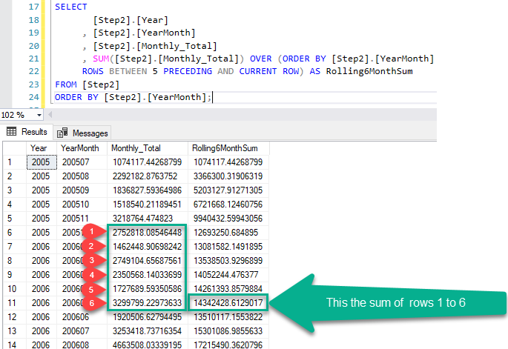
Results Set
Notes:
Repeat including current row

Slide 35
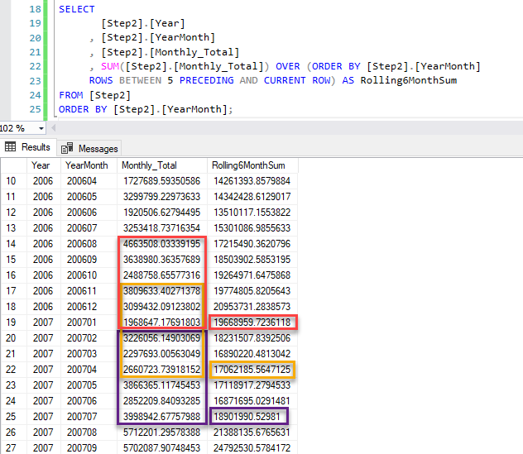
More of the results Set
Can anyone explain this?

Slide 36


Slide 37
Lets add a

Slide 38
Lets build a query part 7
WITH
[Step1]
AS (SELECT [SalesOrderHeader].[OrderDate]
, [SalesOrderHeader].[TotalAmt]
/*cast the date to a suitable format to allow sorting*/
, CAST(FORMAT([SalesOrderHeader].[OrderDate], 'yyyy') + FORMAT([SalesOrderHeader].[OrderDate], 'MM') AS NVARCHAR(6)) AS [YearMonth]
, CAST(FORMAT([SalesOrderHeader].[OrderDate], 'yyyy')AS NVARCHAR(4)) AS [Year]
FROM [AdventureWorks2012].[Sales].[SalesOrderHeader])
,
[Step2]
AS (SELECT [Step1].[YearMonth]
, SUM([Step1].[TotalAmt]) AS [Monthly_Total]
, [Step1].[Year]
FROM [Step1]
GROUP BY [Step1].[YearMonth], [Step1].[Year])
SELECT
[Step2].[Year]
, [Step2].[YearMonth]
, [Step2].[Monthly_Total]
, SUM([Step2].[Monthly_Total]) OVER (PARTITION BY [Step2].[Year] ORDER BY [Step2].[YearMonth]
ROWS BETWEEN 2 PRECEDING AND CURRENT ROW) AS Rolling3MonthSum
FROM [Step2]
ORDER BY [Step2].[YearMonth];
Notes:
LetsBuildQueryPart4

