Slide 1

10/5/2025

Slide 3
모든 영광과 존귀 주께 드리리
You deserve the glory and the honor
Notes:
모든 영광과 존귀 주께 드리리
You deserve the glory and the honor

Slide 4
나의 두 손을 높이 들고 주의 이름 찬양해
Lord, we lift our hands in worship As we bless your holy name
Notes:
나의 두 손을 높이 들고 주의 이름 찬양해
Lord, we lift our hands in worship As we bless Your holy name

Slide 5
나의 주는 위대하신 하나님
For you are great, You do miracles so great
Notes:
나의 주는 위대하신 하나님
For You are great, You do miracles so great

Slide 6
전능하신 나의 왕 아름다우신 주님
There is no one else like you There is no one else like you
Notes:
전능하신 나의 왕 아름다우신 주님
There is no one else like You There is no one else like You

Slide 7
나의 주는 위대하신 하나님
For you are great You do miracles so great
Notes:
나의 주는 위대하신 하나님
For You are great You do miracles so great

Slide 8
모든 것 가능케 할 전능하신 하나님
There is no one else like you There is no one else like you
Notes:
모든 것 가능케 할 전능하신 하나님
There is no one else like You There is no one else like You

Slide 9
전능하신 하나님
There is no one else like you
Notes:
전능하신 하나님
There is no one else like You

Slide 10
I exalt Thee
I exalt Thee

Slide 11
I exalt Thee
O Lord

Slide 13
Gathered here within this place We can share in God’s redeeming grace
Notes:
여기에 모인 우리 주의 은총 받은 자여라
Gathered here within this place, We can share in God’s redeeming grace

Slide 14
There’s no room for doubt or fear We can feel his presence here
Notes:
주께서 이 자리에 함께 계심을 아노라
There’s no room for doubt or fear We can feel His presence here

Slide 15
As we face each passing day We will serve and honor and obey
Notes:
언제나 주님만을 찬양하며 따라가리니
As we face each passing day We will serve and honor and obey

Slide 16
And if hope should start to dim We will know our trust is in him
Notes:
시험을 당할 때도 함께 계심을 믿노라
And if hope should start to dim, We will know our trust is in Him

Slide 17
And we will keep our faith alive God will always be our guide
Notes:
이 믿음 더욱 굳세라 주가 지켜주신다
And we will keep our faith alive God will always be our guide

Slide 18
Through the darkest night We will see God’s light We will keep our faith alive
Notes:
어둔 밤에도 주의 밝은 빛 인도하여 주신다
Through the darkest night, we will see God’s light We will keep our faith alive!

Slide 19
We will live as God has planned Though at times we may not understand
Notes:
주님이 뜻하신 일 헤아리기 어렵더라도
We will live as God has planned, Though at times we may not understand

Slide 20
Many things we may not see
But our faith will help us believe
Notes:
언제나 주 뜻 안에 내가 있음을 아노라
Many things we may not see, But our faith will help us believe

Slide 21
From the word we learn the truth Through his love we all are born anew
Notes:
사랑과 말씀들이 나를 더욱 새롭게 하니
From the word we learn the truth Through His love we all are born anew

Slide 22
With his help we will not fail For we know our God will prevail
Notes:
때로는 넘어져도 최후 승리를 믿노라
With His help we will not fail For we know our God will prevail

Slide 23
And we will keep our faith alive God will always be our guide
Notes:
이 믿음 더욱 굳세라 주가 지켜주신다
And we will keep our faith alive God will always be our guide

Slide 24
Through the darkest night We will see God’s light We will keep our faith alive
Notes:
어둔 밤에도 주의 밝은 빛 인도하여 주신다
Through the darkest night, we will see God’s light We will keep our faith alive!

Slide 25
When we share the love he gives All the world will know that we are his
Notes:
여기에 모인 우리 사랑 받는 주의 자녀라
When we share the love He give, All the world will know that we are His

Slide 26
In God’s name we stand as one And through us, his work will be done
Notes:
주께서 뜻하신 바 우리 통해 펼치신다
In God’s name we stand as one And through us, His work will be done

Slide 27
Through all trials and all pain We will trust alone in Jesus’ name
Notes:
고통과 슬픔 중에 더욱 주님 의지하오니
Through all trials and all pain, we will trust alone in Jesus’ name

Slide 28
In his name there’s victory Let us worship him eternally
Notes:
어려움 이겨내고 주님 더욱 찬양하라
In his name there’s victory, let us worship him eternally

Slide 29
And we will keep our faith alive God will always be our guide
Notes:
이 믿음 더욱 굳세라 주가 지켜주신다
And we will keep our faith alive God will always be our guide

Slide 30
Through the darkest night We will see God’s light We will keep our faith alive
Notes:
어둔 밤에도 주의 밝은 빛 인도하여 주신다
Through the darkest night, we will see God’s light We will keep our faith alive!

Slide 32
Gathered here within this place We can share in God’s redeeming grace
Notes:
여기에 모인 우리 주의 은총 받은 자여라
Gathered here within this place, We can share in God’s redeeming grace

Slide 33
There’s no room for doubt or fear We can feel his presence here
Notes:
주께서 이 자리에 함께 계심을 아노라
There’s no room for doubt or fear We can feel His presence here

Slide 34
As we face each passing day We will serve and honor and obey
Notes:
언제나 주님만을 찬양하며 따라가리니
As we face each passing day We will serve and honor and obey

Slide 35
And if hope should start to dim We will know our trust is in him
Notes:
시험을 당할 때도 함께 계심을 믿노라
And if hope should start to dim, We will know our trust is in Him

Slide 36
And we will keep our faith alive God will always be our guide
Notes:
이 믿음 더욱 굳세라 주가 지켜주신다
And we will keep our faith alive God will always be our guide

Slide 37
Through the darkest night We will see God’s light We will keep our faith alive
Notes:
어둔 밤에도 주의 밝은 빛 인도하여 주신다
Through the darkest night, we will see God’s light We will keep our faith alive!

Slide 38
We will live as God has planned Though at times we may not understand
Notes:
주님이 뜻하신 일 헤아리기 어렵더라도
We will live as God has planned, Though at times we may not understand

Slide 39
Many things we may not see
But our faith will help us believe
Notes:
언제나 주 뜻 안에 내가 있음을 아노라
Many things we may not see, But our faith will help us believe

Slide 40
From the word we learn the truth Through his love we all are born anew
Notes:
사랑과 말씀들이 나를 더욱 새롭게 하니
From the word we learn the truth Through His love we all are born anew

Slide 41
With his help we will not fail For we know our God will prevail
Notes:
때로는 넘어져도 최후 승리를 믿노라
With His help we will not fail For we know our God will prevail

Slide 42
And we will keep our faith alive God will always be our guide
Notes:
이 믿음 더욱 굳세라 주가 지켜주신다
And we will keep our faith alive God will always be our guide

Slide 43
Through the darkest night We will see God’s light We will keep our faith alive
Notes:
어둔 밤에도 주의 밝은 빛 인도하여 주신다
Through the darkest night, we will see God’s light We will keep our faith alive!

Slide 44
When we share the love he gives All the world will know that we are his
Notes:
여기에 모인 우리 사랑 받는 주의 자녀라
When we share the love He give, All the world will know that we are His

Slide 45
In God’s name we stand as one And through us, his work will be done
Notes:
주께서 뜻하신 바 우리 통해 펼치신다
In God’s name we stand as one And through us, His work will be done

Slide 46
Through all trials and all pain We will trust alone in Jesus’ name
Notes:
고통과 슬픔 중에 더욱 주님 의지하오니
Through all trials and all pain, we will trust alone in Jesus’ name

Slide 47
In his name there’s victory Let us worship him eternally
Notes:
어려움 이겨내고 주님 더욱 찬양하라
In his name there’s victory, let us worship him eternally

Slide 48
And we will keep our faith alive God will always be our guide
Notes:
이 믿음 더욱 굳세라 주가 지켜주신다
And we will keep our faith alive God will always be our guide

Slide 49
Through the darkest night We will see God’s light We will keep our faith alive
Notes:
어둔 밤에도 주의 밝은 빛 인도하여 주신다
Through the darkest night, we will see God’s light We will keep our faith alive!

Slide 50

How to Be Right with Christ
Scripture: Romans 13:11–14
WHAT ARE YOU DOING TO BE RIGHT WITH GOD?
Pastor Joshua Park

Slide 51
Scripture: Romans 13: 11
SPIRITUAL LOVE
And do this, understanding the present time: The hour has already come for you to wake up from your slumber, because our salvation is nearer now than when we first believed.

Slide 52
Scripture: Romans 13: 12
SPIRITUAL LOVE
The night is nearly over; the day is almost here. So let us put aside the deeds of darkness and put on the armor of light.

Slide 53
Scripture: Romans 13: 13
SPIRITUAL LOVE
let us behave decently, as in the daytime, not in carousing and drunkenness, not in sexual immorality and debauchery, not in dissension and jealousy.

Slide 54
Scripture: Romans 13: 14
SPIRITUAL LOVE
Rather, clothe yourselves with the Lord Jesus Christ, and do not think about how to gratify the desires of the flesh.

Slide 55
How to Be Right with Christ
Scripture: Romans 13:11–14
WHAT ARE YOU DOING TO BE RIGHT WITH GOD?
Pastor Joshua Park

Slide 56
Today’s question:
WHAT ARE YOU DOING TO BE RIGHT WITH GOD?

Slide 57
Point 1: Wake Up
"The hour has come for you to wake up from your slumber, because our salvation is nearer now than when we first believed."- Romans 13:11
• Paul is sounding the trumpet
• Spiritual sleep is dangerous
• Many believers today are drowsy

Slide 58
Point 2: Throw Off
"So let us put aside the deeds of darkness and put on the armor of light.“ -Romans 13:12
Hebrews 12:1 says, “Let us throw off everything that hinders and the sin that so easily entangles.”
verse 13; carousing, drunkenness, sexual immorality, dissension, jealousy.

Slide 59
Point 3: Put On
"Rather, clothe yourselves with the Lord Jesus Christ, and do not think about how to gratify the desires of the sinful nature." -Romans 13:14
Galatians 3:27 “For all of you who were baptized into Christ have clothed yourselves with Christ.”
Armor of God” truth, righteousness, faith, salvation, the Word, and prayer.

Slide 60
Challenges / Call to Action
TO BE RIGHT WITH CHRIST, WE MUST
• Wake up - from spiritual sleep.
• Throw off - the old sinful self.
• Put on - the Lord Jesus Christ.

Slide 61
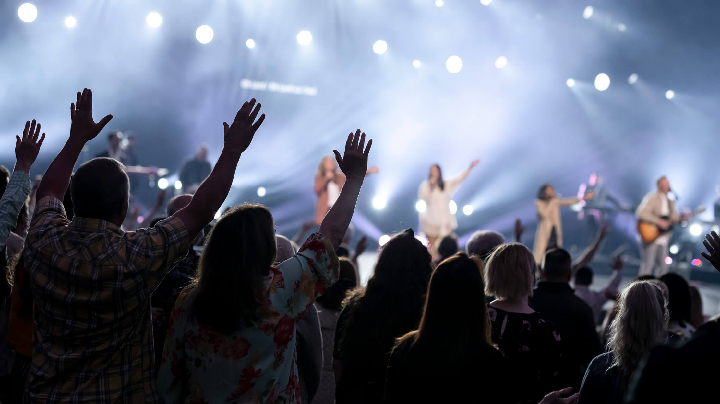
ANNOUNCEMENTS
ALL GEN WORSHIP AT 11:00 AM – “OCT 26 ICE” - Invite, Cheer, and Engage (ice)
ALL GEN SUNDAY FELLOWSHIP @ 2:00PM
VOLUNTEERS – ACTIVELY SEEKING VOLUNTEERS FOR 11AM ALL GEN WORSHIP – usher, praise, media, worship prep, live broadcasting
Rejoice with those who rejoice, weep with those who weep. – Romans 12:15

Slide 62


