Slide 2
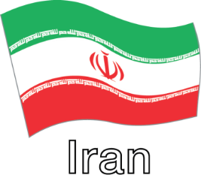
I lift my eyes and look to you, Lord
My Jesus, my Lord and my God
Iran
Notes:
내 눈 들어 주를 봅니다 나의 주 나의 하나님
I lift my eyes and look to you, Lord
My Jesus, my Lord and my God

Slide 3
You bore my sins upon the cross
I give praise to you, my Savior King
Iran
Notes:
내 모든 죄 사하신 주 십자가 사랑 찬양합니다
You bore my sins upon the cross
I give praise to you, my Savior King

Slide 4
I lift my hands and worship you, God
My Jesus, my Lord and my King
Iran
Notes:
내 손 들어 경배합니다 나의 왕 나의 예수님
I lift my hands and worship You, God
My Jesus, my Lord and my King

Slide 5
It’s you alone that I desire
Come and take your place, my Glorious King
Iran
Notes:
주님만 간절히 원해 주 영광으로 임하소서
It’s You alone that I desire
Come and take Your place, my glorious King

Slide 6
Open the heavens, Lord Lead us to see your face
Iran
Notes:
하늘을 여소서 주 보게 하소서
Open the heavens, Lord Lead us to see Your face

Slide 7
Spirit come set our hearts on fire
Iran
Notes:
성령의 불 내리소서
Spirit come set our hearts on fire

Slide 8
All nations will bow down Worship and bless your name
Iran
Notes:
열방이 주 앞에 엎드려 경배해
All nations will bow down Worship and bless Your name

Slide 9
Glorious King who is to come
Iran
Notes:
다시 오실 영광의 왕
Glorious King who is to come

Slide 10
Jesus
Iran
Notes:
예수
Jesus

