Slide 1
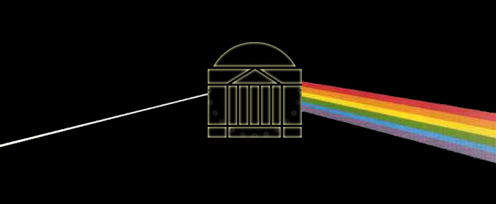
Optical Spectroscopy
and Spectrographs
ASTR 511
6 October 2003
Topics:
Brief (very) overview of spectroscopy
Mechanics of slit spectrographs
Fiber-fed systems
The Fan Mountain spectrograph

Slide 2
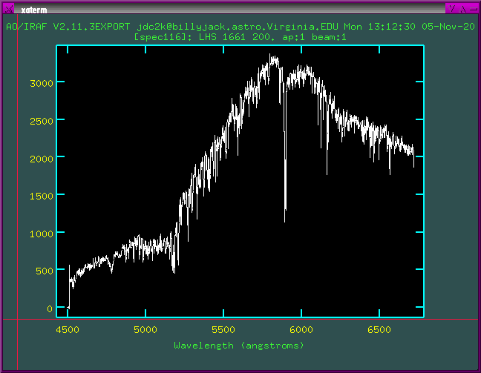
Spectroscopy in General
What useful information is gathered?
Galaxies:
Velocity dispersion
Rotation curves
Distance (redshift)
Other stuff
Stars:
Spectral class
Radial velocity
Metallicity
Gravity (luminosity class)
Effective temperature
Other derivative information such as multiplicity, distance, mass

Slide 3
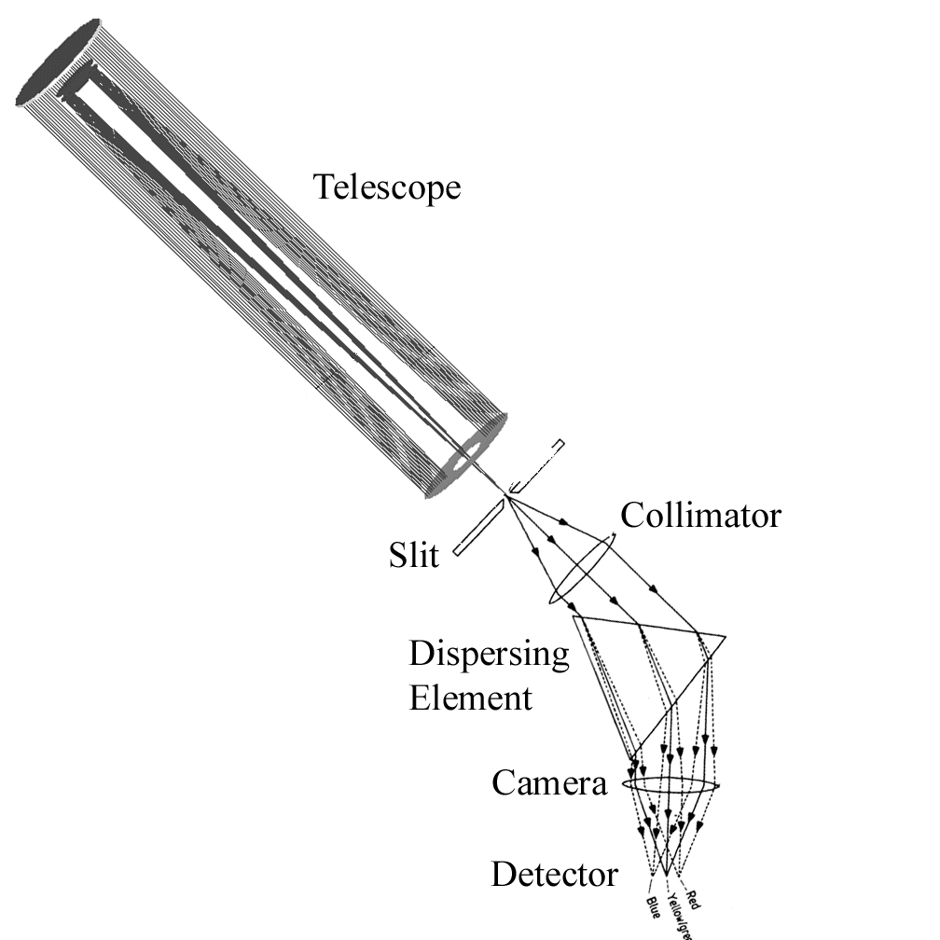
Spectrograph Mechanics
Purpose: Take the light collected from the telescope, select only photons from the object of interest, and disperse the broadband emission in wavelength space.
Basic Components:

Slide 4
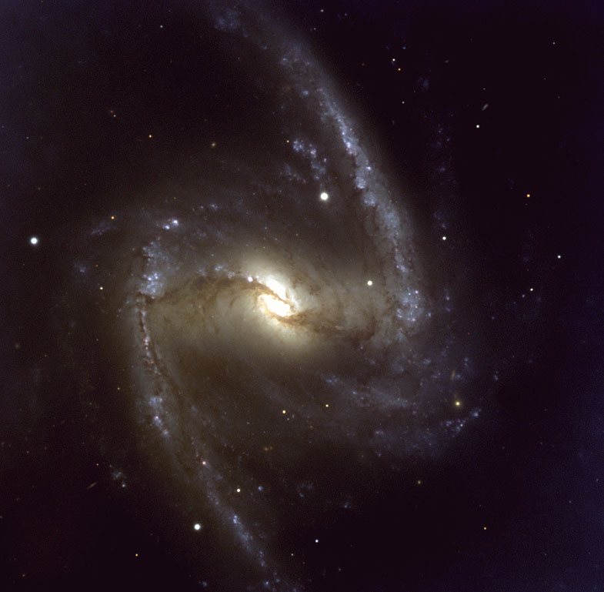
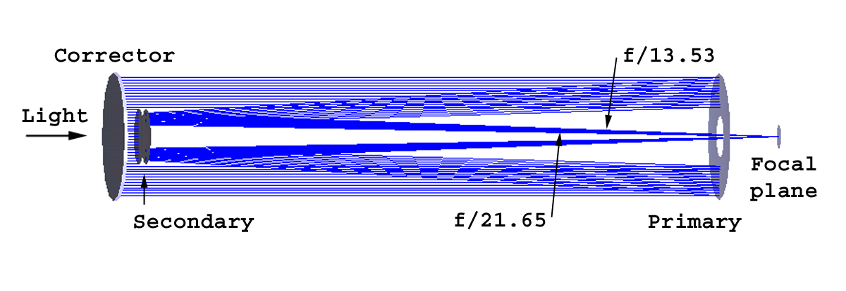
The Telescope
Serves as a "Light Bucket" – Collects light over a broad range of wavelengths and over a large Field of View.
Takes parallel light and converges it over a range of f/ratios
(f/ratio is [f/D]_{optic})
FMO 40”

Slide 5
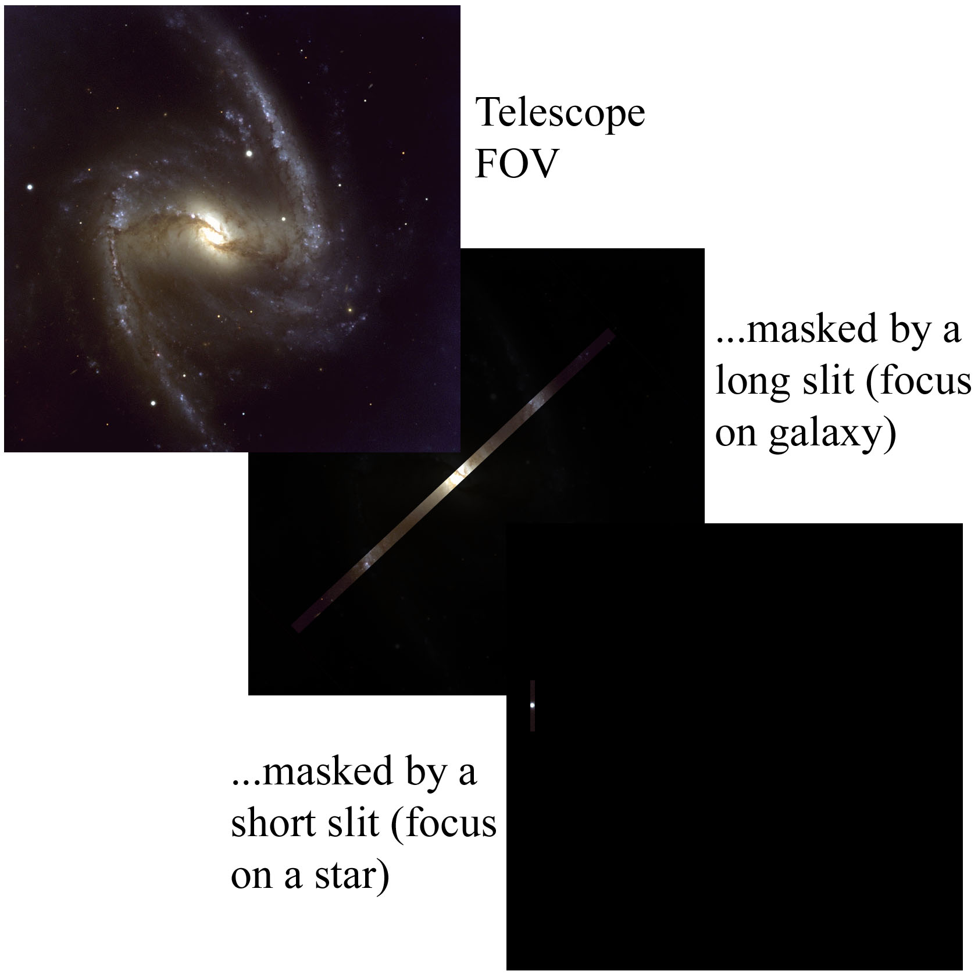
The Entrance slit
Selects light from a particular object in the telescope's focal plane.
Helps to give good "shape" and resolution to the spectrum produced by the instrument.

Slide 6
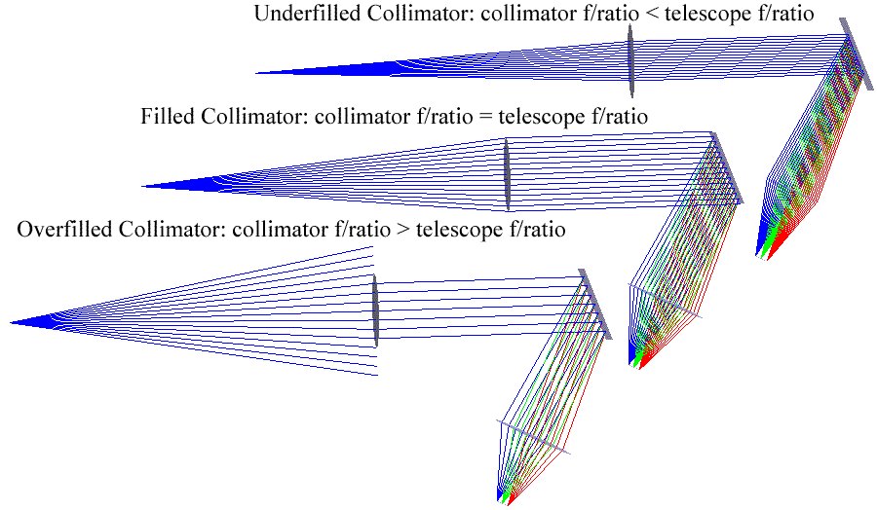
The Collimator
Takes the diverging (post-telescope focus) rays and collimates them
Can either be refractive (lens) or reflective (mirror) optics
f/ratio should match that of the incoming telescope-focused light
- Underfilled collimator = loss of resolution
- Overfilled collimator = loss of light

Slide 7
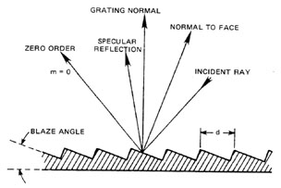
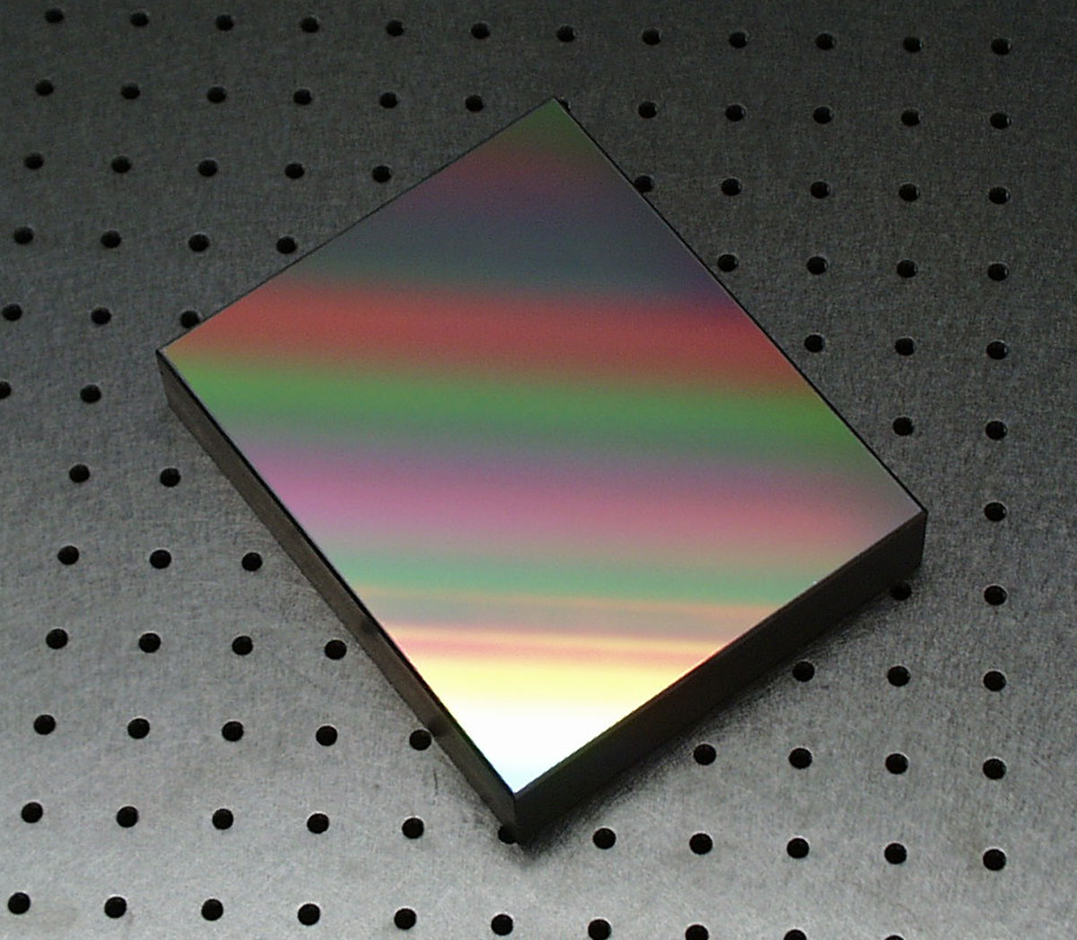
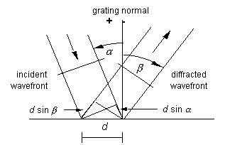
Dispersing Element
Can be a prism, etalon, grating, or grism
(we will focus on the reflection grating)
Reflection grating is basically a large number of long, but very very thin, parallel mirrors
The grating as a whole acts as a mirror, but convoluted with the diffracting effect of all of the parallel reflecting lines.
For a given grating line density, diffraction order, and angle α of collimated input, each wavelength has a unique diffraction angle β
mλ = d(sinα + sinβ)

Slide 8
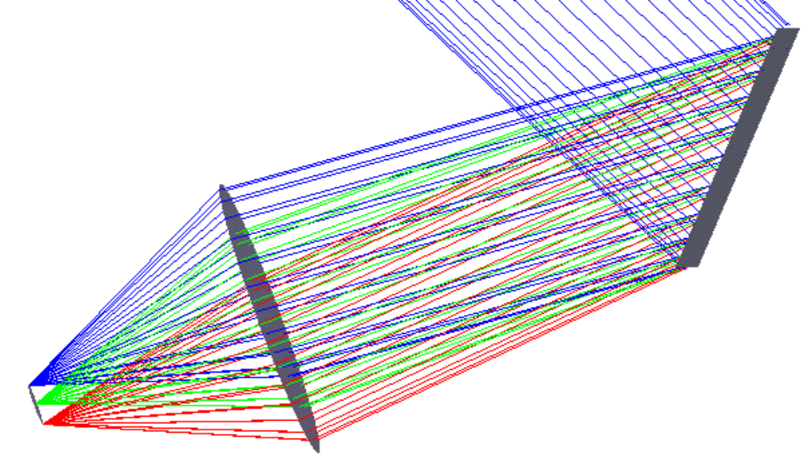
Camera (focusing) Optics
The diffracted light is just a continuum of
monochromatic, collimated beams; optics are
required to focus this light onto a detector.
Can be either refractive or reflective
Typically has to be quite fast
(small f/ratio) compared to the collimator. Why?
... because the spectral resolution is a convolution of the grating function and the width of the image of the entrance slit.
(De)magnification of slit ~ f_{camera}/f_{collimator}
The camera/collimator system is an imaging system, which produces an image of the entrance slit on the detector. This usually determines the width of spectral features.

Slide 9
Fiber-fed spectrographs
The spectrograph can be separated from the telescope, fed light by optical fibers aligned on objects in the telescope’s focal plane.
Some possible uses/benefits:
Work requiring great stability –
By disconnecting the spectrograph from the telescope, flexure effects are removed and spectra become more homogeneous.
Example: FMO spectrograph
Multi-object spectroscopy –
Collect spectra from many objects at one time by positioning many fibers.
Example: 2dF at AAO

Slide 10
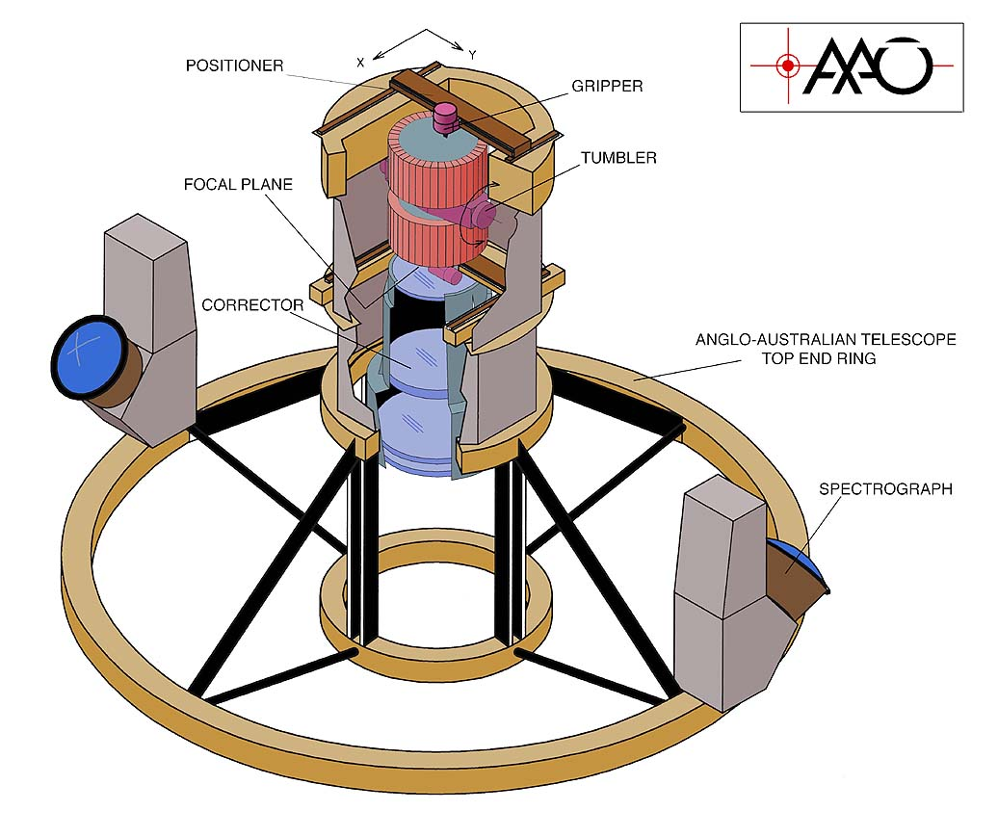
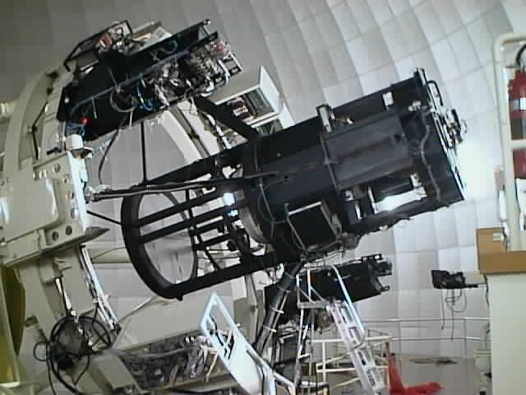

Slide 11
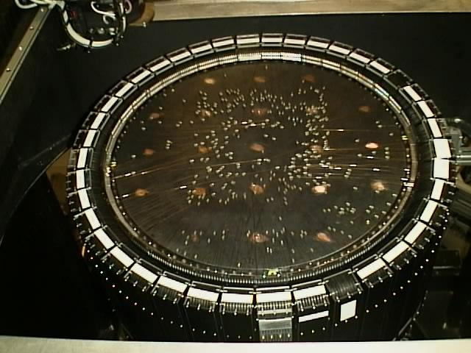
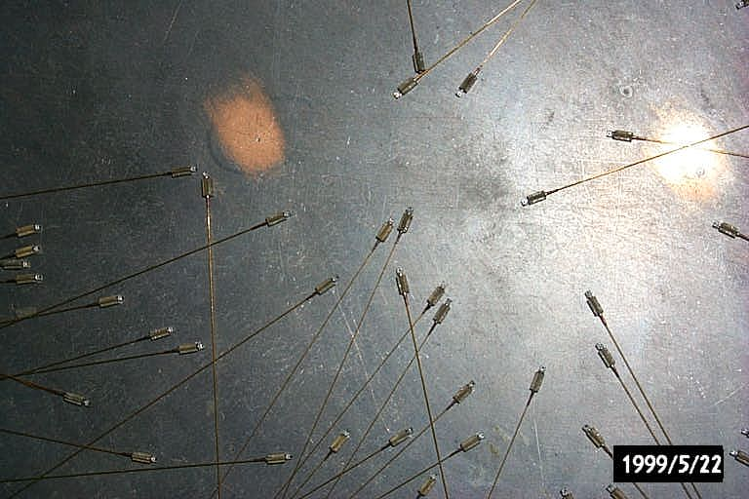

Slide 12
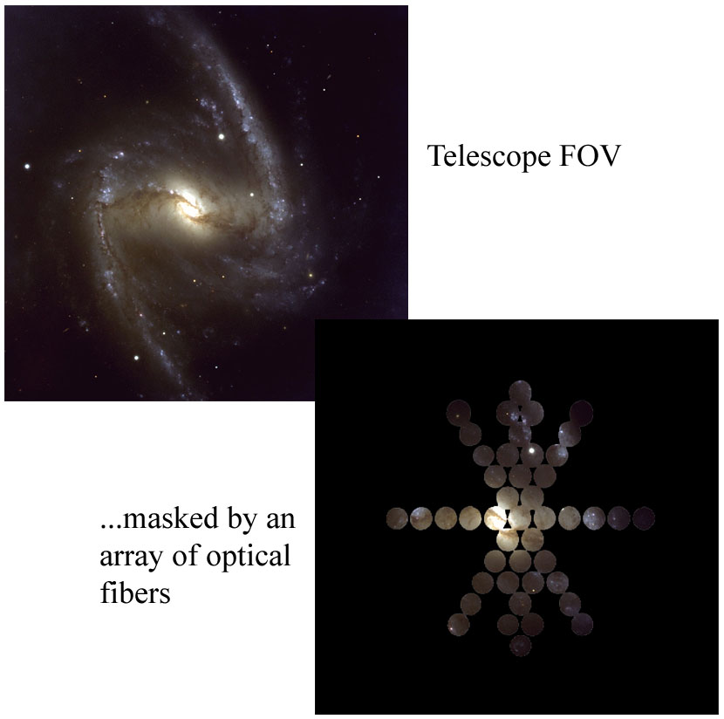
Integral Field Spectroscopy –
Collect spectra from many parts of an extended object simultaneously

Slide 13
Difficulties with fiber-fed systems
Added complexity
Lower efficiency (throughput) for an individual spectrum, although this can be made up for by collecting lots of spectra simultaneously
Problems associated with Focal Ratio Degradation (FRD)
- microbending in optical fibers leads to a net lowering of the f/ratio of light transmitted to the spectrograph
- uncertainty of spectrograph input f/ratio can make choice of collimator difficult
- since the collimator ends up being faster, the camera in turn has to be equivalently faster. Ugh.

Slide 14
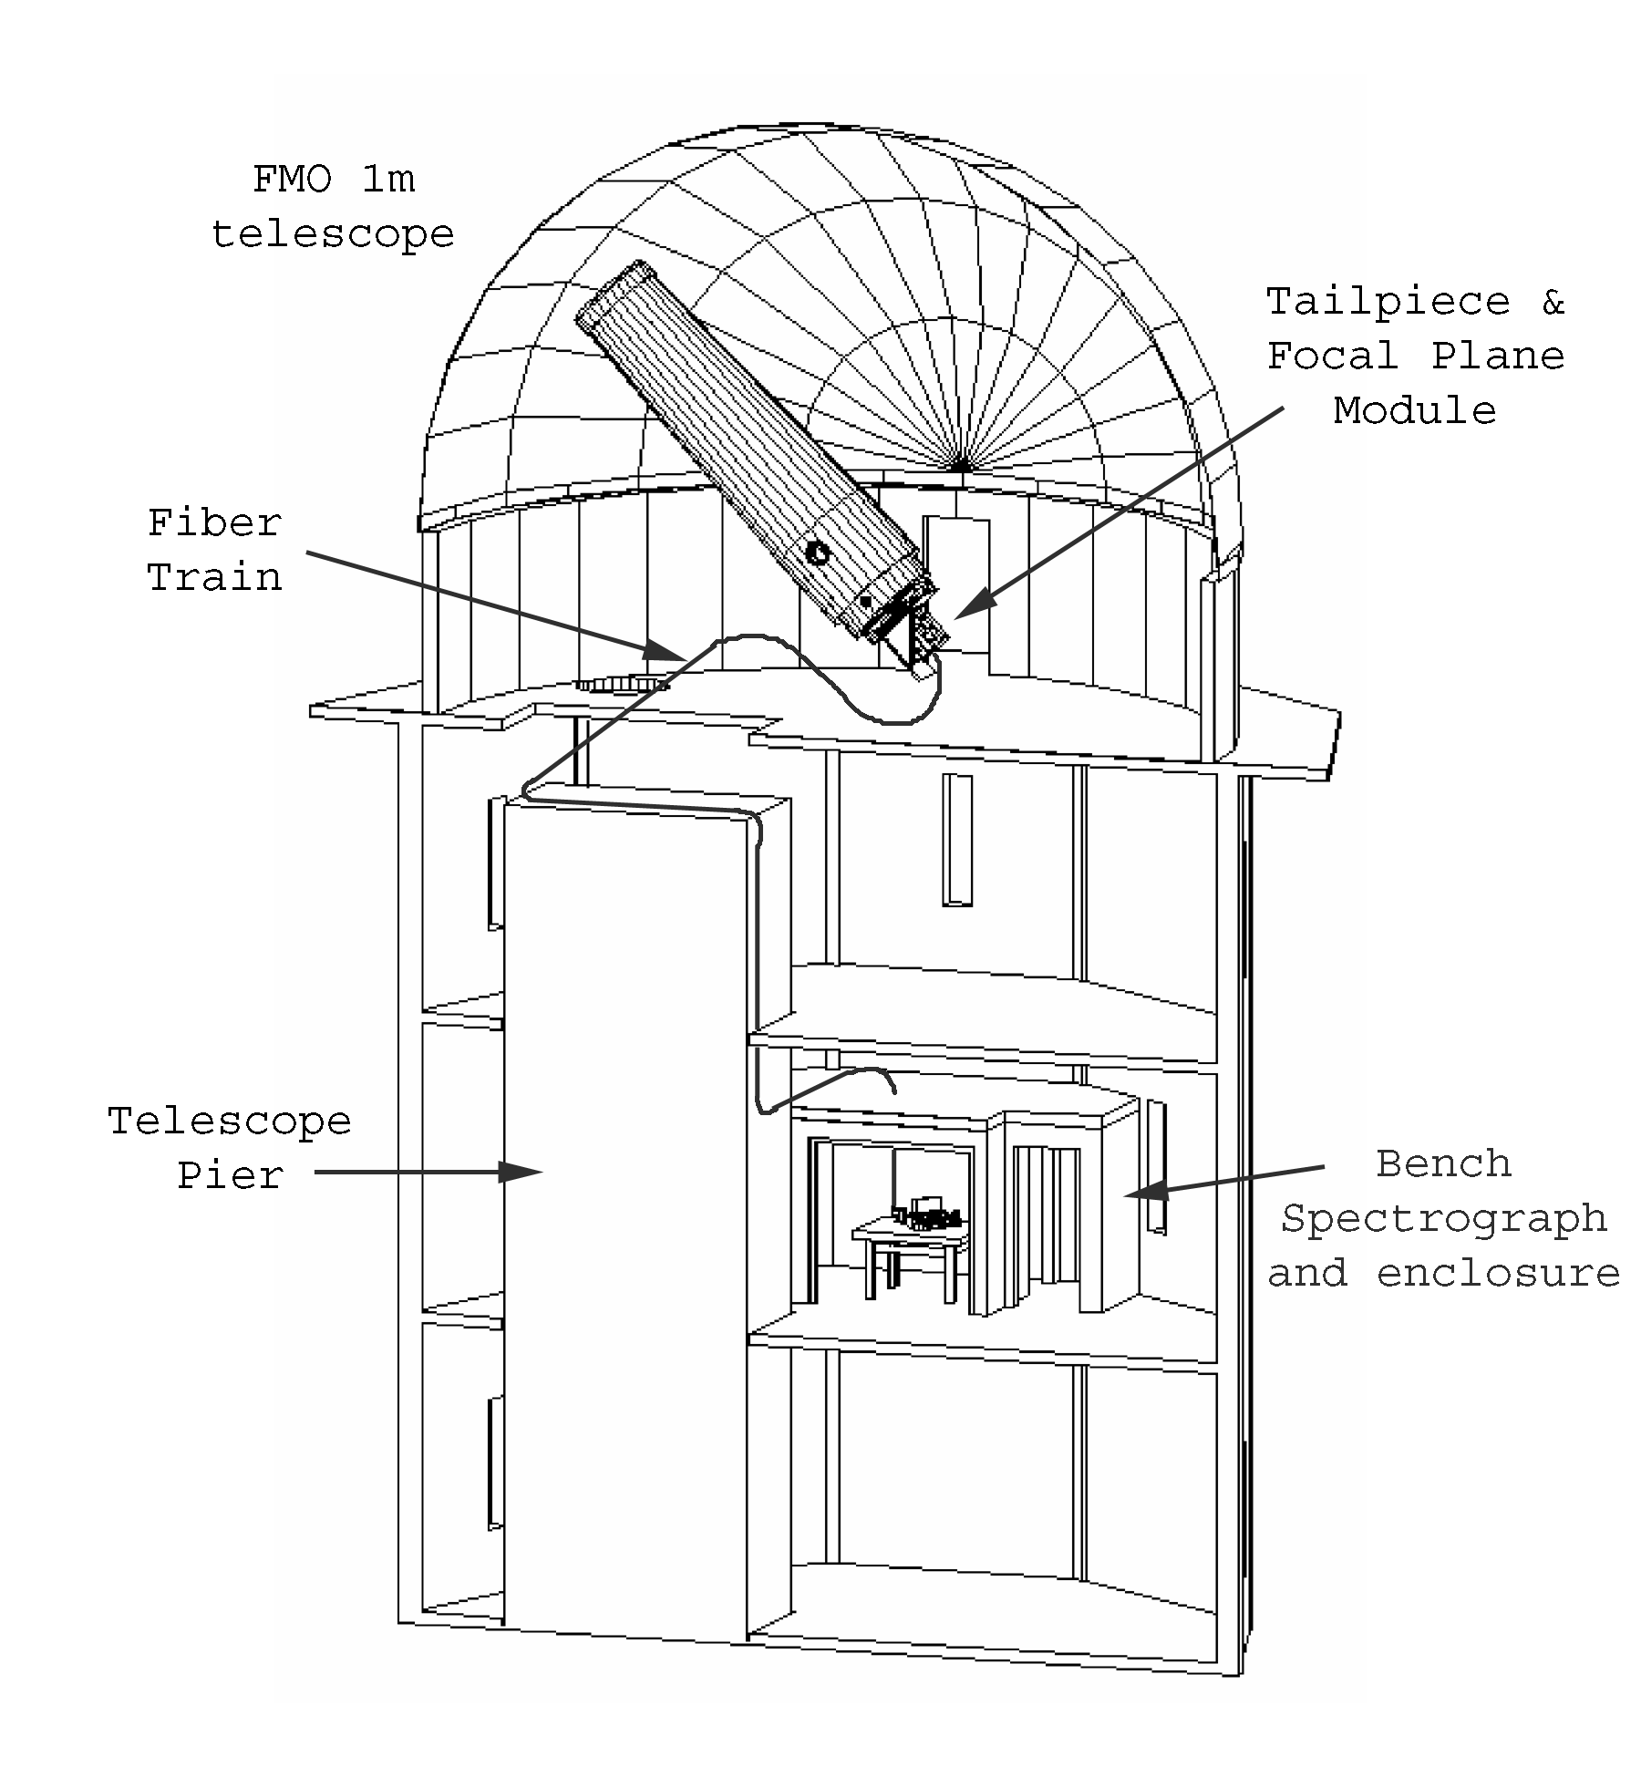
Fan Mountain Observatory
Bench Spectrograph
Project Overview:
Single object, fiber-fed, bench-mounted spectrograph
Low to medium spectral resolution
Primary wavelength coverage: 470 < λ < 670 nm
(although full visual coverage eventually)
Target velocity resolution: 7-10 km/s
Instrument components:
Focal plane module
Fiber train
Bench spectrograph

Slide 15
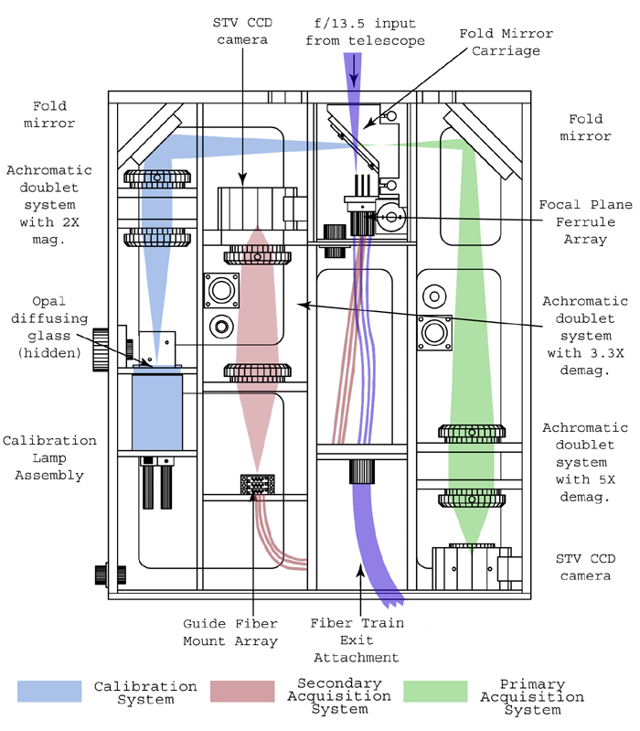
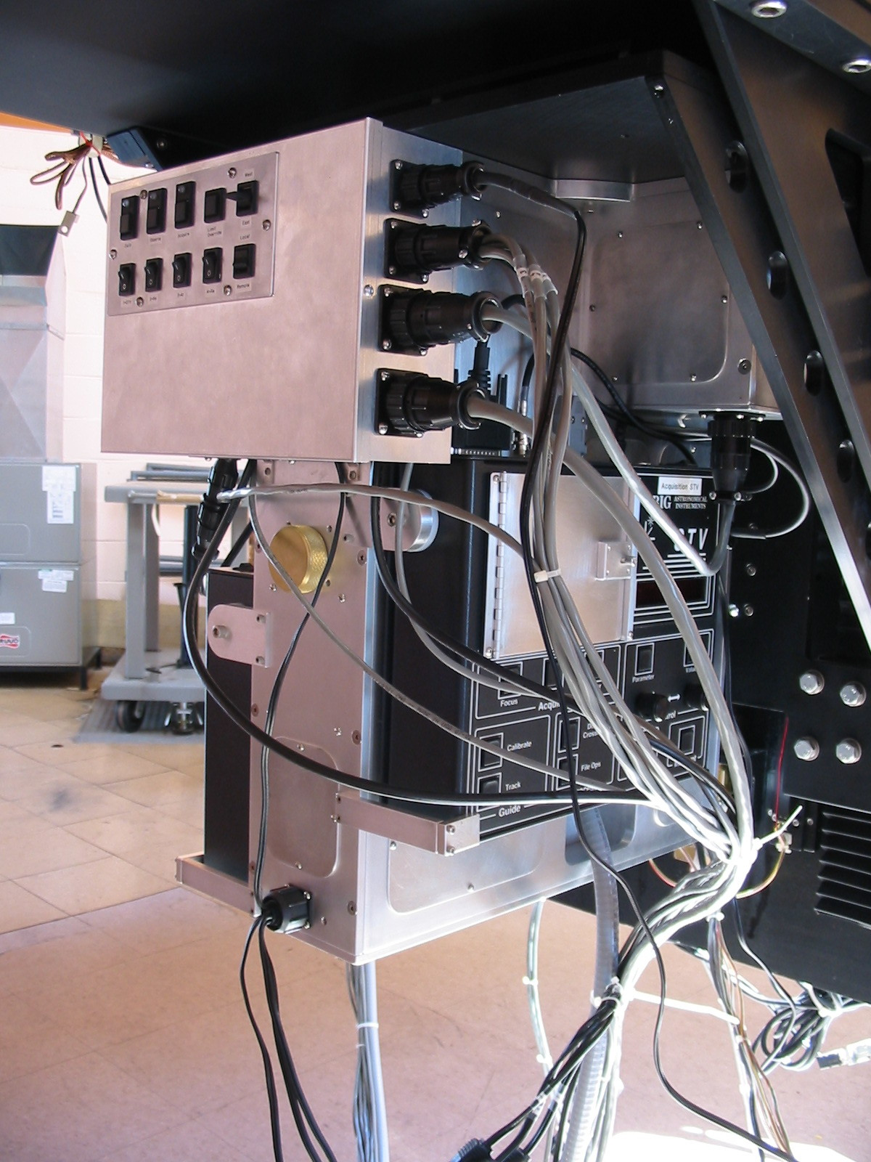
Focal Plane Module
Functions:
Fiber alignment, coarse
Fiber alignment, fine
Calibration light injection

Slide 16
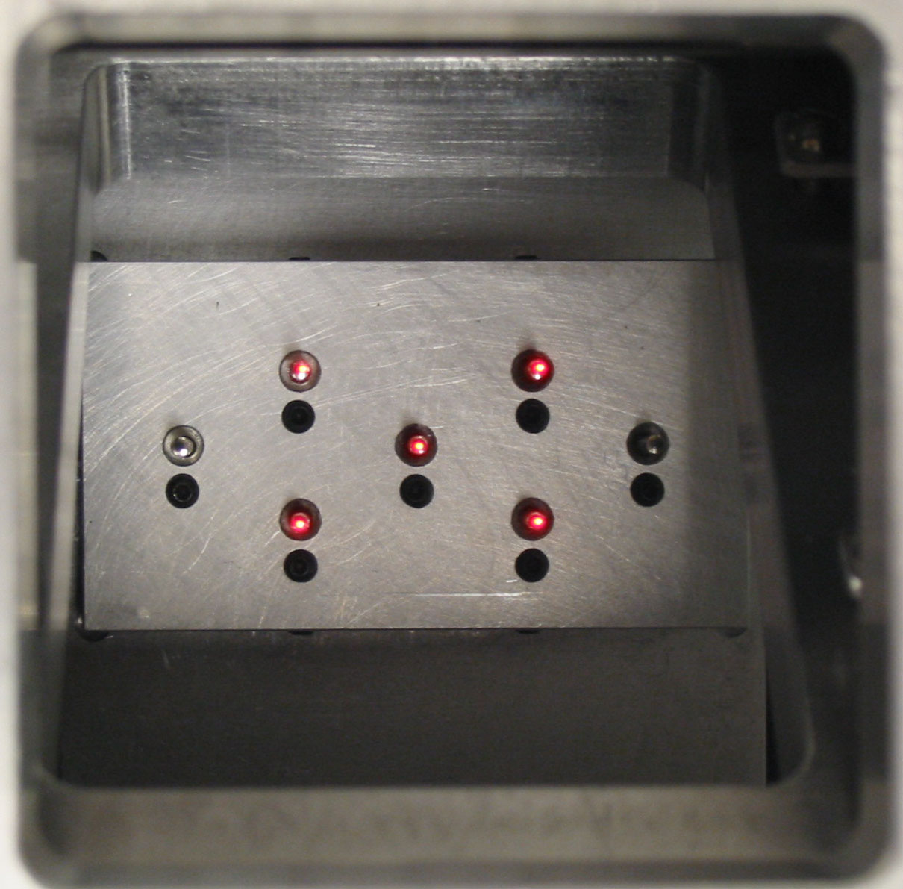
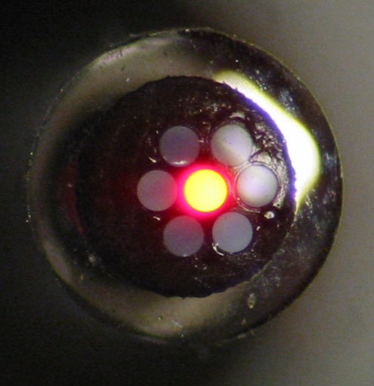
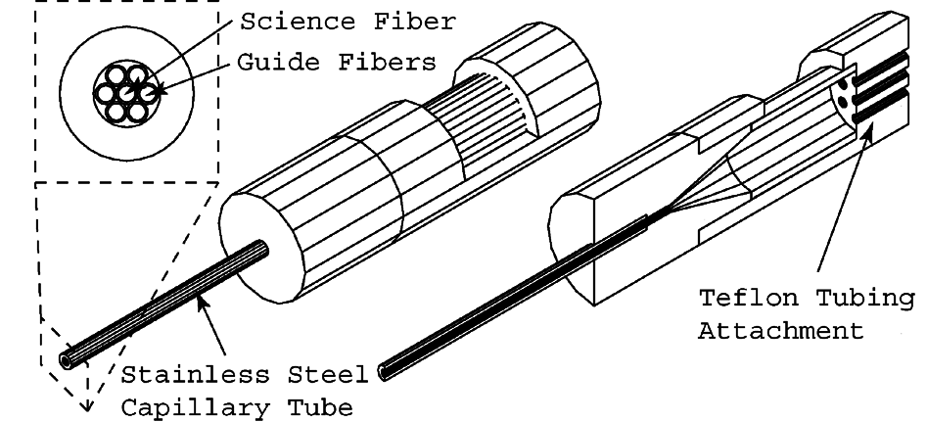
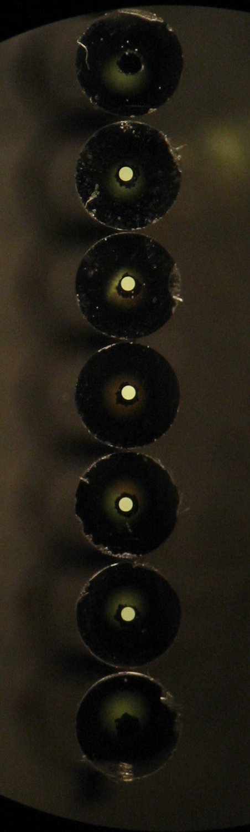
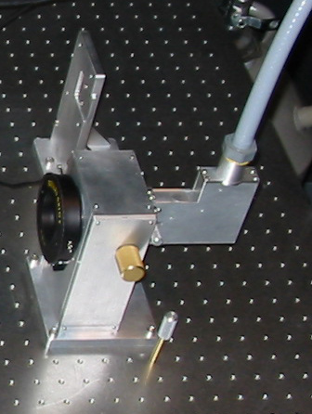
Fiber Train
Functions:
Transmit stellar light to spectrograph
Transmit guide fiber light to acquisition camera

Slide 17
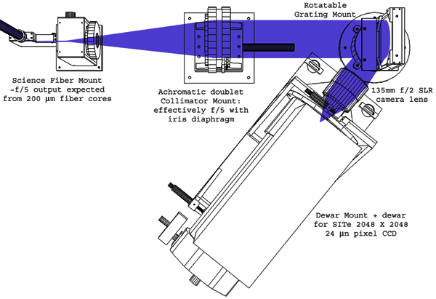
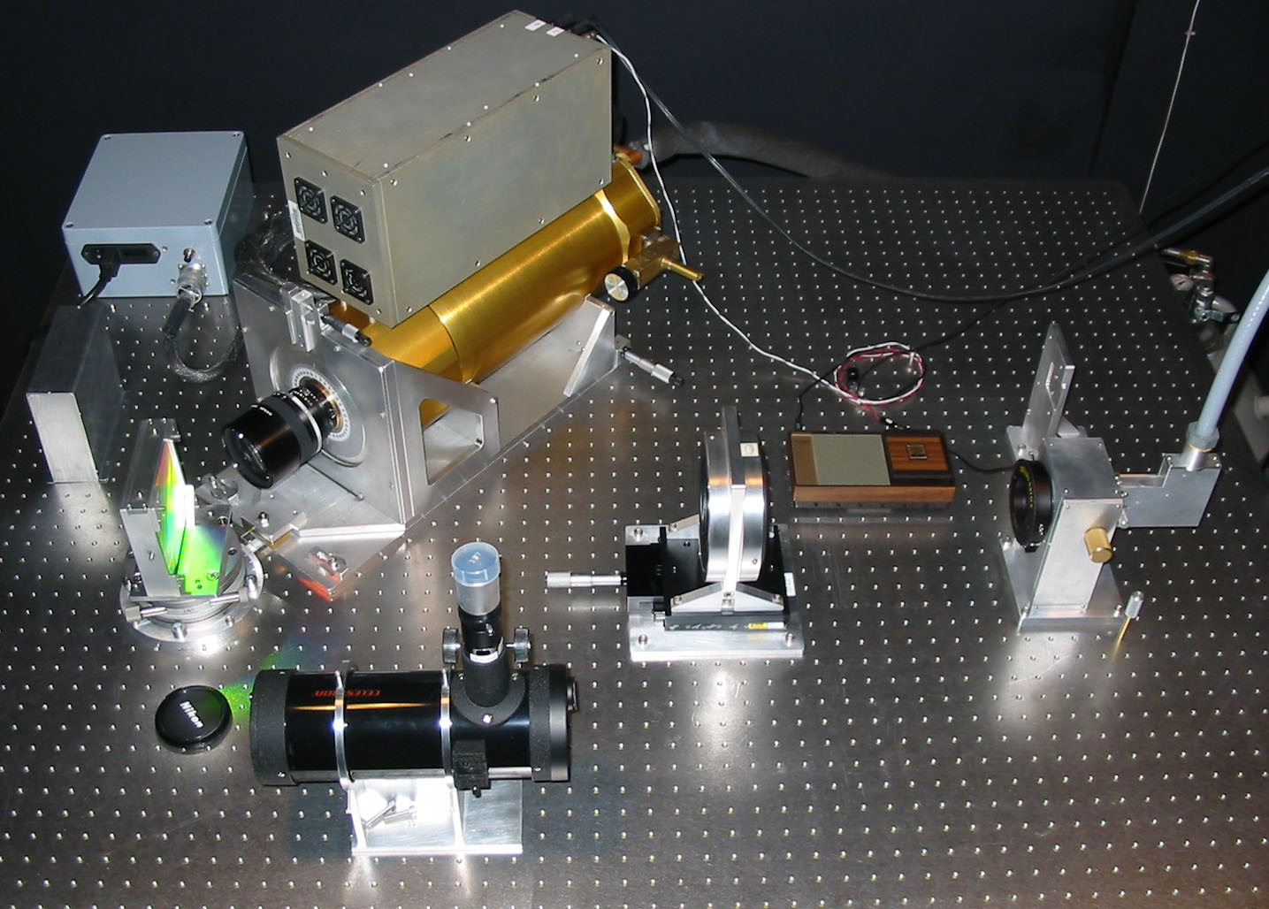
Bench Spectrograph
Design Overview:
Linear array of 7 science fibers, f/4-f/5 output
f/5 Achromatic Doublet collimator
1200 line/mm reflection grating
f/2 SLR lens for camera
SITe 2048x2048 CCD

Slide 18
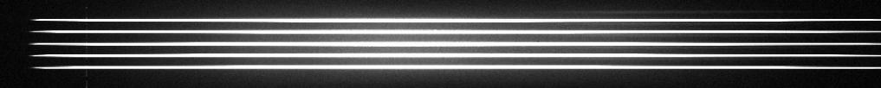
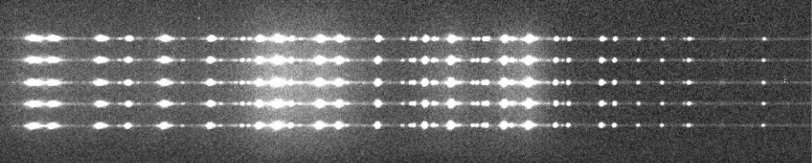
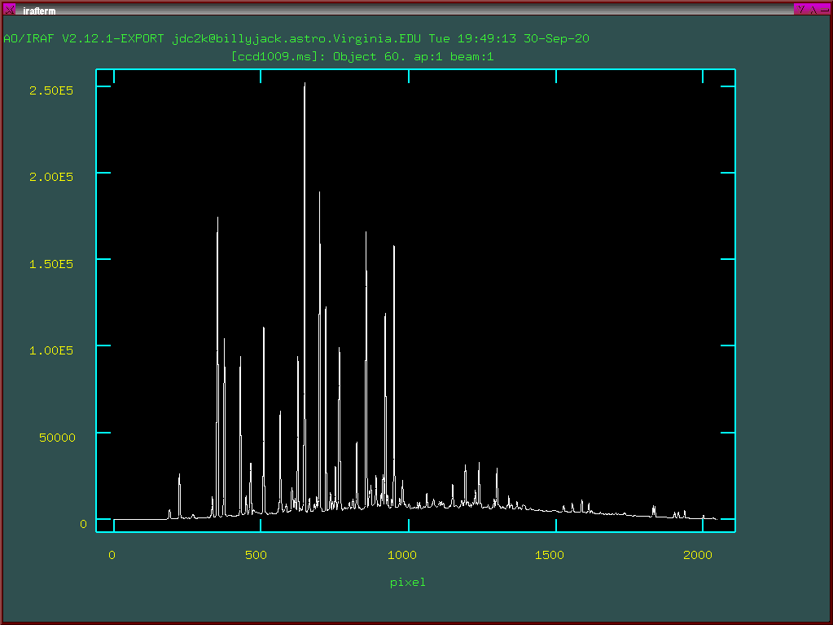
Data
Quartz lamp image
Neon-Argon-Xenon image
Neon-Argon-Xenon spectrum
In addition to target spectra, you need…
Quartz lamp spectra to determine how to trace the fainter spectra
Arc lamp spectra for wavelength calibration
Flat fields to remove pixel-level variations
Bias frames
Standard stars, depending on your science

