Slide 1
Logistic Regression Suppliment
Ray Ptucha

Slide 2
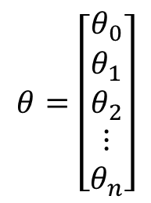
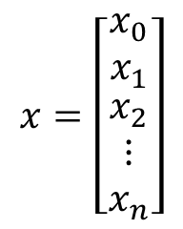

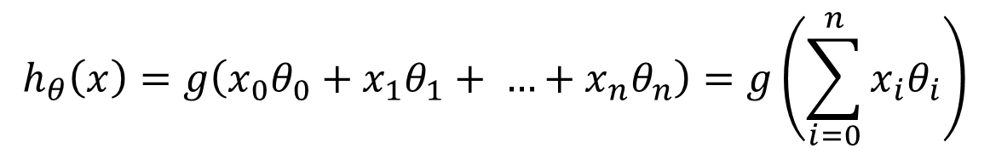
Artificial Neuron
x₀
Note, x₀ is the bias unit, x₀=1
θ₀
$$x=\left[\begin{matrix}x_{0} \\ x_{1} \\ \begin{matrix}x_{2} \\ \begin{matrix}⋮ \\ x_{n}\end{matrix}\end{matrix}\end{matrix}\right]$$
$$θ=\left[\begin{matrix}θ_{0} \\ θ_{1} \\ \begin{matrix}θ_{2} \\ \begin{matrix}⋮ \\ θ_{n}\end{matrix}\end{matrix}\end{matrix}\right]$$
x₁
θ₁
θ₂
g ( )
x₂
h_{θ}(x)
…
…
θ_{n}
x_{n}
Axons
Activation function
dendrites
$$h_{θ}\left(x\right)=g\left(x_{0}θ_{0}+x_{1}θ_{1}+ …+x_{n}θ_{n}\right)=g\left(\sum_{i=0}^{n}{x_{i}θ_{i}}\right)$$
$$h_{θ}\left(x\right)=g\left(θ^{T}x\right)$$

Slide 3

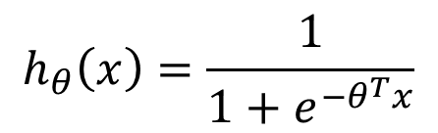
Logistic Regression
Ground truth samples will be ‘0’ or ‘1’
‘0’ is negative class, ‘1’ is positive class
Could use linear regression, then if
h_{θ} (x) >= 0.5, then predicted class is ‘1’
h_{θ} (x) < 0.5, then predicted class is ‘0’
Constrain 0 <= h_{θ} (x) <= 1 via sigmoid function
In linear regression,
In logistic regression,
$$h_{θ}\left(x\right)=θ^{T}x$$
$$h_{θ}\left(x\right)=\frac{1}{1+e^{−θ^{T}x}}$$

Slide 4
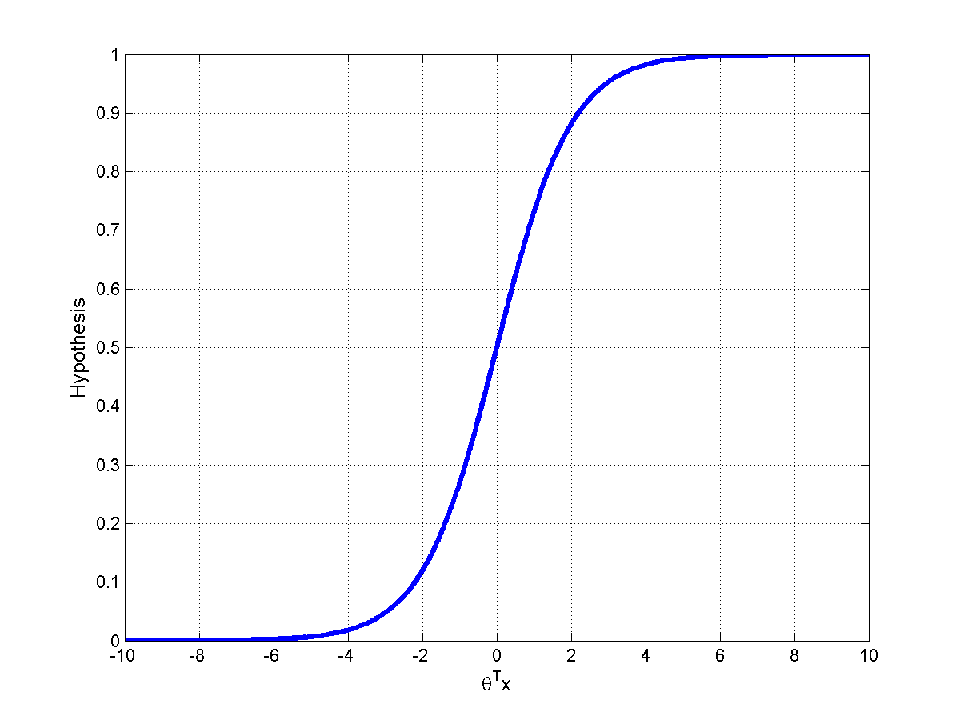
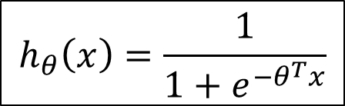
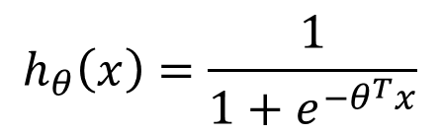


Why Sigmoid Function?
$$h_{θ}\left(x\right)=\frac{1}{1+e^{−θ^{T}x}}$$
We are matching our input attributes to ground truth values, y.
θ ^{T}x is a real number, which is perfect for regression:
For classification, we want either a ‘1’ or ‘0’:
$$y∈ℝ$$
$$y∈\left\{0,1\right\}$$
$$h_{θ}\left(x\right)=\frac{1}{1+e^{−θ^{T}x}}$$
Notes:
Sigmoid constrains \theta^Tx to be in the range [0:1], and pushed output to 0 or 1 to match ground truth better

Slide 5
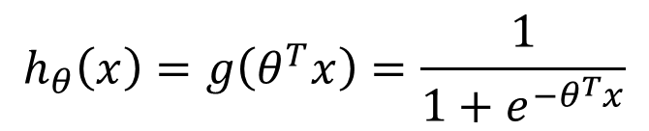


Logistic Regression
$$h_{θ}\left(x\right)=g\left(θ^{T}x\right)=\frac{1}{1+e^{−θ^{T}x}}$$
Hypothesis
Interpretation
Probabilities sum to 1
$$h_{θ}\left(x\right)=P\left(y=1|x;θ\right)$$
If h_{θ} (x) = 0.7, can say 70% probability test point belongs to class ‘1’
If h_{θ} (x) >= 0.5, classify as class ‘1’ (e.g.: malignant tumor)
$$P\left(y=0|x;θ\right)=1−P\left(y=1|x;θ\right)$$
Notes:
Note: P(y|x,q) = prob of y given x and q P(y|x;q) = prob of y given x, parameterized by q

Slide 6

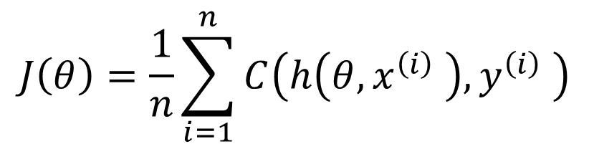

Training Data and Model
Given n training samples:
$$\left\{\left(x^{\left(1\right)},y^{\left(1\right)}\right),\left(x^{\left(2\right)},y^{\left(2\right)}\right),⋯,\left(x^{\left(n\right)},y^{\left(n\right)}\right)\right\}$$
where:
$$x∈ℝ^{D}$$
D dimensions or attributes per sample
$$y∈\left\{0,1\right\}$$
y is either “0” (FALSE) or “1” (TRUE)
Define an average error via a “cost” function:
$$J\left(θ\right)=\frac{1}{n}\sum_{i=1}^{n}{C\left(h\left(θ,x^{\left(i\right)} \right),y^{\left(i\right)} \right)}$$

Slide 7
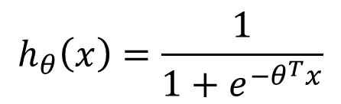
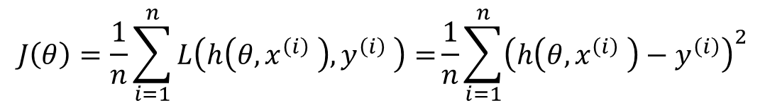
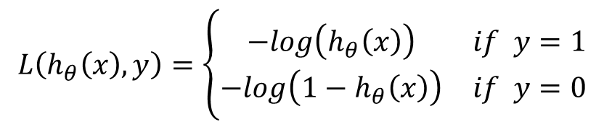
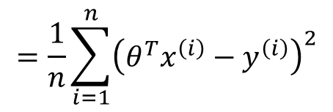

Cost Function
$$J\left(θ\right)=\frac{1}{n}\sum_{i=1}^{n}{L\left(h\left(θ,x^{\left(i\right)} \right),y^{\left(i\right)} \right)=}\frac{1}{n}\sum_{i=1}^{n}{{\left(h\left(θ,x^{\left(i\right)} \right)−y^{\left(i\right)}\right)}^{2}}$$
$$=\frac{1}{n}\sum_{i=1}^{n}{{\left(θ^{T}x^{\left(i\right)}−y^{\left(i\right)}\right)}^{2}}$$
For linear regression,
$$h_{θ}\left(x\right)=θ^{T}x$$
$$h_{θ}\left(x\right)=\frac{1}{1+e^{−θ^{T}x}}$$
For logistic regression:
If we insert our new hypothesis into our cost function, J(θ) would no longer be convex (non-convex functions can have multiple minima). We will use:
$$L\left(h_{θ}\left(x\right),y\right)=\left\{\begin{matrix}−log\left(h_{θ}\left(x\right)\right) & if y=1 \\ −log\left(1−h_{θ}\left(x\right)\right) & if y=0\end{matrix}\right.$$
?\!*?!

Slide 8
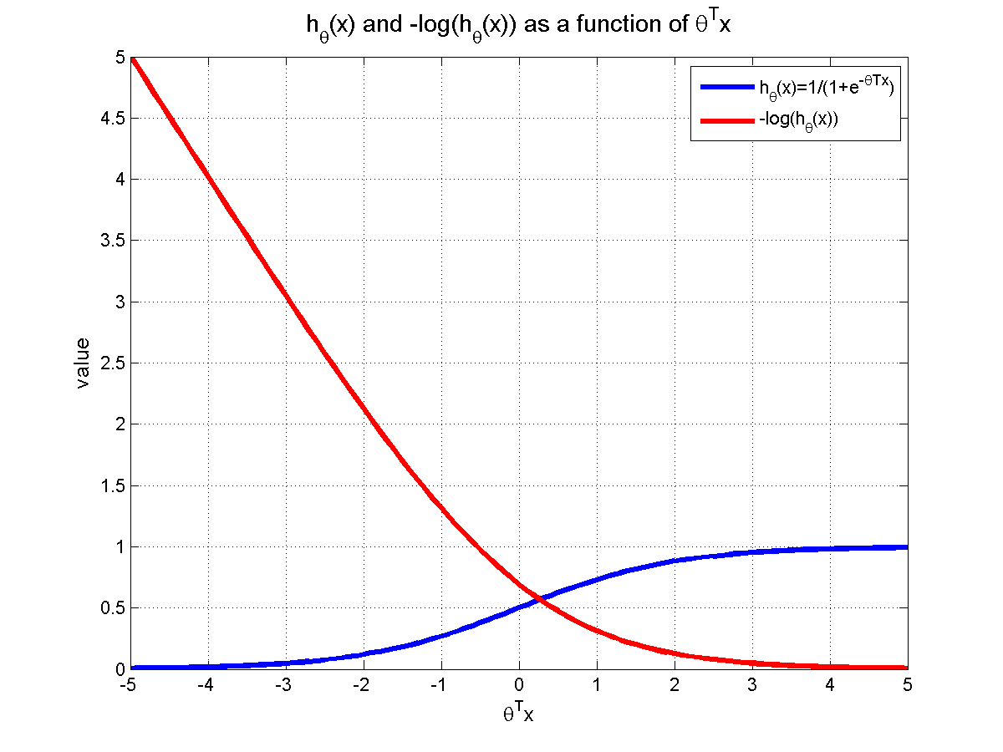
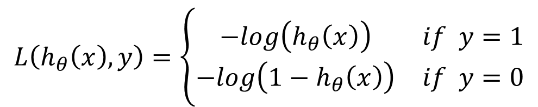

Cost Function- Case y=1:
$$L\left(h_{θ}\left(x\right),y\right)=\left\{\begin{matrix}−log\left(h_{θ}\left(x\right)\right) & if y=1 \\ −log\left(1−h_{θ}\left(x\right)\right) & if y=0\end{matrix}\right.$$
$$h_{θ}\left(x\right) and −log\left(h_{θ}\left(x\right)\right) as a functin of θ^{T}x$$
As h_{θ}(x) → 1, cost→0
As h_{θ}(x) → 0, cost→∞
value
-5
0
5
$$θ^{T}x$$
Notes:
Lets see what would happen if we modify our cost function by adding a log and some inversions…
Remember, purpose of sigmoid is to constrain \theta^Tx to range [0:1]

Slide 9
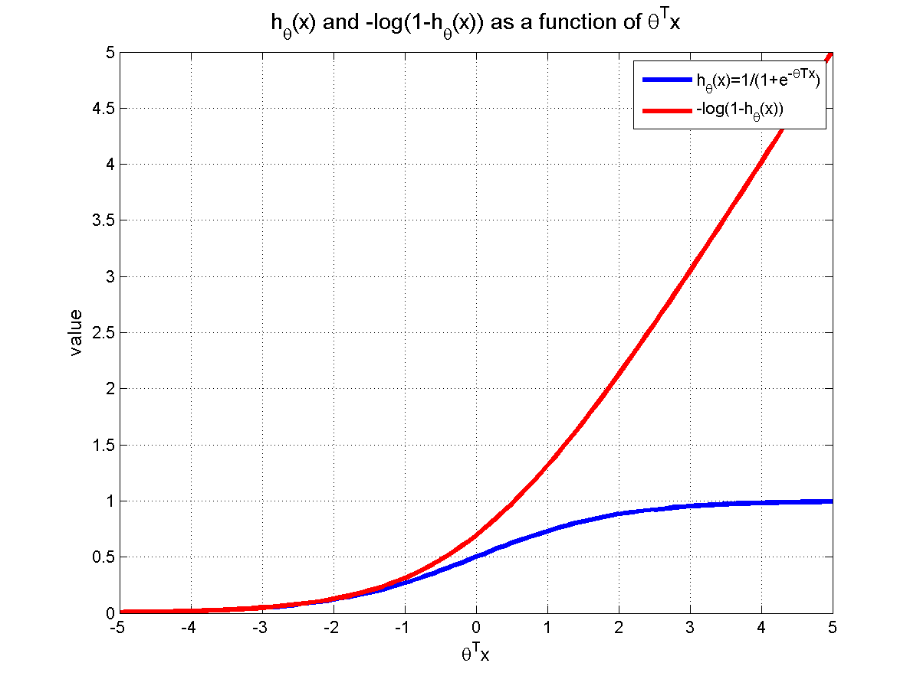

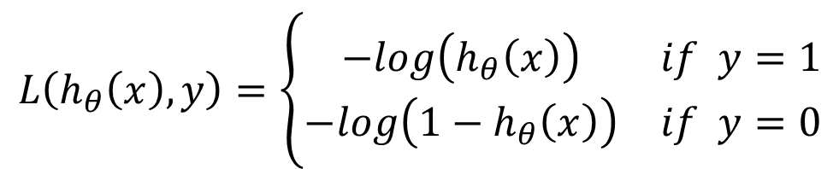
Cost Function- Case y=0:
$$L\left(h_{θ}\left(x\right),y\right)=\left\{\begin{matrix}−log\left(h_{θ}\left(x\right)\right) & if y=1 \\ −log\left({1−h}_{θ}\left(x\right)\right) & if y=0\end{matrix}\right.$$
$$h_{θ}\left(x\right) and −log\left(h_{θ}\left(x\right)\right) as a functin of θ^{T}x$$
As h_{θ}(x) → 1, cost→∞
As h_{θ}(x) → 0, cost→0
value
-5
0
5
$$θ^{T}x$$
Notes:
Note: in matlab, log = ln, (log10 is base10 log)

Slide 10
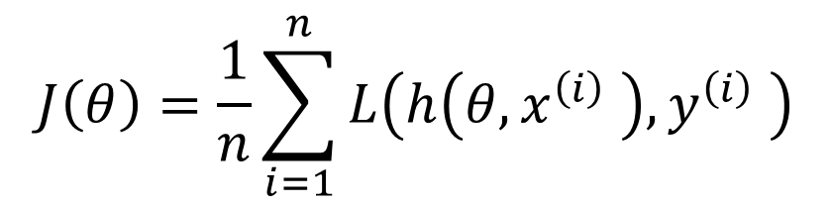
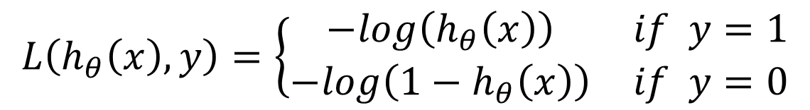
Logistic Regression Cost Function
$$J\left(θ\right)=\frac{1}{n}\sum_{i=1}^{n}{L\left(h\left(θ,x^{\left(i\right)} \right),y^{\left(i\right)} \right)}$$
$$L\left(h_{θ}\left(x\right),y\right)=\left\{\begin{matrix}−log\left(h_{θ}\left(x\right)\right) & if y=1 \\ −log\left({1−h}_{θ}\left(x\right)\right) & if y=0\end{matrix}\right.$$
Since y is either 0 or 1, we can simplify our cost function:
$$L\left(h_{θ}\left(x\right),y\right)=−ylog\left(h_{θ}\left(x\right)\right)−\left(1−y\right)log\left({1−h}_{θ}\left(x\right)\right)$$

Slide 11
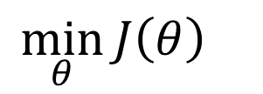
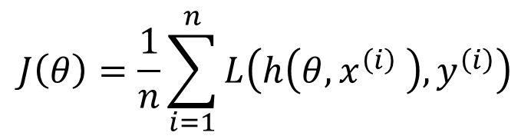
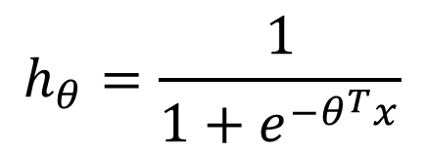
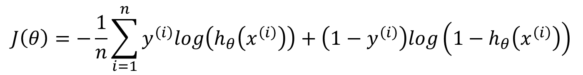
Logistic Regression Cost Function
$$J\left(θ\right)=\frac{1}{n}\sum_{i=1}^{n}{L\left(h\left(θ,x^{\left(i\right)} \right), y^{\left(i\right)}\right)}$$
Average Error
$$J\left(θ\right)=−\frac{1}{n}\sum_{i=1}^{n}{y^{\left(i\right)}log\left(h_{θ}\left(x^{\left(i\right)}\right)\right)}+\left(1−y^{\left(i\right)}\right)log\left(1−h_{θ}\left(x^{\left(i\right)}\right)\right)$$
Average Error, pos. samples
Average Error, neg. samples
Goal:
$${\min_{θ}{J\left(θ\right)}}_{}$$
$$h_{θ}=\frac{1}{1+e^{−θ^{T}x}}$$

Slide 12

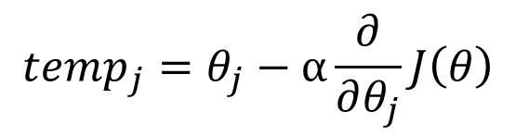
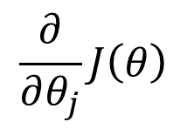
Gradient Descent for Logistic Regression
Repeat until convergence:
Repeat for all j:
$${temp}_{j}=θ_{j}−α\frac{∂}{∂θ_{j}}J\left(θ\right)$$
%Update each parameter
End repeat for all j:
$$θ_{}=temp$$
End repeat until convergence
What is
$$\frac{∂}{∂θ_{j}}J\left(θ\right)$$
?

Slide 13
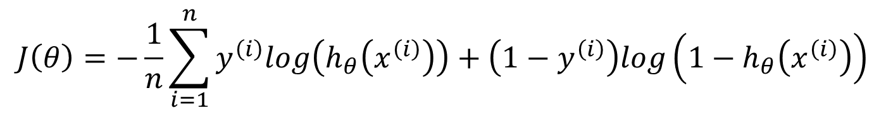
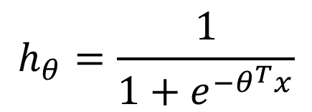
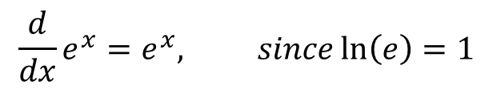

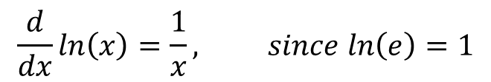
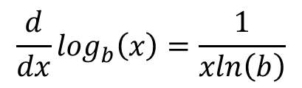
Derivative of our Cost Function
$$J\left(θ\right)=−\frac{1}{n}\sum_{i=1}^{n}{y^{\left(i\right)}log\left(h_{θ}\left(x^{\left(i\right)}\right)\right)}+\left(1−y^{\left(i\right)}\right)log\left(1−h_{θ}\left(x^{\left(i\right)}\right)\right)$$
$$h_{θ}=\frac{1}{1+e^{−θ^{T}x}}$$
$$\frac{d}{dx}\log_{b}\left(x\right)=\frac{1}{xln\left(b\right)}$$
$$\frac{d}{dx}ln\left(x\right)=\frac{1}{x}, since ln\left(e\right)=1$$
$$\frac{d}{dx}b^{x}=b^{x}ln\left(b\right)$$
$$\frac{d}{dx}e^{x}=e^{x}, since\ln\left(e\right)=1$$
Notes:
Remind them all our logs( ) will be ln( )

Slide 14
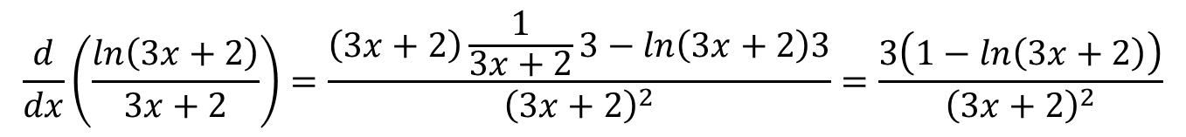
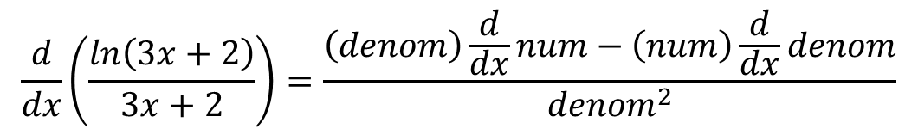
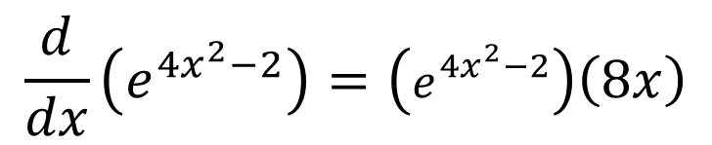
Practice Problems
$$\frac{d}{dx}\left(\frac{ln\left(3x+2\right)}{3x+2}\right)=\frac{\left(denom\right)\frac{d}{dx}num−\left(num\right)\frac{d}{dx}denom}{{denom}^{2}}$$
$$\frac{d}{dx}\left(\frac{ln\left(3x+2\right)}{3x+2}\right)=\frac{\left(3x+2\right)\frac{1}{3x+2}3−ln\left(3x+2\right)3}{{\left(3x+2\right)}^{2}}=\frac{3\left(1−ln\left(3x+2\right)\right)}{{\left(3x+2\right)}^{2}}$$
$$\frac{d}{dx}\left(e^{4x^{2}−2}\right)=\left(e^{4x^{2}−2}\right)\left(8x\right)$$

Slide 15
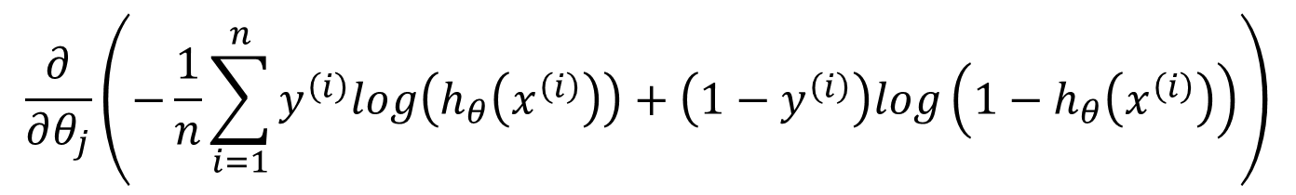
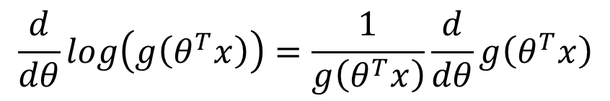
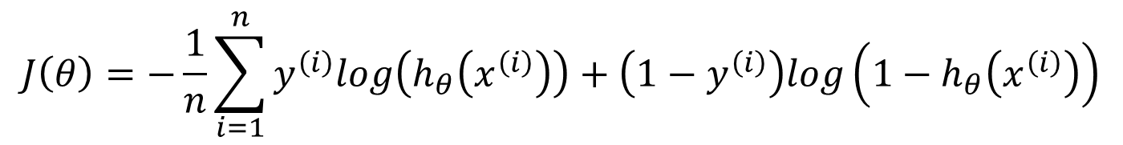
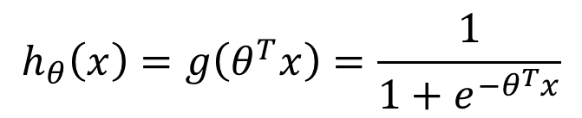
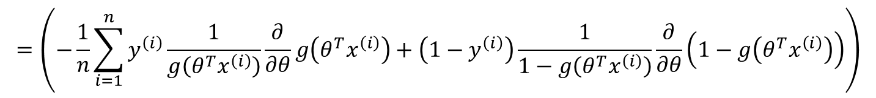
$$J\left(θ\right)=−\frac{1}{n}\sum_{i=1}^{n}{y^{\left(i\right)}log\left(h_{θ}\left(x^{\left(i\right)}\right)\right)}+\left(1−y^{\left(i\right)}\right)log\left(1−h_{θ}\left(x^{\left(i\right)}\right)\right)$$
For gradient descent, we need:
$$\frac{∂}{∂θ_{j}}\left(−\frac{1}{n}\sum_{i=1}^{n}{y^{\left(i\right)}log\left(h_{θ}\left(x^{\left(i\right)}\right)\right)}+\left(1−y^{\left(i\right)}\right)log\left(1−h_{θ}\left(x^{\left(i\right)}\right)\right)\right)$$
$$h_{θ}\left(x\right)=g\left(θ^{T}x\right)=\frac{1}{1+e^{−θ^{T}x}}$$
$$\frac{d}{dθ}log\left(g\left(θ^{T}x\right)\right)=\frac{1}{g\left(θ^{T}x\right)}\frac{d}{dθ}g\left(θ^{T}x\right)$$
$$=\left(−\frac{1}{n}\sum_{i=1}^{n}{y^{\left(i\right)}\frac{1}{g\left(θ^{T}x^{\left(i\right)}\right)}\frac{∂}{∂θ}g\left(θ^{T}x^{\left(i\right)}\right)}+\left(1−y^{\left(i\right)}\right)\frac{1}{1−g\left(θ^{T}x^{\left(i\right)}\right)}\frac{∂}{∂θ}\left(1−g\left(θ^{T}x^{\left(i\right)}\right)\right)\right)$$
Notes:
Write formula for g(\theta^Tx) and derivative of log(g(\theta^Tx)) on board before going to next page. Remind log( ) is actually ln( ).

Slide 16
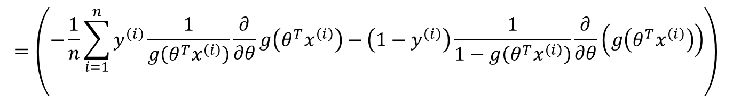
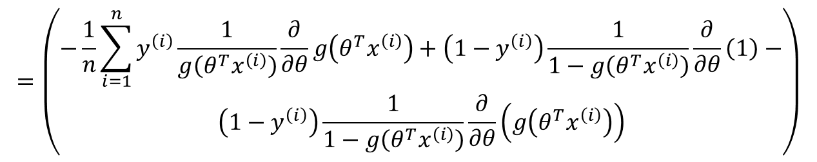
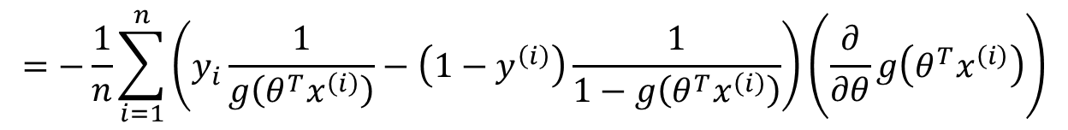
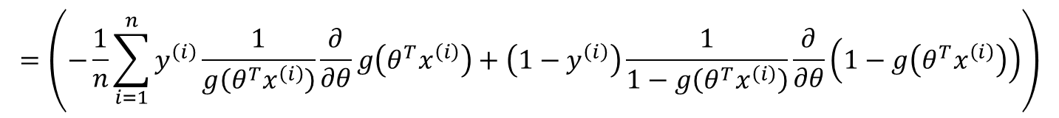
$$=\left(−\frac{1}{n}\sum_{i=1}^{n}{y^{\left(i\right)}\frac{1}{g\left(θ^{T}x^{\left(i\right)}\right)}\frac{∂}{∂θ}g\left(θ^{T}x^{\left(i\right)}\right)}+\left(1−y^{\left(i\right)}\right)\frac{1}{1−g\left(θ^{T}x^{\left(i\right)}\right)}\frac{∂}{∂θ}\left(1−g\left(θ^{T}x^{\left(i\right)}\right)\right)\right)$$
$$=\left(\begin{aligned}−\frac{1}{n}\sum_{i=1}^{n}{y^{\left(i\right)}\frac{1}{g\left(θ^{T}x^{\left(i\right)}\right)}\frac{∂}{∂θ}g\left(θ^{T}x^{\left(i\right)}\right)}+\left(1−y^{\left(i\right)}\right)\frac{1}{1−g\left(θ^{T}x^{\left(i\right)}\right)}\frac{∂}{∂θ}\left(1\right)− \\ \left(1−y^{\left(i\right)}\right)\frac{1}{1−g\left(θ^{T}x^{\left(i\right)}\right)}\frac{∂}{∂θ}\left(g\left(θ^{T}x^{\left(i\right)}\right)\right)\end{aligned}\right)$$
$$=\left(\begin{aligned}−\frac{1}{n}\sum_{i=1}^{n}{y^{\left(i\right)}\frac{1}{g\left(θ^{T}x^{\left(i\right)}\right)}\frac{∂}{∂θ}g\left(θ^{T}x^{\left(i\right)}\right)}−\left(1−y^{\left(i\right)}\right)\frac{1}{1−g\left(θ^{T}x^{\left(i\right)}\right)}\frac{∂}{∂θ}\left(g\left(θ^{T}x^{\left(i\right)}\right)\right) \\ \end{aligned}\right)$$
$$=−\frac{1}{n}\sum_{i=1}^{n}{\left(y_{i}\frac{1}{g\left(θ^{T}x^{\left(i\right)}\right)}−\left(1−y^{\left(i\right)}\right)\frac{1}{1−g\left(θ^{T}x^{\left(i\right)}\right)}\right)}\left(\frac{∂}{∂θ}g\left(θ^{T}x^{\left(i\right)}\right)\right)$$

Slide 17
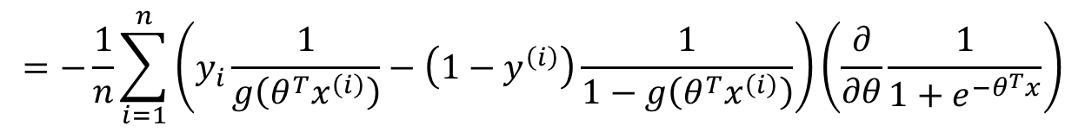
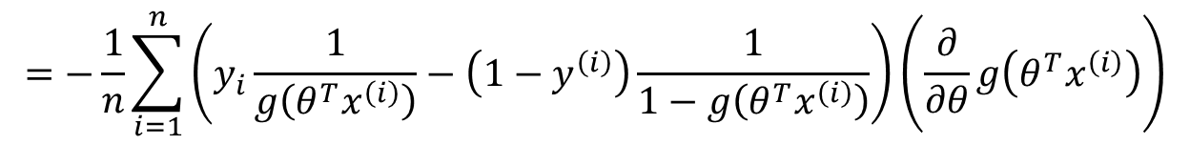
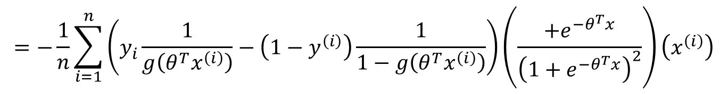
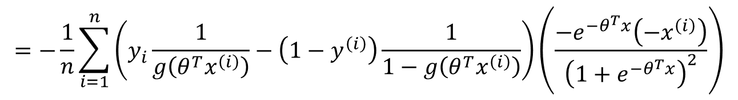
$$=−\frac{1}{n}\sum_{i=1}^{n}{\left(y_{i}\frac{1}{g\left(θ^{T}x^{\left(i\right)}\right)}−\left(1−y^{\left(i\right)}\right)\frac{1}{1−g\left(θ^{T}x^{\left(i\right)}\right)}\right)}\left(\frac{∂}{∂θ}g\left(θ^{T}x^{\left(i\right)}\right)\right)$$
$$=−\frac{1}{n}\sum_{i=1}^{n}{\left(y_{i}\frac{1}{g\left(θ^{T}x^{\left(i\right)}\right)}−\left(1−y^{\left(i\right)}\right)\frac{1}{1−g\left(θ^{T}x^{\left(i\right)}\right)}\right)}\left(\frac{∂}{∂θ}\frac{1}{1+e^{−θ^{T}x}}\right)$$
$$=−\frac{1}{n}\sum_{i=1}^{n}{\left(y_{i}\frac{1}{g\left(θ^{T}x^{\left(i\right)}\right)}−\left(1−y^{\left(i\right)}\right)\frac{1}{1−g\left(θ^{T}x^{\left(i\right)}\right)}\right)}\left(\frac{−e^{−θ^{T}x}\left(−x^{\left(i\right)}\right)}{{\left(1+e^{−θ^{T}x}\right)}^{2}}\right)$$
$$=−\frac{1}{n}\sum_{i=1}^{n}{\left(y_{i}\frac{1}{g\left(θ^{T}x^{\left(i\right)}\right)}−\left(1−y^{\left(i\right)}\right)\frac{1}{1−g\left(θ^{T}x^{\left(i\right)}\right)}\right)}\left(\frac{+e^{−θ^{T}x}}{{\left(1+e^{−θ^{T}x}\right)}^{2}}\right)\left(x^{\left(i\right)}\right)$$

Slide 18
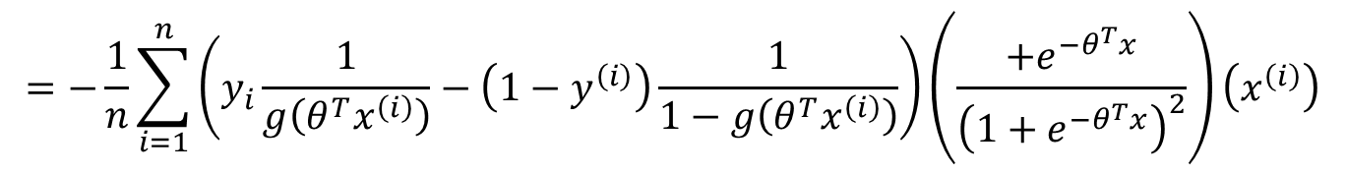
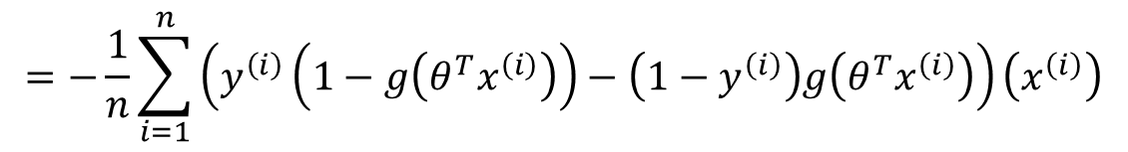
$$=−\frac{1}{n}\sum_{i=1}^{n}{\left(y_{i}\frac{1}{g\left(θ^{T}x^{\left(i\right)}\right)}−\left(1−y^{\left(i\right)}\right)\frac{1}{1−g\left(θ^{T}x^{\left(i\right)}\right)}\right)}\left(\frac{+e^{−θ^{T}x}}{{\left(1+e^{−θ^{T}x}\right)}^{2}}\right)\left(x^{\left(i\right)}\right)$$
$$=−\frac{1}{n}\sum_{i=1}^{n}{\left(y_{i}\frac{1}{g\left(θ^{T}x^{\left(i\right)}\right)}−\left(1−y^{\left(i\right)}\right)\frac{1}{1−g\left(θ^{T}x^{\left(i\right)}\right)}\right)\left(\frac{1}{\left(1+e^{−θ^{T}x}\right)}\right)}\left(\frac{e^{−θ^{T}x}}{\left(1+e^{−θ^{T}x}\right)}\right)\left(x^{\left(i\right)}\right)$$
$$=−\frac{1}{n}\sum_{i=1}^{n}{\left(y_{i}\frac{1}{g\left(θ^{T}x^{\left(i\right)}\right)}−\left(1−y^{\left(i\right)}\right)\frac{1}{1−g\left(θ^{T}x^{\left(i\right)}\right)}\right)\left(g\left(θ^{T}x^{\left(i\right)}\right)\right)}\left(\frac{1+e^{−θ^{T}x}−1}{\left(1+e^{−θ^{T}x}\right)}\right)\left(x^{\left(i\right)}\right)$$
$$=−\frac{1}{n}\sum_{i=1}^{n}{\left(y_{i}\frac{1}{g\left(θ^{T}x^{\left(i\right)}\right)}−\left(1−y^{\left(i\right)}\right)\frac{1}{1−g\left(θ^{T}x^{\left(i\right)}\right)}\right)\left(g\left(θ^{T}x^{\left(i\right)}\right)\right)}\left(1−\frac{1}{\left(1+e^{−θ^{T}x}\right)}\right)\left(x^{\left(i\right)}\right)$$
$$=−\frac{1}{n}\sum_{i=1}^{n}{\left(y_{i}\frac{1}{g\left(θ^{T}x^{\left(i\right)}\right)}−\left(1−y^{\left(i\right)}\right)\frac{1}{1−g\left(θ^{T}x^{\left(i\right)}\right)}\right)\left(g\left(θ^{T}x^{\left(i\right)}\right)\right)}\left(1−g\left(θ^{T}x^{\left(i\right)}\right)\right)\left(x^{\left(i\right)}\right)$$
$$=−\frac{1}{n}\sum_{i=1}^{n}{\left(y^{\left(i\right)}\left(1−g\left(θ^{T}x^{\left(i\right)}\right)\right)−\left(1−y^{\left(i\right)}\right)g\left(θ^{T}x^{\left(i\right)}\right)\right)}\left(x^{\left(i\right)}\right)$$

Slide 19
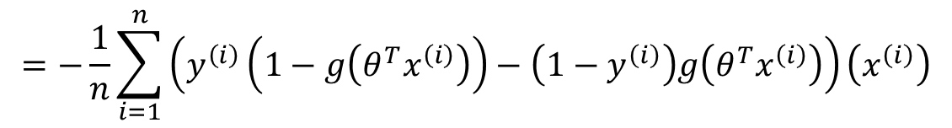
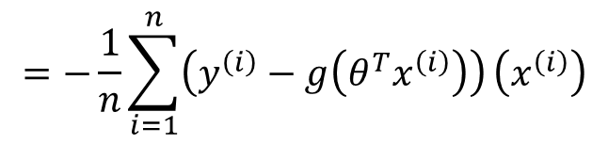





$$=−\frac{1}{n}\sum_{i=1}^{n}{\left(y^{\left(i\right)}\left(1−g\left(θ^{T}x^{\left(i\right)}\right)\right)−\left(1−y^{\left(i\right)}\right)g\left(θ^{T}x^{\left(i\right)}\right)\right)}\left(x^{\left(i\right)}\right)$$
$$=−\frac{1}{n}\sum_{i=1}^{n}{\left(y^{\left(i\right)}−y^{\left(i\right)}g\left(θ^{T}x^{\left(i\right)}\right)−g\left(θ^{T}x^{\left(i\right)}\right)+y^{\left(i\right)}g\left(θ^{T}x^{\left(i\right)}\right)\right)}\left(x^{\left(i\right)}\right)$$
$$=−\frac{1}{n}\sum_{i=1}^{n}{\left(y^{\left(i\right)}−g\left(θ^{T}x^{\left(i\right)}\right)\right)}\left(x^{\left(i\right)}\right)$$
$$=\frac{1}{n}\sum_{i=1}^{n}{\left(g\left(θ^{T}x^{\left(i\right)}\right)−y^{\left(i\right)}\right)}\left(x^{\left(i\right)}\right)$$
$$\frac{∂}{∂θ_{j}}J\left(θ\right)$$
$$=\frac{1}{n}\sum_{i=1}^{n}{\left(h_{θ}\left(x^{\left(i\right)}\right)−y^{\left(i\right)}\right)}\left(x^{\left(i\right)}\right)$$
$$=\frac{1}{n}\sum_{i=1}^{n}{\left(\frac{1}{1+e^{−θ^{T}x^{\left(i\right)}}}−y^{\left(i\right)}\right)}\left(x^{\left(i\right)}\right)$$

Slide 20
Gradient Descent for Logistic Regression
Repeat until convergence:
Repeat for all j:
$${temp}_{j}=θ_{j}−α\frac{∂}{∂θ_{j}}J\left(θ\right)$$
%Update each parameter
End repeat for all j:
$$θ_{}=temp$$
End repeat until convergence

Slide 21



Gradient Descent for Logistic Regression
Identical to linear regression!
Repeat until convergence:
Repeat for all j:
$${temp}_{j}=θ_{j}−α\frac{1}{n}\sum_{i=1}^{n}{\left(h_{θ}\left(x^{\left(i\right)}\right)−y^{\left(i\right)}\right)}\left(x^{\left(i\right)}\right)$$
End repeat for all j:
$$θ_{}=temp$$
Linear regression:
$$h_{θ}\left(x\right)=θ^{T}x$$
End repeat until convergence
Logistic regression:
$$h_{θ}\left(x\right)=\frac{1}{1+e^{−θ^{T}x}}$$

Slide 22
Go to Week2_LogisticRegression.pptx

