Slide 1
Nnet Fwd & Rev Suppliment
Ray Ptucha

Slide 2









Z^{[1]}
A^{[1]}
Z^{[2]}
Y=A^{[2]}
X=A^{[0]}
W^{[1]}
W^{[2]}
(3×m)
(4×3)
(4×m)
(1×4)
(1×m)
$$x_{1}$$
$$x_{2}$$
$$\hat{y}$$
$$x_{3}$$
$$Z^{\left[1\right]}=W^{\left[1\right]}X+b^{\left[1\right]}$$
$$Z^{\left[1\right]}=W^{\left[1\right]}A^{\left[0\right]}+b^{\left[1\right]}$$
$$Z^{\left[2\right]}=W^{\left[2\right]}A^{\left[1\right]}+b^{\left[2\right]}$$
$$A^{\left[1\right]}=tanh\left(Z^{\left[1\right]}\right)$$
$$A^{\left[2\right]}=sigmoid\left(Z^{\left[2\right]}\right)$$

Slide 3
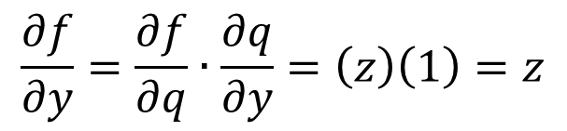

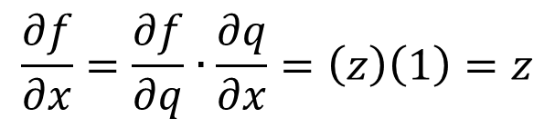
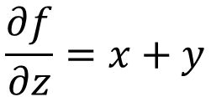
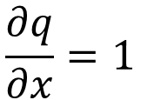
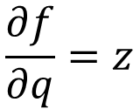
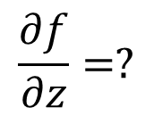
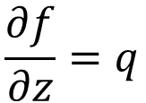
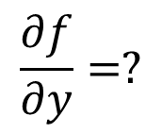
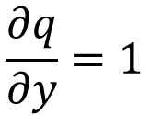
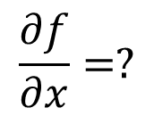
Basic Chain Rule
$$\frac{∂f}{∂x}=?$$
$$\frac{∂f}{∂y}=?$$
$$\frac{∂f}{∂z}=?$$
$$f\left(x,y,z\right)=\left(x+y\right)z$$
Define:
q = x + y
, therefore:
f = qz
$$\frac{∂q}{∂x}=1$$
$$\frac{∂q}{∂y}=1$$
$$\frac{∂f}{∂z}=q$$
$$\frac{∂f}{∂q}=z$$
$$\frac{∂f}{∂x}=\frac{∂f}{∂q}∙\frac{∂q}{∂x}=\left(z\right)\left(1\right)=z$$
$$\frac{∂f}{∂y}=\frac{∂f}{∂q}∙\frac{∂q}{∂y}=\left(z\right)\left(1\right)=z$$
$$\frac{∂f}{∂z}=x+y$$

Slide 4

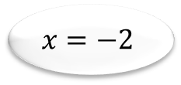

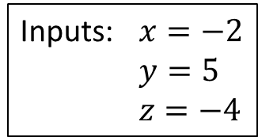

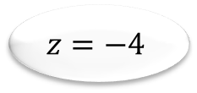

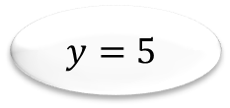

Lets draw problem with inputs…
$$f\left(x,y,z\right)=\left(x+y\right)z$$
Inputs: $x=−2$
$y=5$
$z=−4$
$$x=−2$$
$$+$$
$$q=x+y$$
$$y=5$$
$$×$$
$$f=qz$$
$$z=−4$$
Inspired by Karpathy/Fei-Fei cs231n

Slide 5



Solve Forward
$$f\left(x,y,z\right)=\left(x+y\right)z$$
$$x=−2$$
$$+$$
$q=x+y=\left(−2\right)+\left(5\right)=3$
$$y=5$$
$$×$$
$$f=qz$$
$$=\left(3\right)\left(−4\right)=−12$$
$$z=−4$$
Inspired by Karpathy/Fei-Fei cs231n

Slide 6
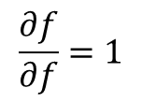
Propagate Backward
$$f\left(x,y,z\right)=\left(x+y\right)z$$
$$x=−2$$
$$+$$
$q=x+y=\left(−2\right)+\left(5\right)=3$
$$y=5$$
$$×$$
$$f=qz$$
$$=\left(3\right)\left(−4\right)=−12$$
$$z=−4$$
$$\frac{∂f}{∂f}=1$$
Inspired by Karpathy/Fei-Fei cs231n

Slide 7
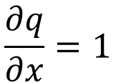



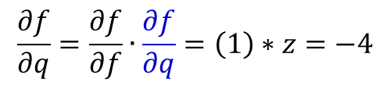
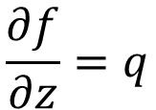

Propagate Backward
$$\frac{∂f}{∂z}=q$$
$$\frac{∂f}{∂q}=z$$
$$\frac{∂q}{∂x}=1$$
$$\frac{∂q}{∂y}=1$$
$$f\left(x,y,z\right)=\left(x+y\right)z=qz$$
$$\frac{∂f}{∂q}=\frac{∂f}{∂f}∙\frac{∂f}{∂q}=\left(1\right)∗z=−4$$
$$x=−2$$
$$+$$
$q=x+y=\left(−2\right)+\left(5\right)=3$
$$y=5$$
$$×$$
$$f=qz$$
$$=\left(3\right)\left(−4\right)=−12$$
$$z=−4$$
$$\frac{∂f}{∂f}=1$$
Inspired by Karpathy/Fei-Fei cs231n

Slide 8

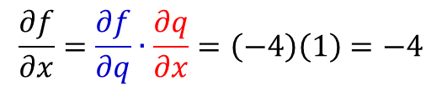
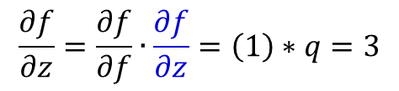
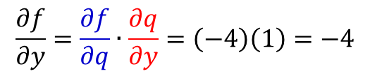
Propagate Backward
$$\frac{∂f}{∂z}=q$$
$$\frac{∂f}{∂q}=z$$
$$\frac{∂q}{∂x}=1$$
$$\frac{∂q}{∂y}=1$$
$$f\left(x,y,z\right)=\left(x+y\right)z=qz ;q=\left(x+y\right)$$
$$\frac{∂f}{∂q}=\frac{∂f}{∂f}∙\frac{∂f}{∂q}=\left(1\right)∗z=−4$$
$$x=−2$$
$$\frac{∂f}{∂x}=\frac{∂f}{∂q}∙\frac{∂q}{∂x}=\left(−4\right)\left(1\right)=−4$$
$$+$$
$q=x+y=\left(−2\right)+\left(5\right)=3$
$$y=5$$
$$×$$
$$f=qz$$
$$\frac{∂f}{∂y}=\frac{∂f}{∂q}∙\frac{∂q}{∂y}=\left(−4\right)\left(1\right)=−4$$
$$=\left(3\right)\left(−4\right)=−12$$
$$z=−4$$
$$\frac{∂f}{∂f}=1$$
$$\frac{∂f}{∂z}=\frac{∂f}{∂f}∙\frac{∂f}{∂z}=\left(1\right)∗q=3$$
Inspired by Karpathy/Fei-Fei cs231n

Slide 9
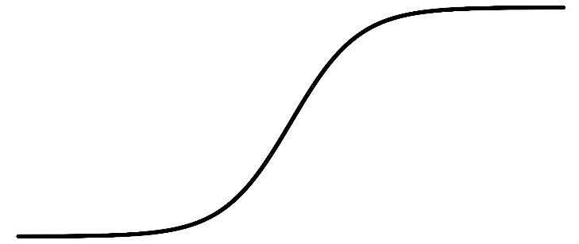
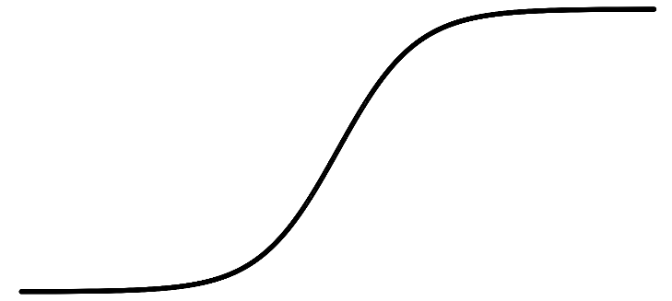
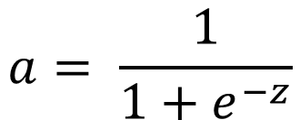
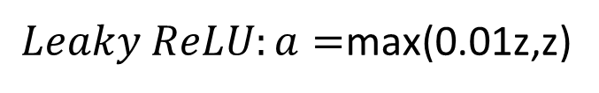
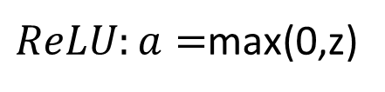
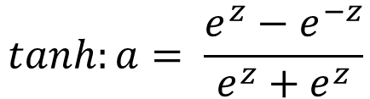
a
a
x
z
$$a= \frac{1}{1+e^{−z}}$$
$$tanh:a= \frac{e^{z}−e^{−z}}{e^{z}+e^{z}}$$
sigmoid:
a
a
z
z
$ReLU:a=$max(0,z)
$Leaky ReLU:a=$max(0.01z,z)

Slide 10
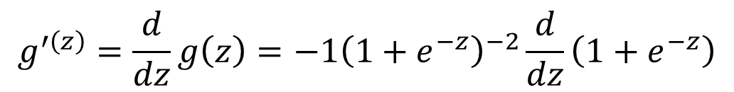
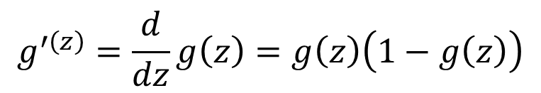
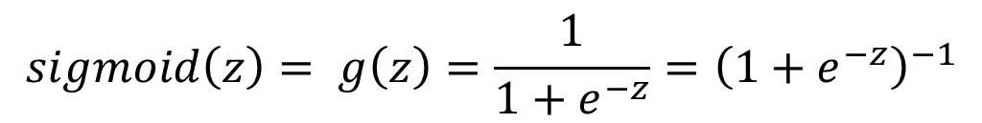
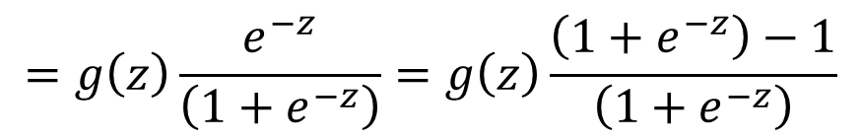
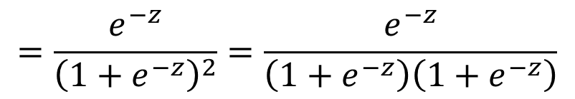

Sigmoid Gradient
$$sigmoid\left(z\right)= g\left(z\right)=\frac{1}{1+e^{−z}}={\left(1+e^{−z}\right)}^{−1}$$
$$g^{′\left(z\right)}=\frac{d}{dz}g\left(z\right)=−1{\left(1+e^{−z}\right)}^{−2}\frac{d}{dz}\left(1+e^{−z}\right)$$
$$=−1{\left(1+e^{−z}\right)}^{−2}\left(−e^{−z}\right)$$
$$=\frac{e^{−z}}{{\left(1+e^{−z}\right)}^{2}}=\frac{e^{−z}}{\left(1+e^{−z}\right)\left(1+e^{−z}\right)}$$
$$=g\left(z\right)\frac{e^{−z}}{\left(1+e^{−z}\right)}=g\left(z\right)\frac{\left(1+e^{−z}\right)−1}{\left(1+e^{−z}\right)}$$
$$g^{′\left(z\right)}=\frac{d}{dz}g\left(z\right)=g\left(z\right)\left(1−g\left(z\right)\right)$$

Slide 11
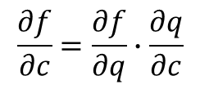

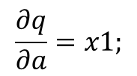
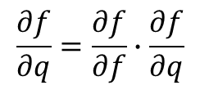
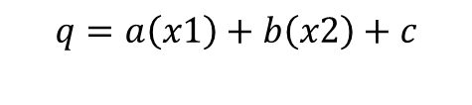
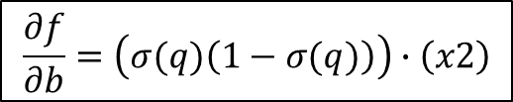
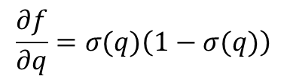
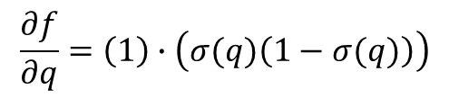
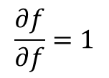

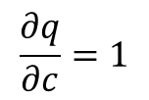

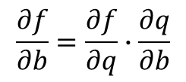
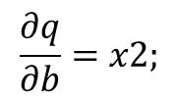
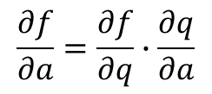

Basic Neuron
$$\frac{∂q}{∂a}=x1;$$
$$\frac{∂q}{∂b}=x2;$$
$$\frac{∂q}{∂c}=1$$
$$\frac{∂f}{∂q}=σ(q)\left(1−σ(q)\right)$$
q = a*x1 + b*x2 + c;
f = σ(q); // σ is the sigmoid function
1
$$\frac{∂f}{∂c}=\frac{∂f}{∂q}∙\frac{∂q}{∂c}$$
$$\frac{∂f}{∂q}=\frac{∂f}{∂f}∙\frac{∂f}{∂q}$$
$$\frac{∂f}{∂f}=1$$
$$c\left(1\right)$$
$$\frac{∂f}{∂q}=\left(1\right)∙\left(σ(q)\left(1−σ(q)\right)\right)$$
$$\frac{∂f}{∂a}=\frac{∂f}{∂q}∙\frac{∂q}{∂a}$$
x1
q
σ
$$a\left(x1\right)$$
$$f=σ\left(q\right)$$
$$\frac{∂f}{∂b}=\frac{∂f}{∂q}∙\frac{∂q}{∂b}$$
$$q=a\left(x1\right)+b\left(x2\right)+c$$
$$b\left(x2\right)$$
x2
$$\frac{∂f}{∂b}=\left(σ(q)\left(1−σ(q)\right)\right)∙\left(x2\right)$$

Slide 12
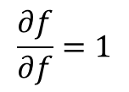


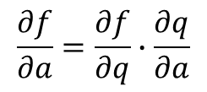
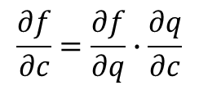
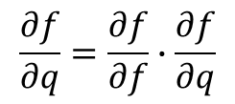
Basic Neuron (pseudo code)
$$\frac{∂q}{∂a}=x1;$$
$$\frac{∂q}{∂b}=x2;$$
$$\frac{∂q}{∂c}=1$$
$$\frac{∂f}{∂q}=σ(q)\left(1−σ(q)\right)$$
// forward:
q = a*x1 + b*x2 + c;
f = σ(q); // σ is the sigmoid function
// and now backward pass:
df/df = 1;
df/dq = df/df*df/dq = (1)(f * (1 - f));
// and now we chain it to the inputs
df/da = df/dq*dq/da = df/dq*x1;
df/dx1 = df/dq*a;
df/dx2 = df/dq*b;
df/db = df/dq*x2;
df/dc = df/dq*1.0;
$$\frac{∂f}{∂c}=\frac{∂f}{∂q}∙\frac{∂q}{∂c}$$
1
c
$$\frac{∂f}{∂f}=1$$
x1
a
q
σ
x2
b
$$\frac{∂f}{∂q}=\frac{∂f}{∂f}∙\frac{∂f}{∂q}$$
$$\frac{∂f}{∂a}=\frac{∂f}{∂q}∙\frac{∂q}{∂a}$$
$$=\left(σ(q)\left(1−σ(q)\right)\right)∙x1$$
$$=\left(f\left(1−f\right)\right)∙x1$$
We don’t need to compute these as x1 and x2 are inputs

Slide 13




Basic Neuron with ReLU (pseudo code)
$$\frac{∂q}{∂a}=x1;$$
$$\frac{∂q}{∂b}=x2;$$
$$\frac{∂q}{∂c}=1$$
$$\frac{∂f}{∂q}=relu_deriv\left(q,\frac{∂f}{∂f}\right)$$
// forward:
q = a*x1 + b*x2 + c;
f = relu(q); // relu is the ReLU function
// and now backward pass:
df/df = 1;
df/dq = df/df*df/dq =(1)*relu_deriv(q,df/df);
// and now we chain it to the inputs
df/da = df/dq*dq/da = df/dq*x1;
df/dx1 = df/dq*a;
df/dx2 = df/dq*b;
df/db = df/dq*x2;
df/dc = df/dq*1.0;
1
c
x1
a
q
relu
x2
b
If going forward q was positive, pass df/df, else pass 0
Note:
relu(x) = max(x,0)
relu_deriv(x,dx):
if x>0, dx=dx
else dx = 0
If going forward x was positive, pass deriv, else clip to zero
We don’t need to compute these as x1 and x2 are inputs
Notes:
relu_deriv: if x was positive, pass derivative backwards, otherwise clip it to zero.

Slide 14
Two Layer Network w/ ReLU and Simple Delta Error (score)
1
h1 = max(0,a1*x1+b1*x2 +c1)
h2 = max(0,a2*x1+b2*x2 +c2)
h3 = max(0,a3*x1+b3*x2 +c3)
o1 = a4*h1+b4*h2 + c4*h3 + d4
If y == 1 && o1 <1
score = 1 //pull higher
else If y == -1 && o1 > -1
score = -1 //pull lower
else
score = 0
c1
h1
x1
a1
a4
1
a2
1
d4
a3
c2
h2
b4
o1
b1
x2
b2
1
b3
c3
h3
c4
y
= ground truth label
Think of score as error we will propagate back to weights
Notes:
Need to find change in score with respect to [a1:a4, b1:b4, c1:c4,d4]

Slide 15
Learning
We have input: {x1,x2,y} for each training sample
We have parameters {a1,b1,c1,a2,b2,c2,a3,b3,c3,a4,b4,c4,d4}
If we can calculate the change of score with respect to each parameter (gradient), we can update using gradient descent:
a1 = a1 + stepSize*da1
b1 = b1 + stepSize*db1
c1 = c1 + stepSize*dc1
a4 = a4 + stepSize*da4
b4 = b4 + stepSize*db4
c4 = c4 + stepSize*dc4
d4 = d4 + stepSize*dd4
…
stepSize is the learning rate

Slide 16





Backpropagation
$$\frac{∂f}{∂o1}$$
do1 = score
da4 = h1 * do1
dh1 = a4* do1
db4 = h2 * do1
dh2 = b4 * do1
dc4 = h3 * do1
dh3 = c4 * do1
dd4 = 1 * do1
$$\frac{∂f}{∂a4}=\frac{∂f}{∂o1}∙\frac{∂o1}{∂a4}$$
// Forward model:
h1 = max(0,a1*x1+b1*x2 +c1)
h2 = max(0,a2*x1+b2*x2 +c2)
h3 = max(0,a3*x1+b3*x2 +c3)
o1 = a4*h1 + b4*h2 + c4*h3 + d4
If y == 1 && o1 <1
score = 1 //pull higher
else If y == -1 && o1 > -1
score = -1 //pull lower
else
score = 0
// We learn: {h1,h2,h3,o1,score} foreach sample
…
$$\frac{∂f}{∂h2}=\frac{∂f}{∂o1}∙\frac{∂o1}{∂h2}$$
…
$$\frac{∂f}{∂d4}=\frac{∂f}{∂o1}∙\frac{∂o1}{∂d4}$$

Slide 17
Backpropagation
…and just like that…we computed 4 of our partial derivatives!!! (We know what direction to update if we are to lower our cost function.)
$$\frac{∂f}{∂o1}$$
do1 = score
da4 = h1 * do1
dh1 = a4* do1
db4 = h2 * do1
dh2 = b4 * do1
dc4 = h3 * do1
dh3 = c4 * do1
dd4 = 1 * do1
$$\frac{∂f}{∂a4}=\frac{∂f}{∂o1}∙\frac{∂o1}{∂a4}$$
// Forward model:
h1 = max(0,a1*x1+b1*x2 +c1)
h2 = max(0,a2*x1+b2*x2 +c2)
h3 = max(0,a3*x1+b3*x2 +c3)
o1 = a4*h1 + b4*h2 + c4*h3 + d4
If y == 1 && o1 <1
score = 1 //pull higher
else If y == -1 && o1 > -1
score = -1 //pull lower
else
score = 0
// We learn: {h1,h2,h3,o1,score} foreach sample
…
$$\frac{∂f}{∂h2}=\frac{∂f}{∂o1}∙\frac{∂o1}{∂h2}$$
…
$$\frac{∂f}{∂d4}=\frac{∂f}{∂o1}∙\frac{∂o1}{∂d4}$$

Slide 18
Backpropagation of ReLU
If h1 going forward was 0, dh1, going backward is set to zero; Otherwise dh1, going backwards, is passed through.
If h1 == 0 dh1 = 0
//else dh1 = dh1
If h2 == 0 dh2 = 0
//else dh2 = dh2
If h3 == 0 dh3 = 0
//else dh3 = dh3
Note: this means you have to save your forward values to do back propagation. We will save in a ‘cache’ bucket in the homework.
// Forward model:
h1 = max(0,a1*x1+b1*x2 +c1)
h2 = max(0,a2*x1+b2*x2 +c2)
h3 = max(0,a3*x1+b3*x2 +c3)
o1 = a4*h1 + b4*h2 + c4*h3 + d4
If y == 1 && o1 <1
score = 1 //pull higher
else If y == -1 && o1 > -1
score = -1 //pull lower
else
score = 0
// We learn: {h1,h2,h3,n4,score} foreach sample

Slide 19



Backpropagation of hidden parameters
//params from h1
da1 = x1*dh1
db1 = x2*dh1
dc1 = 1*dh1
//params from h2
da2 = x1*dh2
db2 = x2*dh2
dc2 = 1*dh2
//params from h3
da3 = x1*dh3
db3 = x2*dh3
dc3= 1*dh3
$$\frac{∂f}{∂a1}=\frac{∂f}{∂h1}∙\frac{∂h1}{∂a1}$$
// Forward model:
h1 = max(0,a1*x1+b1*x2 +c1)
h2 = max(0,a2*x1+b2*x2 +c2)
h3 = max(0,a3*x1+b3*x2 +c3)
o1 = a4*h1 + b4*h2 + c4*h3 + d4
If y == 1 && o1 <1
score = 1 //pull higher
else If y == -1 && o1 > -1
score = -1 //pull lower
else
score = 0
// We learn: {h1,h2,h3,n4,score} foreach sample
…
$$\frac{∂f}{∂b2}=\frac{∂f}{∂h2}∙\frac{∂h2}{∂b2}$$
…
$$\frac{∂f}{∂c3}=\frac{∂f}{∂h3}∙\frac{∂h3}{∂c3}$$
Notes:
And note, we previously solved for df/dh1, df/dh2, df/dh3

