Slide 1

Basics of Neural Network Programming
Broadcasting in
Python
deeplearning.ai

Slide 2
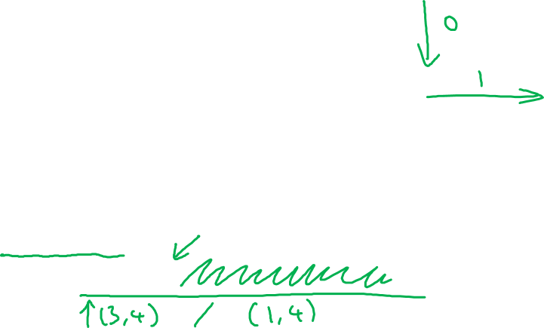
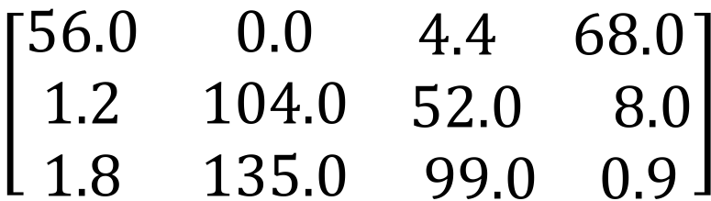
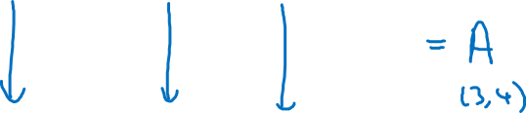
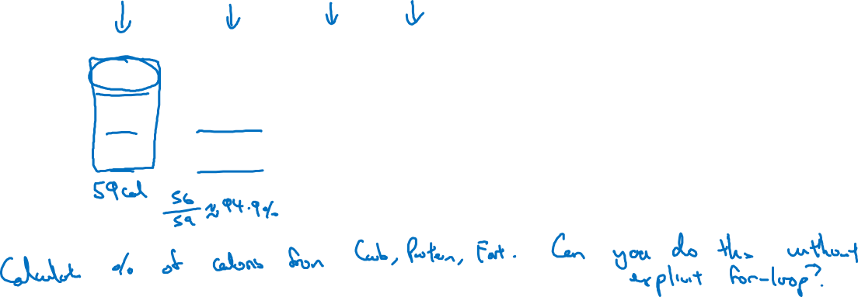
Broadcasting example
Calories from Carbs, Proteins, Fats in 100g of different foods:
Apples
Beef
Eggs
Potatoes
Carb
$$\left[\begin{matrix}56.0 & 0.0 & \begin{matrix}4.4 & 68.0\end{matrix} \\ 1.2 & 104.0 & \begin{matrix}52.0 & 8.0\end{matrix} \\ 1.8 & 135.0 & \begin{matrix}99.0 & 0.9\end{matrix}\end{matrix}\right]$$
Protein
Fat
#sum vertically
cal = A.sum(axis = 0)
percentage = 100*A/(cal.reshape(1,4))

Slide 3
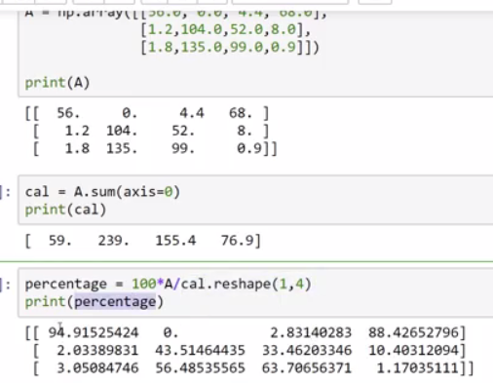

Slide 4

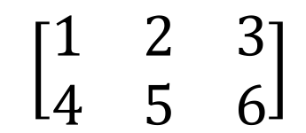
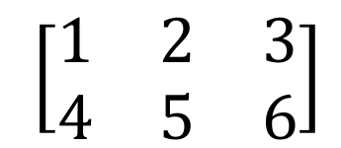
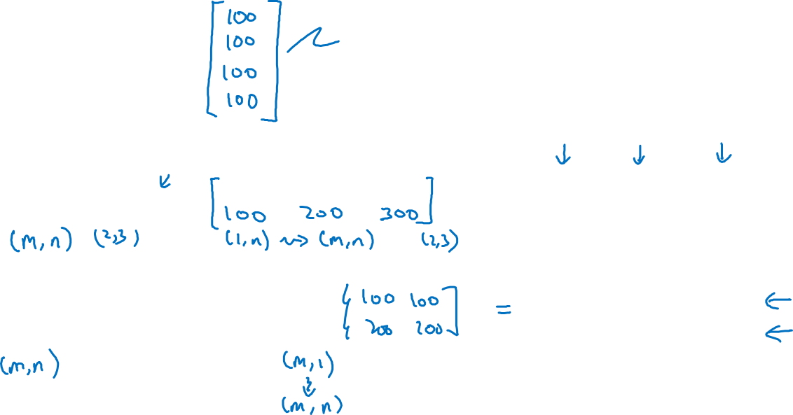
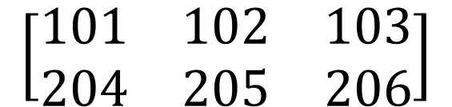

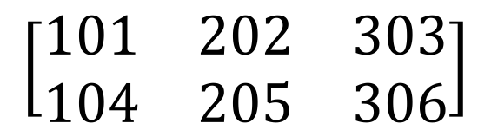



Broadcasting example
$$\left[\begin{matrix}1 \\ \begin{aligned}\begin{matrix}2 \\ 3\end{matrix} \\ 4\end{aligned}\end{matrix}\right]$$
$$\left[\begin{matrix}101 \\ \begin{aligned}\begin{matrix}102 \\ 103\end{matrix} \\ 104\end{aligned}\end{matrix}\right]$$
$$100$$
100 is auto-expanded into a 4x1 vector
=
+
$\left[\begin{matrix}1 & 2 & 3 \\ 4 & 5 & 6\end{matrix}\right]$
$$\left[\begin{matrix}100 & 200 & 300\end{matrix}\right]$$
$$\left[\begin{matrix}101 & 202 & 303 \\ 104 & 205 & 306\end{matrix}\right]$$
=
+
1x3 is auto-expanded (copied) into a 2x3 matrix
$\left[\begin{matrix}1 & 2 & 3 \\ 4 & 5 & 6\end{matrix}\right]$
$$\left[\begin{matrix}100 \\ 200\end{matrix}\right]$$
$$\left[\begin{matrix}101 & 102 & 103 \\ 204 & 205 & 206\end{matrix}\right]$$
+
=
2x1 is auto-expanded (copied) into a 2x3 matrix

Slide 5
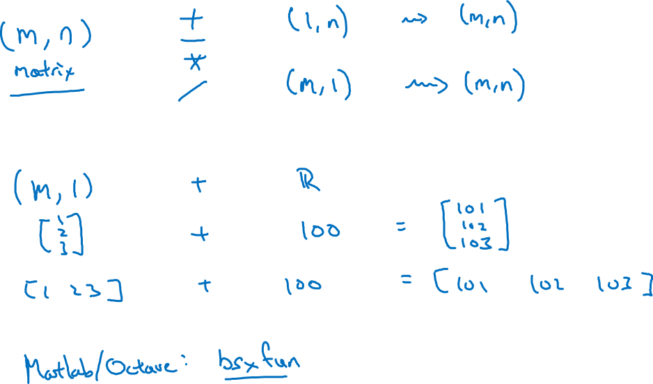
General Principle
bsxfun function in Matlab similar to Python broadcasting behavior

