Slide 1

Basics of Neural Network Programming
A note on python/
numpy vectors
deeplearning.ai

Slide 2
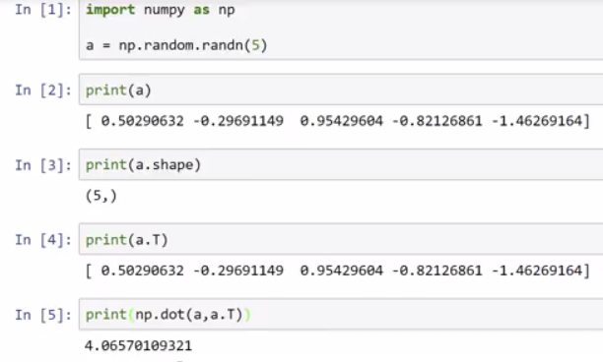
Python Demo
Rank1 vector which is neither row, nor column vector!
Same as a!

Slide 3
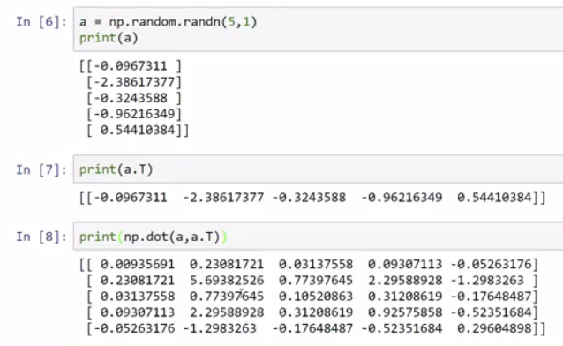
Best to explicitly give a dimensions!
Now a and a^{T} different.
Notice double [[ ]]
Expected outer product
[5x1][1x5] = [5x5]

Slide 4
Python / numpy vectors
import numpy as np
a = np.random.randn(5)
don’t use rank 1 arrays
If you do have this, can fix with a=a.reshape((5,1))
a = np.random.randn((5,1))
← a.shape = (5.1)
a = np.random.randn((1,5))
assert(a.shape = (5,1))
← Use assertion statement to ensure dimensions are as expected

Slide 5
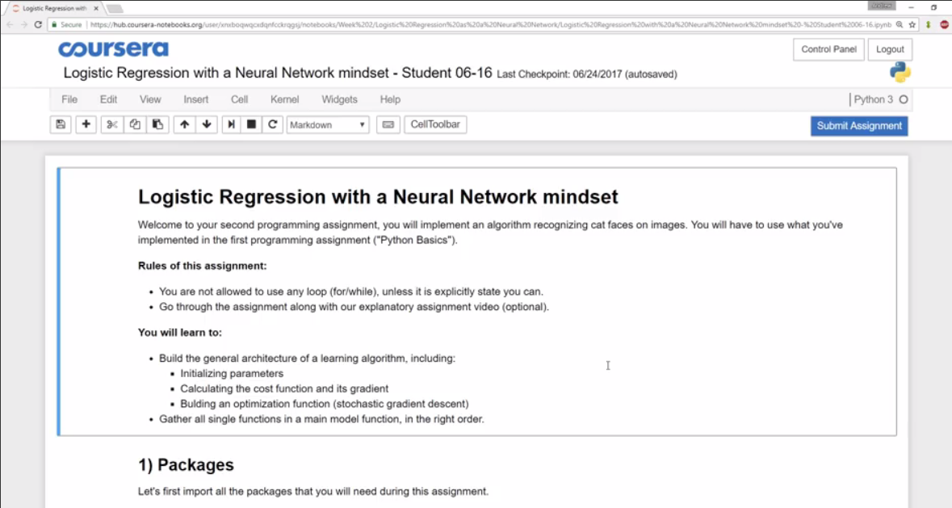
Jupyter/Python Notebooks

Slide 6
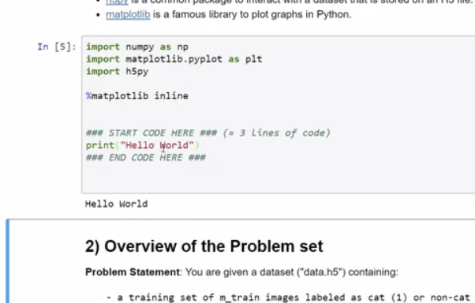
Insert code in light gray areas
Insert code in between the
### START CODE HERE ###
### END CODE HERE ###
Use <shift><enter> to execute and go to next block
<ctrl><enter> to execute and stay in same block
Use use Cell→ Run Cell at menu
If you accidentally double click on instruction cell and get ugly markup language, you can fix be executing the instruction cell.
Code runs on the server. If the kernel dies
Use menu Kernel→Restart
When done, hit the blue “Submit Assignment” in the upper right corner

