Slide 1
Deep Neural Networks
Building blocks of
deep neural networks

Slide 2
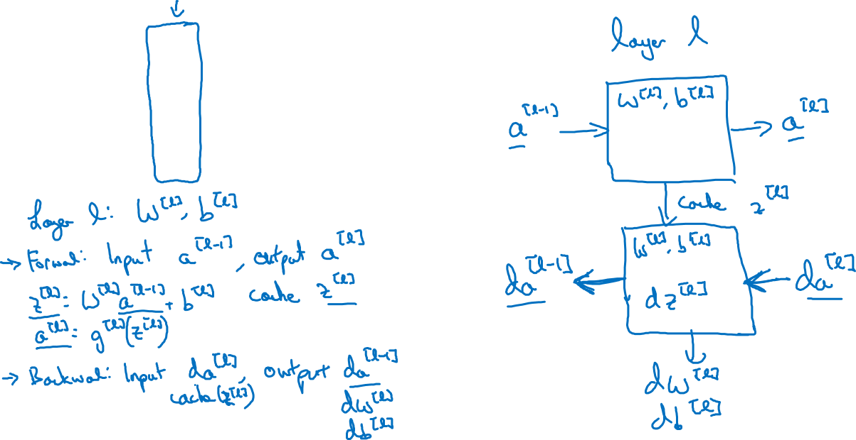






Forward and backward functions
$$x_{1}$$
$$x_{2}$$
$$\hat{y}$$
$$x_{3}$$
$$x_{4}$$
Forward box
Backprop box

Slide 3
Forward and backward functions
Going forward from left to right:
Input a^[0]
First box takes in a^[0] and uses learned weights w^[1], b^[1] to output a^[1]. Also saves z^[1] for later use in backprop.
Second box takes in a^[1] and uses learned weights w^[2], b^[2] to output a^[2]. Also saves z^[2] for later use in backprop.
…
The last box takes in a^[L-1] and uses learned weights w^[L], b^[l] to output a^[L] (which is y_hat). Also saves z^[L] for later use in backprop.

Slide 4
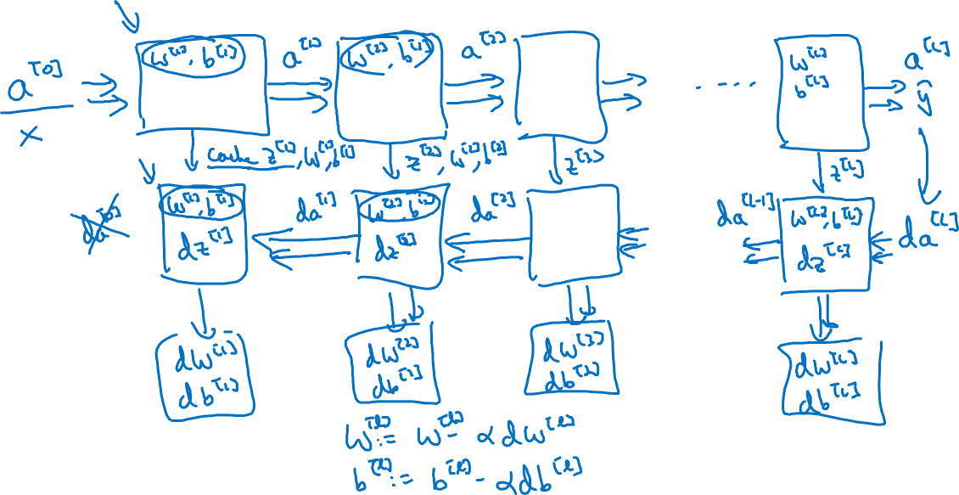
Forward and backward functions
Backprop from right to left:
1st box takes in da^[L] (this will eventually come from cost function), cache value z^[L], and w^[L],b^[L]; and returns da^[L-1] as well as gradient vectors dw^[L] and db^[L], and internal variable dz^[L].
dw and db are the terms we want to update our weights

Slide 5
Deep Neural Networks
Forward and backward
propagation

Slide 6
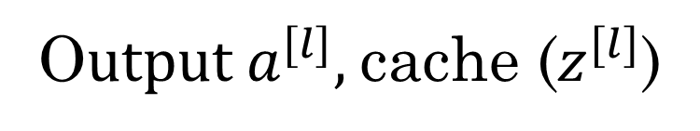
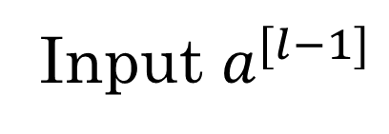
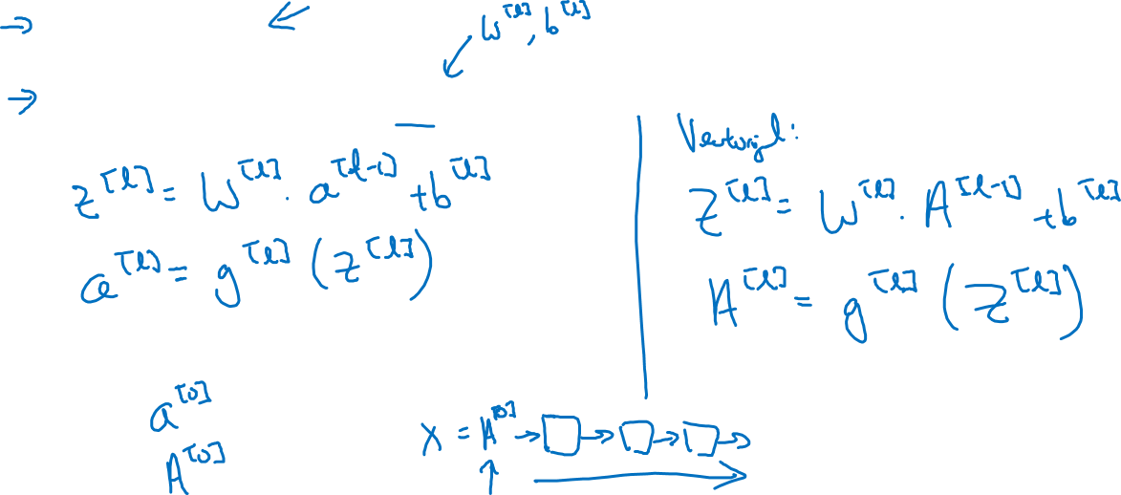
Forward propagation for layer l
Input $a^{[l−1]}$
O$utput a^{[l]},$cache ($z^{[l]}$)
Python broadcasting will be used for b

Slide 7
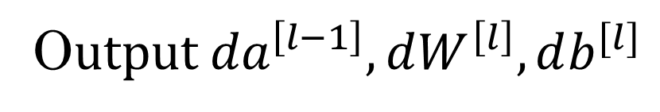
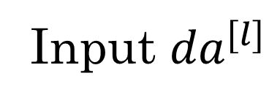
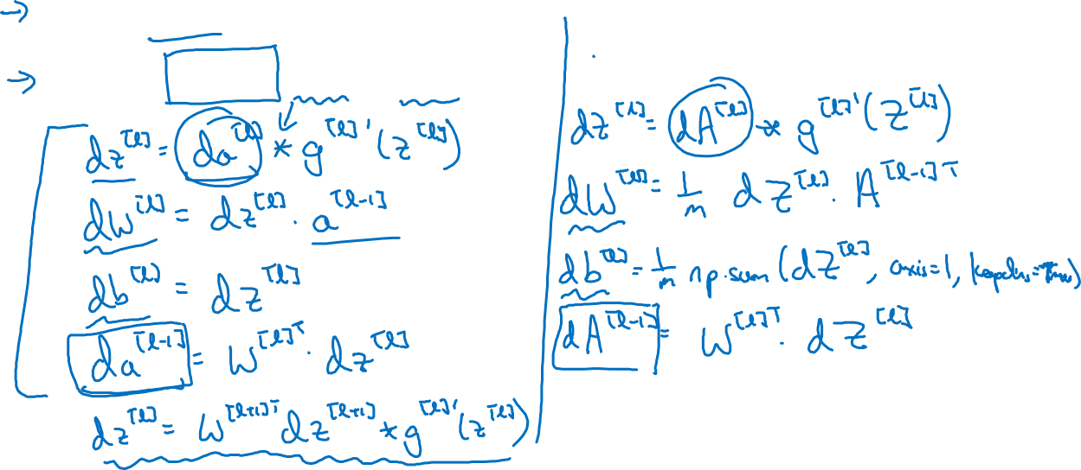
Backward propagation for layer l
Elementwise product
Input ${da}^{[l]}$
O$utput {da}^{\left[l−1\right]},dW^{\left[l\right]},db^{[l]}$
Use blue equations for arbitrary deep nnets
From last week

Slide 8
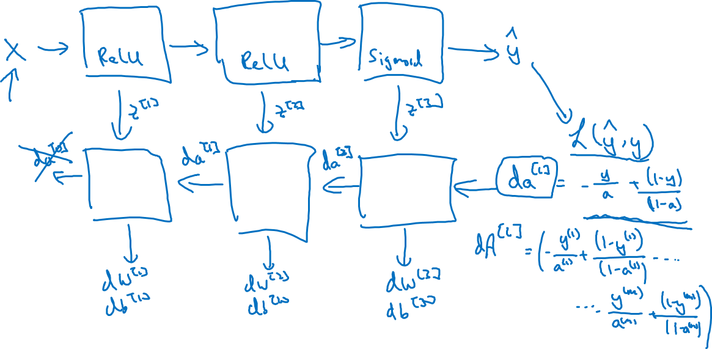

Summary
$${da}^{\left[L\right]}=−\frac{y}{a}+\frac{\left(1−y\right)}{\left(1−a\right)}$$
cache

