Slide 1
One hidden layer
Neural Network
Vectorizing across
multiple examples

Slide 2




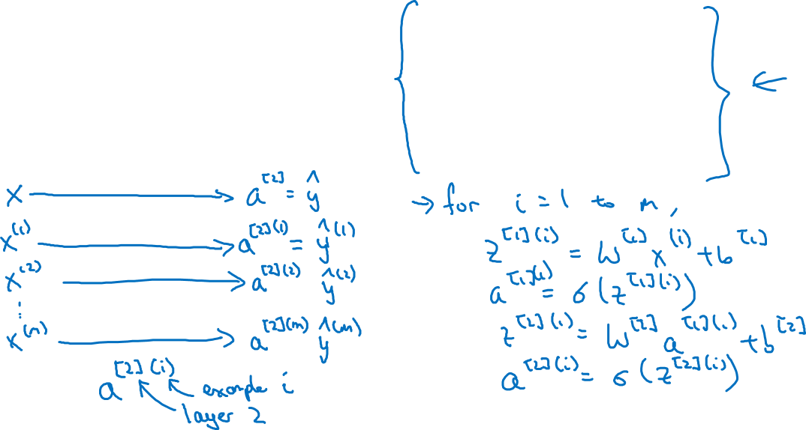

Vectorizing across multiple examples
$$z^{\left[1\right]}=W^{\left[1\right]}x+b^{\left[1\right]}$$
$$x_{1}$$
$$a^{\left[1\right]}=σ(z^{\left[1\right]})$$
$$x_{2}$$
$$\hat{y}$$
$$z^{\left[2\right]}=W^{\left[2\right]}a^{\left[1\right]}+b^{\left[2\right]}$$
$$x_{3}$$
$$a^{\left[2\right]}=σ(z^{\left[2\right]})$$

Slide 3
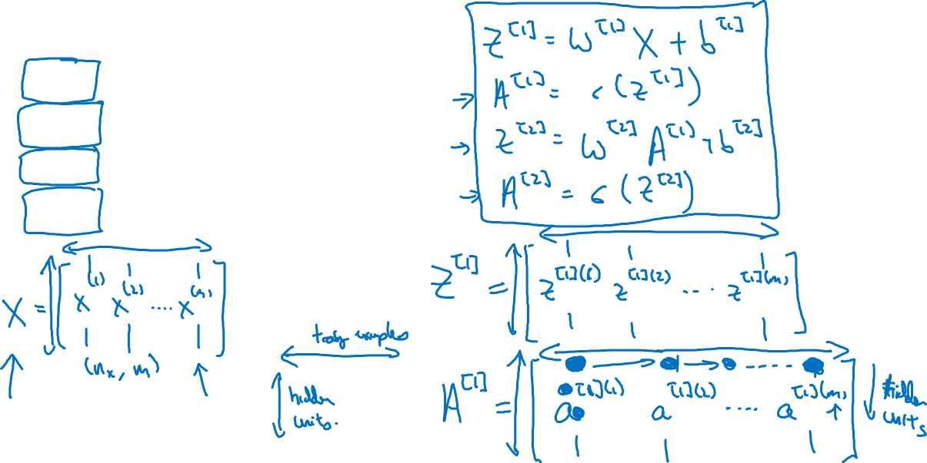




Vectorizing across multiple examples
for i = 1 to m:
$$z^{\left[1\right](i)}=W^{\left[1\right]}x^{(i)}+b^{\left[1\right]}$$
$$a^{\left[1\right](i)}=σ(z^{\left[1\right]\left(i\right)})$$
$$z^{\left[2\right](i)}=W^{\left[2\right]}a^{\left[1\right](i)}+b^{\left[2\right]}$$
$$a^{\left[2\right](i)}=σ(z^{\left[2\right]\left(i\right)})$$

Slide 4
One hidden layer
Neural Network
Explanation
for vectorized
implementation

Slide 5
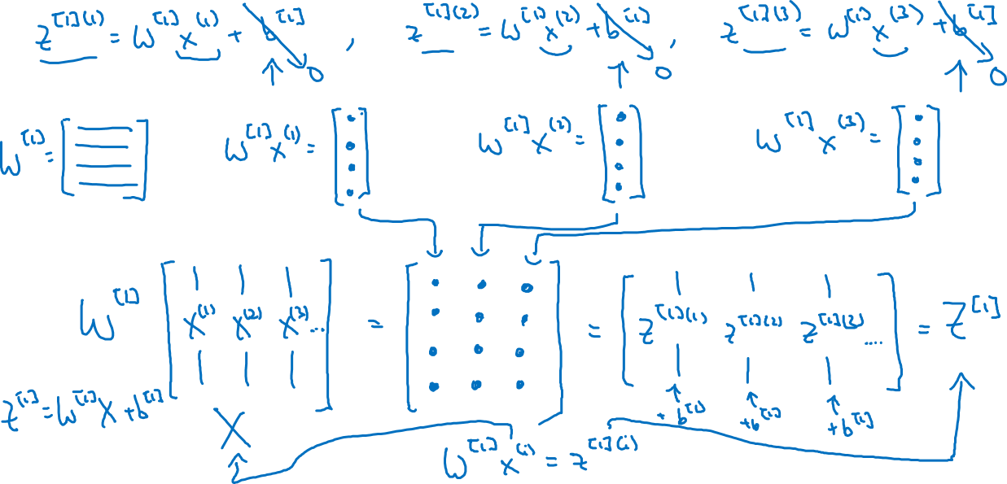
Justification for vectorized implementation
Simplify and say b=0
(Use python broadcasting for b)
Summary of first step
Other steps similar

Slide 6











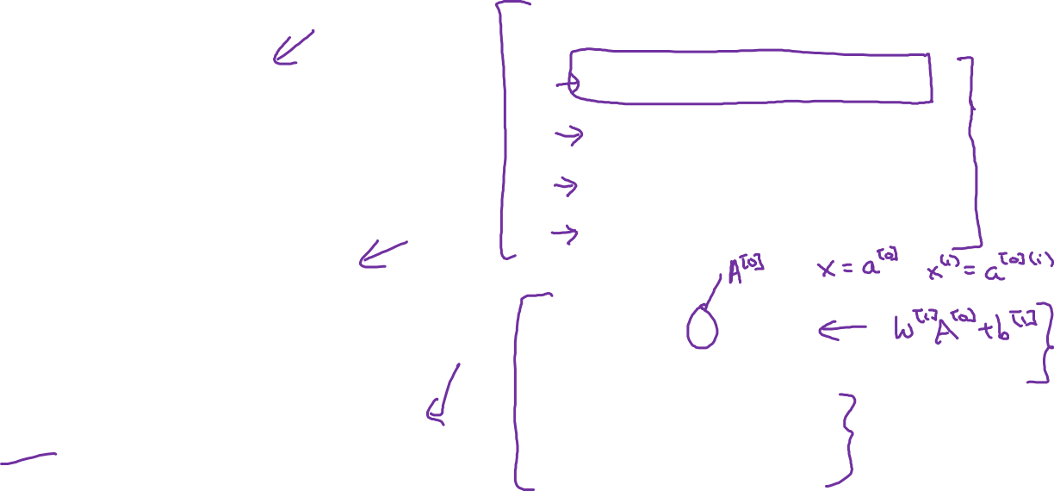





Recap of vectorizing across multiple examples
for i = 1 to m
$$x_{1}$$
$$z^{\left[1\right](i)}=W^{\left[1\right]}x^{(i)}+b^{\left[1\right]}$$
$$x_{2}$$
$$\hat{y}$$
$$x_{3}$$
$$a^{\left[1\right](i)}=σ(z^{\left[1\right]\left(i\right)})$$
$$z^{\left[2\right](i)}=W^{\left[2\right]}a^{\left[1\right](i)}+b^{\left[2\right]}$$
$$a^{\left[2\right](i)}=σ(z^{\left[2\right]\left(i\right)})$$
$$X=$$
$$x^{(1)}$$
$$x^{(2)}$$
…
$$x^{(m)}$$
$$Z^{\left[1\right]}=W^{\left[1\right]}X+b^{\left[1\right]}$$
$$A^{\left[1\right]}=σ(Z^{\left[1\right]})$$
$$Z^{\left[2\right]}=W^{\left[2\right]}A^{\left[1\right]}+b^{\left[2\right]}$$
$A^{[1]}=$
$$a^{[1](1)}$$
$$a^{[1](2)}$$
$$a^{[1](m)}$$
…
$$A^{\left[2\right]}=σ(Z^{\left[2\right]})$$

